Slide 1

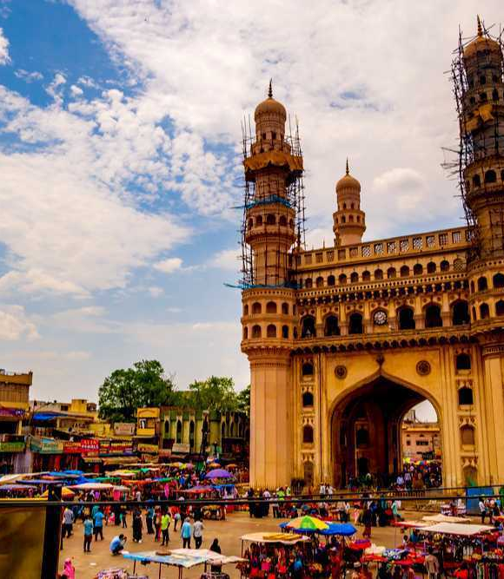
Telangana Growth Analysis
Pratik Bhikadiya Yash Soni

Slide 2
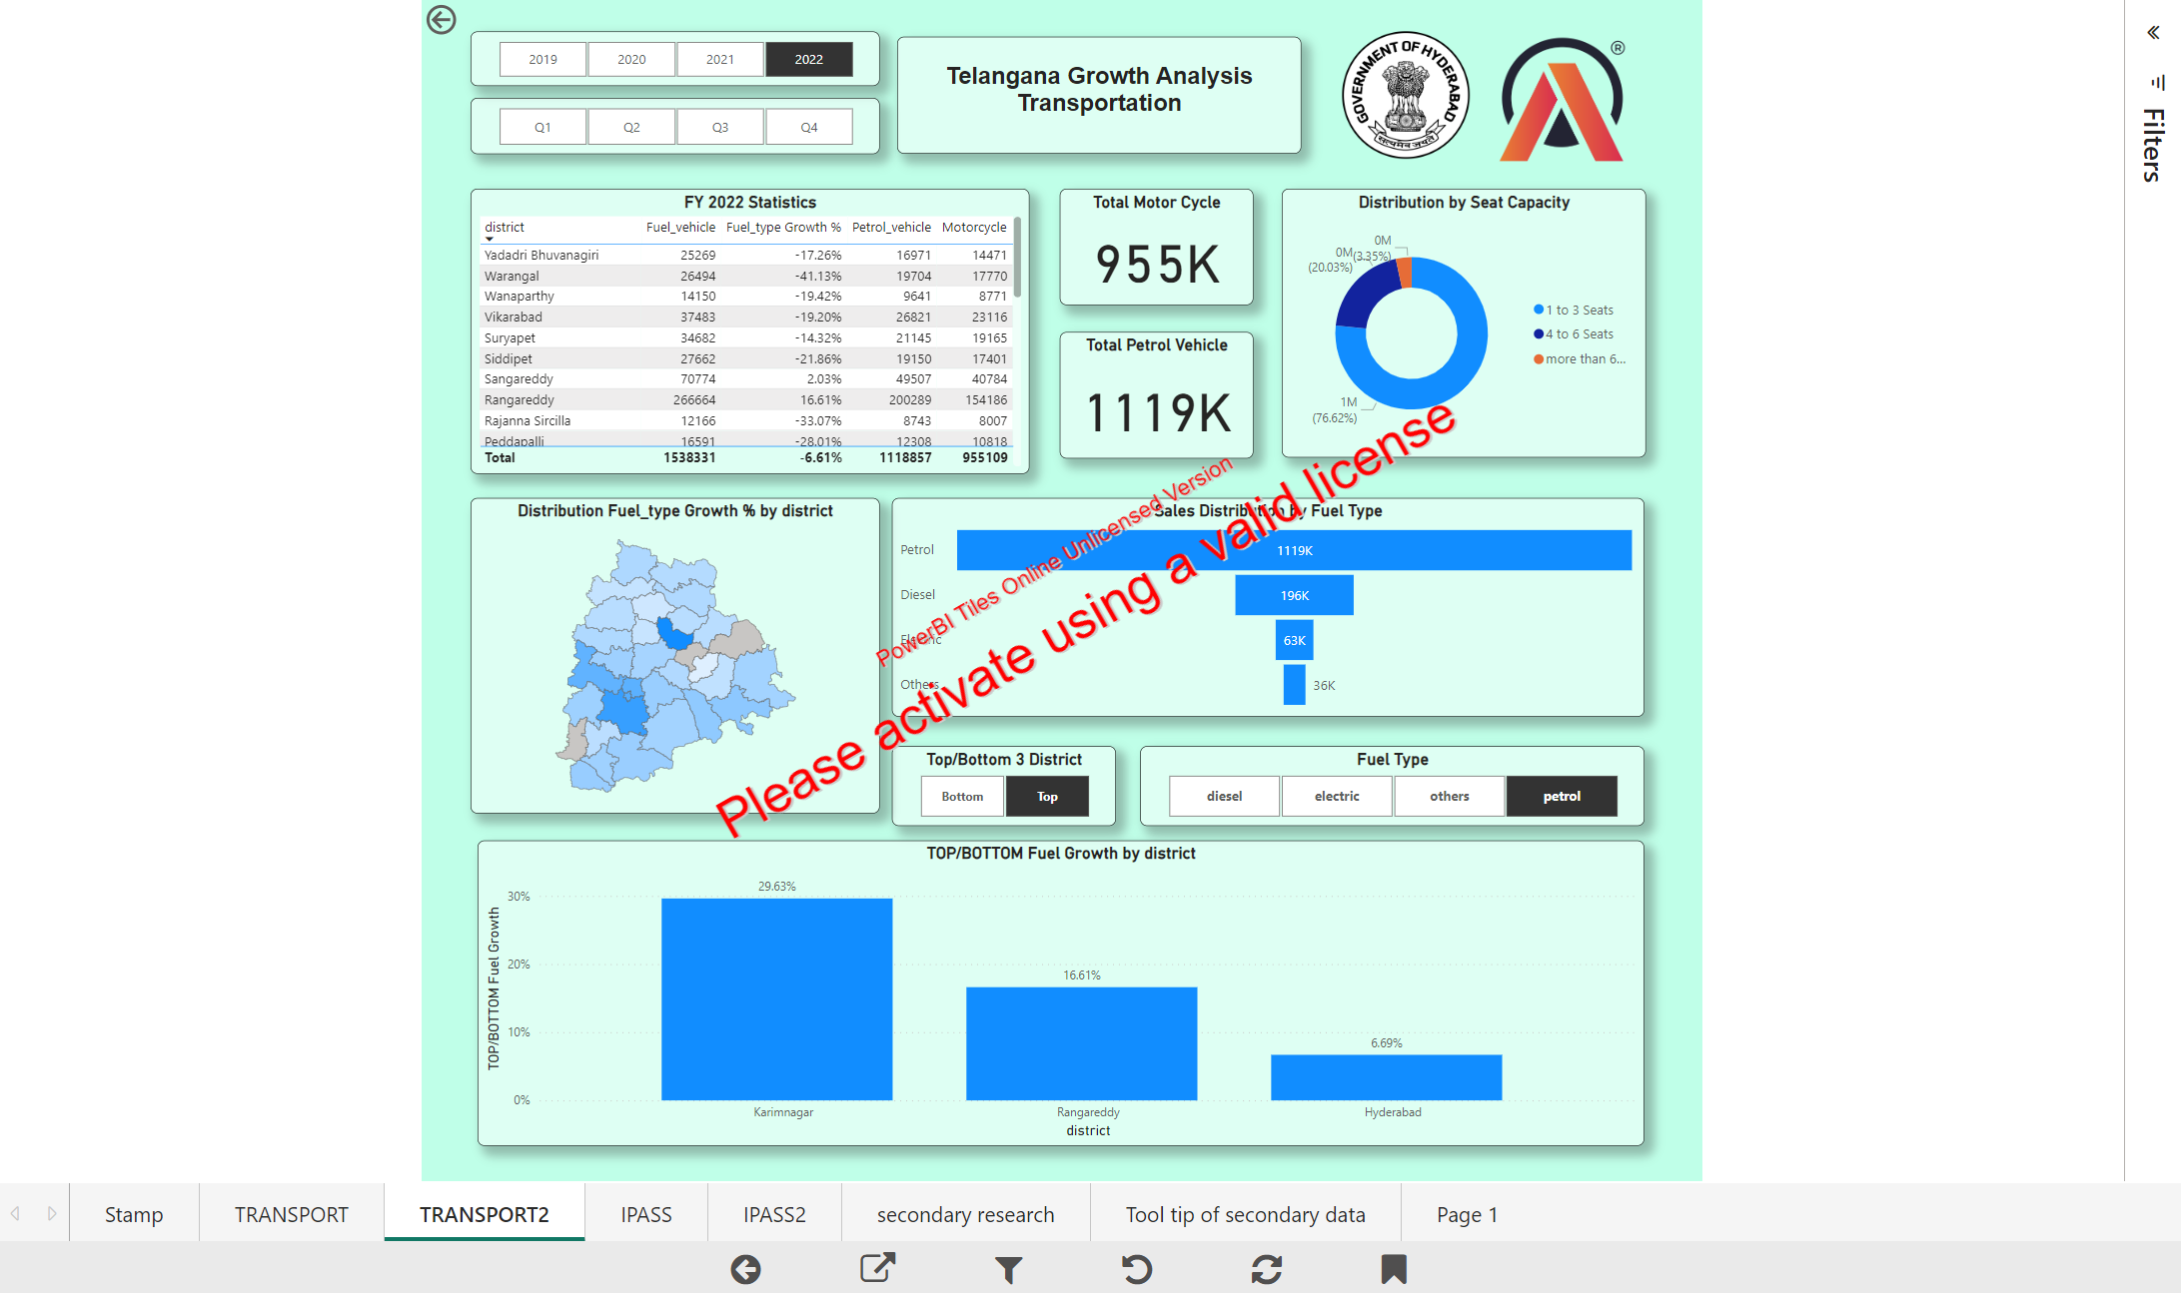

Slide 3
Agenda
Introduction
Stamp Registration
Transportation
Investment
Secondary Research

Slide 4
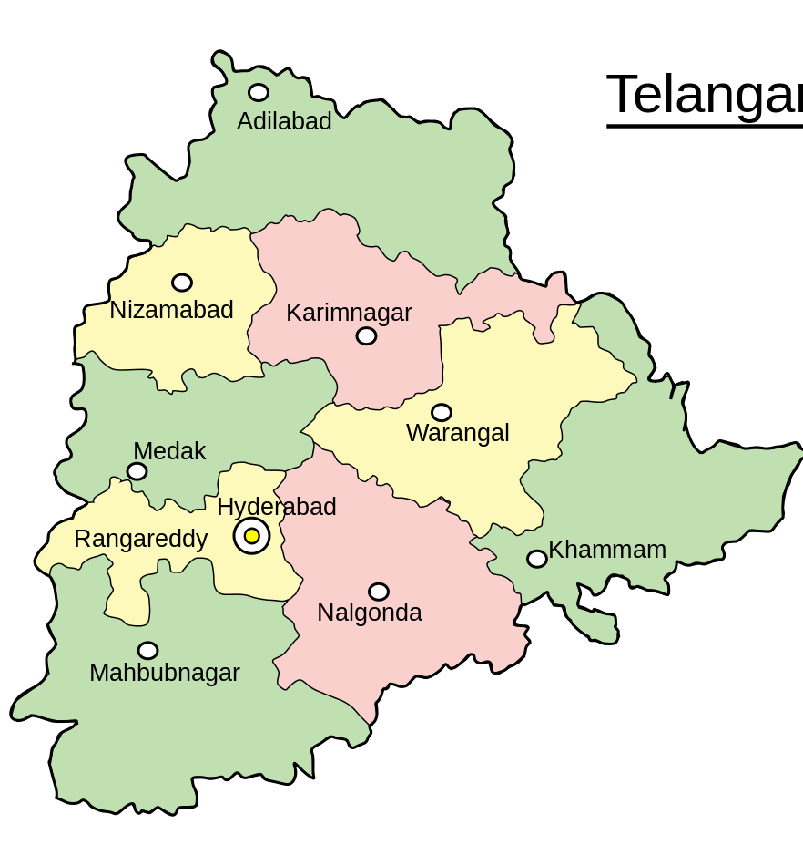
Introduction
At Contoso, we empower organizations to foster collaborative thinking to further drive workplace innovation. By closing the loop and leveraging agile frameworks, we help business grow organically and foster a consumer-first mindset.

Slide 5

Stamp Registration

Slide 6
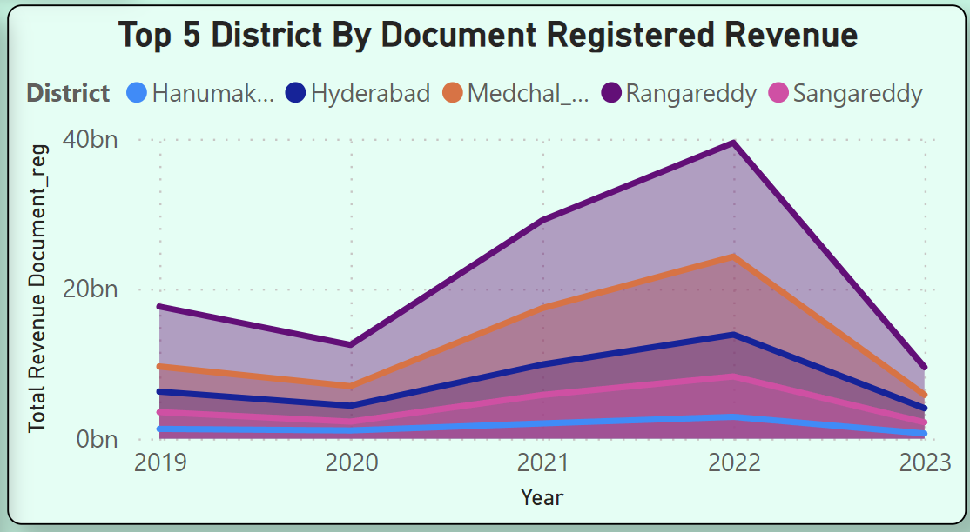
Top 5 District by Document Registration Revenue
Notes:
*Answer:* We plotted an area chart to visualize the revenue growth across years for document registration in various districts. The top 5 districts with the highest revenue growth during FY 2019-2022 are:
1. Hanimankoda
2. Hyderabad
3. Medchal Malkajgiri
4. Sangareddy
5. Rangareddy

Slide 7
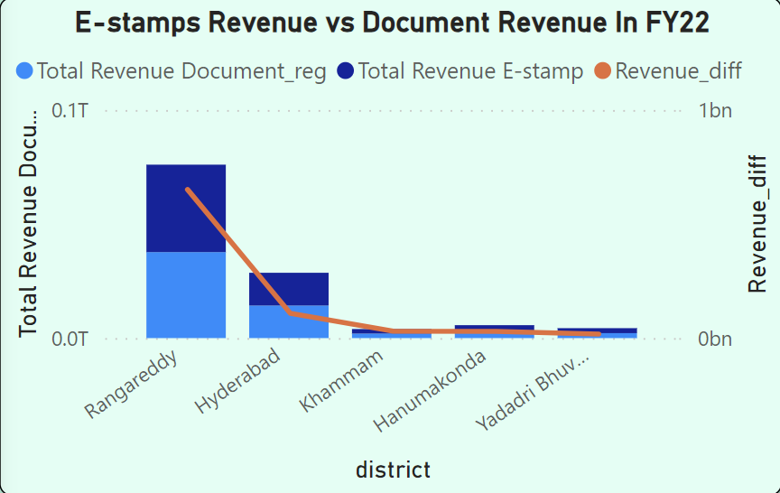
E-stamp Revenue vs Document Revenue in FY22
Notes:
We compared total e-stamp revenue and total document registration revenue, calculated the revenue difference, and identified the top 5 districts where e-stamps revenue outperformed document revenue in FY 2022:
1. Rangareddy
2. Hyderabad
3. Khammam
4. Hanumakonda
5. Yadadri Bhuvangiri

Slide 8
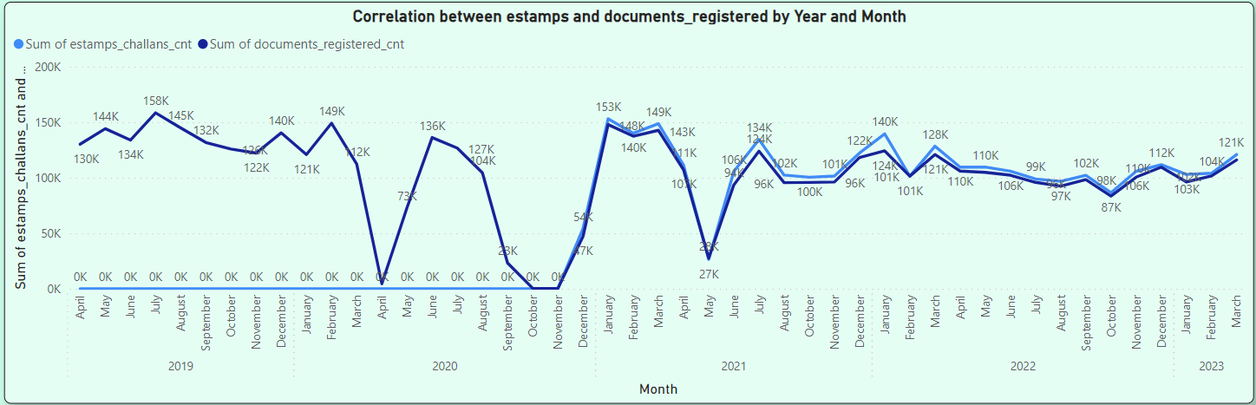
Correlation btw E-stamp and Document Registration
Notes:
We observed that e-stamp challan counts and document registration counts have followed similar trends since the introduction of e-stamp in December 2020. However, there were notable declines in April 2020, November 2020, and May 2021. The emergence of COVID-19 might have influenced this decline. To address this, the government could consider promoting online stamp duty submissions and ensuring pandemic resilience in revenue collection.

Slide 9
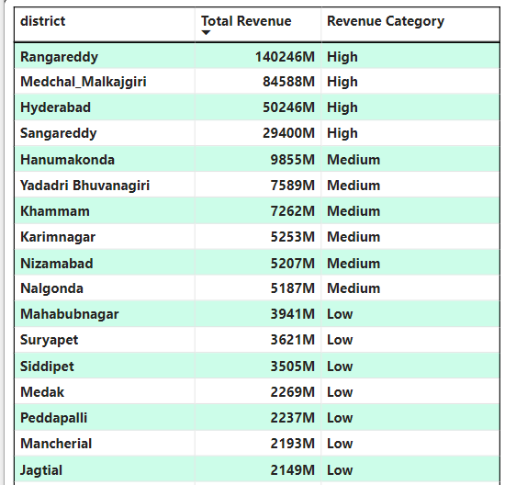
District into Three Segments
Notes:
*Answer:* We categorized the 33 districts into three revenue segments: high, medium, and low, based on their stamp registration revenue during FY 2021-2022.

Slide 10
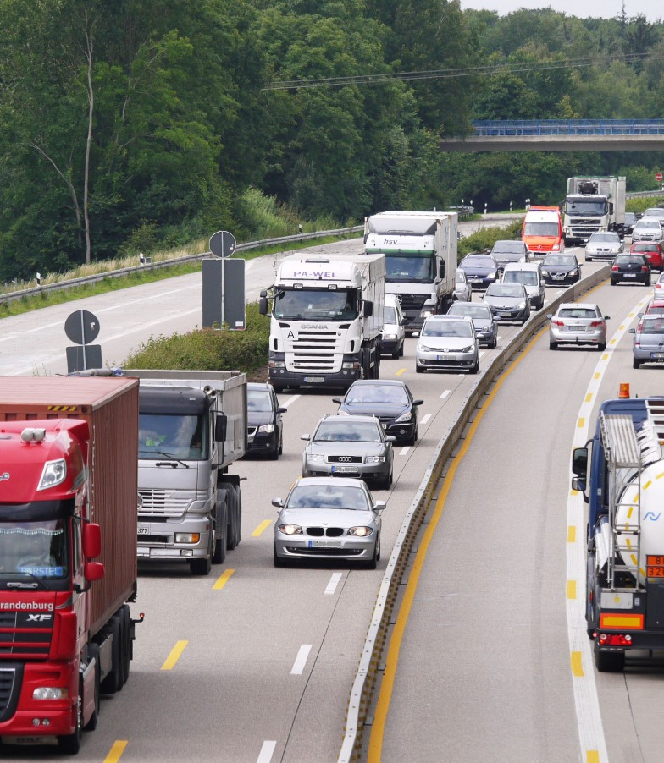
Transportation

Slide 11
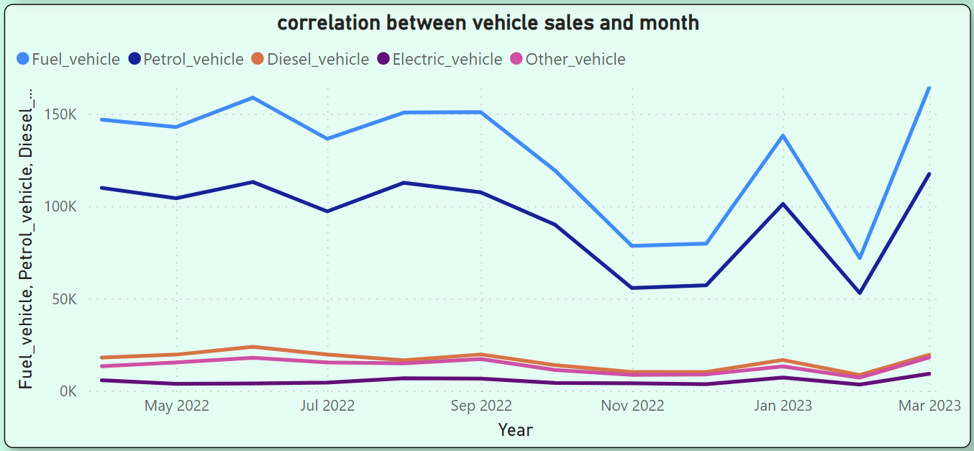
Correlation btw Vehicle Sales and months
Notes:
We analyzed the correlation between vehicle sales and months, observing that December and January consistently showed higher sales. COVID-19-induced fluctuations were also noted. Factors such as year-end discounts and seasonal demand could be driving the observed patterns.

Slide 12
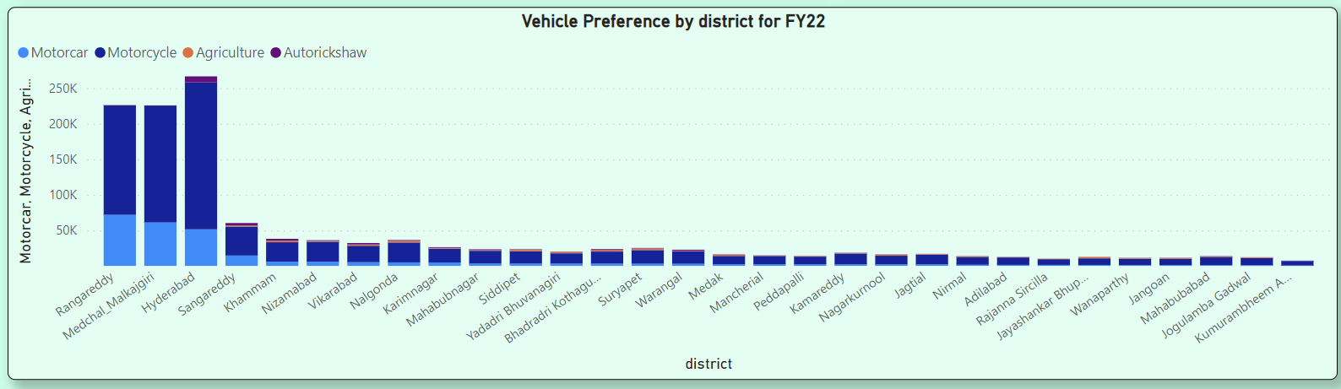
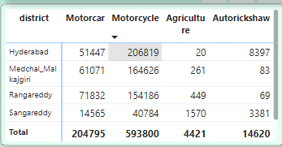
Vehicle Preference by District for FY22
Notes:
In FY 2022, districts like Rangareddy, Medchal, Hyderabad, and Sangareddy exhibited a higher concentration of vehicles, with motorcycles being the preferred vehicle class. The metropolitan nature of these districts, coupled with potential parking issues, likely influences this preference.

Slide 13
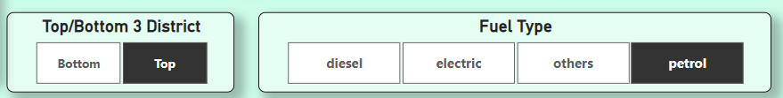
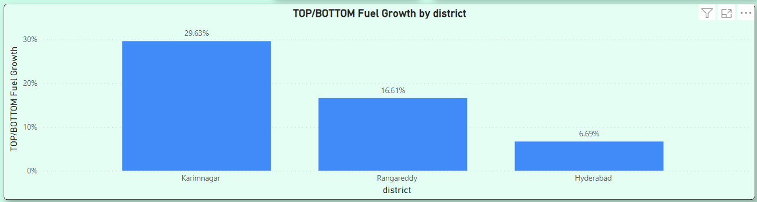
Top – Bottom 3 Districts by Fuel Growth
Notes:
We categorized districts based on vehicle sales growth in FY 2022 compared to FY 2021, considering fuel types. The top and bottom 3 districts for each category were identified based on their growth rates.

Slide 14

Ts-Ipass Investment Analysis

Slide 15
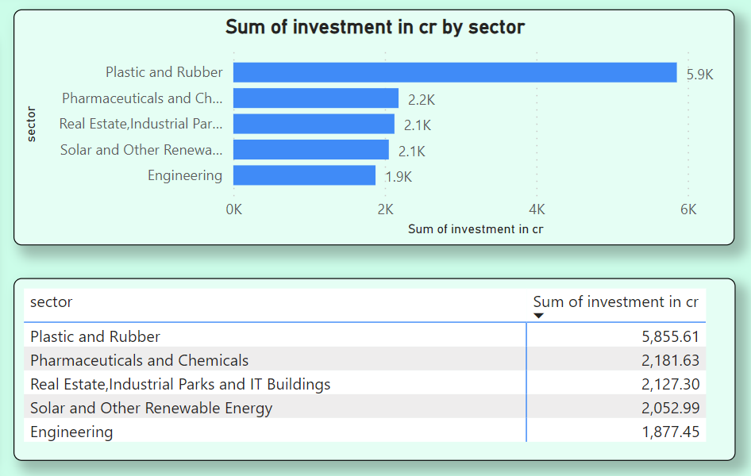
Top 5 Sectors with Significant Investment
Notes:
The top 5 sectors with the most significant investments in FY 2022 are:
1. Plastic and Rubber
2. Pharmaceuticals and Chemicals
3. Real Estate, Industrial Parks, and IT Buildings
4. Solar and Other Renewables
5. Engineering

Slide 16
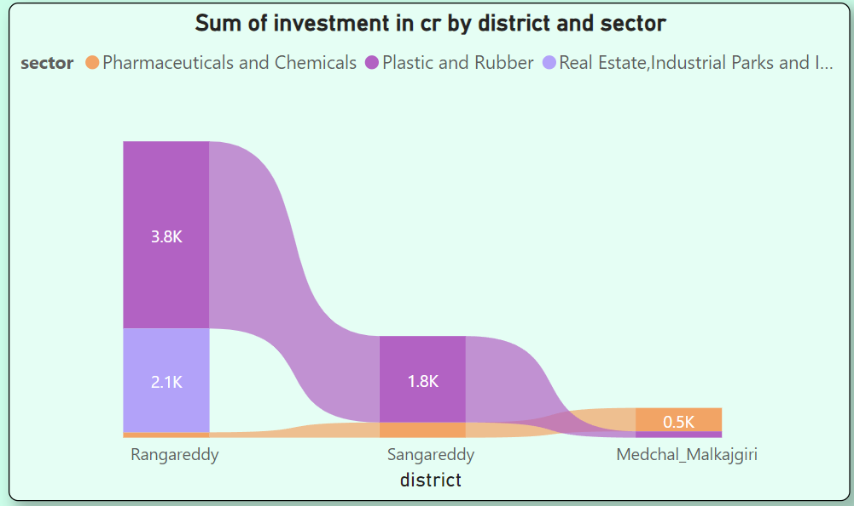
Top 3 District with significant Investment
Notes:
The top 3 districts attracting significant sector investments during FY 2019-2022 are Rangareddy, Sangareddy, and Medchal Malkajgiri. These districts likely attracted investments due to their strategic locations and infrastructure, coupled with the presence of top sectors like Pharmaceuticals, Real Estate, and Engineering.

Slide 17
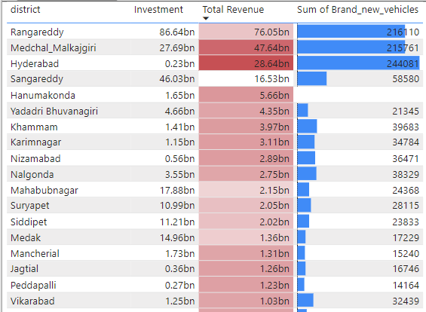
Relation btw Investment, Revenue and Vehicle Sales
Notes:
A relationship between district investments, vehicle sales, and stamps revenue was observed in certain districts. Rangareddy, for example, had substantial investment, high stamp revenue, and significant vehicle sales, suggesting a correlation between economic activity, revenue collection, and vehicle demand.

Slide 18
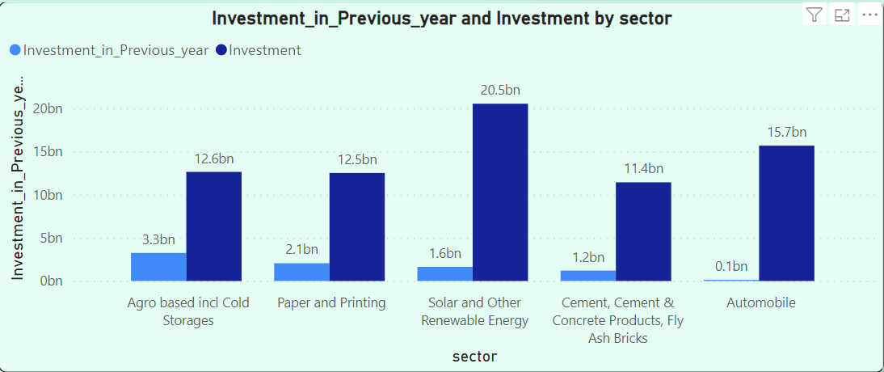
Sectors with substantial Investment btw FY21-22
Notes:
Five sectors showed substantial investment in multiple districts between FY 2021 and 2022: Solar and Renewable, Automobile, Agro-based including Cold Storage, Paper and Printing, and Cement and Concrete Products.

Slide 19
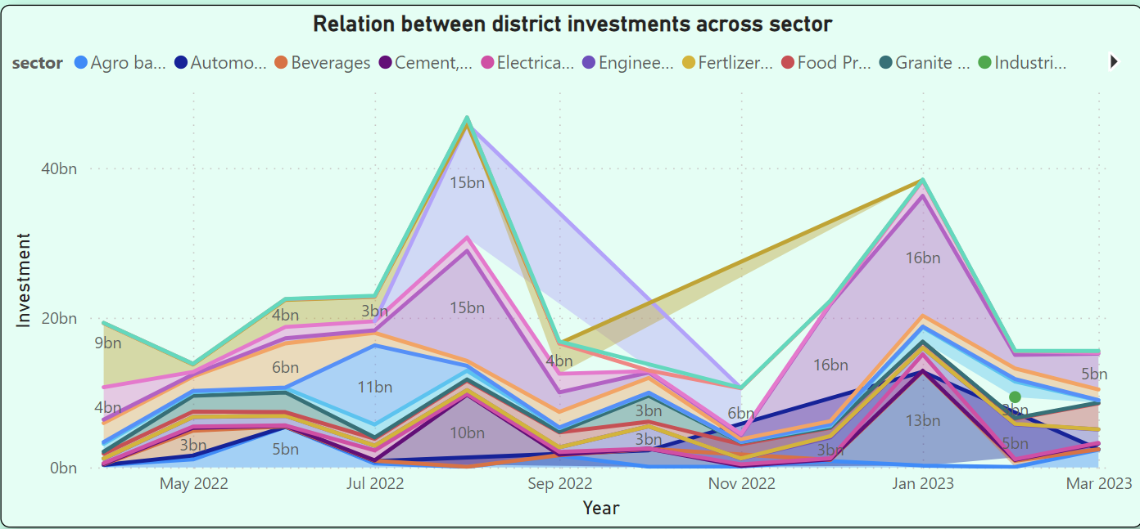
Seasonal trend in Investment for Different Sectors
Notes:
Investment patterns in sectors revealed cyclicality, with higher investments in August 2022 and January 2023. This seasonality may be influenced by factors such as budget cycles, market conditions, or government policies.

Slide 20
Secondary Research
This Photo by Unknown Author is licensed under CC BY-ND

Slide 21
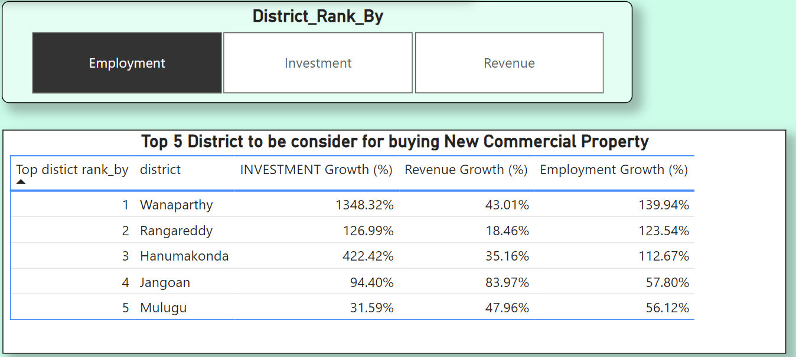
Top 5 District to buy Commercial properties
Notes:
for buying commercial property people consider three kpi
like perticular district what's employement growth
and revenue growth
and district attracts investors
so we can take call on which perticular emerging district is to be consider for investment

Slide 22
Major Insights:
Real Estate & IT Dominance: The sector "Real Estate, Industrial Parks and IT Buildings" has seen the highest investments and also offers the most employment, making it a crucial sector for the state.
Pharmaceuticals & Chemicals: This sector ranks second in both investments and employment, indicating its significance in the state's industrial landscape.
Diverse Economic Landscape: Sectors like "Plastic and Rubber," "Solar and Other Renewable Energy," and "Engineering" have attracted notable investments, showing the diverse economic activities in the state.
Steady Economic Growth: The upward trend in monthly investments suggests a steadily growing economy in Telangana.
Vehicle Sales & Stamps Revenue Correlation: The correlation between vehicle sales and stamp revenues in districts indicates the interconnectedness of economic growth and commercial activities.
Notes:
for buying commercial property people consider three kpi
like perticular district what's employement growth
and revenue growth
and district attracts investors
so we can take call on which perticular emerging district is to be consider for investment

Slide 23
Some Recommendation:
Promote Real Estate & IT: Given its dominance, the government should continue to promote and support the "Real Estate, Industrial Parks, and IT Buildings" sector.
Enhance Infrastructure: Improve infrastructure in districts showing high vehicle sales and stamp revenues, as these areas likely have burgeoning commercial activities.
Diversify Investments: While certain sectors dominate, it's essential to diversify investments to ensure economic stability. The government could introduce policies favouring emerging sectors.
Skill Development: With sectors like "Pharmaceuticals and Chemicals" showing significant employment, invest in skill development programs tailored for these industries.
Analyse Policy Impact: Regularly analyse investment data to assess the impact of introduced policies. This will help in refining strategies and ensuring sustained growth.
Notes:
for buying commercial property people consider three kpi
like perticular district what's employement growth
and revenue growth
and district attracts investors
so we can take call on which perticular emerging district is to be consider for investment

Slide 24


Summary
At Contoso, we believe in giving 110%. By using our next-generation data architecture, we help organizations virtually manage agile workflows. We thrive because of our market knowledge and great team behind our product. As our CEO says, “Efficiencies will come from proactively transforming how we do business.”

Slide 25




Thank you
Any Questions ?
Mail/Msg us

