Slide 1
Covid Data Analysis in AWS :-

Slide 2
Objective:-
To perform data analysis and visualization on Covid-19 data using ETL tools.
To perform data analysis on Covid_19 data and extract the meaningful information from the dataset which will help in taking quick and informed decision.

Slide 3
Technologies Used:-
AWS Glue
SparkSql
Redshift
AWS S3
Crawler
AWS Lambda
Pyspark

Slide 4
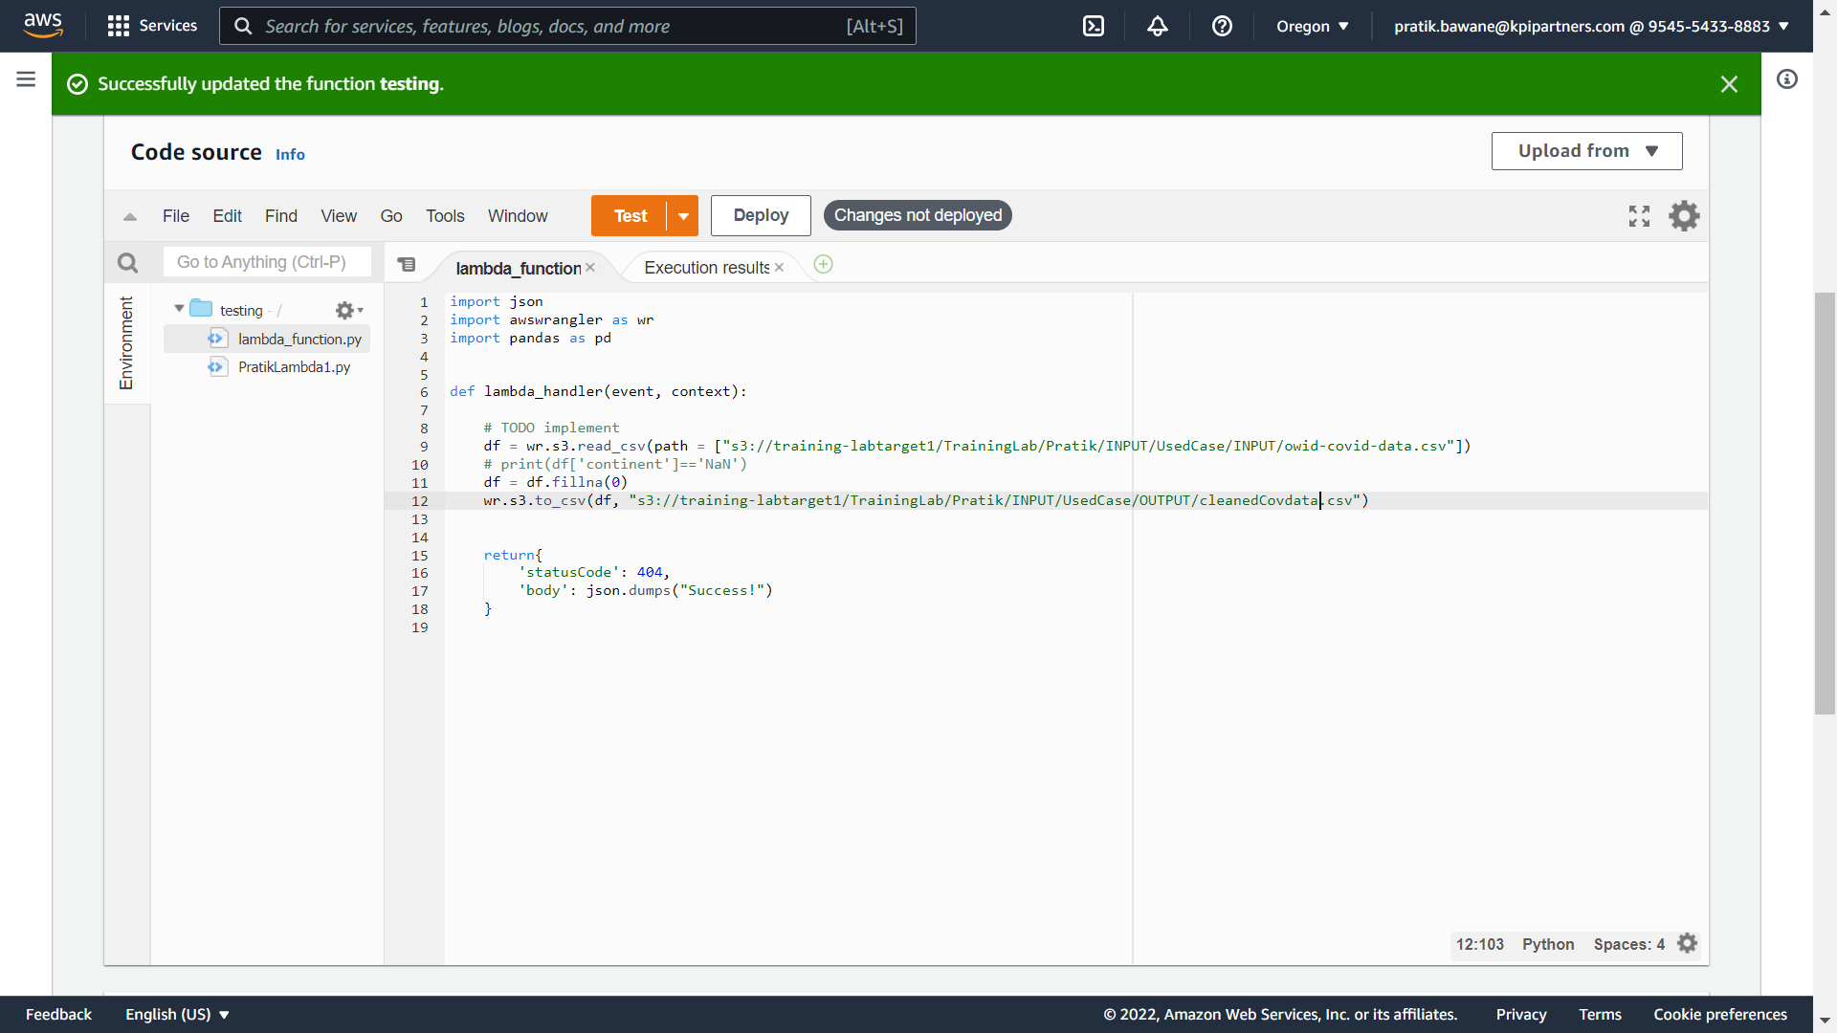
Problem Statement: 1) Clean and transform data for processing

Slide 5
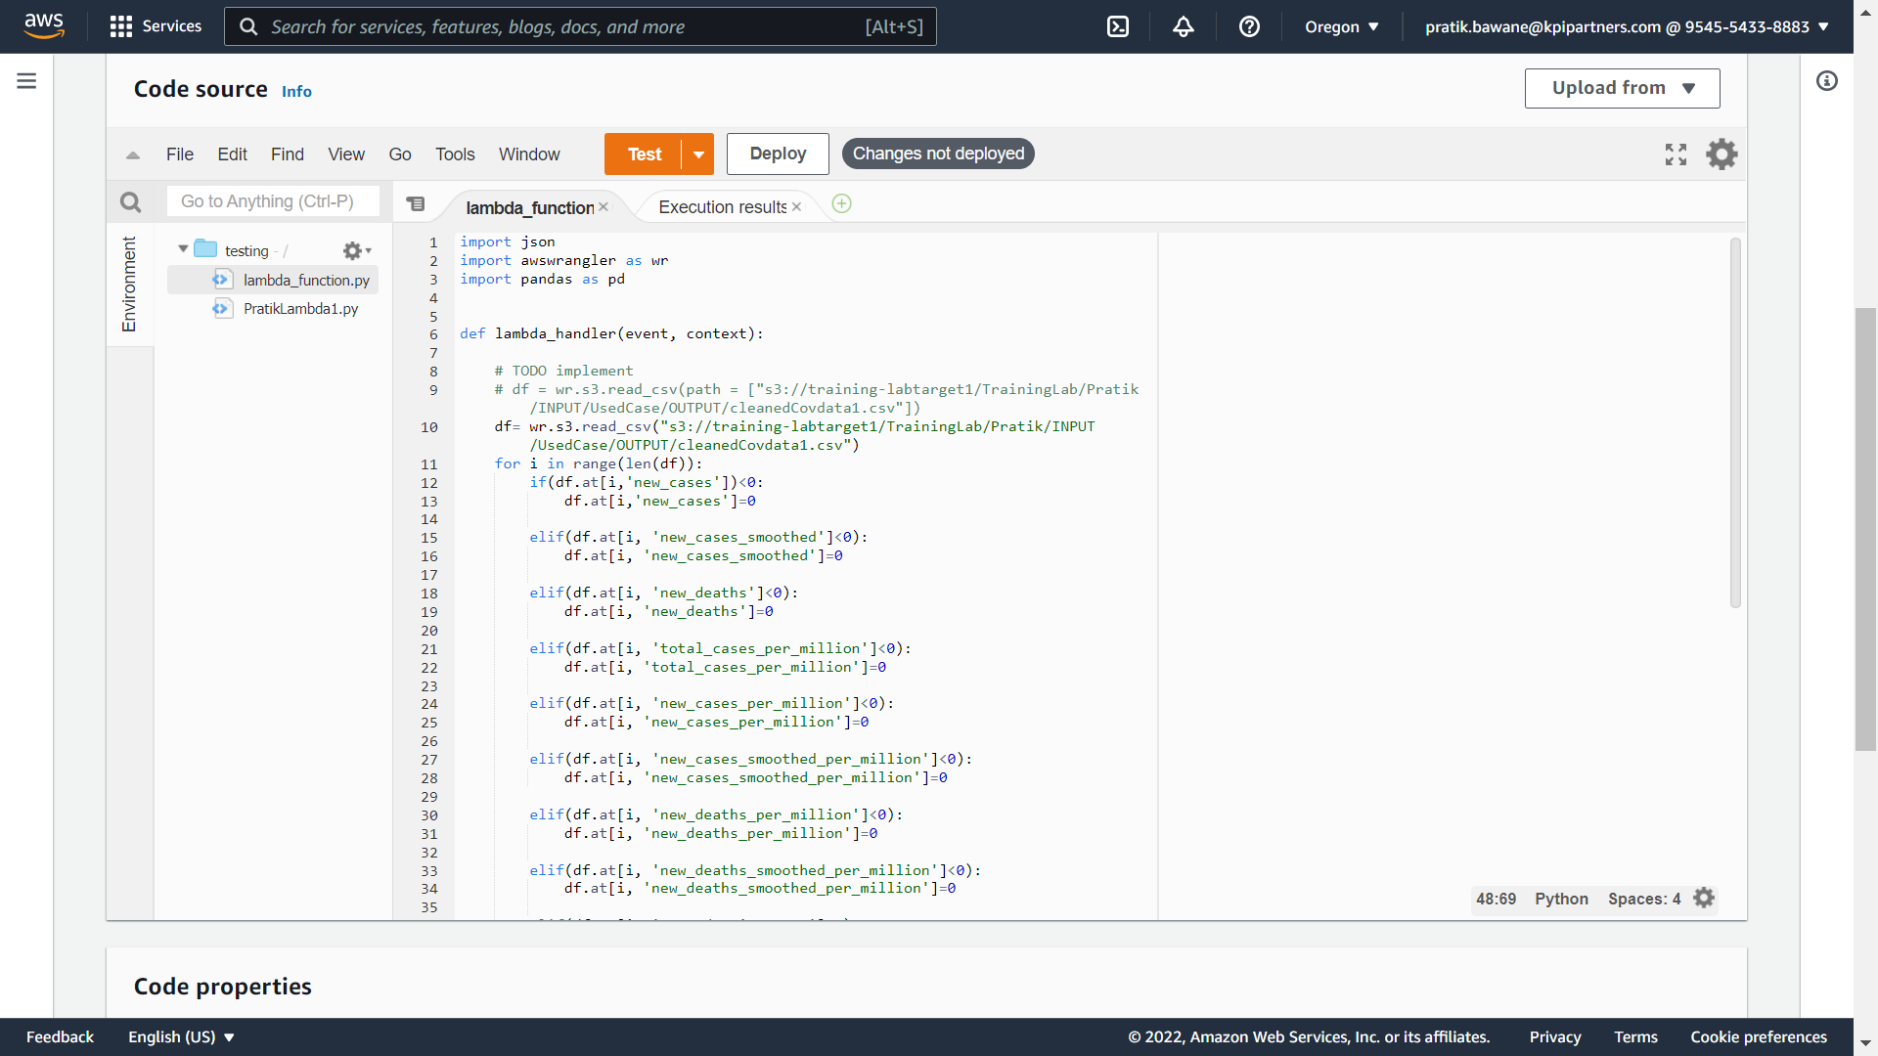
2) ETL operations on dataset

Slide 6
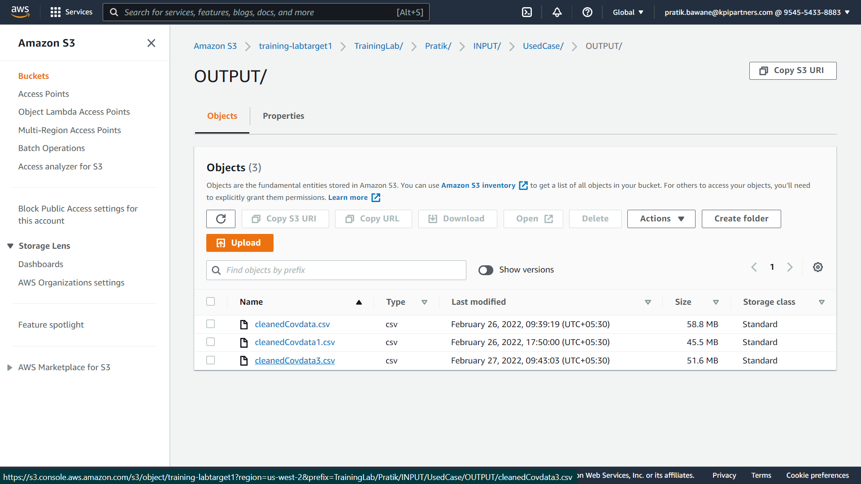
3) Storing the modified data in S3.

Slide 7
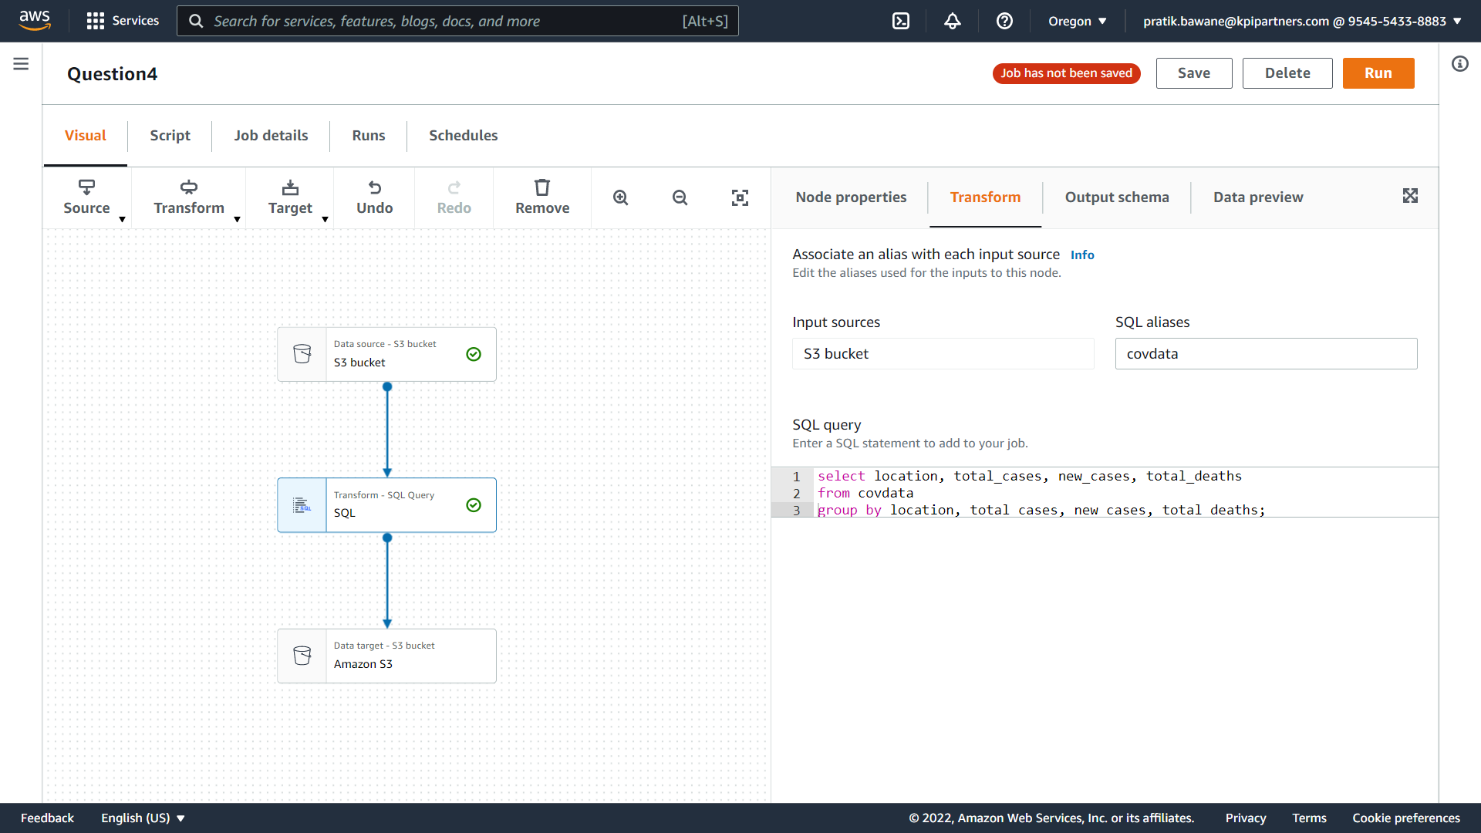
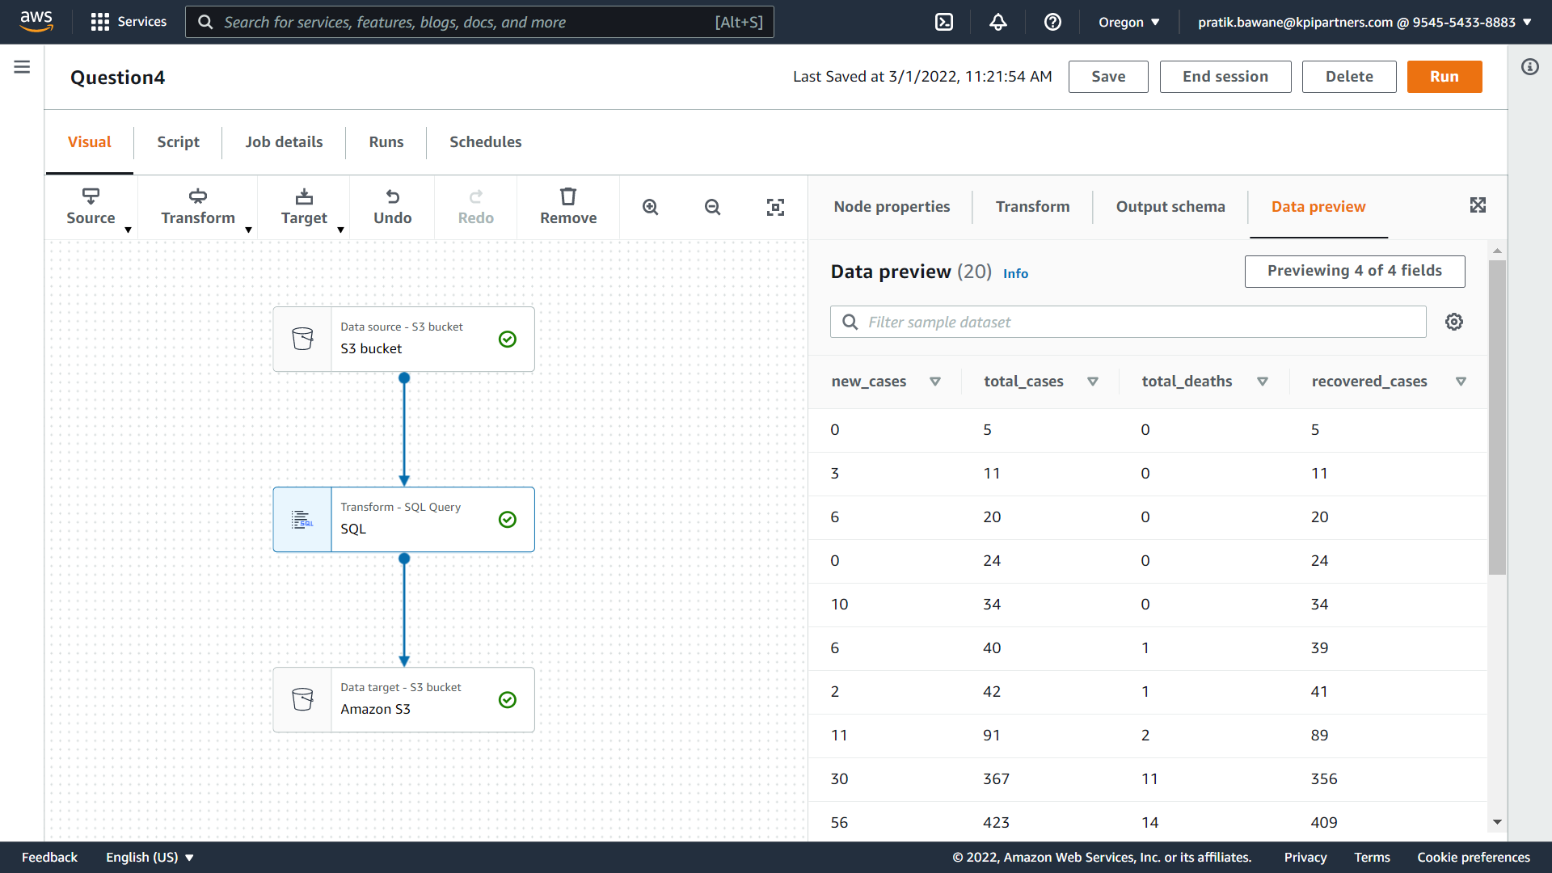
4) Display total_cases, new_cases, recovered_cases and total_deaths

Slide 8
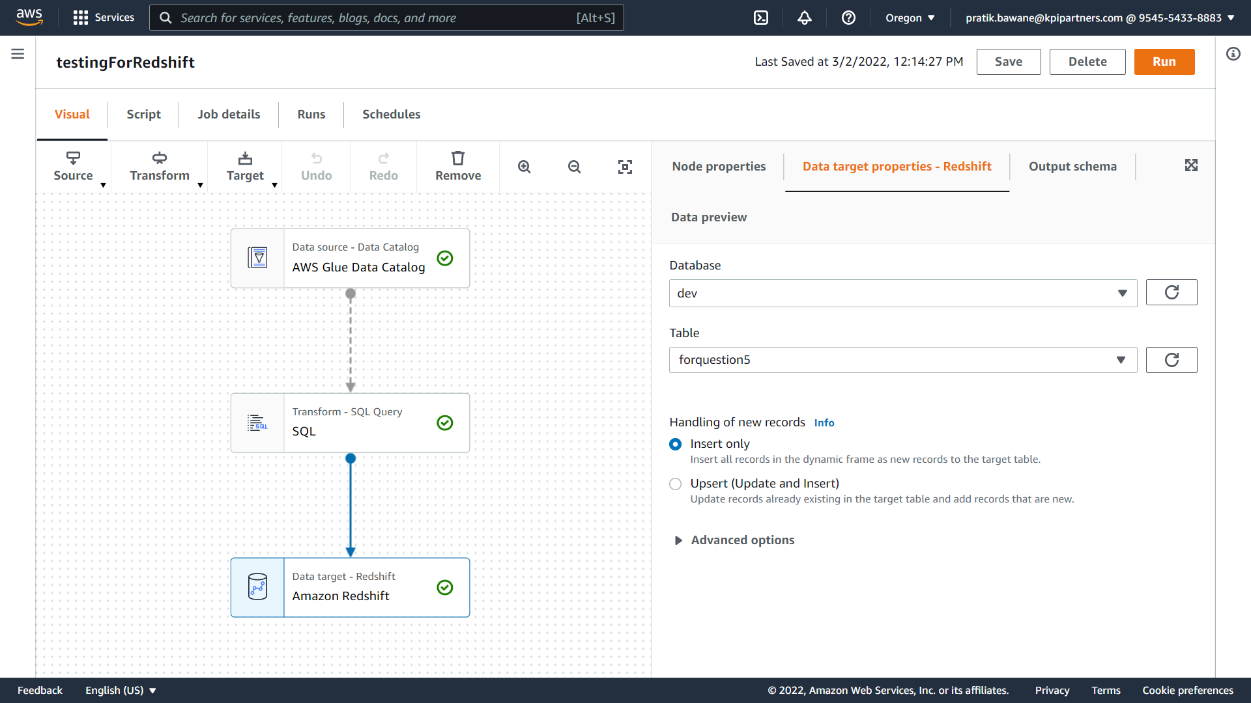
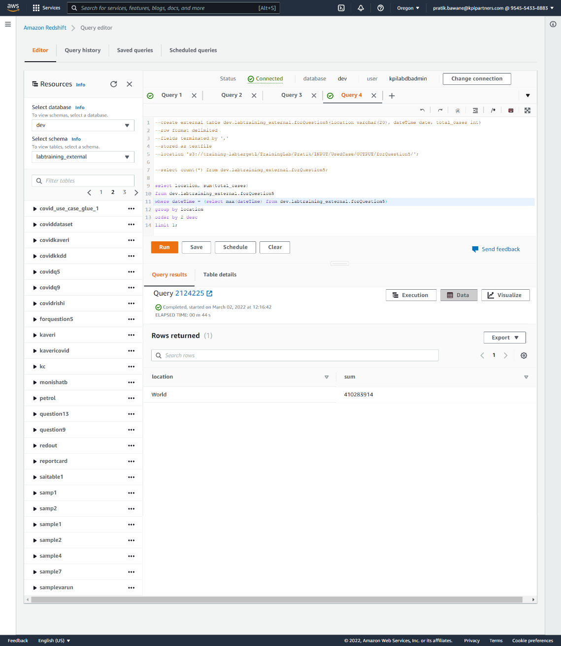
5) Which country in Distinct WHO region highest cases in till date.

Slide 9
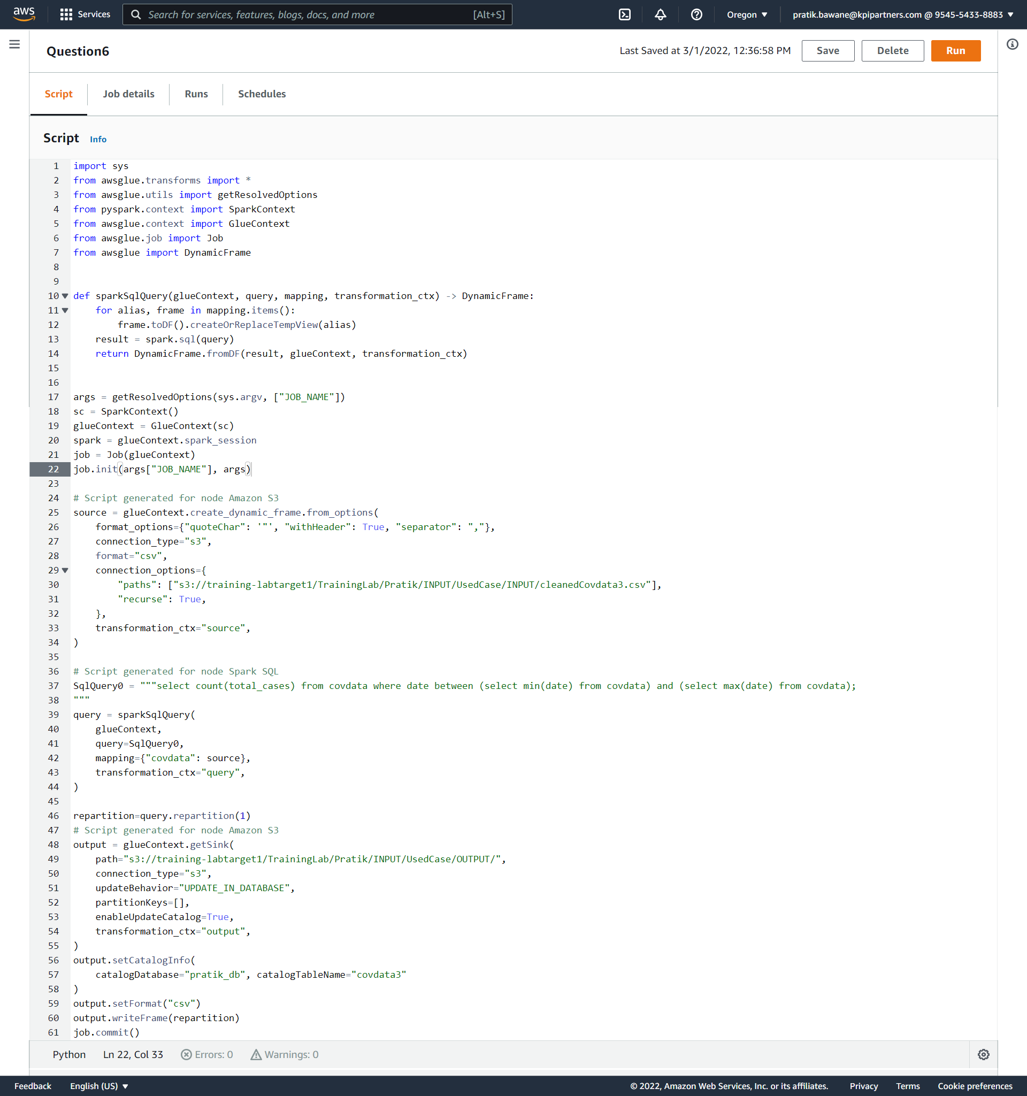
6) Total no of confirmed cases over between a certain date.
Click on this icon to access this file

Slide 10
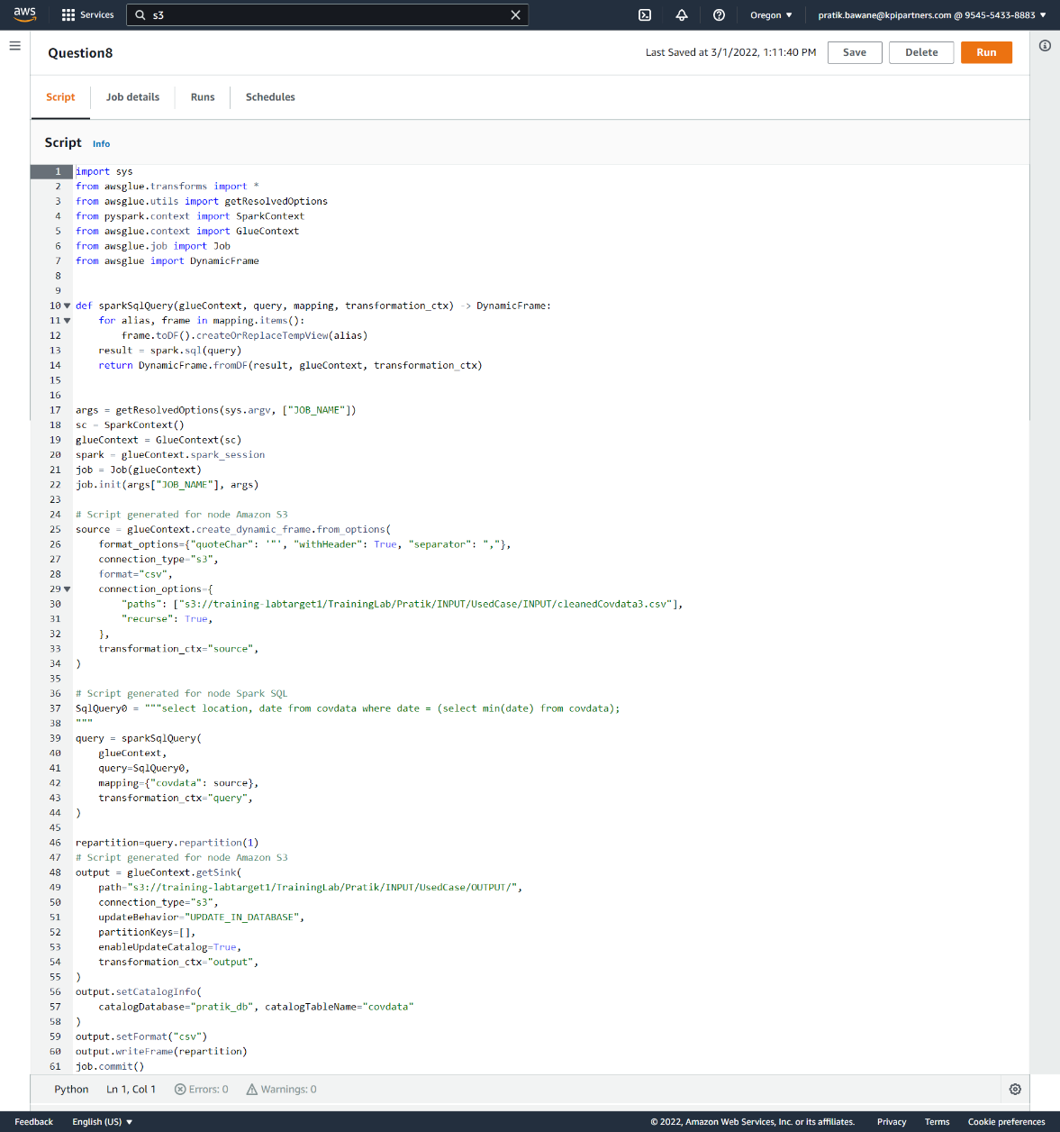
8) Date of first confirmed case in a particular region.
Click on this icon to access this file

Slide 11
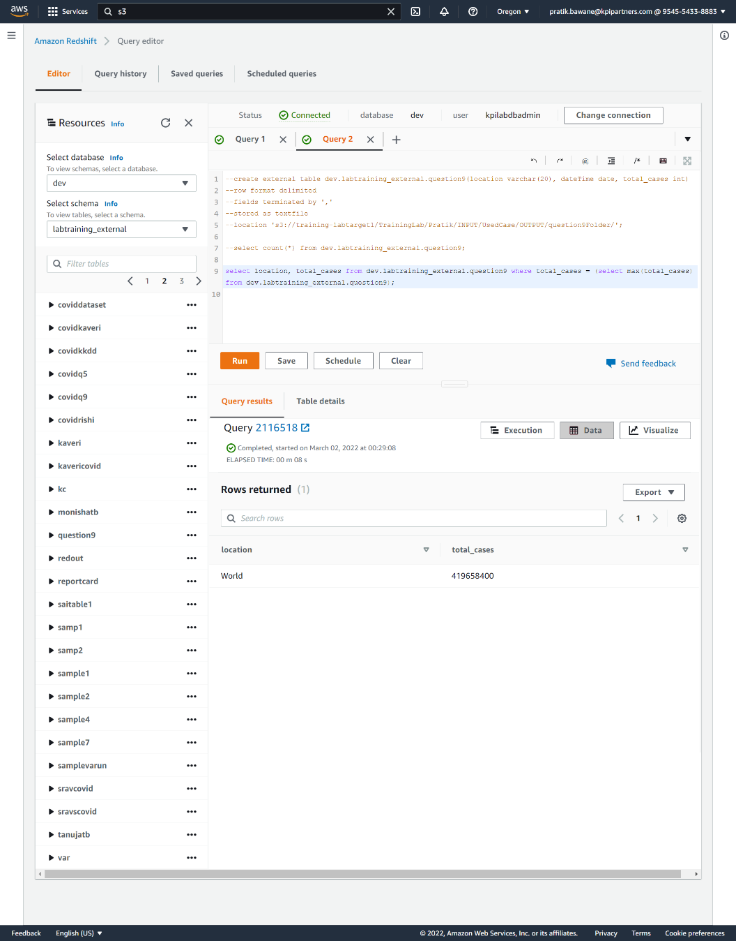
9) Date on which max no. cases were reported in a country.

Slide 12
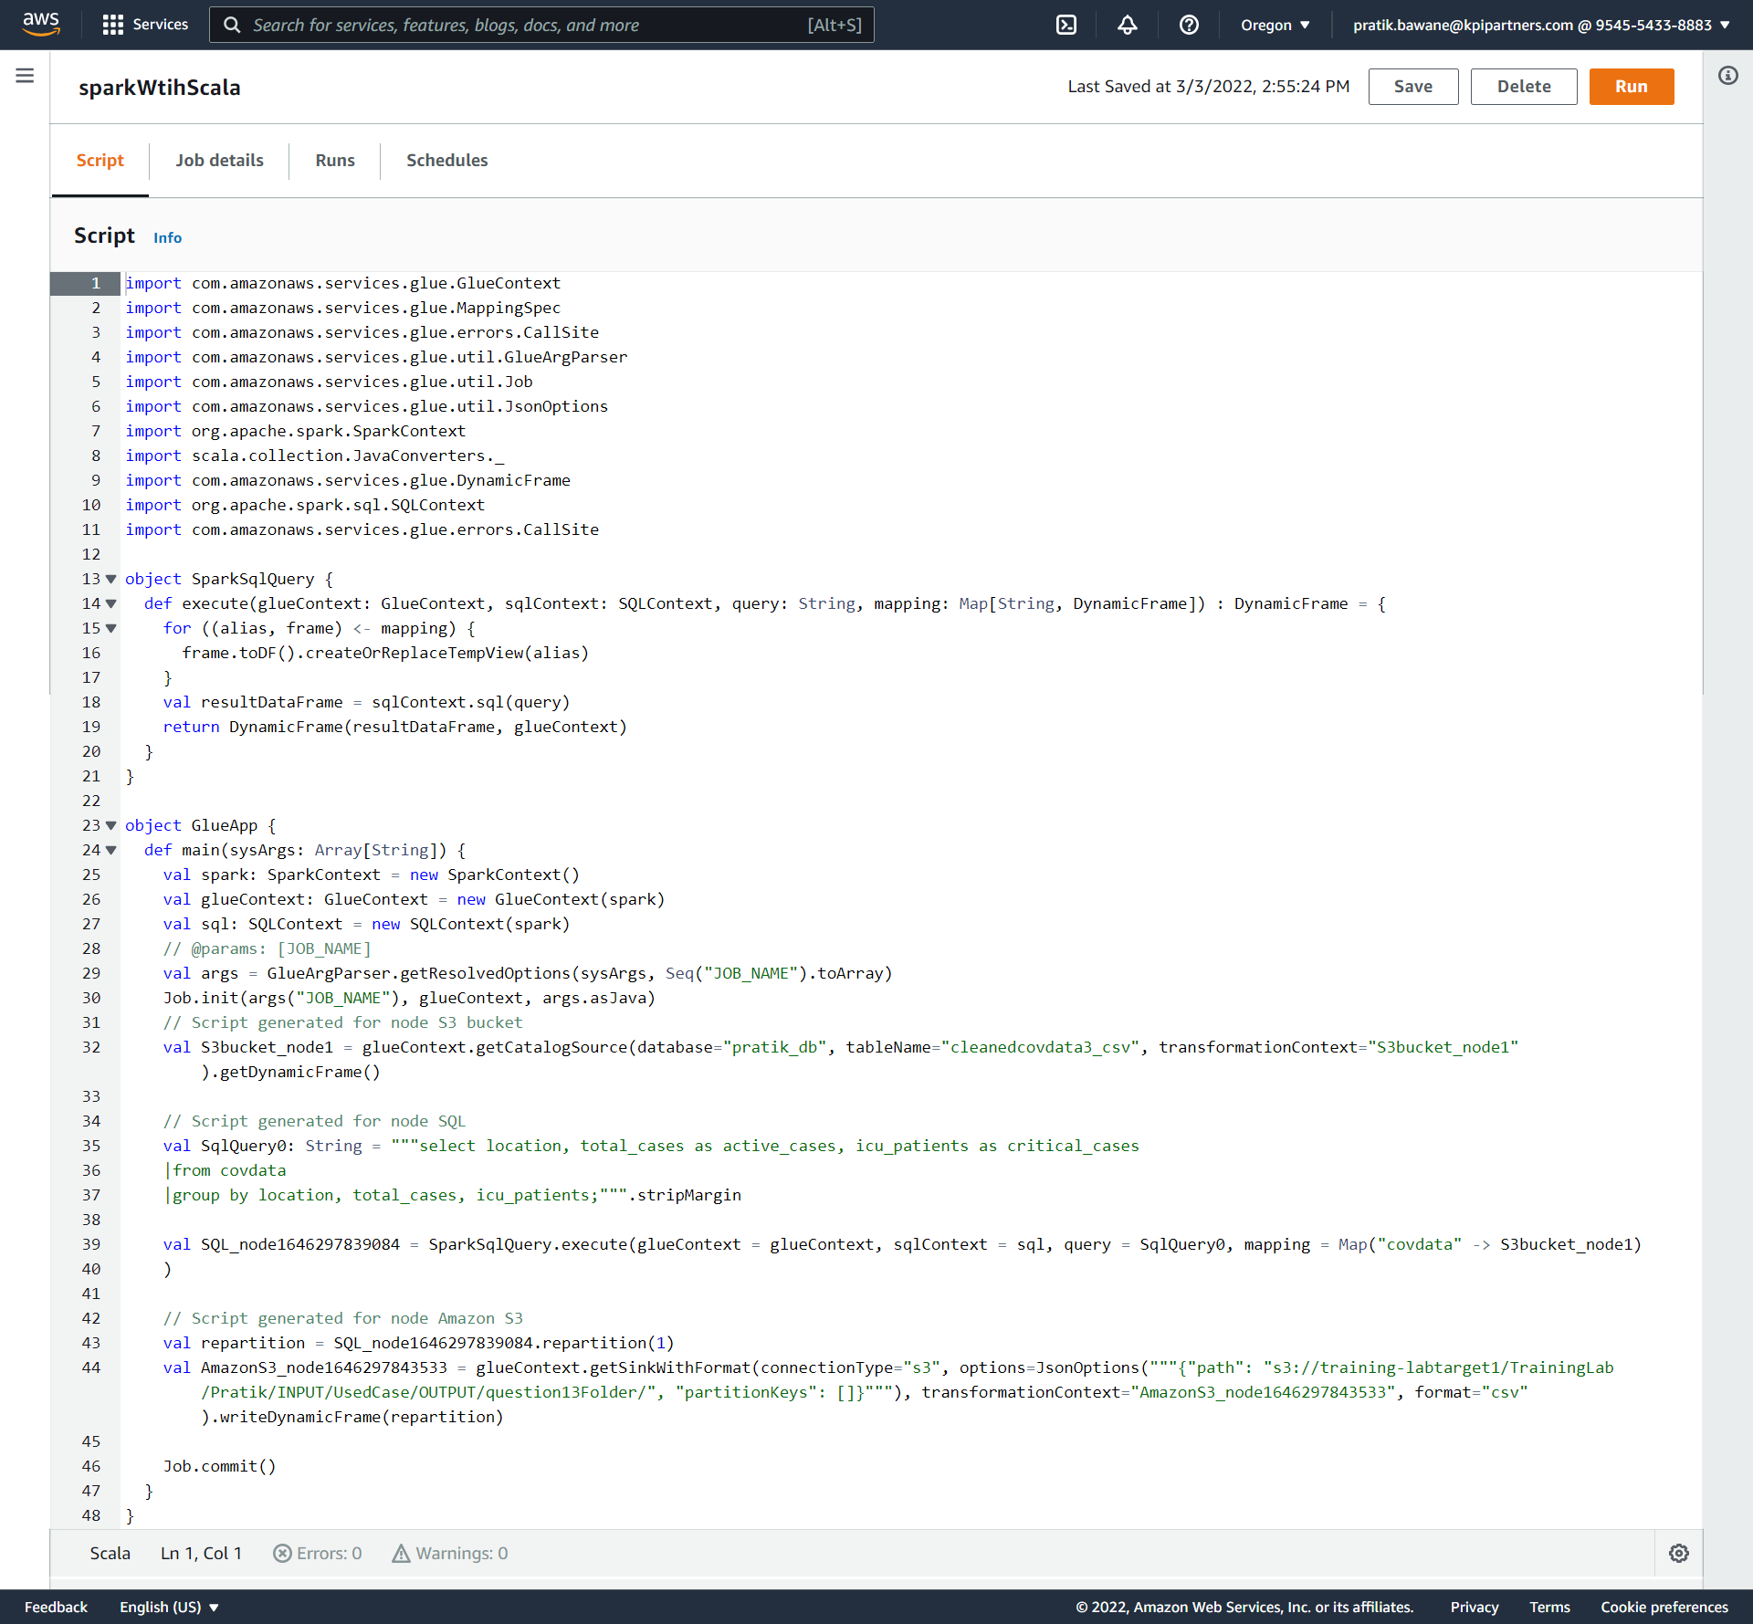
13 ) No. of active cases vs critical cases of a country.
Click on this icon to access this file

Slide 13
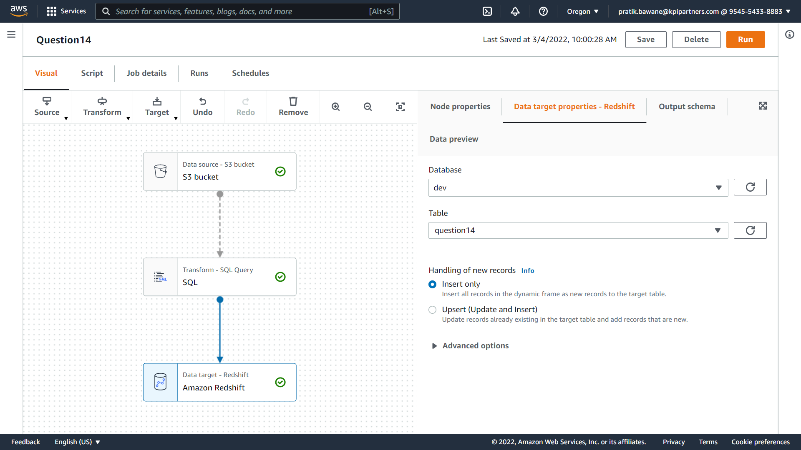
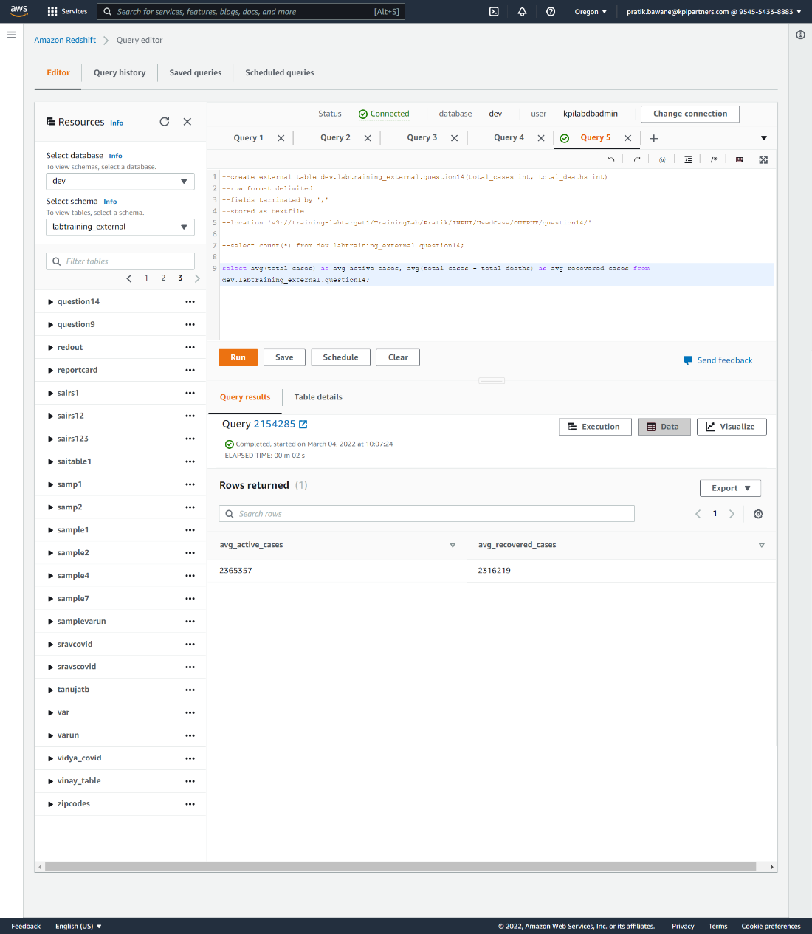
14) Avg active_cases and recovered_cases in a day

Slide 14
Thank You!!!

