Slide 1
GOOGLE CLOUD RAPID AGENT HACKATHON | DYNATRACE TRACK
ZeroTouch SRE
Autonomous incident triage and mitigation planning for production outages.
Built by Pratik Shah • Powered by Google Gemini & Dynatrace OpenPipeline

Slide 2
ZEROTOUCH SRE
The 3 AM Scramble: Production Incident Chaos
The Challenge
When critical systems go down, SRE and DevOps teams lose invaluable time doing context-switching: searching through logs, analyzing dashboards, and opening incident channels.
• First 15 Minutes are wasted purely forming a hypothesis. • Alert Storms create high cognitive load and noise. • Manual Runbooks are static, outdated, or hard to locate.
The Opportunity
What if we could automate the entire first phase of incident response? Go from raw webhook alert to fully-diagnosed root cause, safe mitigations, and runbooks in under 5 seconds.
• Instant Triage: Immediate diagnosis using real-time telemetry. • Bidirectional Audit: observability systems are kept updated. • Safe Execution: Gated actions to protect the production surface.

Slide 3
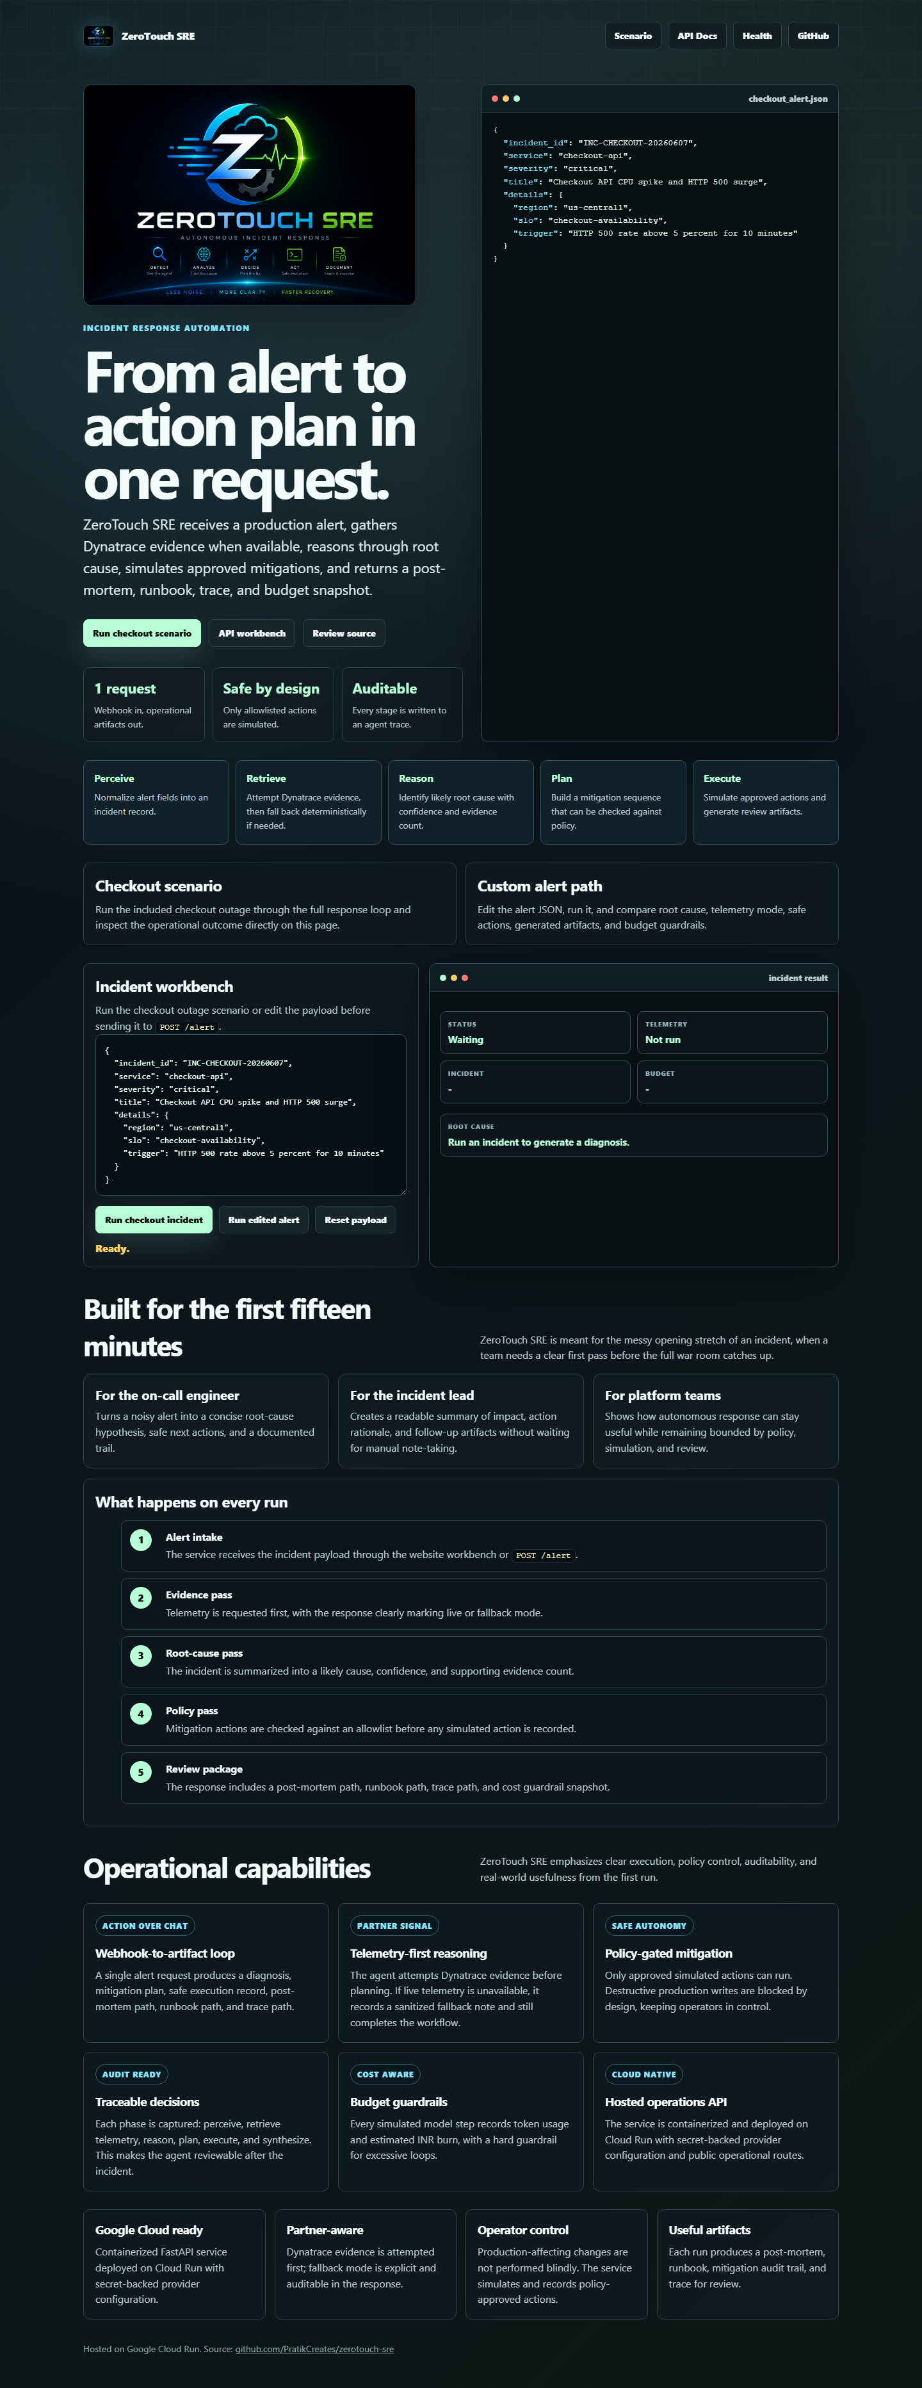
ZEROTOUCH SRE
ZeroTouch SRE: Webhook-to-Artifact Automation
Autonomous Response Loop
✔ Webhook Integration
Receives raw alerts directly from PagerDuty, Alertmanager, or Dynatrace webhooks.
✔ Bidirectional Telemetry
Pushes structured audit events into Dynatrace OpenPipeline AND pulls Grail logs dynamically.
✔ Gemini-Powered Reasoning
Determines root cause with confidence score and suggests allowlisted mitigations.
✔ Auto-Generated Artifacts
Instantly writes Post-Mortem reports, JSON runbooks, and detailed execution traces.

Slide 4

ZEROTOUCH SRE
Live Outage Analysis: Checkout Incident
Incident: CPU Spike & 500 Surge
1. Root Cause Analysis
Detected checkout-api saturated CPU at 88.0% correlated with a recent deployment. HTTP 500 error rate surged to 5.5%.
2. Safe Mitigations Planned
Proposed: scale_service (scale checkout-api), rollback_release (revert last deployment), open_incident_channel.
3. Telemetry Evidence
Verified using live Grail logs via Dynatrace APIs. Log context analyzed by Gemini to generate diagnosis.
4. Performance Metrics
Triage loop completed in 4.1 seconds. Cost: < 0.05 INR using optimized Gemini token controls.

Slide 5
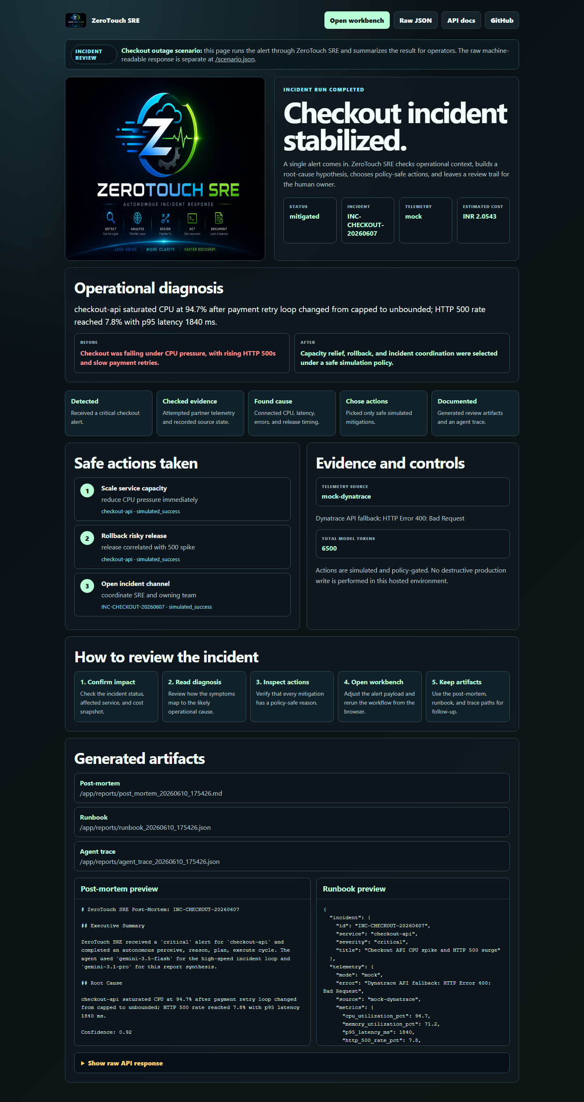
ZEROTOUCH SRE
Safety Model: Useful, Not Dangerous
Designed for Production Safety
🛡 Simulation-Only execution by default. No live production writes.
Allows full agent evaluation and scenario reviews without risk of service disruption.
🛡 Strict operation allowlists (scale, rollback, notify).
Any command or script outside the allowed SRE playbook is blocked instantly at the gate.
🛡 Cost limits and token budgets checked on every single execution.
Prevents runaway loops. Estimated token burn tracked in INR against custom budgets.

Slide 6
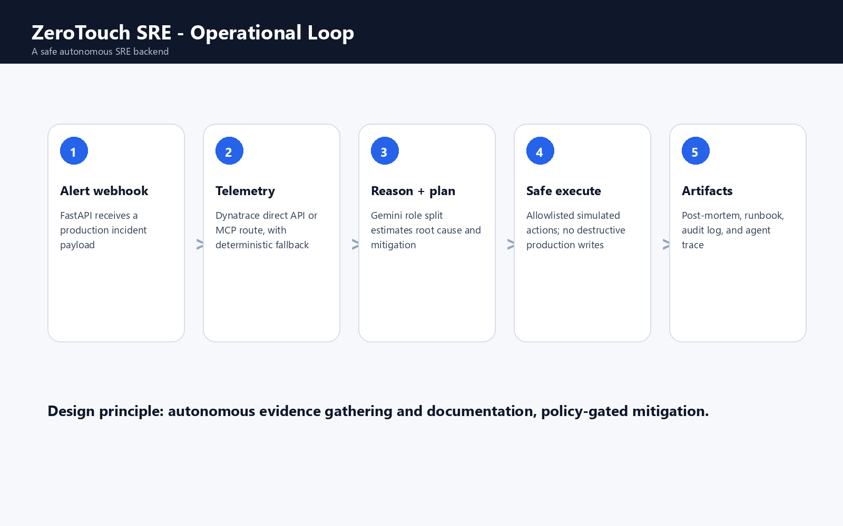
ZEROTOUCH SRE
Under the Hood: Cloud Architecture & Integration
Architecture Components
⚡ FastAPI Backend
Lightweight, async Python framework serving high-speed API endpoints and incident review templates.
⚡ Google Cloud Run
Serverless deployment scaling to zero, ensuring minimal idle cost while remaining instantly responsive to incoming webhooks.
⚡ Dynatrace Grail & OpenPipeline
Bidirectional flow via standard REST APIs. Pushes alert audit trails and pulls real-time log evidence.
⚡ Vertex AI / Google Gemini
High-context LLM reasoning about telemetry, generating structured incident reports and executable action plans.

