Slide 1


Offline-First Emergency & Community Network
When the network fails, critical communication shouldn't.
Problem Statement: Offline by Default
Build resilient solutions that remain secure, accessible, and functional even without reliable internet connectivity.
NEXUS
Pratik Das | Lakshya Bhivgade
M. Rajesh | Harshavarshan
ANVESHAN'26 • 24 HR HACKATHON

Slide 2
01. Problem Understanding
Disasters can break internet and cellular connectivity when communication is most critical.
Citizens may be unable to report emergencies, share location, request help or find resources.
Offline messaging enables communication, but does not provide structured emergency intelligence.
Responders need location, urgency, affected people and status — not scattered conversations.
The real gap is offline emergency coordination — not just offline messaging.
Problem Gap: Emergency information becomes fragmented, delayed, duplicated, and difficult to prioritize.
ANVESHAN'26 • 24 HR HACKATHON

Slide 3
02. Proposed Solution
CAPTURE
Offline-first emergency coordination for network-disrupted environments, using autonomous nearby peer-to-peer relay.
Structured Reports
Type • Location • Priority • People • Status
Offline Storage
Incidents persist locally and remain queued without internet.
Autonomous Multi-Peer Relay
Queued incidents are automatically exchanged with nearby peers using the available transport.
Responder Sync
Queued incidents synchronize with the responder system when connectivity returns.
STORE
PRIORITIZE
RELAY
SYNC
RESPOND
ANVESHAN'26 • 24 HR HACKATHON

Slide 4
03. Innovation
Structured emergency coordination, not offline chat.
Structured Emergency Intelligence Type, location, priority, people affected and status in every incident.
Priority-Based Propagation Critical incidents are prioritized for propagation before routine updates.
Autonomous Multi-Peer Relay Incidents automatically propagate across dynamically connected nearby peers without manual connection actions.
Responder-Centric Aggregation Relayed incidents converge into a prioritized incident view for responders.
Store-Carry-Forward Incidents remain queued locally until a suitable peer or responder becomes reachable.
Transport-Agnostic Mesh
The same relay engine works across Native Nearby, WebRTC and WebSocket transports.
ANVESHAN'26 • 24 HR HACKATHON

Slide 5
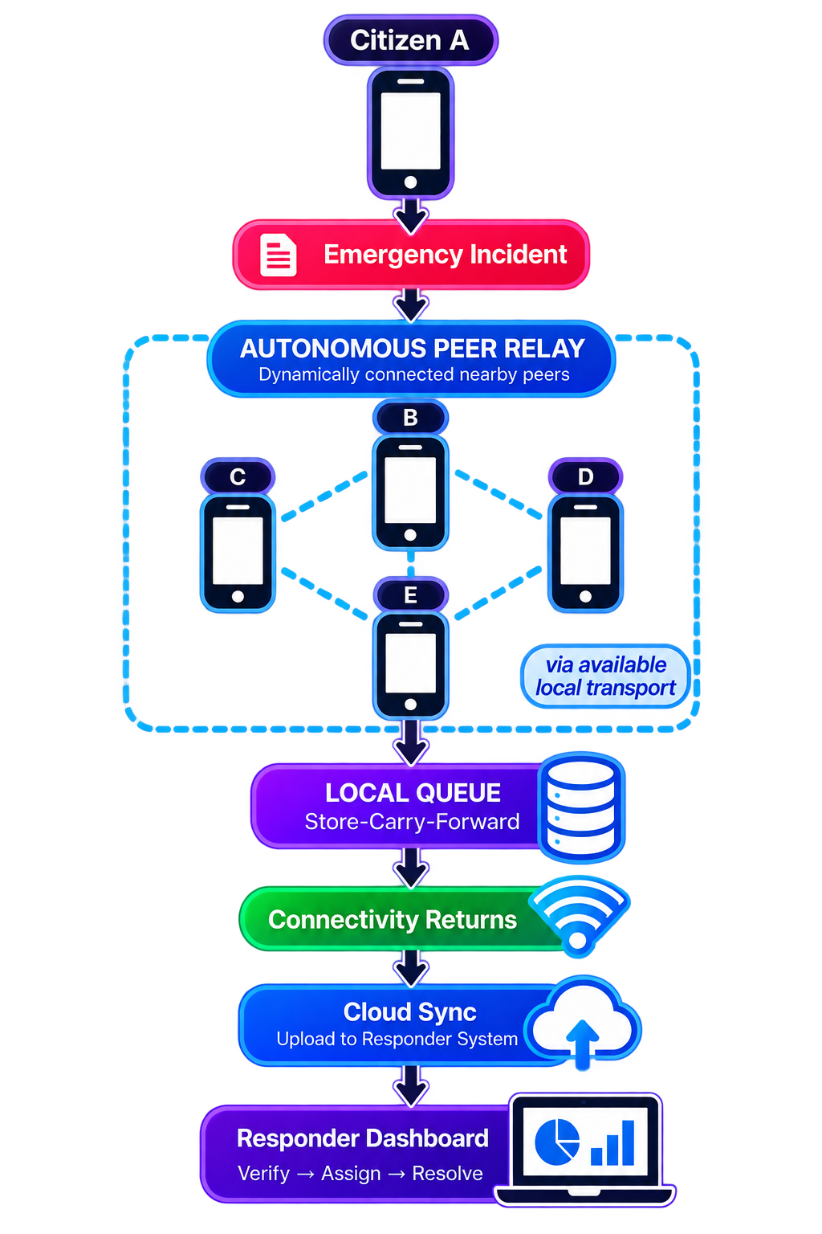
04. Methodology
Emergency incidents are captured and stored locally, then autonomously relayed across nearby peers until they can reach responders.
CAPTURE Structured incident report
VALIDATE Verify incident structure and integrity
PRIORITIZE Severity-based queue
STORE
Persist locally
RELAY Autonomous nearby peer exchange
SYNC Synchronize when connectivity returns
RESPOND Verify → Assign → Resolve
SAMPLE INCIDENT REPORT
NX-1042 Medical Emergency
Priority: P0 — Critical People: 2 Location: 13.0827, 80.2707 Time: 10:42 AM Status: Queued Need: Immediate medical assistance
ANVESHAN'26 • 24 HR HACKATHON

Slide 6



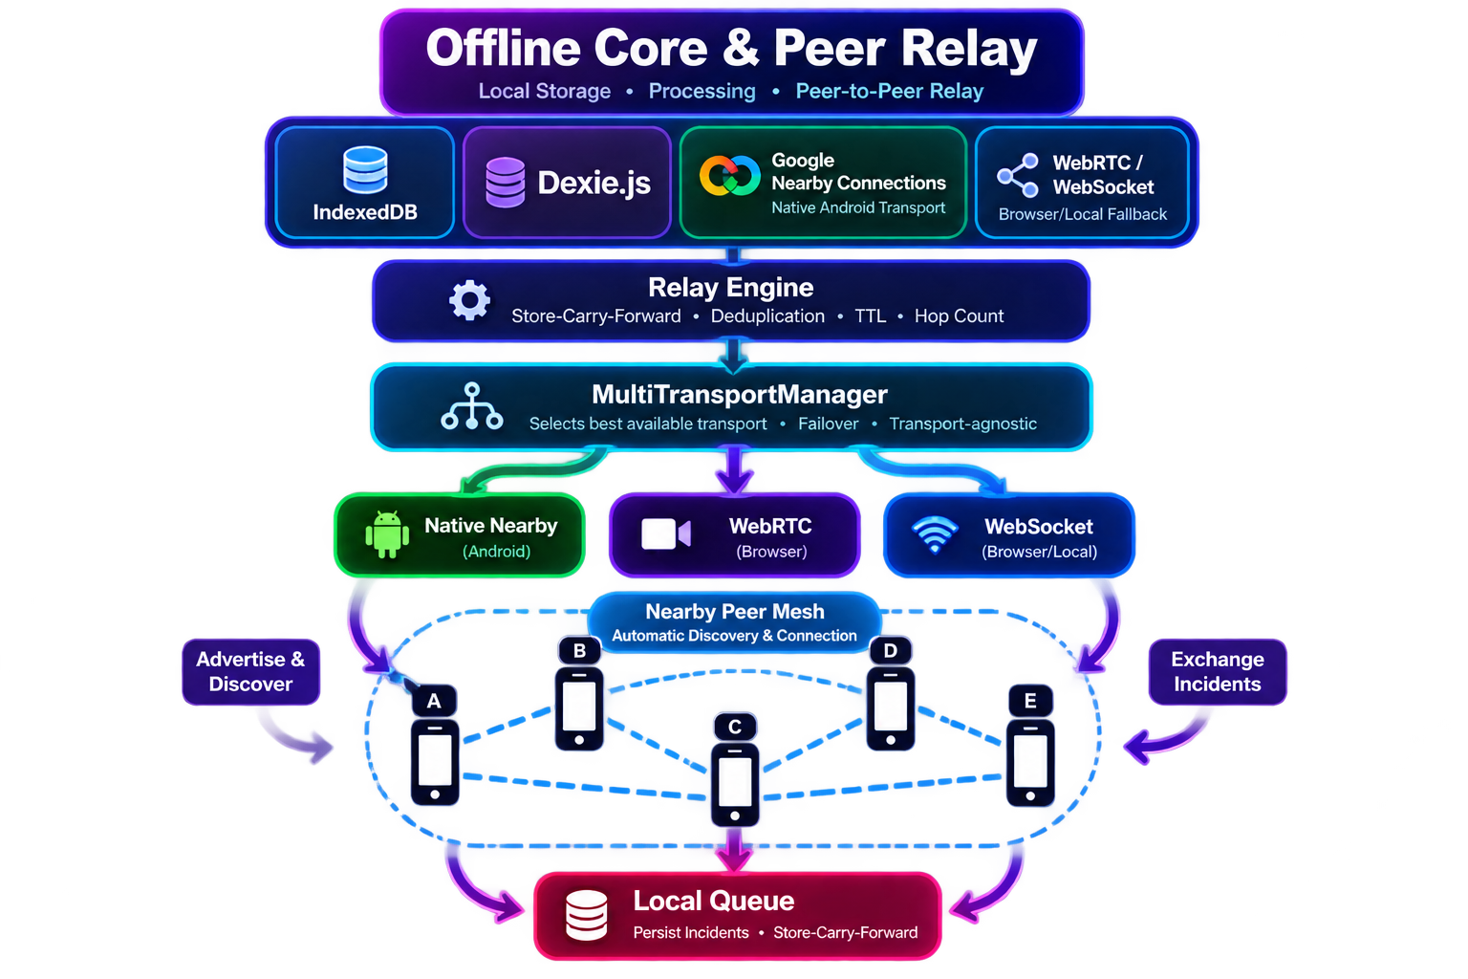


05. Implementation Approach
Application Layer
Offline Core & Peer Relay
Sync & Response Layer
Emergency Report
Type • Location • Priority • People • Status
Location Capture
Geolocation API + Manual Fallback
Status Tracking
Reported → Queued → Relayed → Synced → Verified → Assigned → Resolved
Cloud Sync
Synchronize queued incidents when connectivity returns
Responder Dashboard
Priority Queue Verify → Assign → Resolve
Firebase Firestore
ANVESHAN'26 • 24 HR HACKATHON

Slide 7
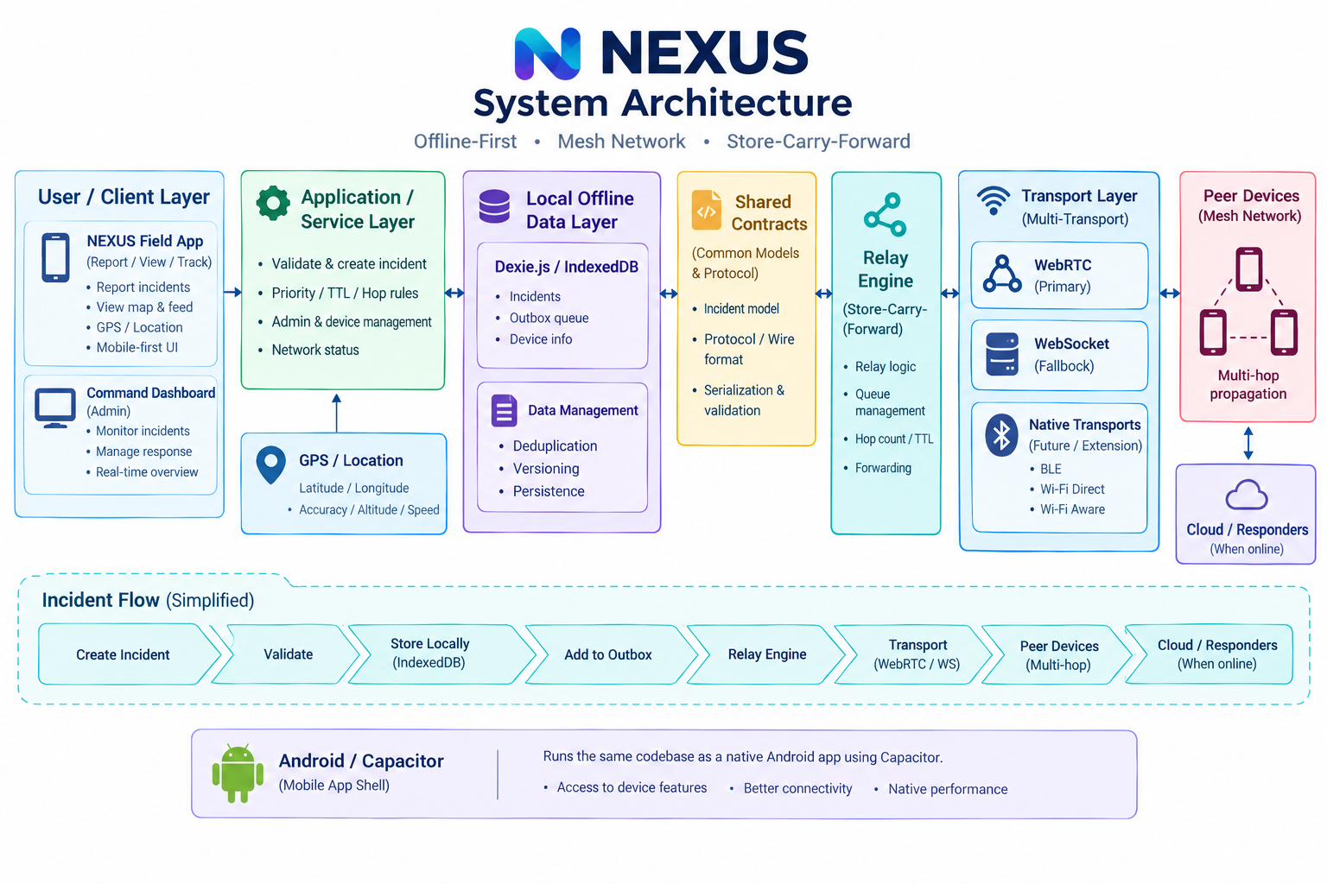
06. Architecture Diagram

Slide 8
07. Expected Impact
Faster Emergency Response | Better Situational Awareness
Critical incidents are prioritized for propagation before routine updates. | Structured incidents show location, priority, people affected and status.
Resilient Community Communication | Efficient Resource Coordination
Incidents can be created, stored and relayed during connectivity loss. | Coordinate shelters, food, water, medical needs and safety updates.
From scattered messages to one prioritized Floods • Cyclones • Rural Areas | emergency picture — even when connectivity fails. • Relief Camps • Campuses • Large Events
ANVESHAN'26 • 24 HR HACKATHON

Slide 9
08. MVP, Feasibility & Viability
MVP SCOPE | TECHNICAL FEASIBILITY | VIABILITY & SCALABILITY
Offline-First Mobile App — Emergency reporting + autonomous local operation | React + Vite + Capacitor — Cross-platform UI + native Android container | Disaster Operations — Floods, cyclones, outages, relief camps
Structured Incidents — Type, location, priority, people, status | IndexedDB + Dexie.js — Offline persistence + local queue | Community Coordination — Resources, shelters, safety updates
Autonomous Peer Relay — Nearby device-to-device communication | Google Nearby Connections — Native Android peer discovery + P2P communication | Store-Carry-Forward — Queue incidents until suitable peers become available
Priority & Deduplication — Critical-first + version-aware duplicate filtering | Firebase Firestore — Synchronization when connectivity returns | Transport Evolution — Additional native transports through the transport abstraction
Responder Dashboard — Map, priority, verification, assignment | Web Crypto API — Integrity / security support | Deployment Expansion — Campuses, communities, emergency operations
ANVESHAN'26 • 24 HR HACKATHON

Slide 10
THANK YOU

