Slide 1
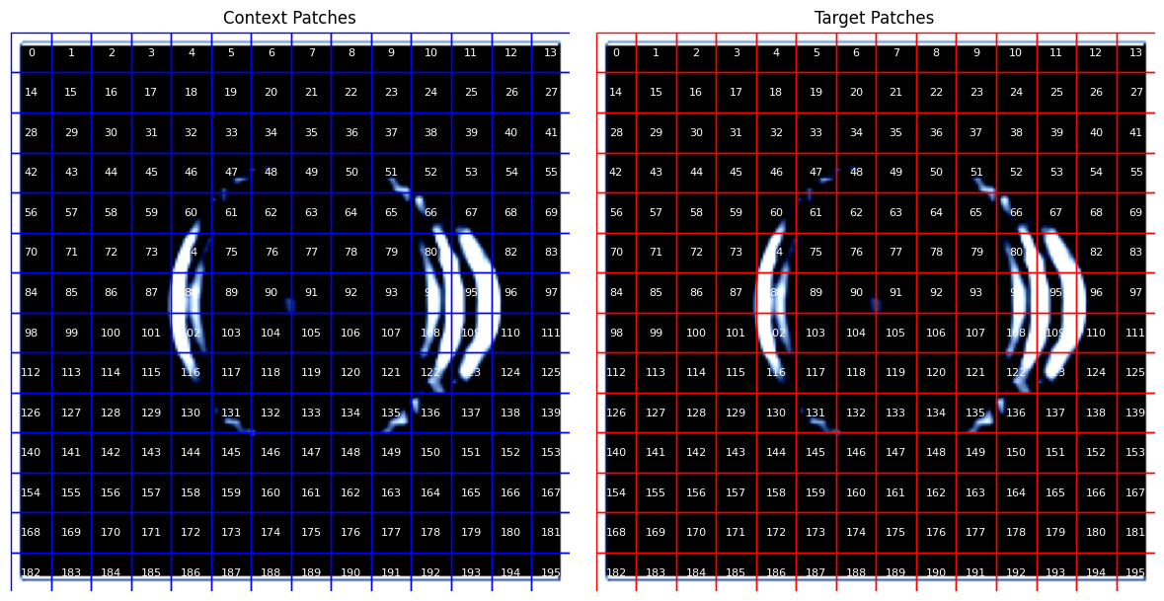
Used context and target patches covering the entire image area

Slide 2
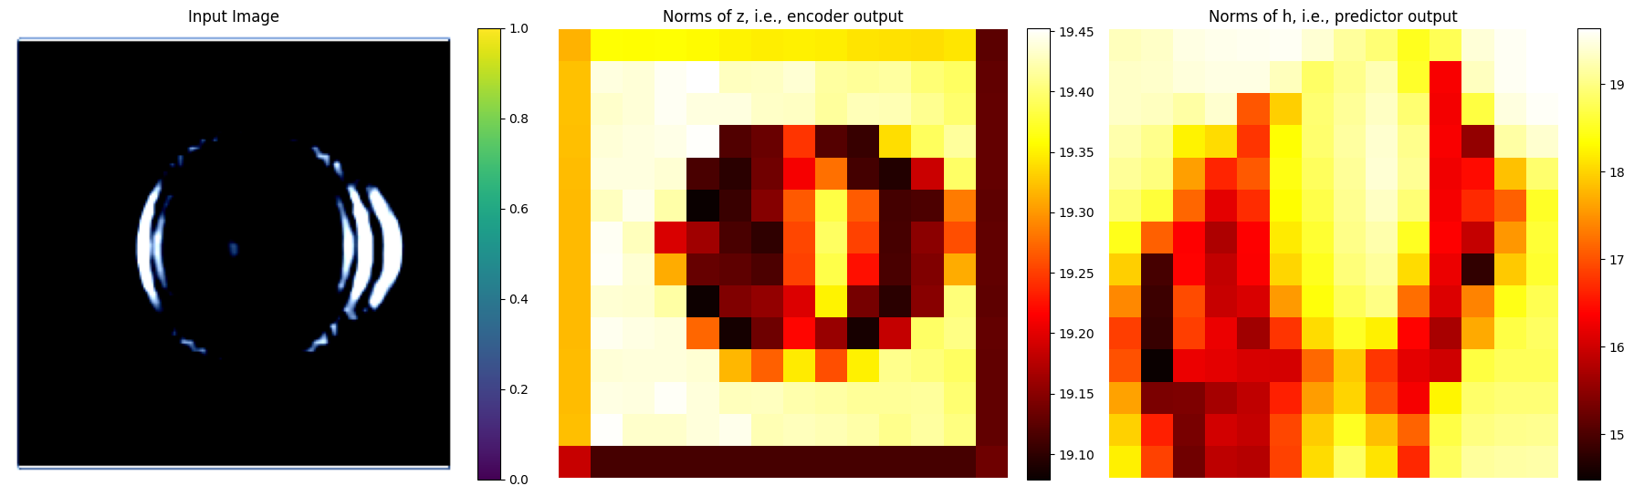
Passed all those patches through the encoder and predictor.
Figure below shows heatmaps of the norms of the embeddings output by the encoder and predictor.
Both encoder and predictor embeddings seem to have relevant information with encoder seeming to have a better understanding about the geometry.

Slide 3
Then MLP decoders were trained to perform two classification tasks:
to detect if the object is solid or hollow
to identify the tissues contained in the image
Although unique and distinct, images in train/val/test sets were too similar.
With this dataset, the MLP decoders performed too well – possibly overfitting ??
This indicated that embeddings did learn something and weren’t just produce garbage.
Because if they had produced garbage, even the MLP decoders couldn’t have overfit.

Slide 4
To check whether the trained MLP decoders were indeed overfitting or not, Leah suggested to test the trained MLP decoders on images that were never seen before during IJEPA or MLP training.
So I tested the MLP decoders on images of “sphere_with_conical_spikes”.
It is a spherical object containing water and fatty_tissue.
Both the IJEPA and MLP decoders had seen spherical objects and water/fatty_tissue during their respective training but they never seen this object specifically.
If they perform well on this new object, then we can say that the networks understand.

