Slide 1
Azure · Python · Microsoft Agent Framework
Harness Engineering
Seven patterns for putting an AI agent into production — re-built in Python on managed Azure primitives.
A local-first practice project · all 7 lessons implemented & tested
Notes:
One-line hook: an LLM on its own is not a product. The 'harness' is everything you wrap around the model to make it safe, durable, and useful in production. This deck walks the seven patterns and how each maps onto a managed Azure service.

Slide 2
First: which "harness"?
The term is overloaded. Two different things share the name — this project is the first one.
This project
Not this project
Runtime harness
Dev-time harness
The scaffolding wrapped around a deployed agent: guardrails, memory, tools, orchestration, human-in-the-loop. From the Hendrixer/harness-engineering course.
OpenAI's "humans steer, agents execute" — the environment & feedback loops that let coding agents write your software. Same words, different layer.
We're building the harness an agent runs inside, not the harness a team builds software with.
Notes:
Pre-empt the confusion. If someone in the audience read OpenAI's 'harness engineering' post, clarify up front that this is the runtime meaning. Both are about 'scaffolding around agents' — but one is production runtime, the other is a development methodology.

Slide 3
The thesis
The original course builds the whole harness by hand in TypeScript. This project takes a different altitude:
Let Azure supply the harness. Prefer managed primitives over from-scratch infrastructure.
Spend the effort on orchestration, guardrails, and observability instead.
You still learn all 7 patterns — as configuration & orchestration, not plumbing.
Working rule throughout: keep implementations thin. If a lesson can be solved by configuring a managed service, don't hand-roll it.
Notes:
The core design decision. Contrast with the source course. The payoff: less infrastructure code, more focus on the interesting agent problems. Every lesson is framed 'Azure provides X / you build Y'.

Slide 4
Two layers do the work
Azure provides — the agents
You build — the harness around them
AI Foundry · Agent Service. Model calls + the tool loop, managed threads (memory), and sandboxed tools: Code Interpreter, File Search, Function, AI Search.
Microsoft Agent Framework. Middleware/guardrails, durable checkpointed workflows, multi-agent orchestration, and human-in-the-loop.
Our own code is a thin FastAPI orchestration API (destined for Azure Container Apps) that drives these agents. Agent Framework is public preview — pin versions
Notes:
Agent Service = the agents themselves. Agent Framework = the harness around agents (successor to Semantic Kernel + AutoGen). Our FastAPI app is the glue. Note the preview caveat: the Agent Framework API shifts, so we pin exact versions per lesson.

Slide 5
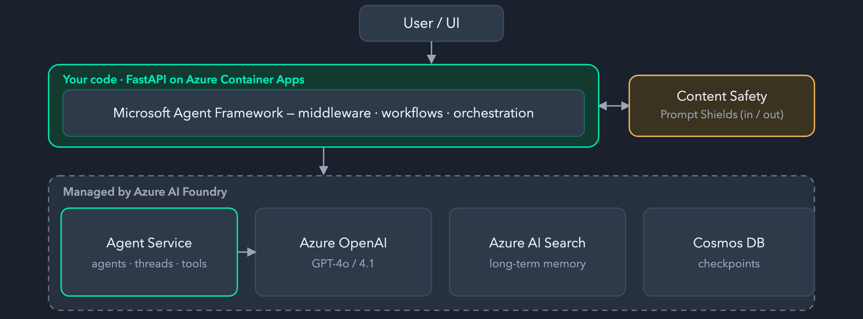
Architecture
You host only the API; everything in the dashed band is managed by Azure. Cross-cutting: App Insights (OpenTelemetry traces) · Entra Managed Identity (keyless, DefaultAzureCredential).
Notes:
Walk top to bottom. The API is the only thing we host; everything under it is managed. Observability (App Insights + Foundry tracing) is the 'is it actually working' signal — it replaces the course's React 'Harness Inspector'. Auth is keyless by default.

Slide 6
The one convention: the seam pattern
Every Azure dependency is stubbed behind a seam, so the whole suite runs with no cloud and no network.
A typing.Protocol (or injectable callable/table) = the swap point.
A local implementation whose docstring names the Azure service it stands in for.
It honestly documents where the local stand-in is weaker — "state the leak."
# durable/checkpoint.py — same interface, local SQLite today, Cosmos DB later
class CheckpointStore(Protocol):
def load(self, run_id: str) -> Checkpoint | None: ...
def save(self, checkpoint: Checkpoint) -> None: ...
Swap local → Azure without touching the workflow logic. Match this pattern when adding code.
Notes:
This is THE thing to remember from the codebase. Protocol boundary + local impl + honest docstring. 'State the leak' means the stand-in never pretends to be as strong as the managed service — it says exactly where it's weaker. This is what makes the repo runnable offline yet ready to wire to Azure.

Slide 7
The seven lessons
#
PATTERN
YOU BUILD (LOCAL MODULE)
1
Agent Harness
guardrails.py + app.py
local ✓
2
Durable Execution
workflow.py + durable/
local ✓
3
Secure Sandboxing
sandbox.py
local ✓
4
Advanced Memory
memory/ (thread·knowledge·summarize)
local ✓
5
Orchestration
orchestration/router.py
local ✓
6
Hierarchical Supervision
orchestration/supervisor.py
local ✓
7
Human-in-the-Loop
hitl.py (on durable/)
local ✓
"local ✓" = runnable + unit-tested with Azure stubbed behind a seam. Azure-wired impls are the next increment.
Notes:
The map for the rest of the talk — one slide per lesson coming up. Emphasize all seven are DONE locally and green. The Azure wiring is deliberately future work; the point of the exercise is to learn the patterns first, offline.

Slide 8
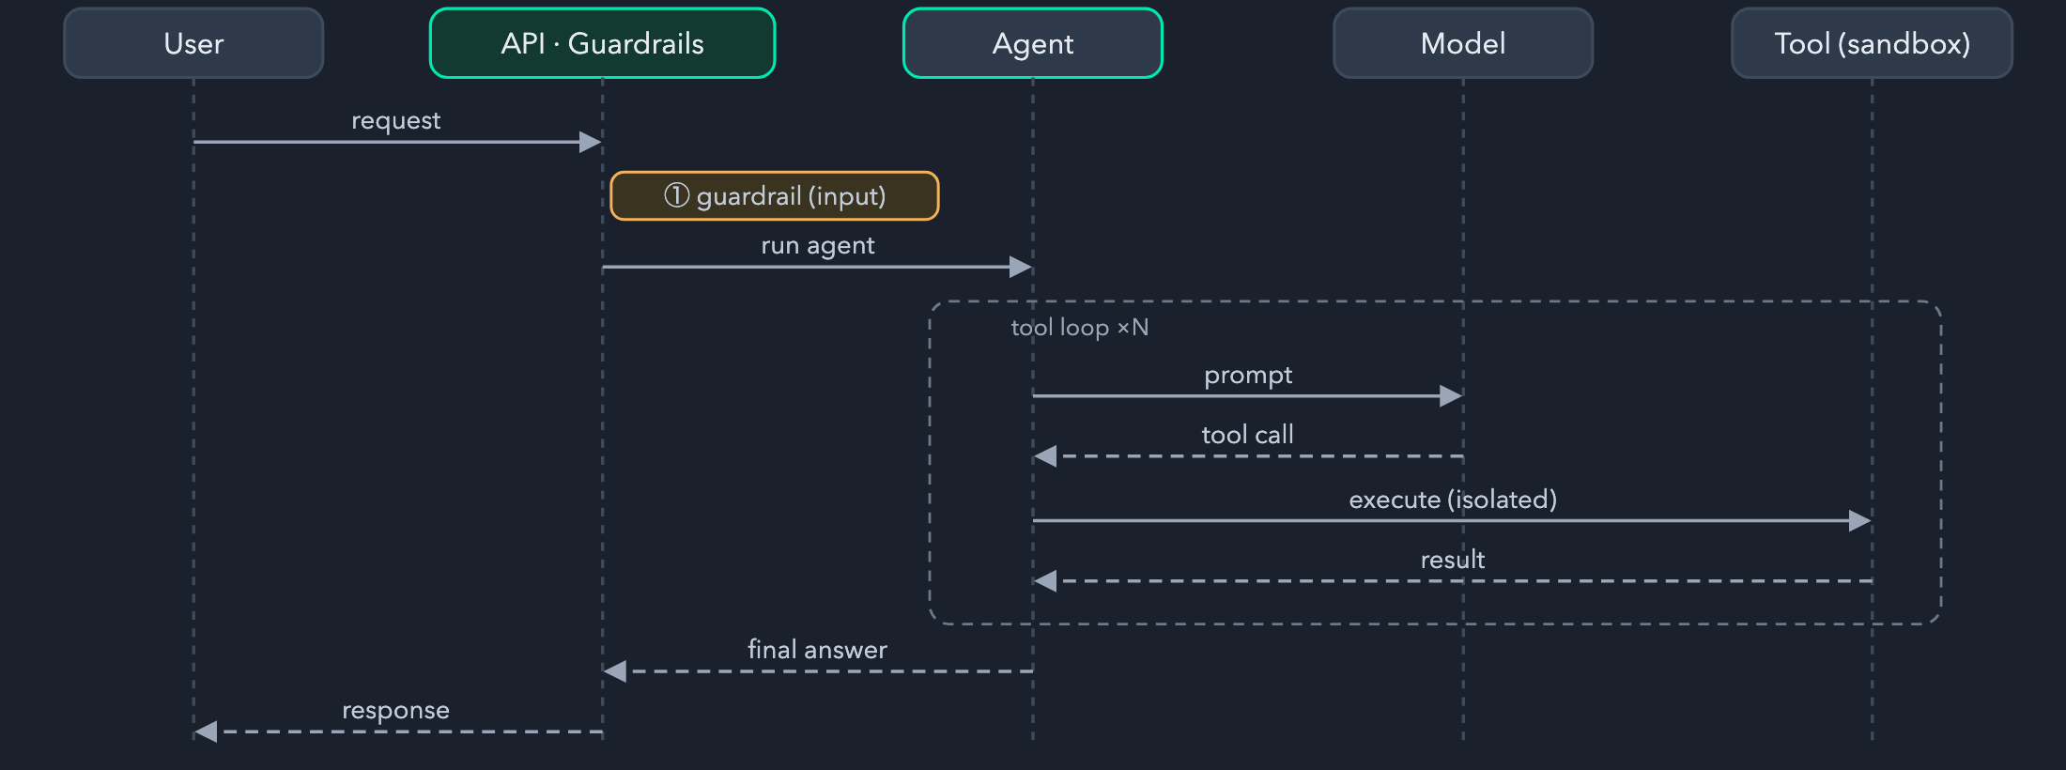
L1
Agent Harness
Guardrails wrap the model as middleware — with a tool loop in the middle.
guardrails.check_input blocks empty, oversize & injection markers before the model — a Content Safety Prompt Shields stand-in.
Only /health and /chat are wired today; the other six lessons are standalone modules.
Notes:
Lesson 1 is the frame for everything: the model in the middle, guardrails on the way in (and, in production, out). The agent call is a stub locally — the pattern being learned is the middleware wrap, not the model itself.

Slide 9
L1+
Evasion-resistant safety layer
A naive marker list is trivially bypassed. safety/ hardens it into a real Prompt-Shields stand-in.
normalize
detectors
Folds obfuscation — homoglyphs, zero-width chars, spacing — before matching.
Heuristic attack-family detectors run over the folded text.
redteam
state the leak
A corpus of attacks + a scorer to measure the layer against itself.
Still heuristic, not ML — the docstring says so. No false confidence.
check_input re-checks markers over folded text, so the block-list resists homoglyph / zero-width evasion. Threat model: docs/safety-layer.md.
Notes:
This is the repo's most 'productiony' bit. The insight: attackers evade keyword filters with unicode tricks, so you normalize FIRST, then match. Red-team corpus + scorer means the defense is measurable. And it honestly labels itself heuristic — the real thing is Azure Content Safety.

Slide 10
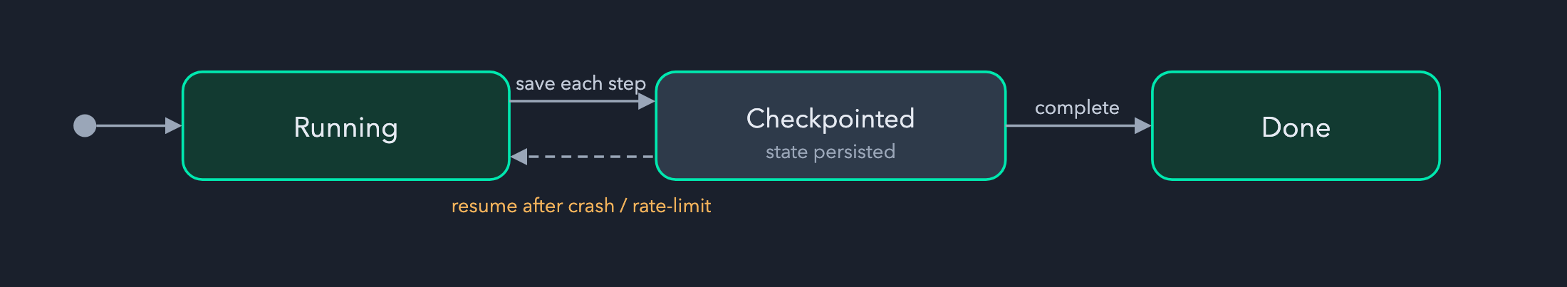
L2
Durable Execution
A run must survive a crash — resume from the last checkpoint instead of restarting.
workflow.py runs steps; durable/ persists a Checkpoint(run_id, step, state) after each.
Local SQLite store today (writes to a gitignored .harness/) → Cosmos DB later, same interface.
A crash-recovery test proves resume works — completed steps don't re-run.
Notes:
Checkpoint after each step, keyed by run_id + step index. On restart, load the last checkpoint and continue. The seam: CheckpointStore Protocol. Local = SQLite in .harness/, prod = Cosmos DB. There's an actual test that kills the run mid-way and asserts it resumes.

Slide 11
L3
Secure Sandboxing
Agent-generated code can't run in your process. sandbox.py isolates it.
Executes in an isolated subprocess with a hard timeout.
Local stand-in for the Agent Service Code Interpreter tool.
State the leak: a subprocess is not a real sandbox — the managed tool gives true isolation, network controls, and resource limits.
The pattern that matters: never exec() untrusted output in-process — put a boundary (and a clock) around it.
Notes:
The lesson isn't 'we built a perfect sandbox' — it's 'code from a model is untrusted; isolate it and bound it in time.' Locally that's a subprocess + timeout. In prod it's Code Interpreter, which is a genuinely hardened sandbox. The docstring states that gap plainly.

Slide 12
L4
Advanced Memory
Three memory shapes, three stand-ins — under memory/.
short-term
long-term
compaction
thread
knowledge
summarize
Per-conversation history. Stands in for Agent Service managed threads.
Retrievable facts. Stands in for Azure AI Search (RAG).
Condense history to fit the context window.
Short-term = the conversation; long-term = a knowledge store the agent can query; summarization = keep both affordable within the token budget.
Notes:
Memory isn't one thing. Thread = recent turns (managed threads). Knowledge = durable retrievable facts (AI Search / RAG). Summarize = compress older turns so you don't blow the context window. Together they're 'advanced memory'.

Slide 13
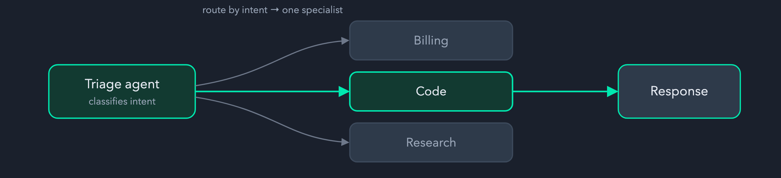
L5
Orchestration — routing & handoff
A triage agent classifies intent and hands off to the right specialist.
orchestration/router.py — intent → specialist, the Agent Framework handoff pattern.
One entry point, many specialists; each specialist stays focused and small.
Notes:
Single-agent is limiting. Routing = a cheap classifier agent picks the specialist. Keeps each specialist's prompt/tools narrow and reliable. This is the Agent Framework handoff pattern; locally it's a routing table.

Slide 14
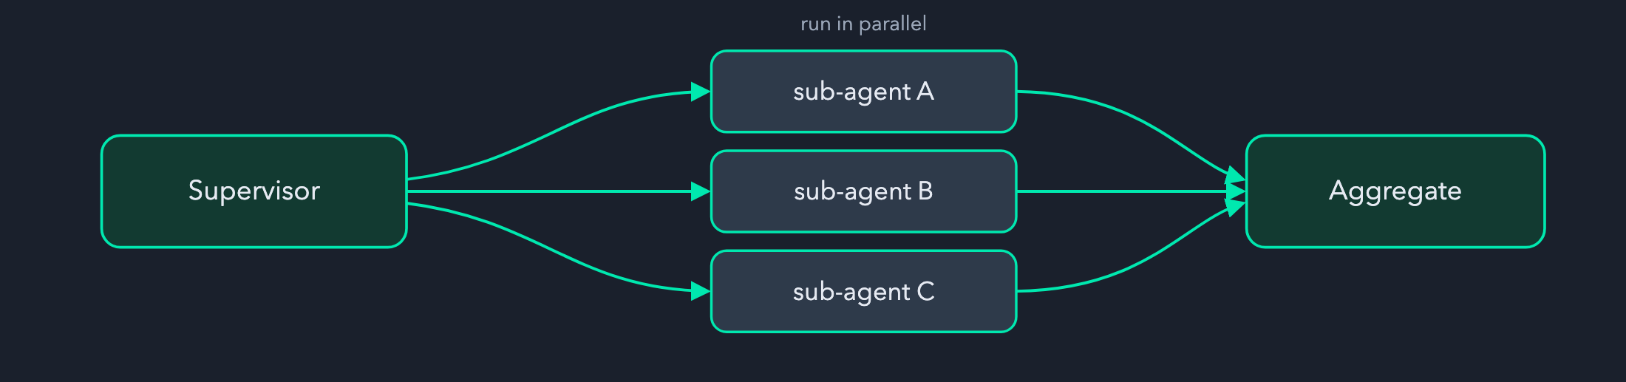
L6
Hierarchical Supervision
Routing escalated: a supervisor decomposes a task, fans out, and aggregates.
orchestration/supervisor.py — parallel fan-out / fan-in.
Maps to Agent Framework Magentic / concurrent orchestration.
Routing picks one agent; supervision runs many in parallel and merges their results.
Notes:
The step up from routing: don't just pick one specialist, break the task into pieces, dispatch them concurrently, and combine. That's the supervisor/orchestrator pattern (Magentic in Agent Framework). Locally: parallel fan-out, fan-in aggregation.

Slide 15
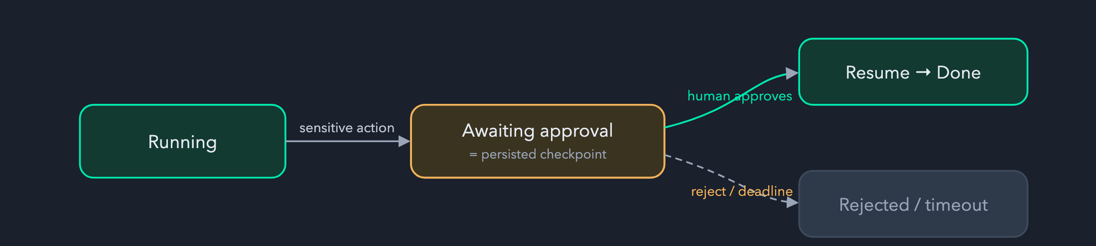
L7
Human-in-the-Loop
Pause before a sensitive action, wait for a human, then resume — built on L2's checkpoints.
hitl.py — checkpointed suspend / resume with a deadline (reject on timeout).
Reuses the durable store: a paused run is just a persisted checkpoint waiting on input.
LangGraph analog: interrupt(). Agent Framework: request/response HITL.
Notes:
HITL falls out of durable execution almost for free: suspend = checkpoint + wait, resume = load + continue. Add a deadline so it doesn't wait forever. This is where the 'survive a crash' machinery pays off twice.

Slide 16
The docs are part of the test suite
Knowledge lives in the repo and is mechanically validated — stale docs turn the suite red.
tests/test_docs.py checks every .md / .excalidraw: balanced fences, resolvable anchors, valid Excalidraw JSON, no HTML-escape artifacts.
Heavier Mermaid render is opt-in: HARNESS_RENDER_MERMAID=1 (needs mmdc).
Two glossaries cross-reference concepts — including a full LangGraph → this repo → Azure map.
A small echo of "repository as system of record": if an agent (or teammate) can't see it in-context, it doesn't exist.
Notes:
Nice detail for an engineering audience: documentation is tested like code. This keeps the design docs honest as the code moves. The LangGraph glossary maps every LangGraph primitive to the repo module that stands in for it and the Azure target.

Slide 17
Status & how to run it
7 / 7 lessons implemented locally & tested.
# run the full suite (no cloud needed)
uv run --extra dev pytest
Suite is deterministic and cloud-free.
# one test
uv run --extra dev pytest \\
Azure wiring pending — the next increment.
tests/test_guardrails.py::test_normal_input_allowed
# the API locally
uv run uvicorn harness.app:app --reload
curl localhost:8000/health
Tooling is uv (provisions Python ≥3.11). Despite the Go-style path, this project is Python.
Notes:
Live demo moment if you want one: run pytest (fast, all green), then curl /health, then POST a prompt-injection string to /chat and show the guardrail block it. Reminder: uv provisions the right Python; don't be fooled by the GOPATH-style directory — it's Python.

Slide 18
Takeaways
Thin over managed. The harness is mostly configuration on Azure primitives, not from-scratch infrastructure.
The seam pattern + "state the leak" let you build and test offline, then swap to Azure without touching logic.
The seven patterns are the vocabulary of production agents: guard, persist, sandbox, remember, route, supervise, ask a human.
Questions?
Design: docs/architecture.md · Plan: docs/azure-implementation-plan.md · Concepts: docs/glossary.md, docs/langgraph-glossary.md
Notes:
Land the three points and open for questions. If asked 'why not just LangGraph?' — point at the langgraph-glossary: this repo maps each LangGraph primitive to a managed Azure equivalent, the bet being that managed services carry the operational load.

