Slide 1
HARNESS ENGINEERING
AZURE TECH TALK · PRATIK DHANAVE
Notes:
Welcome. This talk is about the seven patterns that turn a bare model call into a production agent — and why on Azure you buy most of that machinery instead of building it.

Slide 2
WHERE WE'RE GOING
AGENDA
1
2
The idea
Patterns & code
Which harness we mean, the thesis behind buying it from managed services, and the two Azure layers that do the work.
Seven production patterns — guardrails to human-in-the-loop — each shown as the real Python that ships in the repo today.
3
4
The Azure path
Run it yourself
How every local stand-in swaps for its managed service — Agent Service, Cosmos DB, AI Search, Content Safety, App Insights.
Project status, the exact uv commands to run the suite and the API locally, and three takeaways to carry home.
02 / 24
Notes:
Four acts: the idea, the patterns with real code, the swap to managed Azure services, and how to run everything yourself before we finish.

Slide 3
A DEMO AGENT MEETS PRODUCTION
WHY THIS TALK
PROMPT INJECTION
#1
CRASH MID-RUN
#2
One crafted message and the agent obeys the attacker instead of you — there is nothing between the user and the model.
A rate limit at step nine of ten and the whole run restarts from zero — every completed step repeated, every side effect doubled.
UNTRUSTED CODE
#3
TOTAL AMNESIA
#4
The model writes code and it executes in your process, on your filesystem, with your credentials. Nothing contains it.
Every conversation starts from nothing — no history, no facts, no context the user already gave you three turns ago.
03 / 24
Notes:
Start with the villain. A demo agent dies four ways the moment real users arrive: it obeys attackers, it loses work, it runs anything, it remembers nothing. Add wrong-specialist answers and no human sign-off and you have the full list our seven patterns resolve.

Slide 4
FIRST: WHICH "HARNESS"?
The term is overloaded — two different things share the name. This project is the first one.
THIS PROJECT
NOT THIS PROJECT
Runtime harness
Dev-time harness
The scaffolding wrapped around a deployed agent — guardrails, memory, sandboxed tools, orchestration, human-in-the-loop. From the Hendrixer/harness-engineering course.
OpenAI's "humans steer, agents execute" — the environment and feedback loops that let coding agents write your software. Same words, entirely different layer of the stack.
We're building the harness an agent runs INSIDE, not the harness a team builds software WITH.
04 / 24
Notes:
Disambiguate first — 'harness' is overloaded. We mean the runtime harness an agent runs INSIDE, not OpenAI's dev-time harness where coding agents write software.

Slide 5
THE THESIS: CHANGE THE ALTITUDE
NOT THE SYLLABUS
BUY
Let Azure supply the harness
Prefer managed primitives — Agent Service, Content Safety, Cosmos DB, AI Search — over from-scratch infrastructure you then have to run forever.
OWN
Spend the effort where it counts
Orchestration, guardrails, and observability are the real work. The plumbing underneath them becomes configuration, not code.
The original course builds the whole harness by hand in TypeScript. Same syllabus here — different altitude: managed primitives underneath, our judgement on top.
LEARN
All seven patterns survive
You still learn every course pattern — but as configuration and orchestration on managed services, not as plumbing you maintain.
RULE
Keep implementations thin
If a lesson can be solved by configuring a managed service, don't hand-roll it. This working rule is written into the repo's guidance.
05 / 24
Notes:
The thesis in four words: buy, own, learn, rule. The original course hand-builds everything in TypeScript; we keep the syllabus and change the altitude.

Slide 6
TWO LAYERS DO THE WORK
The division of labour
AZURE PROVIDES
YOU BUILD
OUR OWN CODE
AI Foundry · Agent Service
Microsoft Agent Framework
FastAPI on Container Apps
The agents themselves: model calls plus the tool loop, managed threads for short-term memory, and sandboxed built-in tools — Code Interpreter, File Search, Function, AI Search grounding.
The harness around them: middleware and guardrails, durable checkpointed workflows, multi-agent orchestration, and human-in-the-loop — the unified successor to Semantic Kernel and AutoGen.
A thin orchestration API that drives the agents. It shrinks to composition — routes, policies, observability — precisely because everything below it is managed by the two layers on the left.
the agents
the harness around the agents
composition only
Agent Framework is public preview — pin exact versions and re-verify APIs before each lesson.
06 / 24
Notes:
Two managed layers split the work: Agent Service provides the agents; the Agent Framework provides the harness around them. Our code shrinks to composition. The framework is public preview — pin versions.

Slide 7
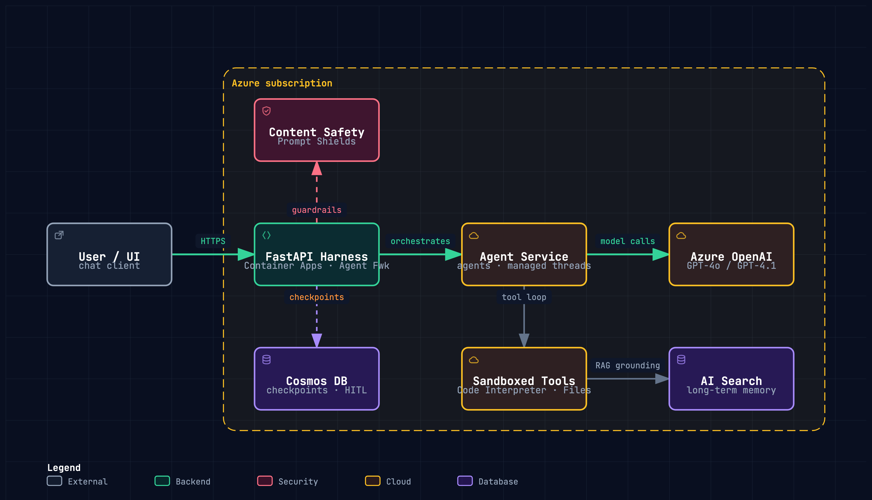
TARGET ARCHITECTURE
One FastAPI layer composes managed services — agents, guardrails, checkpoints, and memory are Azure's job, not ours.
archify · docs/presentation/harness-azure.html (interactive: pan, zoom, focus, export)
07 / 24
Notes:
The target shape on one diagram: one FastAPI layer in Container Apps, everything else managed. The interactive version is in the repo — pan, zoom, focus per node.

Slide 8
THE ONE CONVENTION: THE SEAM PATTERN
Every Azure dependency is stubbed behind a seam, so the whole suite runs with no cloud and no network.
A typing.Protocol — or an injectable callable / rule table — is the swap point.
The local implementation's docstring names the Azure service it stands in for.
It documents honestly where the local stand-in is weaker: "state the leak."
# durable/checkpoint.py — same interface, local SQLite today, Cosmos DB later
class CheckpointStore(Protocol):
def load(self, run_id: str) -> Checkpoint | None: ...
def save(self, checkpoint: Checkpoint) -> None: ...
Swap local → Azure without touching the workflow logic. Match this pattern when adding code.
08 / 24
Notes:
The one convention that makes local-first work: every Azure dependency sits behind a Protocol seam, and every stand-in states honestly where it is weaker — 'state the leak.'

Slide 9
THE SEVEN LESSONS
Seven build increments — every one implemented and unit-tested locally today, framed as "Azure provides X / you build Y."
#
PATTERN
YOU BUILD (LOCAL MODULE)
1
Agent Harness
guardrails.py + app.py
local ✓
2
Durable Execution
workflow.py + durable/
local ✓
3
Secure Sandboxing
sandbox.py
local ✓
4
Advanced Memory
memory/ (thread · knowledge · summarize)
local ✓
5
Orchestration
orchestration/router.py
local ✓
6
Hierarchical Supervision
orchestration/supervisor.py
local ✓
7
Human-in-the-Loop
hitl.py (built on durable/)
local ✓
"local ✓" = runnable + unit-tested with Azure stubbed behind a seam. The Azure-wired implementations are the next increment.
09 / 24
Notes:
The scorecard: seven patterns, all implemented and unit-tested locally today. Azure wiring is the next increment and swaps seams, not logic.

Slide 10
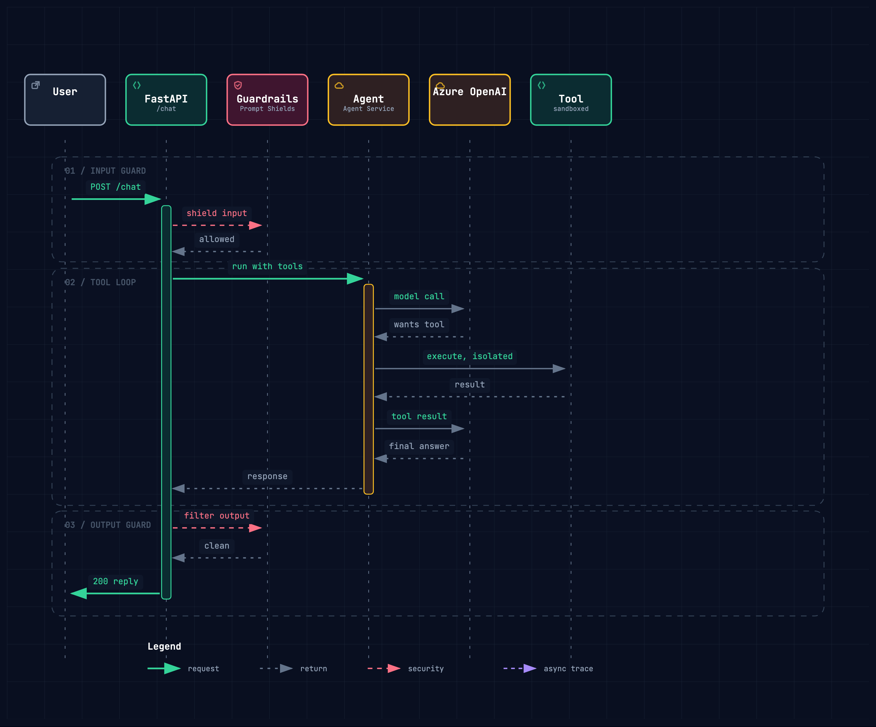
LESSON 1 · THE GUARDED REQUEST
Guardrails wrap the model on the way in and out; the tool loop runs inside — the Lesson 1 shape, end to end.
archify · docs/presentation/harness-request.html (interactive: pan, zoom, focus, export)
10 / 24
Notes:
Lesson 1 answers failure #1. Guardrails wrap the model on the way in AND out; the tool loop runs inside. This is the request lifecycle behind POST /chat.

Slide 11
LESSON 1 · GUARDRAILS
Hard-block at the front door: empty, oversize, and injection-marked input never reaches the model — with an obfuscation-folding second pass.
# guardrails.py — hard-block at the front door
def check_input(text: str) -> GuardrailResult:
if not text or not text.strip():
return GuardrailResult(allowed=False, reason="empty input")
if len(text) > MAX_INPUT_CHARS:
return GuardrailResult(allowed=False, reason="input too long")
lowered = text.lower()
for marker in INJECTION_MARKERS:
if marker in lowered:
return GuardrailResult(allowed=False, reason="possible prompt injection")
folded = normalize(text) # fold homoglyph / zero-width obfuscation
if folded != lowered and any(m in folded for m in INJECTION_MARKERS):
return GuardrailResult(allowed=False, reason="obfuscated injection")
hit = worst(text) # heuristic attack families (role-play, authority, ...)
if hit is not None:
return GuardrailResult(allowed=False, reason=f"{hit.kind}: {hit.reason}")
return GuardrailResult(allowed=True)
src/harness/guardrails.py (abridged)
11 / 24
Notes:
The actual guardrail code — hard-block policy: empty, oversize, marker match, then a folded re-check that catches homoglyph evasion, then heuristic attack families.

Slide 12
A MARKER LIST IS TRIVIALLY BYPASSED
SAFETY LAYER
1
2
normalize
detectors
Folds obfuscation — homoglyphs, zero-width characters, spacing tricks — before matching, so a disguised "ignore previous instructions" cannot slip past the substring check.
Heuristic attack-family detectors run over the folded text — indirect injection, authority escalation, role-play jailbreaks — beyond what a flat marker list can express.
3
4
redteam
state the leak
A corpus of attack strings plus a scorer, so the layer is measured against itself on every test run rather than assumed to work.
Still heuristic, not ML — the docstring says so plainly. Managed Prompt Shields remain the production answer. No false confidence.
12 / 24
Notes:
A flat marker list is trivially bypassed, so the safety layer adds four things: normalize, detectors, a red-team corpus that scores the layer, and an honest statement of the leak.

Slide 13
LESSON 2 · DURABLE EXECUTION
Checkpoint after every step; resume skips completed work. The store is a Protocol — SQLite locally, Cosmos DB in production, same workflow logic.
# durable/checkpoint.py — the seam: SQLite locally, Cosmos DB in production
class CheckpointStore(Protocol):
def load(self, run_id: str) -> Checkpoint | None: ...
def save(self, checkpoint: Checkpoint) -> None: ...
# workflow.py — checkpoint after every step; resume skips completed work
def run_durably(run_id: str, steps: list[Step], store: CheckpointStore) -> dict:
cp = store.load(run_id)
start, state = 0, {}
if cp is not None:
start = cp.step + 1 # resume after the last completed step
state = dict(cp.state)
for index in range(start, len(steps)):
_name, fn = steps[index]
update = fn(state)
if update:
state.update(update)
store.save(Checkpoint(run_id=run_id, step=index, state=state))
return state
src/harness/durable/checkpoint.py · src/harness/workflow.py (abridged)
13 / 24
Notes:
Lesson 2 answers failure #2 in fifteen lines: checkpoint after every step, resume skips completed work. SQLite today, Cosmos DB later, identical workflow logic.

Slide 14
LESSON 3 · SECURE SANDBOXING
Untrusted code runs in an isolated interpreter (-I) with a hard timeout — a runaway loop is killed, not awaited. A teaching boundary, not a real one.
# sandbox.py — untrusted code in an isolated subprocess with a hard timeout
def run_code(code: str, timeout: float = DEFAULT_TIMEOUT_SECONDS) -> SandboxResult:
try:
proc = subprocess.run(
[sys.executable, "-I", "-c", code], # -I: isolated interpreter
capture_output=True,
text=True,
timeout=timeout,
)
except subprocess.TimeoutExpired as exc:
return SandboxResult(ok=False, stdout=_as_text(exc.stdout),
stderr="timed out", exit_code=None, timed_out=True)
return SandboxResult(ok=proc.returncode == 0, stdout=proc.stdout,
stderr=proc.stderr, exit_code=proc.returncode,
timed_out=False)
src/harness/sandbox.py (abridged)
14 / 24
Notes:
Lesson 3 answers failure #3: never exec untrusted output in-process. Isolated interpreter, hard timeout — and honestly, a subprocess is a teaching boundary; Code Interpreter is the real one.

Slide 15
LESSON 4 · ADVANCED MEMORY
Summarisation is lossy by design — keep the first and last turns, drop the middle, and leave the raw thread recoverable in the thread store.
# memory/summarize.py — lossy roll-up; the raw thread stays recoverable
def summarize_thread(messages, max_chars=500, keep=2) -> str:
keep = max(1, keep)
lines = [f"{m.role}: {m.content}" for m in messages]
full = "\n".join(lines)
if len(full) <= max_chars:
return full # fits — nothing is lost
if len(messages) <= 2 * keep:
return full # no droppable middle: a marker would hide nothing
head, tail = lines[:keep], lines[-keep:]
omitted = len(messages) - 2 * keep
marker = f"[...{omitted} earlier turns omitted...]"
return "\n".join([*head, marker, *tail])
src/harness/memory/summarize.py (abridged)
15 / 24
Notes:
Lesson 4 answers failure #4. The summariser is deliberately lossy — keep head and tail, drop the middle — safe because the raw thread never leaves the thread store.

Slide 16
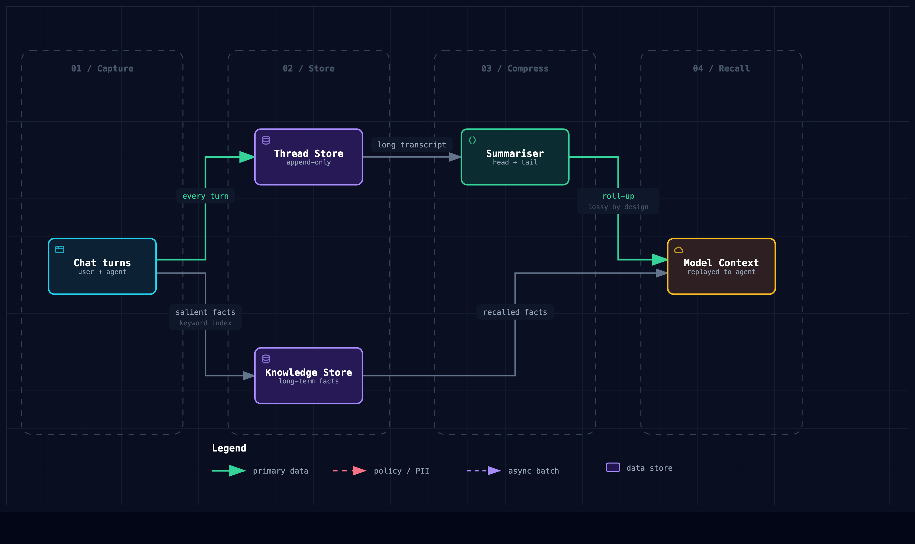
LESSON 4 · MEMORY FLOW
Every turn is kept verbatim; the roll-up is lossy on purpose — a bad summary is always recoverable from the thread store.
archify · docs/presentation/harness-memory.html (interactive: pan, zoom, focus, export)
16 / 24
Notes:
The whole memory system on one picture: capture, store, compress, recall. Managed threads, AI Search, and an Azure OpenAI call are the production equivalents.

Slide 17
LESSON 5 · ROUTING & HANDOFFS
Triage maps intent to a specialist. Locally a first-match keyword table; the leak — no notion of meaning — is stated in the docstring.
# orchestration/router.py — deterministic triage: keyword -> specialist
DEFAULT_RULES = {
"invoice": Specialist.BILLING, "refund": Specialist.BILLING,
"bug": Specialist.CODE, "stack trace": Specialist.CODE,
"paper": Specialist.RESEARCH, "cite": Specialist.RESEARCH, # ...
}
class Router:
def route(self, request: str) -> RouteDecision:
"""First keyword (in table order) found in the request wins."""
lowered = request.lower()
for keyword, specialist in self.rules.items():
if keyword in lowered:
return RouteDecision(specialist=specialist.value,
matched_intent=keyword)
return RouteDecision(specialist=Specialist.FALLBACK.value,
matched_intent=None)
src/harness/orchestration/router.py (abridged)
17 / 24
Notes:
Lesson 5: triage routing. Locally a first-match keyword table — fast, offline, testable — and the docstring states the leak: no notion of meaning.

Slide 18
LESSON 6 · SUPERVISION
Fan out, isolate faults, keep order: a raising worker is contained in its own SubResult, and results return in decomposition order, not finish order.
# orchestration/supervisor.py — fan out, isolate faults, keep order
def run(self, task: str) -> Aggregate:
subtasks = self.decompose(task)
results = [None] * len(subtasks) # slot by index, not completion order
with ThreadPoolExecutor(max_workers=self.max_workers) as pool:
futures = {pool.submit(self.worker, sub): i
for i, sub in enumerate(subtasks)}
for future, i in futures.items():
try:
results[i] = SubResult(subtasks[i], future.result(), error=None)
except Exception as exc: # one bad sub-agent cannot sink the batch
results[i] = SubResult(subtasks[i], output=None, error=str(exc))
succeeded = sum(1 for r in results if r.error is None)
return Aggregate(results, succeeded, failed=len(results) - succeeded)
src/harness/orchestration/supervisor.py (abridged)
18 / 24
Notes:
Lesson 6: the supervisor contract. One bad worker cannot sink the batch, and completion order never leaks into result order. The tests pin exactly that.

Slide 19
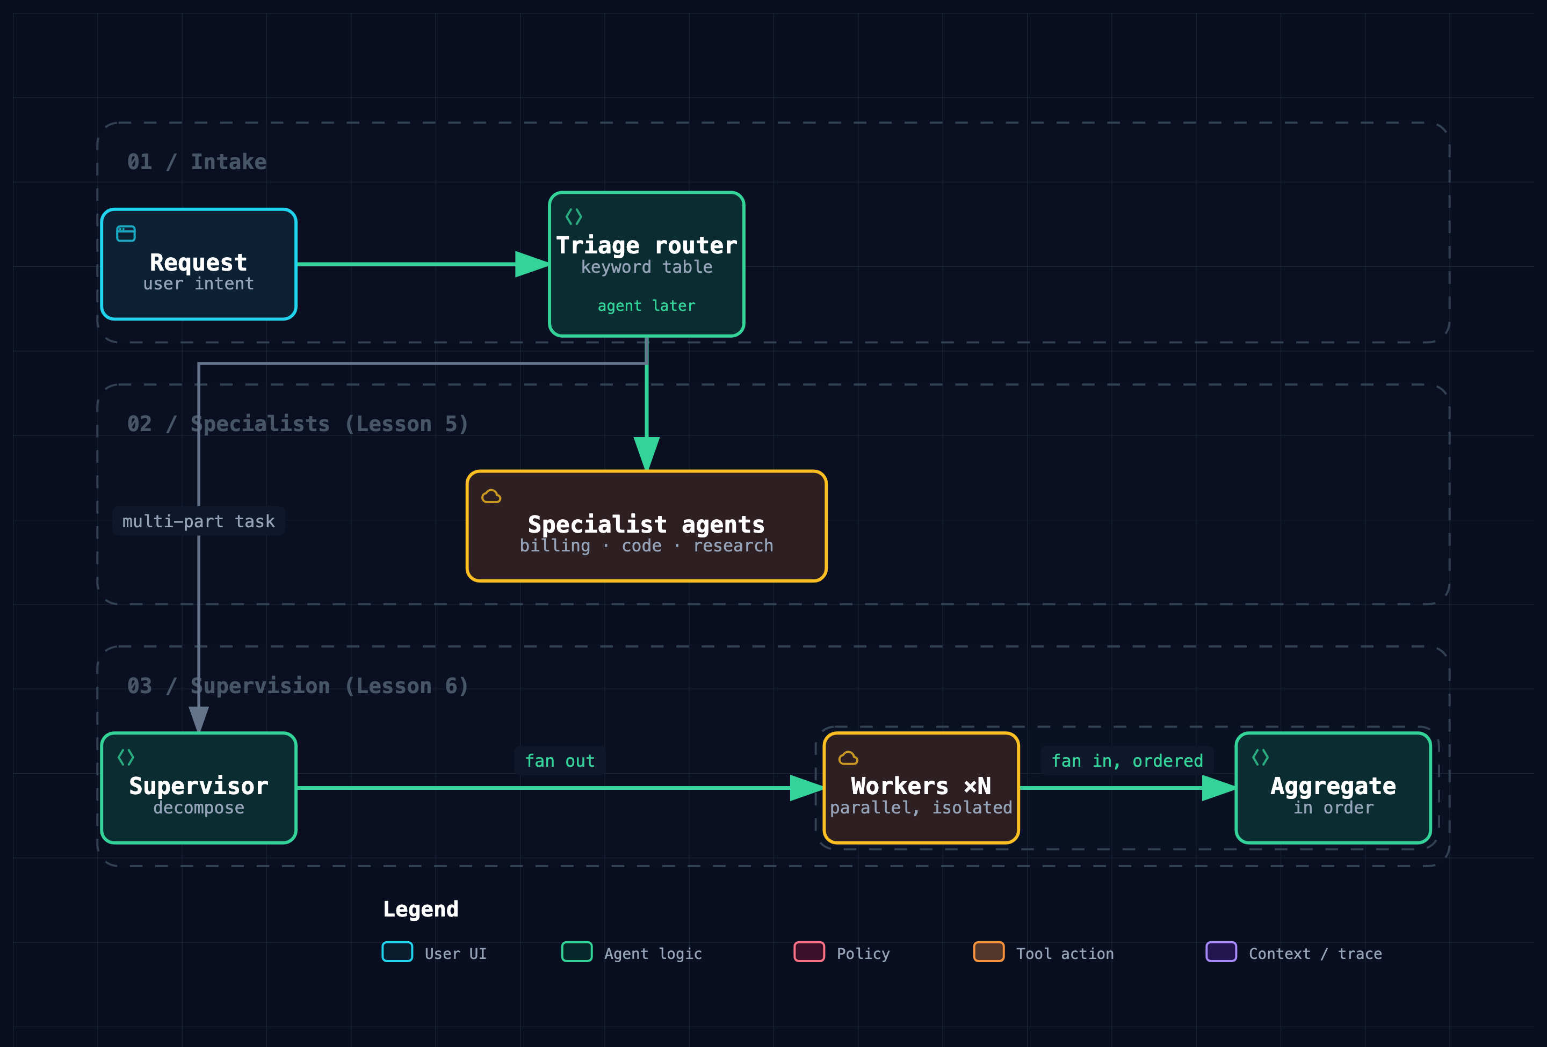
LESSONS 5–6 · ORCHESTRATION
Triage hands off to one specialist; a supervisor splits real work across parallel workers and fans results back in, in order.
archify · docs/presentation/harness-orchestration.html (interactive: pan, zoom, focus, export)
19 / 24
Notes:
Both orchestration patterns on one picture: route to ONE specialist, or supervise MANY workers in parallel. Agent Framework handoffs and Magentic orchestration.

Slide 20
LESSON 7 · HUMAN-IN-THE-LOOP
The pause IS a durable checkpoint — built on Lesson 2's store. Approval, rejection, and deadline resolve against injected time; a late yes is void.
# hitl.py — the pause IS a checkpoint; durability comes free from Lesson 2
def request_approval(run_id, prompt, store, now, *, timeout_seconds=3600.0):
store.save(Checkpoint(run_id=run_id, step=0, state={
"status": "awaiting_approval", "prompt": prompt,
"requested_at": now, "timeout_seconds": timeout_seconds,
}))
return ApprovalPending(run_id=run_id, prompt=prompt)
def resume(run_id, decision, store, now, *, action=None):
cp = _load_pending(run_id, store)
if now - cp.state["requested_at"] > cp.state["timeout_seconds"]:
return ApprovalOutcome("timed_out", ...) # a late "yes" is void
if not decision:
return ApprovalOutcome("rejected", ...) # action NOT performed
update = action(dict(cp.state)) if action is not None else {}
_resolve(cp, store, now, status="approved", performed=True, extra=update)
return ApprovalOutcome("approved", "human approved; action performed")
src/harness/hitl.py (abridged)
20 / 24
Notes:
Lesson 7 reuses Lesson 2: the pause IS a checkpoint. Deadline first, against injected time — a late yes is void. At-least-once, so actions must be idempotent.

Slide 21
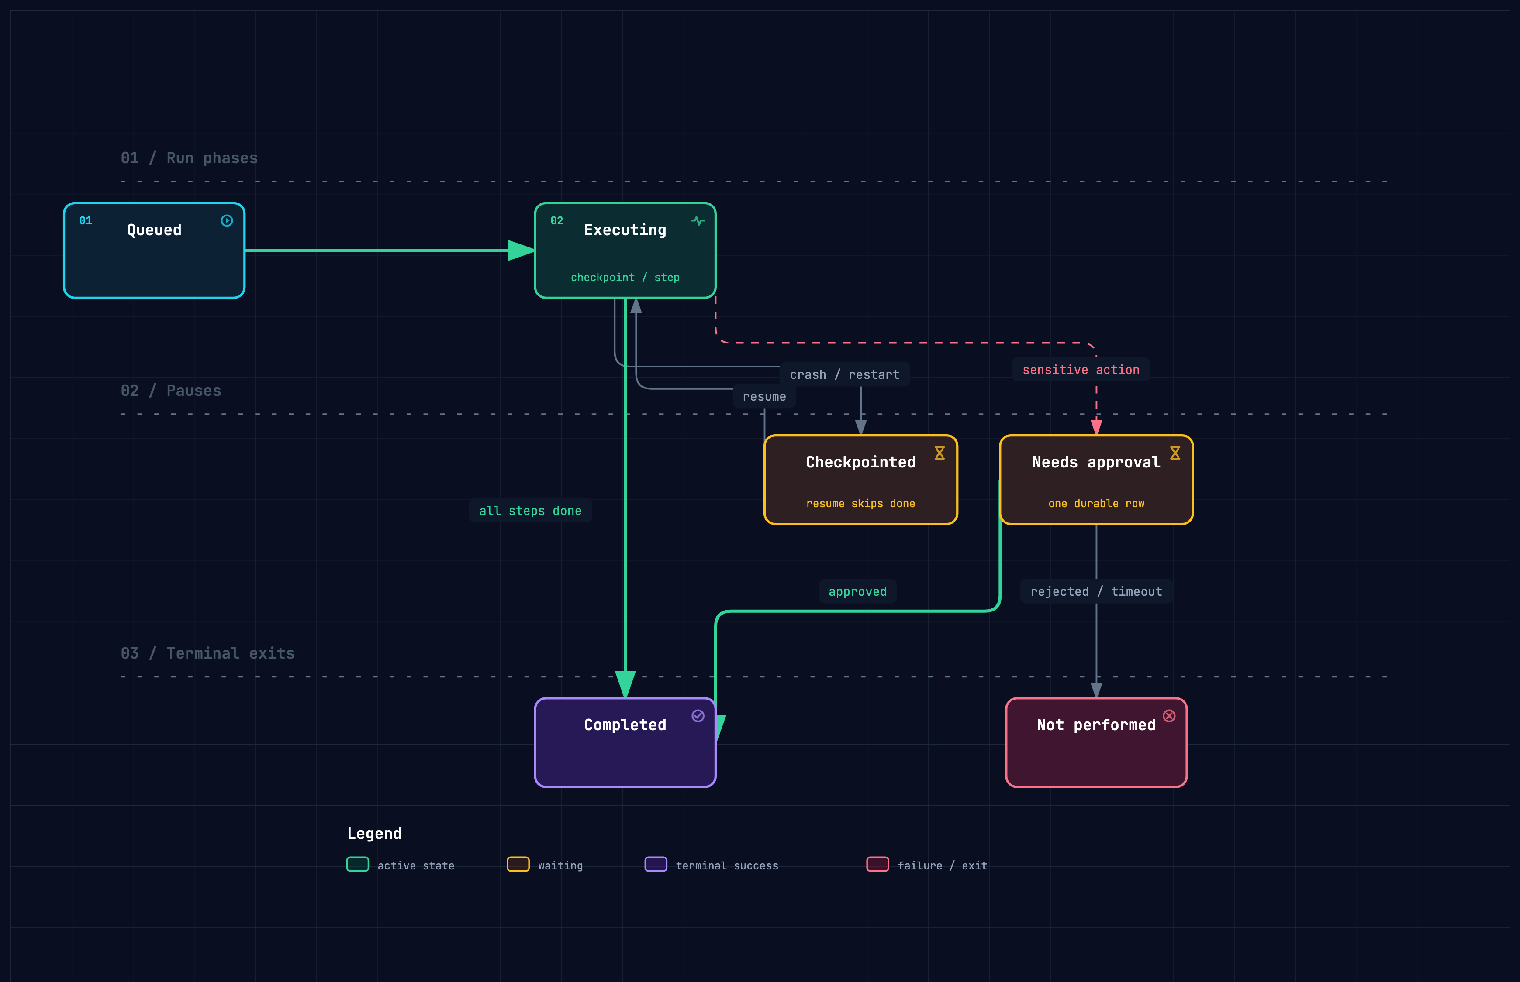
LESSONS 2 & 7 · RUN LIFECYCLE
Crashes resume from checkpoints; sensitive actions park for approval — both are just durable rows, and a late yes is void.
archify · docs/presentation/harness-run-lifecycle.html (interactive: pan, zoom, focus, export)
21 / 24
Notes:
A run's whole life on one state machine: crash and resume through checkpoints, park for approval, two terminal exits. Both pauses are just durable rows.

Slide 22
DOCS ARE PART OF THE TEST SUITE
Knowledge lives in the repo and is mechanically validated — stale docs turn the test suite red.
tests/test_docs.py checks every .md and .excalidraw: balanced code fences, resolvable anchors, valid Excalidraw JSON, no HTML-escape artifacts.
The heavier Mermaid render check is opt-in — HARNESS_RENDER_MERMAID=1, needs the mmdc CLI — so the default suite stays fast and cloud-free.
Two glossaries cross-reference every concept, including a full LangGraph → this repo → Azure mapping (docs/langgraph-glossary.md).
A small echo of "repository as system of record": if an agent — or a teammate — can't see it in-context, it doesn't exist.
22 / 24
Notes:
Unusual but load-bearing: the docs are tested. Broken anchors fail CI. If knowledge isn't in the repo where an agent or teammate can see it, it doesn't exist.

Slide 23
STATUS & HOW TO RUN IT
All seven lessons are implemented locally and tested; the Azure wiring is the next increment — it swaps seams, not logic.
7 / 7 lessons implemented — 101 deterministic tests, no cloud, no network, no keys.
Durable and HITL tests write real checkpoints to a local .harness/ SQLite store.
Despite the Go-style path, this is Python — uv provisions ≥3.11 and everything else.
# run the full suite (no cloud needed)
uv run --extra dev pytest
# one test
uv run --extra dev pytest tests/test_guardrails.py::test_normal_input_allowed
# the API locally
uv run uvicorn harness.app:app --reload
curl localhost:8000/health
23 / 24
Notes:
Everything runs on a laptop: 101 deterministic tests, no cloud, no keys. These are the exact commands — try it after the talk.

Slide 24
TAKEAWAYS
01
Thin over managed. The harness is mostly configuration on Azure primitives — Agent Service, Content Safety, Cosmos DB — not from-scratch infrastructure.
02
The seam pattern + "state the leak". Build and test everything offline, then swap local for Azure without touching the workflow logic — and never hide where a stand-in is weaker.
03
The seven patterns are the vocabulary. Production agents need to guard, persist, sandbox, remember, route, supervise, and ask a human. Everything else is composition.
Questions?
docs/architecture.md · docs/azure-implementation-plan.md · docs/glossary.md · docs/langgraph-glossary.md
Pratik Dhanave · pratik.dhanave@clearroute.io
24 / 24
Notes:
Three takeaways: thin over managed, the seam pattern with stated leaks, and the seven-pattern vocabulary. Questions welcome.

