Slide 1
Azure · Python · Microsoft Agent Framework
Harness Engineering
Seven patterns for putting an AI agent into production — re-built in Python on managed Azure primitives.
A local-first practice project · all 7 lessons implemented & tested
Notes:
One-line hook: an LLM on its own is not a product. The 'harness' is everything you wrap around the model to make it safe, durable, and useful in production. This deck walks the seven patterns and how each maps onto a managed Azure service.

Slide 2
First: which "harness"?
The term is overloaded. Two different things share the name — this project is the first one.
This project
Not this project
Runtime harness
Dev-time harness
The scaffolding wrapped around a deployed agent: guardrails, memory, tools, orchestration, human-in-the-loop. Built here in Python on the Microsoft Agent Framework.
OpenAI's "humans steer, agents execute" — the environment & feedback loops that let coding agents write your software. Same words, different layer.
We're building the harness an agent runs inside, not the harness a team builds software with. From here on we'll call it the runtime — same thing, no collision.
Notes:
Pre-empt the confusion. If someone in the audience read OpenAI's 'harness engineering' post, clarify up front that this is the runtime meaning. Both are about 'scaffolding around agents' — but one is production runtime, the other is a development methodology.

Slide 3
The thesis
Seven runtime patterns, built in pure Python on the Microsoft Agent Framework:
Agent Framework gives you the harness — middleware, checkpointed workflows, multi-agent orchestration, human-in-the-loop.
Azure AI Foundry gives you the agents — the model call, the tool loop, managed threads, sandboxed tools.
You write the orchestration, the guardrails and the observability — not the plumbing underneath them.
Working rule throughout: keep implementations thin. If a pattern can be solved by configuring a managed primitive, don't hand-roll it.
Notes:
The core design decision, and the one line to land: this is pure Python on the Microsoft Agent Framework. Two layers do the work — Agent Framework is the harness AROUND agents (middleware, durable workflows, orchestration, HITL), Foundry Agent Service is the agents themselves (model call, tool loop, managed threads, sandboxed tools). The payoff is less infrastructure code and more attention on the interesting agent problems. Every pattern that follows is framed the same way: the platform provides X, you build Y.

Slide 4
An operating system for your agent
If the model is a process, the runtime is the OS.
#
PATTERN
WHAT IT IS, IN OS TERMS
1
Guardrails
syscall validation — seccomp
2
Durable execution
journaling · checkpoint / restore
3
Sandboxing
process isolation · namespaces
4
Memory
RAM · disk · paging
5
Orchestration
the scheduler
6
Supervision
a process supervision tree
7
Human-in-the-loop
sudo
Nobody writes their own scheduler any more. Azure gives you the OS; you write the program. One honest gap: ring 0 is enforced by hardware — this boundary is software. state the leak.
Notes:
The mental model for the whole talk, and the ENGINEERING cut of it — PICK ONE of slides 4/5/6 for the room (4 engineers · 5 mixed or client · 6 risk/assurance/regulator); they are alternates, not a sequence. The model is untrusted code, so it gets a process, not the run of the machine — and every pattern coming up is something an OS already does. Two to land hard: L1 is syscall validation (the kernel distrusts userspace for exactly the reason we distrust model output), and L7 is sudo — a privileged action stops and asks a human. Say the caveat out loud: ring 0 is hardware-enforced, ours is convention. Overselling isolation is the one thing this talk must not do. ALTERNATE FRAME for a risk/assurance/client room — same seven, as controls: 1 pre-trade risk check (rejected before it reaches the market) · 2 the ledger, append-only, replay never redo · 3 segregation of duties, whatever acts cannot also settle · 4 the book of record · 5 routing to the right desk · 6 the desk head owning the aggregate · 7 four-eyes / maker-checker above a threshold. This one is not a metaphor for the architecture, it IS the architecture: I5 append-only audit is a ledger, I3 human gate is maker-checker. Its leak is sharper than ring 0: controls assume an actor who can be sanctioned, and a model cannot be — so every control must be PREVENTIVE, not detective. 'We'll catch it in review' is not a control when the thing under review generated a thousand outputs overnight.

Slide 5
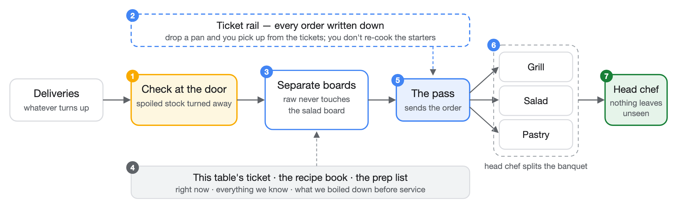
Or: the same seven, without the jargon
If the model is the cook, the runtime is the kitchen around them.
Nobody builds a kitchen from scratch to open a restaurant. Azure gives you the kitchen; you decide the menu.
Notes:
The plain-language pass. PICK ONE of slides 4/5/6 for the room in front of you — engineers get the OS, a mixed or client room gets the kitchen, a risk/assurance/regulator room gets the flight deck. They are alternates, not a sequence; showing all three is three minutes of metaphor before any content. Two to point at: the ticket rail IS durable execution (written down, survives the disaster, nobody re-cooks the starters), and the pass is a human gate everyone has physically watched happen. Say the leak out loud — it is the same point as ring 0, but a non-technical room actually feels it.

Slide 6
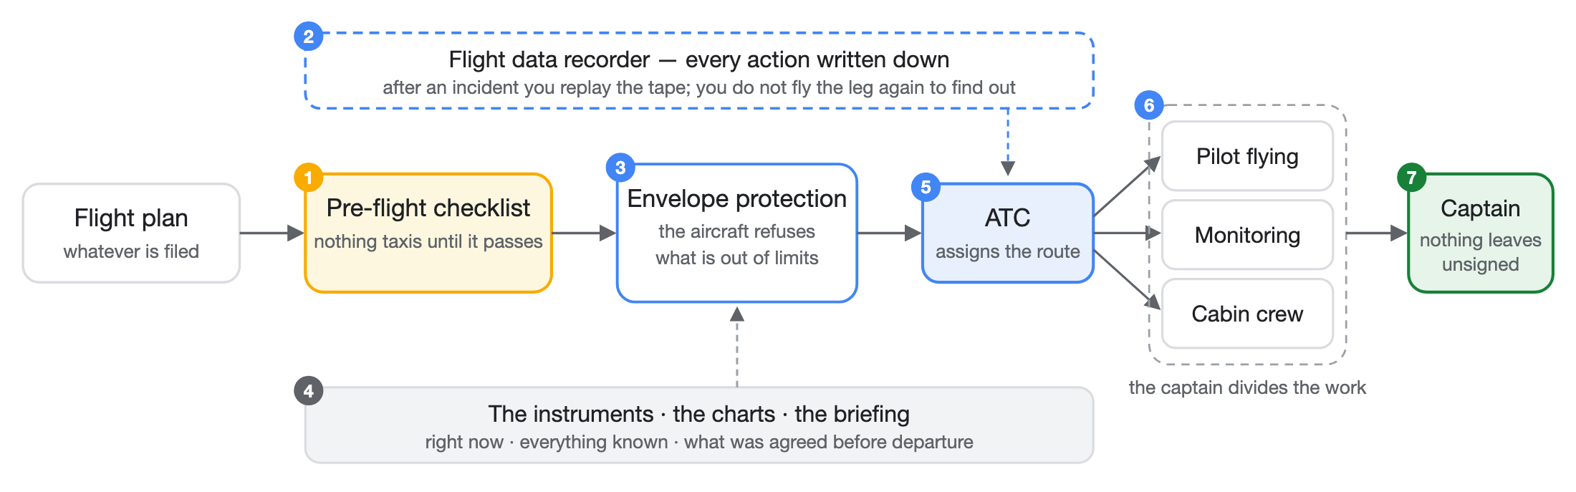
Or: the same seven, on a flight deck
If the model is the autopilot, the runtime is the aircraft around it.
Nobody builds an airframe to run an airline. Azure gives you the aircraft; you fly the route. The honest gap: aviation earned this from decades of mandatory accident reporting. We have no such corpus — state the leak.
Notes:
The third alternate frame — for a risk, assurance or regulator room. PICK ONE of slides 4/5/6; do not run them as a sequence. Deliberately the SAME diagram geometry as slide 5, so if you do show both, the shape repeating is the point: same seven, any domain. The mapping to land is 3 — envelope protection is not a rule in a manual, the flight computer physically refuses the input. That is the whole architectural argument in one image: a boundary you enforce in the machine, not in a policy document. If you are in a client room, this is the slide where the sealed parameter list makes sense — the drafting function's signature IS the envelope. Also strong: 2, the flight data recorder is an append-only audit log and every regulator in the room already trusts that idea. And 7, the captain's authority survives full automation — the autopilot flies, the captain is still accountable. The leak is the sharpest of the three and you must say it: aviation's safety record was bought with decades of investigations feeding back into design, mandatory reporting, and a blame-free incident culture. There is no equivalent corpus for agents. We are borrowing the shape of a mature safety system without the evidence base that made it work.

Slide 7
Two layers do the work
Azure provides — the agents
You build — the harness around them
AI Foundry · Agent Service. Model calls + the tool loop, managed threads (memory), and sandboxed tools: Code Interpreter, File Search, Function, AI Search.
Microsoft Agent Framework. Middleware/guardrails, durable checkpointed workflows, multi-agent orchestration, and human-in-the-loop.
Our own code is a thin FastAPI orchestration API (destined for Azure Container Apps) that drives these agents. Agent Framework is public preview — pin versions
Notes:
Agent Service = the agents themselves. Agent Framework = the harness around agents (successor to Semantic Kernel + AutoGen). Our FastAPI app is the glue. Note the preview caveat: the Agent Framework API shifts, so we pin exact versions per lesson.

Slide 8
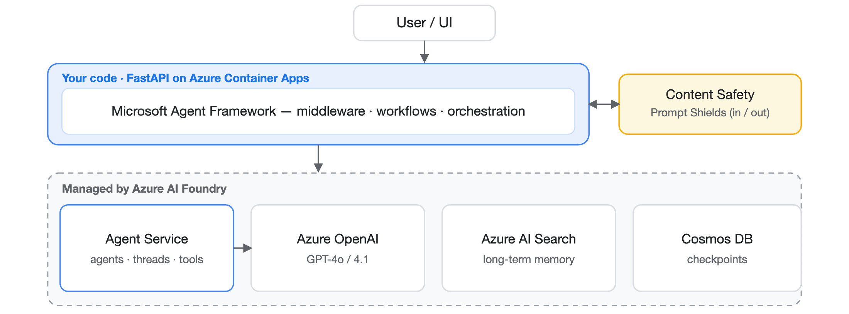
Architecture
You host only the API; everything in the dashed band is managed by Azure. Cross-cutting: App Insights (OpenTelemetry traces) · Entra Managed Identity (keyless, DefaultAzureCredential).
Notes:
Walk top to bottom. The API is the only thing we host; everything under it is managed. Observability (App Insights + Foundry tracing) is the 'is it actually working' signal — it is the 'is it actually working' signal you would otherwise hand-build as an inspector UI. Auth is keyless by default.

Slide 9
The one convention: the seam pattern
Every Azure dependency is stubbed behind a seam, so the whole suite runs with no cloud and no network.
A typing.Protocol (or injectable callable/table) = the swap point.
A local implementation whose docstring names the Azure service it stands in for.
It honestly documents where the local stand-in is weaker — "state the leak."
# durable/checkpoint.py — same interface, local SQLite today, Cosmos DB later
class CheckpointStore(Protocol):
def load(self, run_id: str) -> Checkpoint | None: ...
def save(self, checkpoint: Checkpoint) -> None: ...
Swap local → Azure without touching the workflow logic. Match this pattern when adding code.
Notes:
This is THE thing to remember from the codebase. Protocol boundary + local impl + honest docstring. 'State the leak' means the stand-in never pretends to be as strong as the managed service — it says exactly where it's weaker. This is what makes the repo runnable offline yet ready to wire to Azure. || LIVE DEMO — the slide makes a falsifiable claim ('swap the backend without touching the workflow'), so run it rather than asserting it. Press r. Four beats: (1) three implementations of the one Protocol, all conforming — a dict, localStorage standing in for Cosmos, and an audit wrapper; (2) the SAME run_durably from src/harness/ over all three, identical results; (3) the audit wrapper's call log, proving a decorator is just another implementation — that is I5; (4) someone adds a 'tenant' argument and the boundary check REJECTS it. Land beat 4 hardest: this is the SEALED_DRAFT_PARAMS rule, and the check compares parameter names exactly, which is stricter than structural typing on purpose. A new capability means a new precomputed field upstream, never a new parameter. If asked why so strict: a seam widens one harmless-looking argument at a time, and each one is individually reasonable.

Slide 10
The seven lessons
#
PATTERN
YOU BUILD (LOCAL MODULE)
1
Agent Harness
guardrails.py + app.py
local ✓
2
Durable Execution
workflow.py + durable/
local ✓
3
Secure Sandboxing
sandbox.py
local ✓
4
Advanced Memory
memory/ (thread·knowledge·summarize)
local ✓
5
Orchestration
orchestration/router.py
local ✓
6
Hierarchical Supervision
orchestration/supervisor.py
local ✓
7
Human-in-the-Loop
hitl.py (on durable/)
local ✓
"local ✓" = runnable + unit-tested with Azure stubbed behind a seam. Azure-wired impls are the next increment.
Notes:
The map for the rest of the talk — one slide per lesson coming up. Emphasize all seven are DONE locally and green. The Azure wiring is deliberately future work; the point of the exercise is to learn the patterns first, offline.

Slide 11
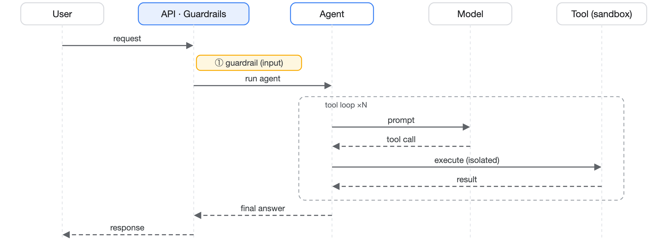
L1
Agent Harness
Guardrails wrap the model as middleware — with a tool loop in the middle.
guardrails.check_input blocks empty, oversize & injection markers before the model — a Content Safety Prompt Shields stand-in.
Only /health and /chat are wired today; the other six lessons are standalone modules.
# app.py — the guardrail runs BEFORE the model, as middleware
verdict = check_input(user_message)
if not verdict.allowed:
return Blocked(verdict.reason) # the model is never called
Notes:
Lesson 1 is the frame for everything: the model in the middle, guardrails on the way in (and, in production, out). The agent call is a stub locally — the pattern being learned is the middleware wrap, not the model itself.

Slide 12
L1+
Evasion-resistant safety layer
A naive marker list is trivially bypassed. safety/ hardens it into a real Prompt-Shields stand-in.
normalize
detectors
Folds obfuscation — homoglyphs, zero-width chars, spacing — before matching.
Heuristic attack-family detectors run over the folded text.
redteam
state the leak
A corpus of attacks + a scorer to measure the layer against itself.
Still heuristic, not ML — the docstring says so. No false confidence.
Threat model: docs/safety-layer.md.
# safety/ — fold the disguise, THEN match
folded = normalize(msg) # homoglyphs · zero-width · spacing
verdict = check_input(msg) # markers re-checked over folded text
Notes:
This is the repo's most 'productiony' bit. The insight: attackers evade keyword filters with unicode tricks, so you normalize FIRST, then match. Red-team corpus + scorer means the defense is measurable. And it honestly labels itself heuristic — the real thing is Azure Content Safety.

Slide 13
L1
Guardrails — the example
The same check_input the test suite exercises, on a disguised attack.
# the naive check most demos ship — a substring scan
naive = next((m for m in INJECTION_MARKERS if m in msg.lower()), None)
# -> None. it sails straight through.
# look at what is actually in the string
# pos 5 U+0435 CYRILLIC SMALL LETTER IE
folded = normalize(msg) # fold the disguise
verdict = check_input(msg) # then match again
# -> BLOCKED: possible prompt injection (obfuscated)
Notes:
The worked example for L1. Beat two is the one that earns it — on a projector the two strings are identical, so the room has to take your word that anything is wrong right up until the codepoint appears. Type an attack from the floor if someone offers one; if it gets through, say so, because slide 12 already states the layer is heuristic.

Slide 14
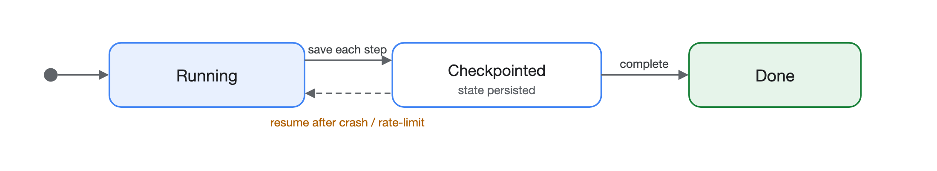
L2
Durable Execution
A run must survive a crash — resume from the last checkpoint instead of restarting.
workflow.py runs steps; durable/ persists a Checkpoint(run_id, step, state) after each.
Local SQLite today → Cosmos DB later → localStorage in this browser. Same interface; run_durably never knows.
# workflow.py — checkpoint after every step; resume skips completed work
state = run_durably(run_id, steps, store)
Notes:
Checkpoint after each step, keyed by run_id + step index. On restart, load the last checkpoint and continue. The seam: CheckpointStore Protocol. Local = SQLite in .harness/, prod = Cosmos DB. There's an actual test that kills the run mid-way and asserts it resumes. || LIVE DEMO — this one is not a simulation, so run it in this order: press r, press 'Start the run'. Steps 1 and 2 execute and print a real side effect; step 3 hits a rate limit and the run dies. Then SAY 'watch — I'm going to destroy everything' and actually reload the page (Cmd-R). The Pyodide interpreter and every Python object in it are gone. The deck comes back to this slide from the hash and the panel re-opens itself in resume mode. Press 'Resume the run': `ran` is empty — brand new interpreter — but the checkpoint came back out of localStorage, so steps 1 and 2 do NOT re-run and their results are still in the final state. The line to land: the work was not redone, it was remembered. Press 'reset' before you rehearse it again. If the venue blocks localStorage or the Pyodide CDN, the panel says so and replays the build-time transcript instead — don't reload in that case, it proves nothing.

Slide 15
L2
Durable execution — the example
A real crash, a real page reload, and a resume that skips completed work.
# same CheckpointStore Protocol as SQLite and Cosmos
store = BrowserCheckpointStore(js.localStorage)
run_durably("banquet-42", STEPS, store)
# ran step-1 · ran step-2 · CRASH: rate limited
# --- reload the page. the interpreter and every object in it die ---
run_durably("banquet-42", STEPS, store) # same run id
# ran step-3 · ran step-4
# step-1 and step-2 never ran again
Notes:
The worked example for L2, and the one demo that is performed rather than depicted. Run the first half, then SAY 'watch — I am going to destroy everything' and actually reload. The deck returns to this slide from the hash and the panel re-opens itself in resume mode. Land: the work was not redone, it was remembered.

Slide 16
L3
Secure Sandboxing
Agent-generated code can't run in your process. sandbox.py isolates it.
Executes in an isolated subprocess with a hard timeout.
Local stand-in for the Agent Service Code Interpreter tool.
State the leak: a subprocess is not a real sandbox — the managed tool gives true isolation, network controls, and resource limits.
The pattern that matters: never exec() untrusted output in-process — put a boundary (and a clock) around it.
# sandbox.py — isolated subprocess, hard timeout
r = run_code(model_written_code, timeout=5.0)
r.ok, r.timed_out, r.stdout
Notes:
The lesson isn't 'we built a perfect sandbox' — it's 'code from a model is untrusted; isolate it and bound it in time.' Locally that's a subprocess + timeout. In prod it's Code Interpreter, which is a genuinely hardened sandbox. The docstring states that gap plainly.

Slide 17
L3
Sandboxing — the example
A subprocess with a clock — and a runtime that refuses outright.
r = run_code("print('hello from inside the sandbox')")
r.ok, r.exit_code, r.stdout
r = run_code("while True: pass", timeout=1.0)
r.timed_out # True — contained by the clock
# but run the same call in this browser:
# OSError — the runtime refuses to spawn a process at all
# a real boundary refuses; a teaching stand-in only pretends
Notes:
The worked example for L3, and the only demo whose interesting result is a failure. Locally the subprocess runs and the timeout contains a runaway. In the browser it is refused outright — and that refusal is the lesson, because sandbox.py's own docstring admits a subprocess is not a security boundary. This is the argument for Code Interpreter in one line.

Slide 18
L4
Advanced Memory
Three memory shapes, three stand-ins — under memory/.
short-term
long-term
compaction
thread
knowledge
summarize
Per-conversation history. Stands in for Agent Service managed threads.
Retrievable facts. Stands in for Azure AI Search (RAG).
Condense history to fit the context window.
Short-term = the conversation; long-term = a knowledge store the agent can query; summarization = keep both affordable within the token budget.
# three memories, three lifetimes
threads.append(tid, "user", msg) # the turn
kb.search("duplicate charge", k=2) # the corpus
summarize_thread(history, max_chars=500) # the context budget
Notes:
Memory isn't one thing. Thread = recent turns (managed threads). Knowledge = durable retrievable facts (AI Search / RAG). Summarize = compress older turns so you don't blow the context window. Together they're 'advanced memory'.

Slide 19
L4
Memory — the example
Three memories, three lifetimes — running on real SQLite in the browser.
threads = SQLiteThreadStore(":memory:")
threads.append("t-1", "user", "my invoice is wrong")
threads.history("t-1") # the turn
kb = InMemoryKnowledgeStore()
kb.add("refunds", "Duplicate charges are refunded in five days.")
kb.search("duplicate charge refund", k=2) # the corpus
summarize_thread(history, max_chars=120, keep=1)
# user: my invoice is wrong
# [...4 earlier turns omitted...]
Notes:
The worked example for L4. All three memories are real here — thread is actual sqlite3 loaded into the browser, not a dict pretending. The line to land is the last one: the raw thread stays in the store because summarising is lossy, so the summary is never the only copy.

Slide 20
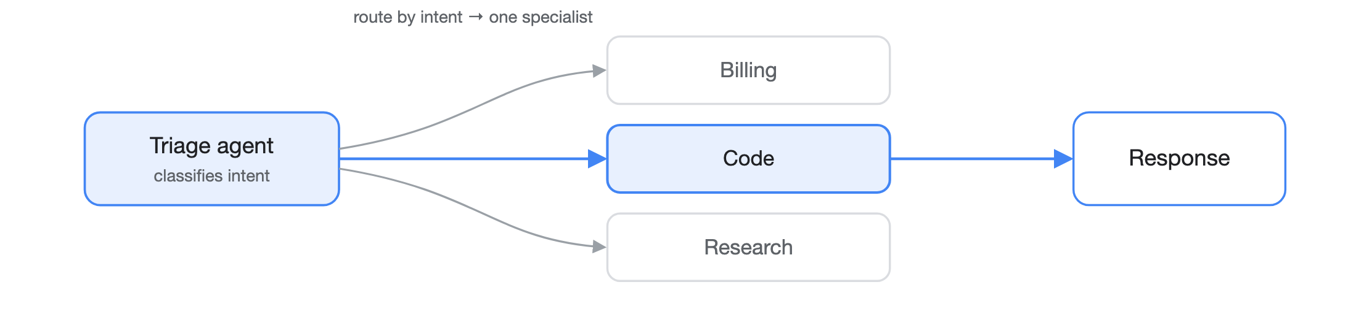
L5
Orchestration — routing & handoff
A triage agent classifies intent and hands off to the right specialist.
orchestration/router.py — intent → specialist, the Agent Framework handoff pattern.
One entry point, many specialists; each specialist stays focused and small.
# orchestration/router.py — intent → specialist
Router().route("refund my invoice")
# RouteDecision(specialist='billing', matched_intent='invoice')
Notes:
Single-agent is limiting. Routing = a cheap classifier agent picks the specialist. Keeps each specialist's prompt/tools narrow and reliable. This is the Agent Framework handoff pattern; locally it's a routing table.

Slide 21
L5
Routing — the example
Three requests routed, one paraphrase missed — and the leak that causes it.
Router().route("I need a refund on my invoice")
# RouteDecision(specialist='billing', matched_intent='invoice')
Router().route("the project won't build any more")
# RouteDecision(specialist='fallback', matched_intent=None)
# a human reads that as a CODE problem instantly.
# 'compile' is in the table; "won't build" is not.
Router({"won't build": Specialist.CODE}).route(...)
# patched in one line — the treadmill a triage agent removes
Notes:
The worked example for L5. Beat two matters most: fallback is a routing decision, not a crash, but a substring table has no notion of meaning. Then patch it in one line and note that you have just signed up to maintain that table forever — which is exactly what a real triage agent takes off you.

Slide 22
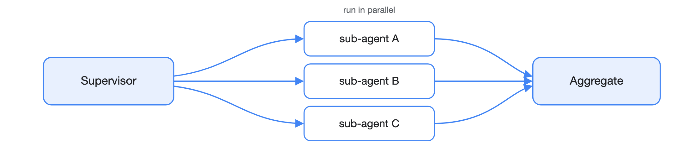
L6
Hierarchical Supervision
Routing escalated: a supervisor decomposes a task, fans out, and aggregates.
orchestration/supervisor.py — parallel fan-out / fan-in.
Maps to Agent Framework Magentic / concurrent orchestration.
# orchestration/supervisor.py — fan-out / fan-in
agg = Supervisor(worker=sub_agent).run("a; b; c")
agg.succeeded, agg.failed # one failure never sinks the batch
Routing picks one agent; supervision runs many in parallel and merges their results.
Notes:
The step up from routing: don't just pick one specialist, break the task into pieces, dispatch them concurrently, and combine. That's the supervisor/orchestrator pattern (Magentic in Agent Framework). Locally: parallel fan-out, fan-in aggregation.

Slide 23
L6
Supervision — the example
Fan out, one sub-agent fails, and the batch survives in a stable order.
sup = Supervisor(worker=sub_agent, executor_factory=SyncExecutor)
agg = sup.run("summarise the outage; check pricing; draft the note")
for r in agg.results: # decomposition order, not completion
r.subtask, r.output, r.error
agg.succeeded, agg.failed # 2, 1
# one sub-agent raised; the exception never escaped run()
# executor_factory is a seam: this browser has no threads,
# so the isolation is real and the parallelism is not
Notes:
The worked example for L6. Two guarantees hold — a failing sub-agent is isolated into its own result, and output order follows decomposition rather than completion. Say the leak plainly: threads are unavailable here so the fan-out ran sequentially, which is why the executor is an injectable seam at all.

Slide 24
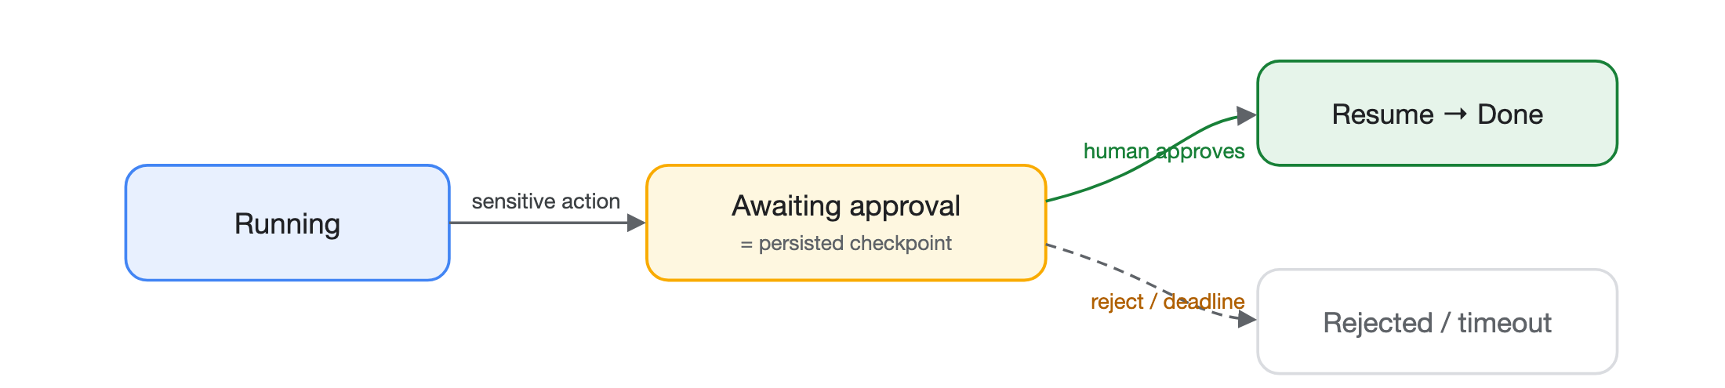
L7
Human-in-the-Loop
Pause before a sensitive action, wait for a human, then resume — built on L2's checkpoints.
hitl.py — checkpointed suspend / resume with a deadline (reject on timeout).
Reuses the durable store: a paused run is just a persisted checkpoint waiting on input.
# hitl.py — suspend, then resume against a deadline
request_approval(run_id, prompt, store, now=t0, timeout_seconds=60)
resume(run_id, decision=True, store=store, now=t1, action=refund)
Notes:
LIVE DEMO — four beats and the fourth is the one nobody expects. A refund reaches the gate and does NOT run; a human approves in time and it fires; a human rejects and it does not; then a human approves TWO HOURS LATE and the gate returns timed_out. The deadline is checked BEFORE the decision, against an injected clock, so a late yes is void. Close on the count: three requests, one refund. || HITL falls out of durable execution almost for free: suspend = checkpoint + wait, resume = load + continue. Add a deadline so it doesn't wait forever. This is where the 'survive a crash' machinery pays off twice.

Slide 25
L7
Human-in-the-loop — the example
Approve, reject, and the one nobody expects — a yes that arrives too late.
request_approval(run_id, "Refund 40.00 GBP", store,
now=0.0, timeout_seconds=60.0)
# status=awaiting_approval performed=False
resume(run_id, True, store, now=10.0, action=issue_refund)
# approved — action performed
resume(run_id, False, store, now=10.0, action=issue_refund)
# rejected — action NOT performed
resume(run_id, True, store, now=7200.0, action=issue_refund)
# timed_out — the deadline is checked BEFORE the decision
Notes:
The worked example for L7, and beat four is the one nobody expects. Three requests, one refund. The deadline is checked before the decision against an injected clock, so a late yes is void — which is what stops an approval queue quietly authorising last week's refunds.

Slide 26
The docs are part of the test suite
Knowledge lives in the repo and is mechanically validated — stale docs turn the suite red.
tests/test_docs.py checks every .md / .excalidraw: balanced fences, resolvable anchors, valid Excalidraw JSON, no HTML-escape artifacts.
Heavier Mermaid render is opt-in: HARNESS_RENDER_MERMAID=1 (needs mmdc).
Two glossaries cross-reference concepts — including a full LangGraph → this repo → Azure map.
A small echo of "repository as system of record": if an agent (or teammate) can't see it in-context, it doesn't exist.
Notes:
Nice detail for an engineering audience: documentation is tested like code. This keeps the design docs honest as the code moves. The LangGraph glossary maps every LangGraph primitive to the repo module that stands in for it and the Azure target.

Slide 27
Status & how to run it
7 / 7 lessons implemented locally & tested.
# run the full suite (no cloud needed)
uv run --extra dev pytest
Suite is deterministic and cloud-free.
# one test
uv run --extra dev pytest \\
Azure wiring pending — the next increment.
tests/test_guardrails.py::test_normal_input_allowed
# the API locally
uv run uvicorn harness.app:app --reload
curl localhost:8000/health
Tooling is uv (provisions Python ≥3.11). Despite the Go-style path, this project is Python.
Notes:
Live demo moment if you want one: run pytest (fast, all green), then curl /health, then POST a prompt-injection string to /chat and show the guardrail block it. Reminder: uv provisions the right Python; don't be fooled by the GOPATH-style directory — it's Python.

Slide 28
Takeaways
Thin over managed. The runtime is mostly configuration on Azure primitives, not from-scratch infrastructure.
The seam pattern + "state the leak" let you build and test offline, then swap to Azure without touching logic.
The seven patterns are the vocabulary of production agents: guard, persist, sandbox, remember, route, supervise, ask a human.
Questions?
Design: docs/architecture.md · Plan: docs/azure-implementation-plan.md · Concepts: docs/glossary.md, docs/langgraph-glossary.md
Notes:
Land the three points and open for questions. If asked 'why not just LangGraph?' — point at the langgraph-glossary: this repo maps each LangGraph primitive to a managed Azure equivalent, the bet being that managed services carry the operational load.

