Slide 1
Arduino in tinkercad
Challenging Tasks

Slide 2
Day 1

Slide 3
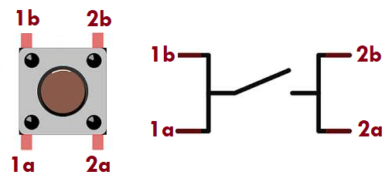
TASK 1
Controlling LED blinking using Switch
Write a program to control two LEDs (Green, Red) state using a switch as per following logic.
When switch is not pressed (LOW) turn ON Red LED continuously and Green LED in OFF state
Whenever switch is pressed (HIGH) turn OFF Red LED and turn ON Green LED for 10 Sec.
After 10 Sec. delay turn OFF Green LED and proceed to turn ON Red LED continuously
Simulate and verify this logic on Arduino Uno using Tinkercad circuits simulator.

Slide 4
TASK 2
Controlling LED brightness using PWM
TASK-4: Write a program to control the LED brightness using PWM signal generated on digital pin 6 with different duty cycle. Verify the duty cycle using oscilloscope.
Case-1: 0% duty cycle
Case-2: 50% duty cycle
Case-3: 100% duty cycle
Simulate and verify this logic on Arduino Uno using Tinkercad circuits simulator.

Slide 5
TASK 3
Controlling RGB LED colours based on the input from user via serial port
Write a program to glow the selective LED colour on RGB LEB by receiving input from user via serial port as per below logic.
If user press a key “G” then glow grey colour on RGB led for 2 seconds
If user press a key “T” then glow teal colour on RGB led for 2 seconds
If user press a key “M” then glow maroon colour on RGB led for 2 second
If user press a key “O” then glow olive colour on RGB led for 2 seconds
If user press a key “P” then glow purple colour on RGB led for 2 seconds
If none of these pressed then glow an random colour on RGB LED
For every selected colour, print its colour name of serial window
Simulate and verify this logic on Arduino Uno using Tinkercad circuits simulator.

Slide 6
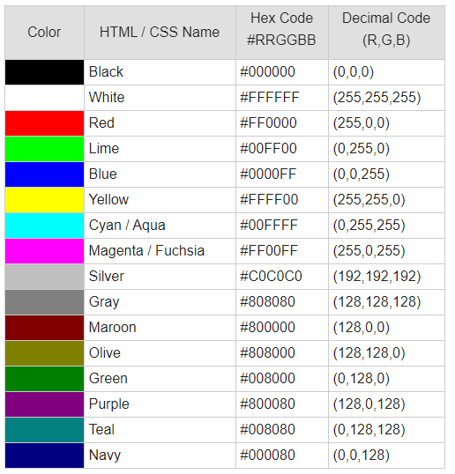
RGB LED value for different colors

Slide 7
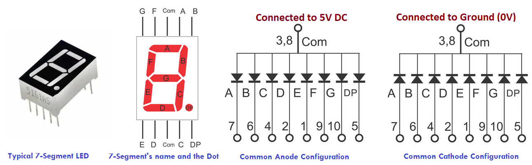
7 SEGMENT DISPLAY

Slide 8
Decimal Digit | Individual Segments Illuminated for Common Anode configuration
 | a | b | c | d | e | f | g | dp
. | 1 | 1 | 1 | 1 | 1 | 1 | 1 | 0
0 | 0 | 0 | 0 | 0 | 0 | 0 | 1 | 1
1 | 1 | 0 | 0 | 1 | 1 | 1 | 1 | 1
2 | 0 | 0 | 1 | 0 | 0 | 1 | 0 | 1
3 | 0 | 0 | 0 | 0 | 1 | 1 | 0 | 1
4 | 1 | 0 | 0 | 1 | 1 | 0 | 0 | 1
5 | 0 | 1 | 0 | 0 | 1 | 0 | 0 | 1
6 | 0 | 1 | 0 | 0 | 0 | 0 | 0 | 1
7 | 0 | 0 | 0 | 1 | 1 | 1 | 1 | 1
8 | 0 | 0 | 0 | 0 | 0 | 0 | 0 | 1
9 | 0 | 0 | 0 | 0 | 1 | 0 | 0 | 1

Slide 9
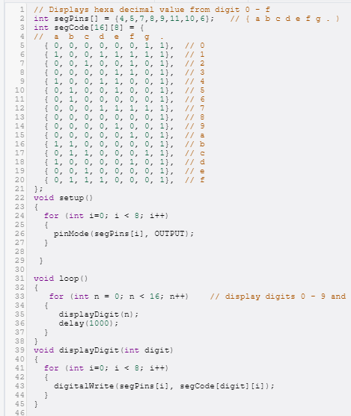
Program

Slide 10
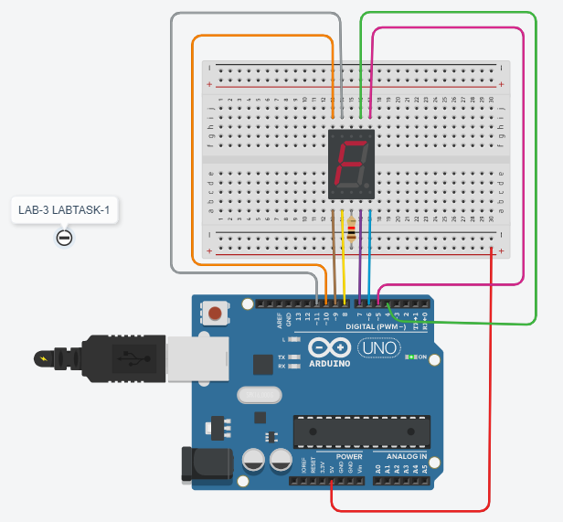
Output

Slide 11
TASK 4
Digital stop watch with start/stop and reset option
Write a program to a digital stop watch with start/stop and reset option. This system consist of three 7-segment LED unit to display the timing in milliseconds precision.
First and second 7-segment LED display seconds value
The last 7-segment LED displays milliseconds value
Use slide switch to start/stop the counting (HIGH-Start, LOW-Stop)
Use push button to reset the counting to initial value (HIGH-Reset)
Once it reaches it’s maximum counting, continue again with initial value
Simulate and verify this logic on Arduino Uno using Tinkercad circuits simulator.

