Slide 1
Arduino in tinkercad
Challenging Tasks

Slide 2
Day 2

Slide 3
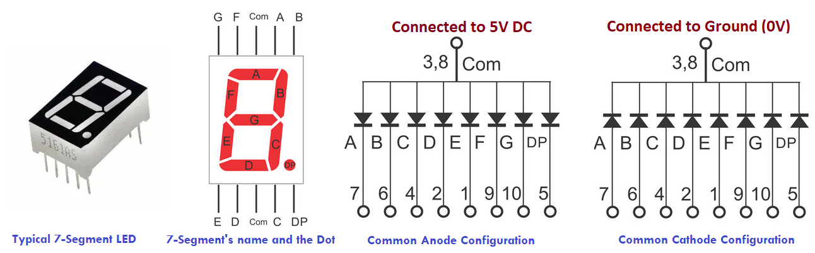
7 SEGMENT DISPLAY

Slide 4
Decimal Digit | Individual Segments Illuminated for Common Anode configuration
 | a | b | c | d | e | f | g | dp
. | 1 | 1 | 1 | 1 | 1 | 1 | 1 | 0
0 | 0 | 0 | 0 | 0 | 0 | 0 | 1 | 1
1 | 1 | 0 | 0 | 1 | 1 | 1 | 1 | 1
2 | 0 | 0 | 1 | 0 | 0 | 1 | 0 | 1
3 | 0 | 0 | 0 | 0 | 1 | 1 | 0 | 1
4 | 1 | 0 | 0 | 1 | 1 | 0 | 0 | 1
5 | 0 | 1 | 0 | 0 | 1 | 0 | 0 | 1
6 | 0 | 1 | 0 | 0 | 0 | 0 | 0 | 1
7 | 0 | 0 | 0 | 1 | 1 | 1 | 1 | 1
8 | 0 | 0 | 0 | 0 | 0 | 0 | 0 | 1
9 | 0 | 0 | 0 | 0 | 1 | 0 | 0 | 1

Slide 5
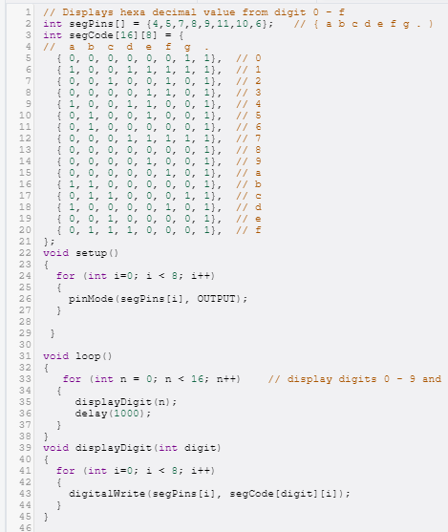
Program

Slide 6
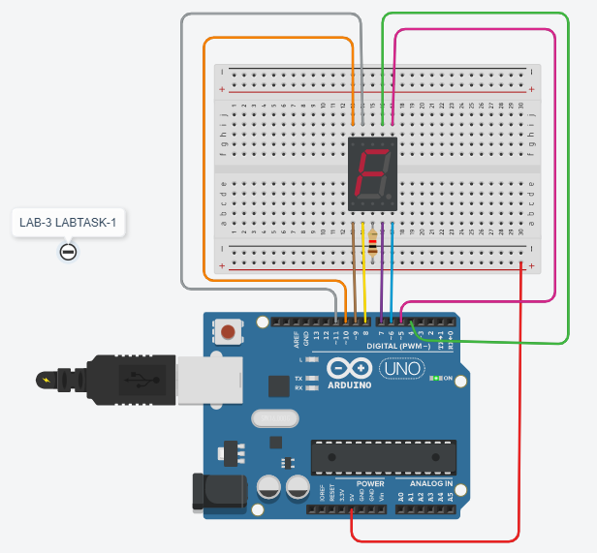
Output

Slide 7
Using two 7 segment displays
Display numbers from 00 to 99
Task-2: Write a program to display a two digit decimal numbers from 00 to 99 using 7-segment LEDs. Use common digital pins of Arduino Uno for both 7-segments LED connection and display the digit using multiplexing logic i.e one digit at a time on each 7-Segment with small delay values (few ms). Use a slide switch to stop the number sequencing. Simulate and verify this logic on Arduino Uno using Tinkercad circuits simulator.
Note: Use millis() API to record number of milliseconds passed since the current program began the execution.

Slide 8
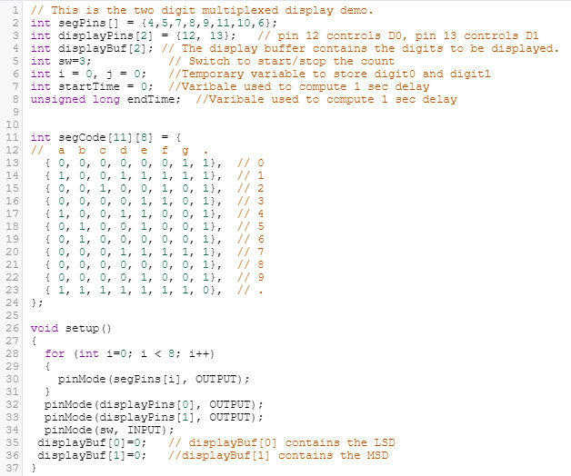
Code

Slide 9
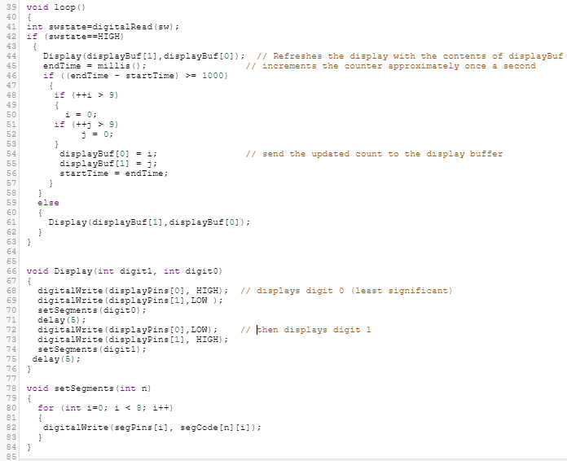

Slide 10
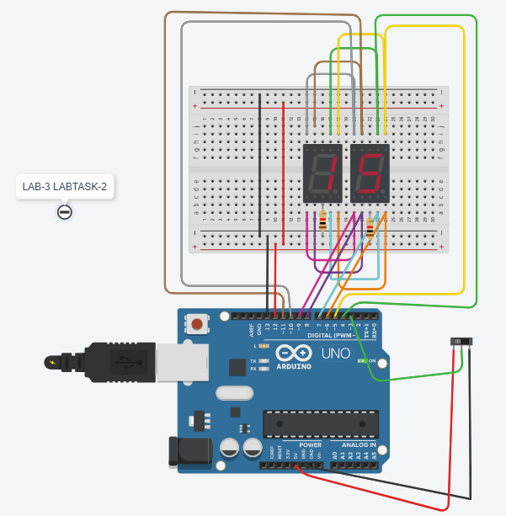
OUTPUT

Slide 11
https://www.tinkercad.com/things/ixcKdNoFTWZ-lab-3-task-1/editel?sharecode=XsJ-9Lag4_enRtGcY5qBbpsPrtWXOcqnPSbNx-_ibbE https://www.tinkercad.com/things/elunQoPj6pz-lab-3-task-2/editel?sharecode=mvEMJwsBrxiDyGvrYO_eG9TXxMcUdibg2SCtc3Etlnc
Links for 7 segment displays

Slide 12
TASK 1
Digital stop watch with start/stop and reset option
Write a program to a digital stop watch with start/stop and reset option. This system consist of three 7-segment LED unit to display the timing in milliseconds precision.
First and second 7-segment LED display seconds value
The last 7-segment LED displays milliseconds value
Use slide switch to start/stop the counting (HIGH-Start, LOW-Stop)
Use push button to reset the counting to initial value (HIGH-Reset)
Once it reaches it’s maximum counting, continue again with initial value
Simulate and verify this logic on Arduino Uno using Tinkercad circuits simulator.

Slide 13
TASK 2
IR Remote Controlled Robot
Write a program for IR Remote Controlled robot using Arduino Uno, in which IR remote control the movement of the robot by controlling its left and right wheels (DC motor) as per following logic.
When “UP” key is pressed make the robot to move in forward direction with left and right wheel on same rpm (positive)
When “DOWN” key is pressed make the robot to move in reverse direction with left and right wheel on same rpm (negative)
When “LEFT” key is pressed, stop the left wheel( 0 rpm) and maximum positive rpm on right wheel to move towards left direction
When “RIGHT” key is pressed, stop the right wheel( 0 rpm) and maximum positive rpm on left wheel to move towards right direction
Simulate and verify this logic on Arduino Uno using Tinkercad circuits simulator.

Slide 14
TASK 3
Bidirectional visitor counter using PIR sensor
Write a program to design a bidirectional visitor counter using PIR sensor. This system consist of two PIR sensor, one on the entry another on exit side. For every human detection on entry side increment count value and every human detection on exit side decrement count value. Whenever human presence detected on entry/exit open the automatic door (DC motor) for 5 seconds and close automatically. Use one 7-segment to display number of human inside the room. Also, ensure always maximum number of human present inside the room must be 9. Whenever any attempt made to enter the room when number of human count is already 9 inside the room then switch ON the buzzer. Simulate and verify this logic on Arduino Uno using Tinkercad circuits simulator.

Slide 15
TASK 4
Voltage level indicator (Exercise)
Write a program to design a voltage level indicator system using potentiometer and LEDs. The system must display the different level of the voltage with the help of 5 LEDs as per following conditions.
If the voltage is between 0 to 1V glow LED1
If the voltage is between 1 to 2V glow LED1 and LED2
If the voltage is between 2 to 3V glow LED1 to LED3
If the voltage is between 3 to 4V glow LED1 to LED4
If the voltage is between 4 to 5V glow LED1 to LED5
Simulate and verify this logic on Arduino Uno using Tinkercad circuits simulator.

