Slide 1
Arduino in tinkercad
Challenging Tasks

Slide 2
Day 3

Slide 3
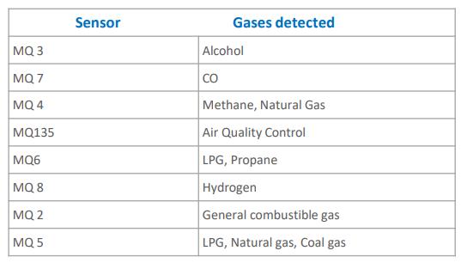
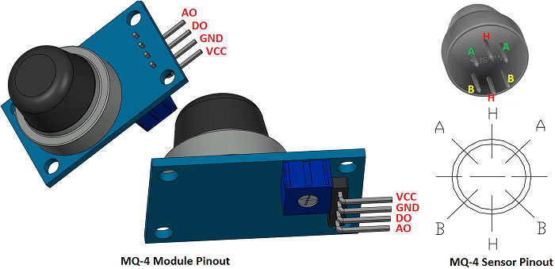
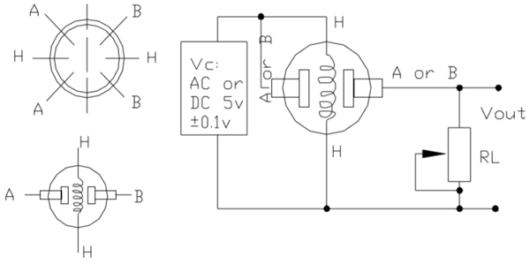
INTRODUCTION TO MQ GAS SENSOR

Slide 4
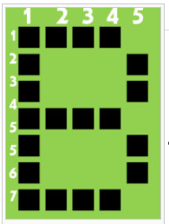
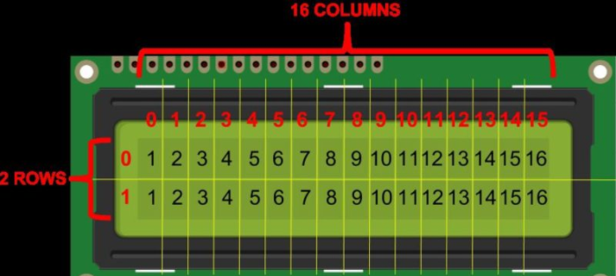
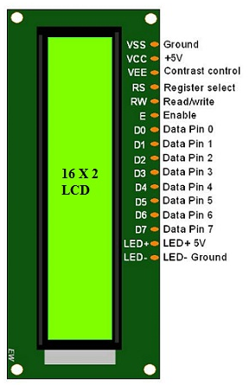
INTRODUCTION TO LCD
Vss- Ground pin
Vcc- Supply (+5V)
VEE- Contrast pin (0.4 to 0.9V)
RS- Register select (1- data register, 0 – command register)
R/W - Read/ Write mode ( 1-Read mode, 0- Write mode)
E- Enable the LCD module (high to low at this pin enable LCD)
DB0-DB7- Data pins (command and data are send to display)
LED+ & LED- - Anode and Cathode of backlight

Slide 5
In Arduino LiquidCrystal library is used #include <LiquidCrystal.h>
The library works with in either 4- or 8-bit mode
To use the LiquidCrystal library - create a named LiquidCrystal object.
LiquidCrystal lcd(rs, enable, d4, d5, d6, d7);
LiquidCrystal lcd(rs, rw, enable, d4, d5, d6, d7);
LiquidCrystal lcd(rs, enable, d0, d1, d2, d3, d4, d5, d6, d7);
LiquidCrystal lcd(rs, rw, enable, d0, d1, d2, d3, d4, d5, d6, d7);
lcd.begin(cols, rows)-Initializes the interface to LCD, and specifies dimensions
lcd.print(data)/lcd.write(data) - the character to write to the display
lcd.clear()-Clears the LCD screen and positions the cursor on upper-left corner
lcd.setCursor(col, row)- Position the LCD cursor
lcd.leftToRight()-Set the direction for text written to the LCD to left-to-right
lcd.scrollDisplayLeft()-Scrolls the contents of the display one space to the left
lcd.blink()-Display the blinking LCD cursor.
lcd.autoscroll()-Turns on automatic scrolling of the LCD

Slide 6
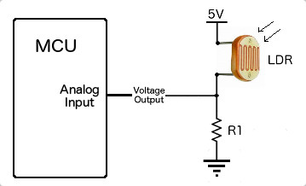
TASK 1
Weather Monitoring Station
Write a program to design a weather monitoring station which display temperature, CO2 level and light intensity on LCD. Print “Weather station” on first line and print the timing as “08:MM:SS” after a delay of 3 Seconds display values of temp, CO2 and light in a rolling display moving from right to left direction. Then repeat the sequence again. Simulate and verify this logic on Arduino Uno using Tinkercad circuits simulator.

