Slide 1
Arduino in tinkercad
Challenging Tasks

Slide 2
Day 4

Slide 3
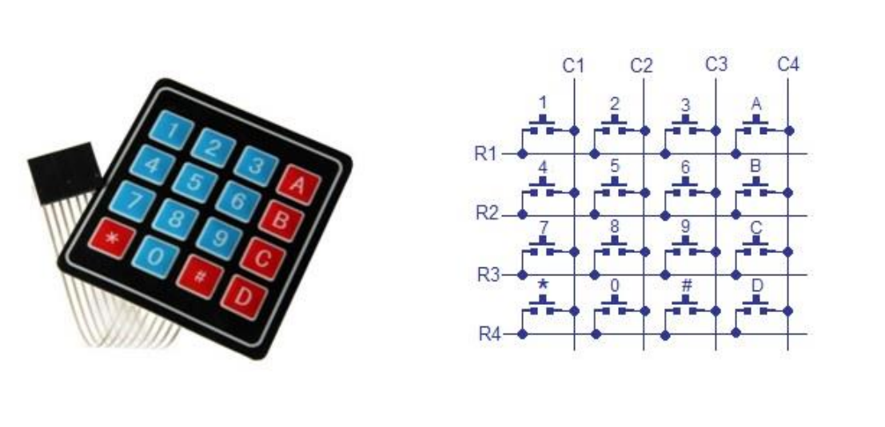
INTRODUCTION TO KEYPAD

Slide 4
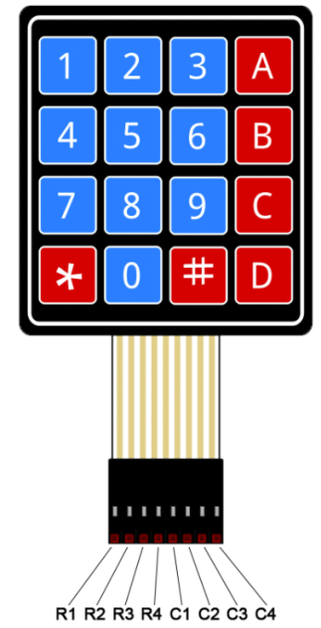
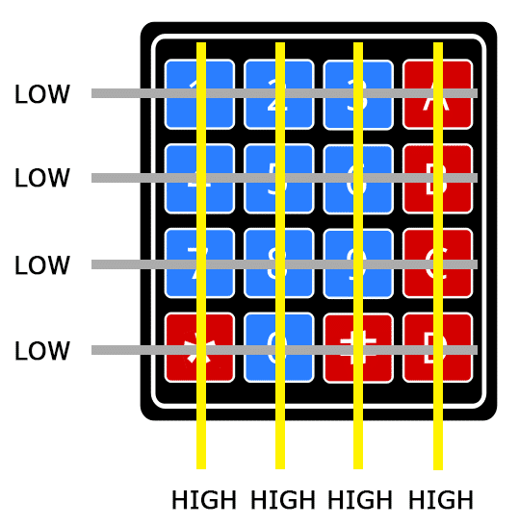
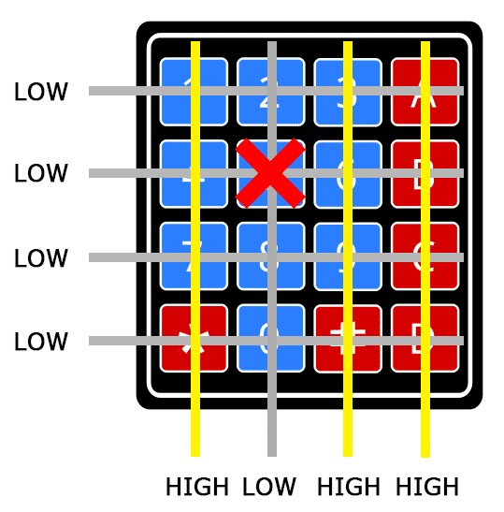
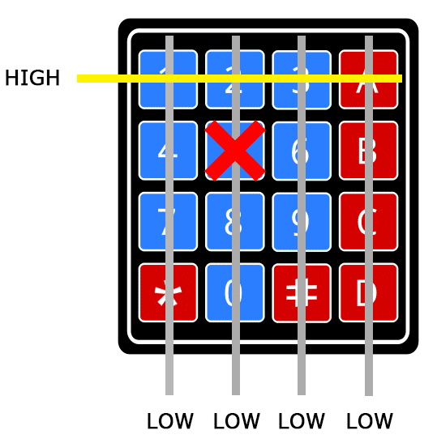
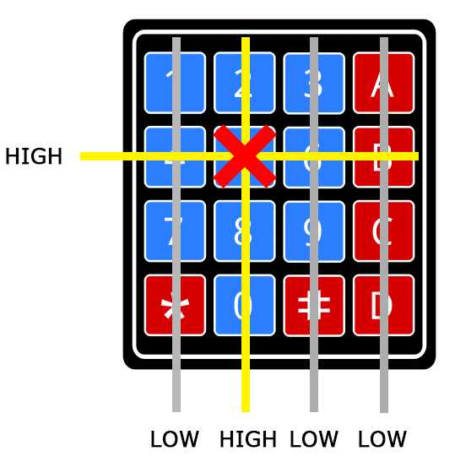
STEP-1
STEP-2
STEP-3
STEP-4

Slide 5
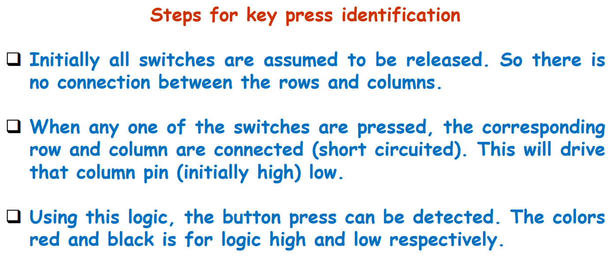

Slide 6
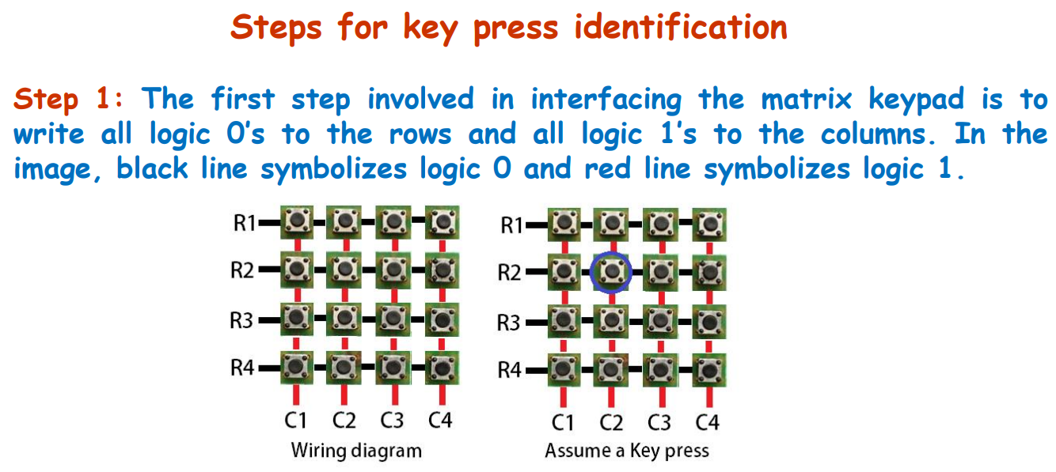

Slide 7
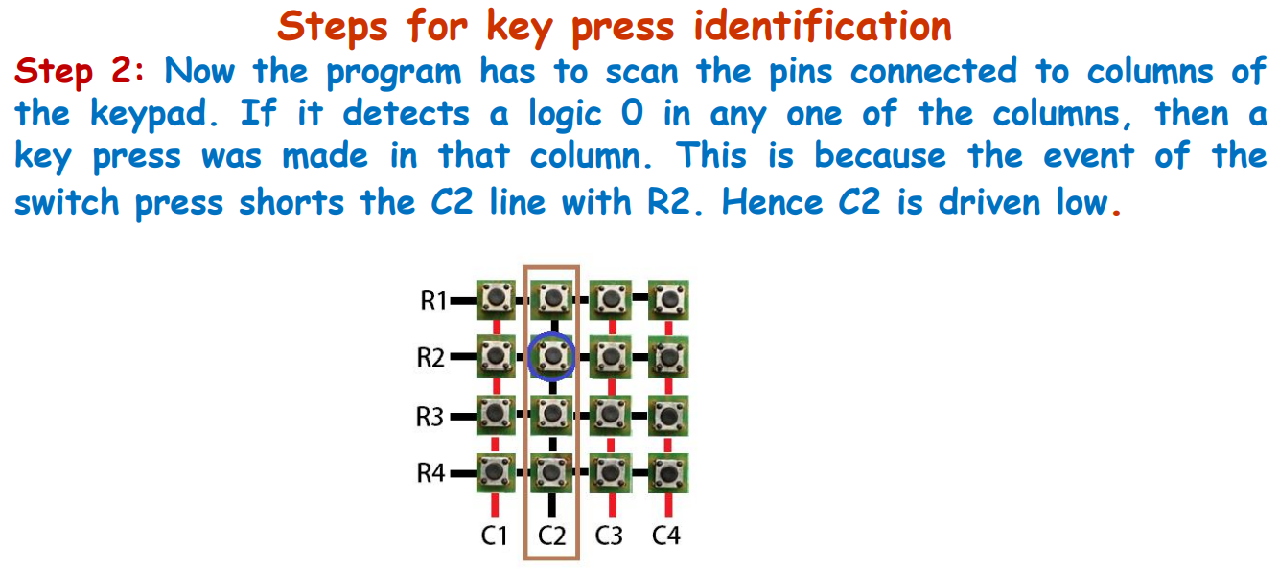

Slide 8
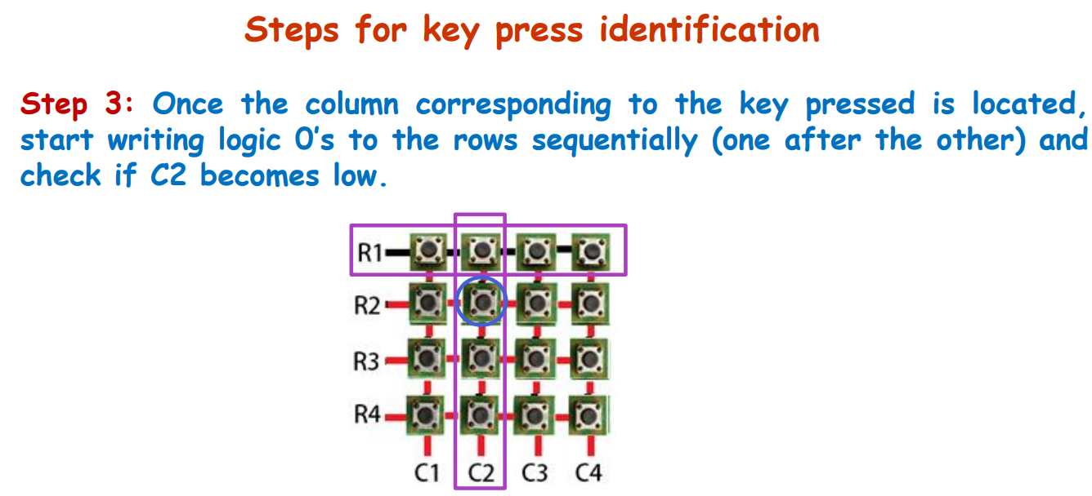

Slide 9
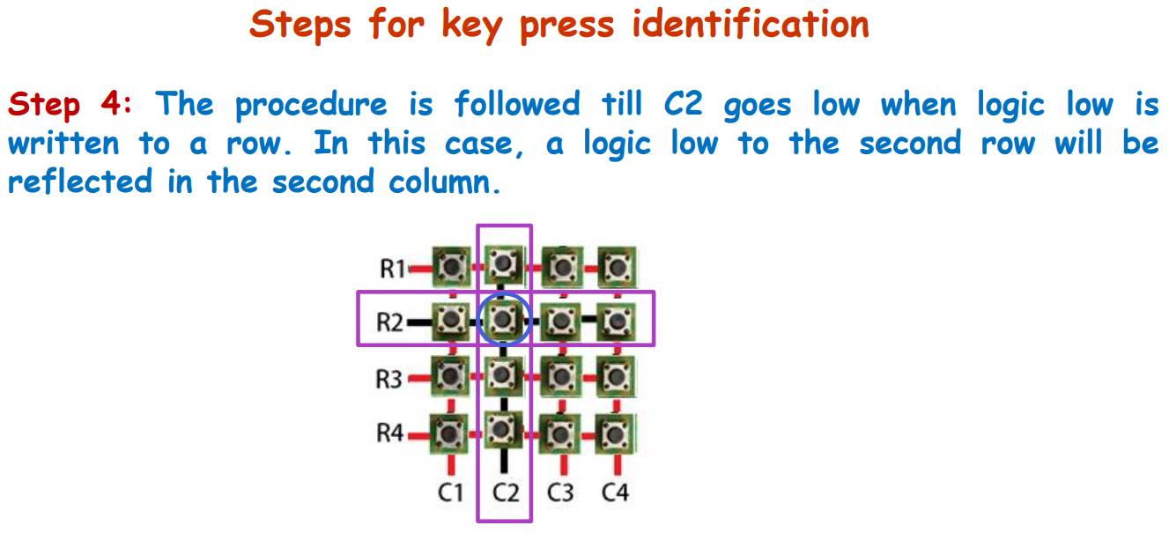

Slide 10
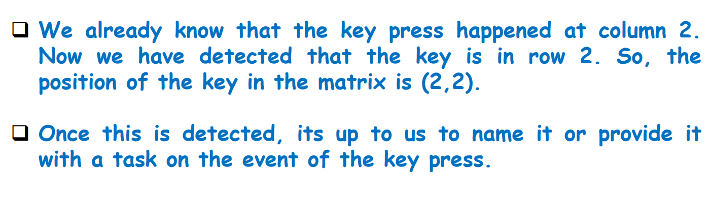

Slide 11
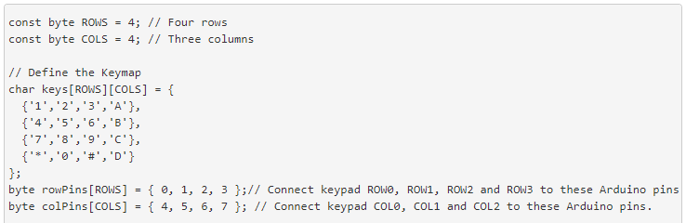
In Arduino keypad library is used with header file #include <Keypad.h>
Keypad(makeKeymap(userKeymap), row[], col[], rows, cols)

Slide 12
char waitForKey() - This function will wait forever until someone presses a key.
char getKey() - Returns the key that is pressed, if any.
KeyState getState() - Returns the current state of any of the keys. The four states are IDLE, PRESSED, RELEASED and HOLD.
boolean keyStateChanged() – Let's you know when the key has changed from one state to another.
setDebounceTime(unsigned int time) - Set the amount of milliseconds the keypad will wait until it accepts a new keypress/keyEvent.
addEventListener(keypadEvent) - Trigger an event if the keypad is used.

Slide 13
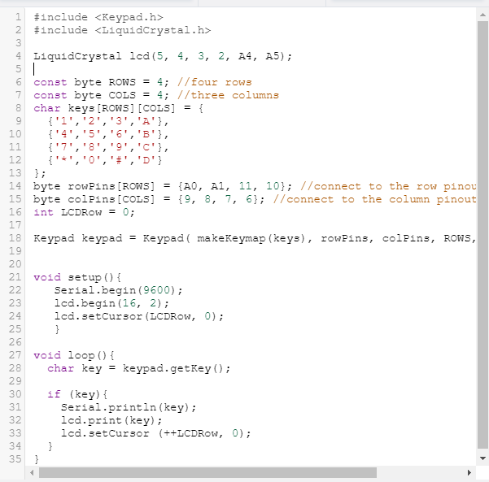
Program & output

Slide 14
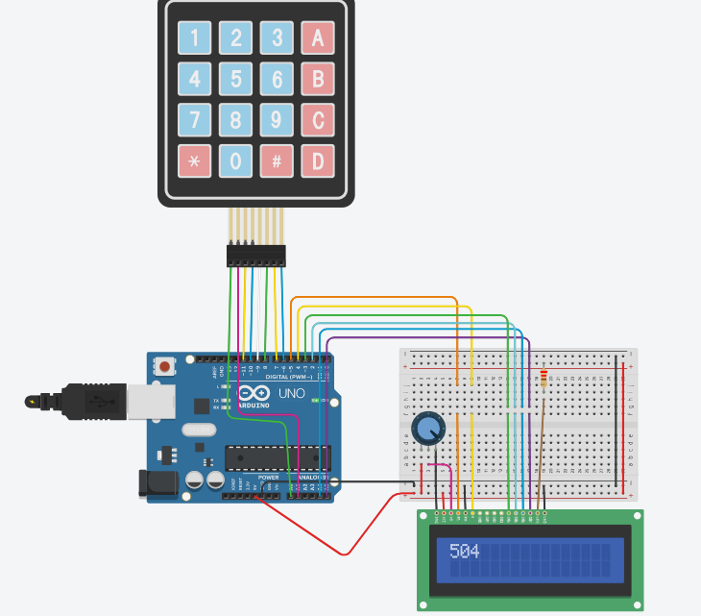
Design

Slide 15
TASK 1
Home security system
Write a program to design home security system that consists of two main modules (1) Intruder detection (2) password based door lock system. The intruder detection system consists of PIR sensor interfaced with processing unit to detect and alert under human presence condition. In password based door lock system numeric keypad to accept the password (last 4-digit of your reg. no) from user and LCD to display the message whether permission is granted or not. Upon receiving correct password signal, enable motor to open the door. In case of password mismatch or intruder detection condition activate the buzzer. Simulate and verify this logic on Arduino Uno using Tinkercad circuits simulator.

Slide 16
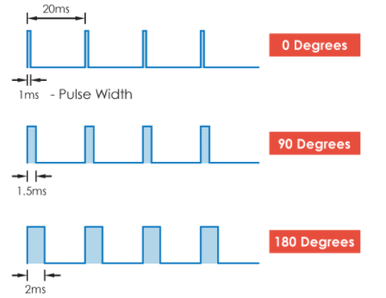
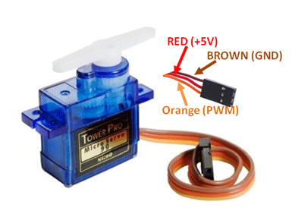
SERVO MOTOR
A servo motor is controlled by sending a series of pulses through the signal line. The frequency of the control signal should be 50Hz or a pulse of 20ms.
Generally pulses with 1ms duration correspond to 0° degrees position, 1.5ms duration to 90° and 2ms to 180° (may vary with different models) .

Slide 17
“Servo” library can control many servo motor with the Arduino and it control 12 servos using only 1 timer.
In Arduino, Servo library is used with header file #include <Servo.h>
servo.attach(pin) or servo.attach(pin, min, max) - Attach the Servo variable to a pin.
servo: a variable of type Servo
pin: the number of the pin that the servo is attached to
min (optional): the pulse width, in microseconds, corresponding to the minimum (0-degree) angle on the servo
max (optional): the pulse width, in microseconds, corresponding to the maximum (180-degree) angle on the servo
servo.write(angle) - Writes a value to the servo, controlling the shaft accordingly.
angle: the value to write to the servo, from 0 to 180

Slide 18
servo.writeMicroseconds(uS)- Writes a value in microseconds (uS) to the servo, controlling the shaft accordingly.
uS: the value of the parameter in microseconds (int)
servo.read()- Read the current angle of the servo, The angle of the servo, from 0 to 180 degrees.
servo.attached() – Check whether the Servo variable is attached to a pin. Return true if the servo is attached to pin; false otherwise.
servo.detach()- Detach the Servo variable from its pin. If all Servo variables are detached, then pins 9 and 10 can be used for PWM output with analogWrite().

Slide 19
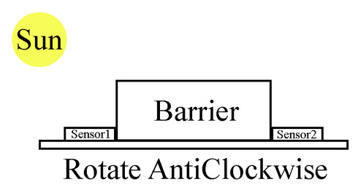
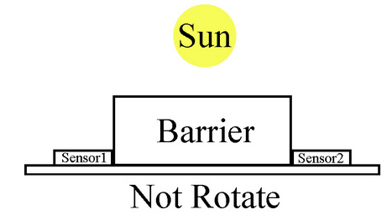
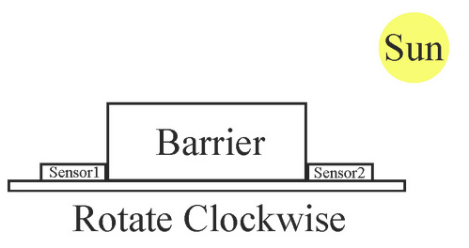
TASK 2
Solar tracking system
Write a program to design a solar tracking system for harvesting solar energy efficiently by the solar panels. This system is constructed by fitting two LDRs, angled away from each other by around 90, to a servo. Continuously read the light value sensed by the two LDRs and rotates the servo so that each is receiving equal light. As a sun-tracking system will be located to track the sun from sunrise to sunset, i.e. not more than 180. Also, display both LDR values and present Servo motor position on LCD. Simulate and verify this logic on Arduino Uno using Tinkercad circuits simulator.

Slide 20
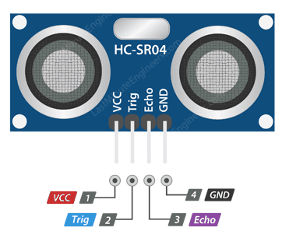
ULTRASONIC SENSOR
Distance = (Speed x Time)/ 2
Distance = (0.034 cm/µs x 500 µs) / 2
Distance = 8.5 cm
When obstacle detected pulse width of 50 µS to 25 mS received
When no obstacles then timeout after 38ms

Slide 21
TASK 3
pulseIn() - Reads a pulse (either HIGH or LOW) on a pin. For example, if value is HIGH, pulseIn() waits for the pin to go from LOW to HIGH, starts timing, then waits for the pin to go LOW and stops timing. Returns the length of the pulse in microseconds or gives up and returns 0 if no complete pulse was received within the timeout.
Smart Parking system (Exercise)
Write a program to design smart parking system using HC-SR04 ultrasonic sensor, servo motor, buzzer, LCD and Arduino Uno.
The ultrasonic sensor module place near the gate entrance continuously check for the incoming vehicles. The LCD display “Smart Parking” on the first row and “Avail. slot: XY” in second row of the display.
When a vehicle comes closer to the ultrasonic sensor detection area and parking slot is available then the system open a gate barrier to 90° (close after 10 seconds) to allow the vehicle to the parking slot and decrement parking slot by 1.
If no parking slot available then display a message “No Parking slot” on LCD (2nd line) and switch on the buzzer (for 5 Seconds). Have a similar system on the exit and increment the free slot by 1 for every vehicle leaves the parking slot.
Simulate and verify this logic on Arduino Uno using Tinkercad circuits simulator.
Note: XY is number of available slot.

