Slide 1
Arduino in tinkercad
Challenging Tasks

Slide 2
Day 5

Slide 3
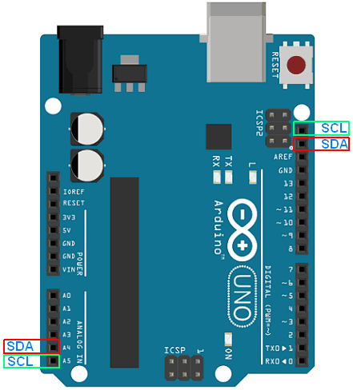
INTER INTEGRATED CIRCUIT (I2C)

Slide 4
The library <Wire.h> is included in the program for using the following I2C functions
Wire.begin() - Initialize the I2C bus
Wire.requestFrom(address, quantity) - Used by master to request bytes from a slave
address- 7 bit address of the device to request bytes
quantity- The number of bytes to request
Wire.receive() – receives a byte of data transmitted from slave to master
Wire.send() – sends data to master from slave on request
Wire.onRequest(handler) – register a function to call when master request data from slave
Wire.onReceive(handler) - Registers a function to be called when a slave device receives a transmission from a master
Wire.read() – reads a byte transmitted form slave to master
Wire.write() – writes data to slave on request from master
Wire.setClock()- modifies the clock frequency of I2C

Slide 5
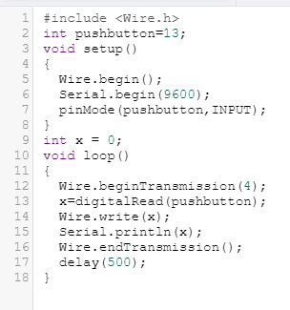
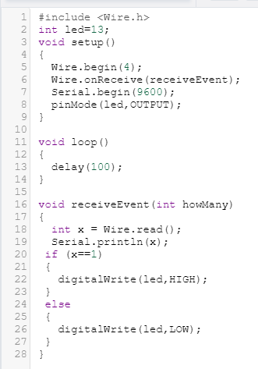
Program (Master)
Program (Slave)

Slide 6
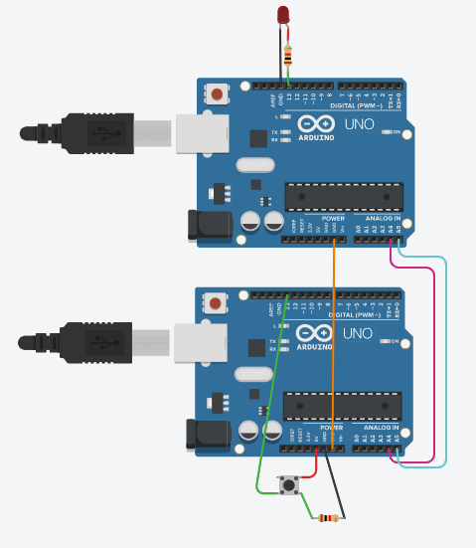
Design

Slide 7
TASK 1
Read temperature sensor value of master and display on slave LCD
Write a program to implement a I2C communication between two Arduino Uno. Configure one of the Arduino as master and other as slave. Master Arduino connected with temperature sensor and slave Arduino connected with LCD. Transfer temperature value read by Master to slave and display it on LCD using I2C communication protocol. Simulate and verify this logic on Arduino Uno using Tinkercad circuits simulator.

Slide 8
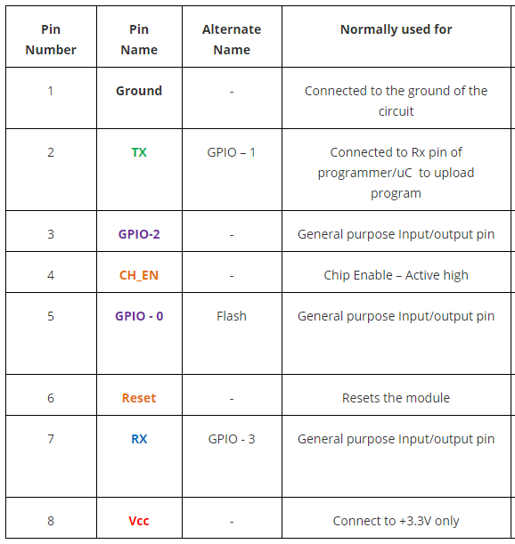
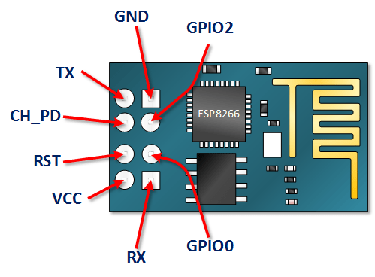
Wi-Fi Module (ESP 8266)

Slide 9
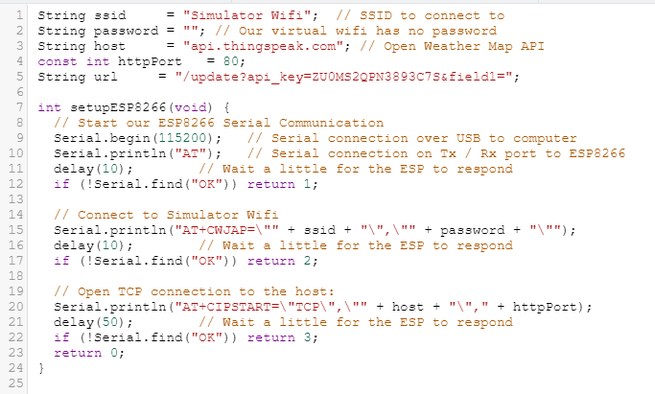
Program

Slide 10
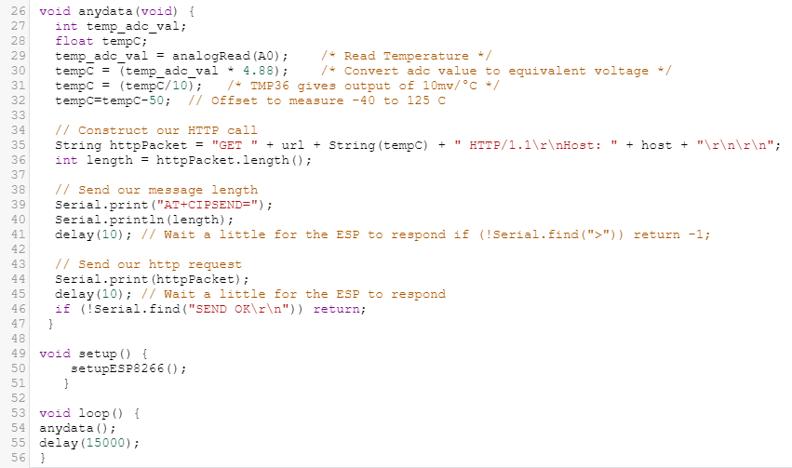

Slide 11
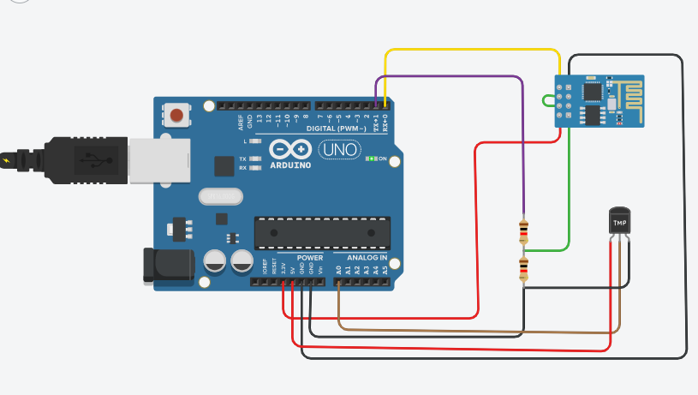
Design

Slide 12
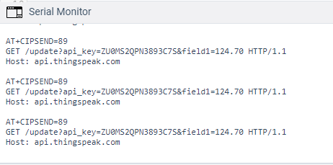
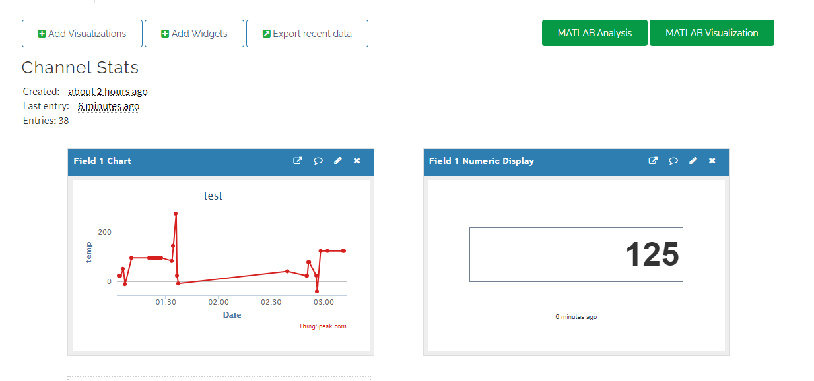
Output

Slide 13
TASK 2
IOT based Weather Monitoring Station
Write a program to design a weather monitoring station which display temperature, CO2 level and light intensity on LCD. Print “Weather station” on first line and print the timing as “08:MM:SS” after a delay of 3 Seconds display values of temp, CO2 and light in a rolling display moving from right to left direction. Then repeat the sequence again. Extend this application by interfacing ESP8266 Wi-Fi module and transferring temp, CO2 and light intensity data continuously to ThingSpeak cloud platform. Simulate and verify this logic on Arduino Uno using Tinkercad circuits simulator.

Slide 14
TASK 3
IOT BASED HOME AUTOMATION
Write a program for IOT based Home Automation using Arduino Uno, in which think speak cloud user interface control two appliances (Blub and Fan) via relay. When “0” send from cloud respective appliance must be set to OFF state, When “1” is send from cloud then respective device must be set to ON state. In addition, Arduino is also connected with PIR sensor continuously monitor for any human presence and update its status in think speak cloud. Also, display the state of each device on the LCD. Simulate and verify this logic on Arduino Uno using Tinkercad circuits simulator.

