Slide 1
ETHICAL HACKING (TASK 2)
Submitted By – Pratik Moharkar

Slide 2
Title: Out-of-date Version (OpenSSL)
Domain : webappsecurity.com
Subdomain: zero.webappsecurity.com

Slide 3
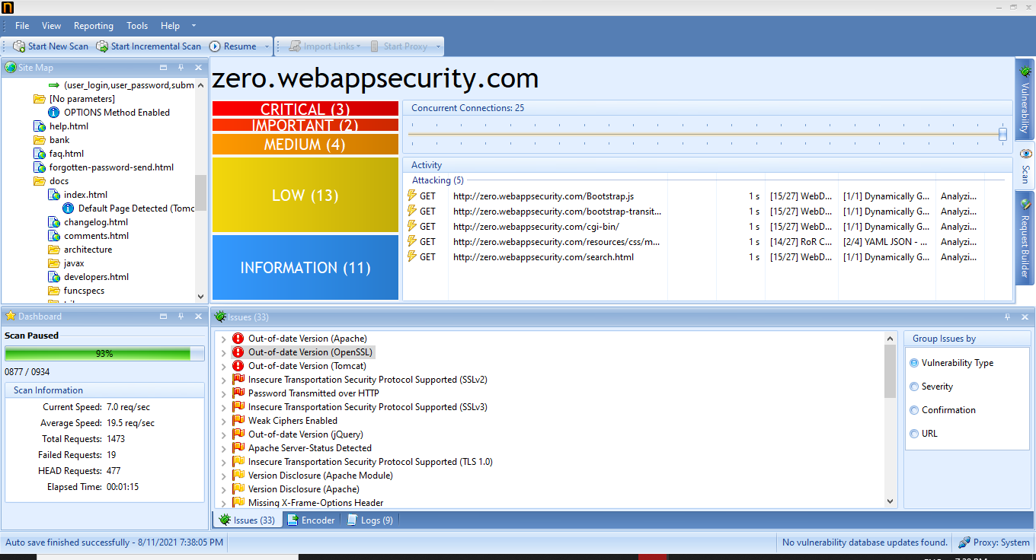
Screenshot of Vulnerabilities

Slide 4
Vulnerability Details
Netsparker identified that the website is using an out-of-date version of OpenSSL.
Identified Version: 0.9.8e (contains 5 critical and 107 other vulnerabilities)
Latest Version: 1.1.1k
Vulnerability Database: Result is based on 7/30/2021 vulnerability database content.

Slide 5
Impact
Since this is an old version of the software, it may be vulnerable to attacks.
It can leads to-
OpenSSL Numeric Errors Vulnerability
OpenSSL Improper Input Validation Vulnerability
OpenSSL Resource Management Errors Vulnerability
OpenSSL Cryptographic Issues Vulnerability
OpenSSL Exposure of Sensitive Information to an Unauthorized Actor Vulnerability
And more.

Slide 6
Remedy
Please upgrade your installation of OpenSSL to the latest stable version.
Beta 2 of OpenSSL 3.0 is now available.
OpenSSL is a robust, commercial-grade, and full-featured toolkit for the Transport Layer Security (TLS) and Secure Sockets Layer (SSL) protocols. It is also a general-purpose cryptography library.
OpenSSL is licensed under an Apache-style license, which basically means that you are free to get and use it for commercial and non-commercial purposes subject to some simple license conditions.

Slide 7
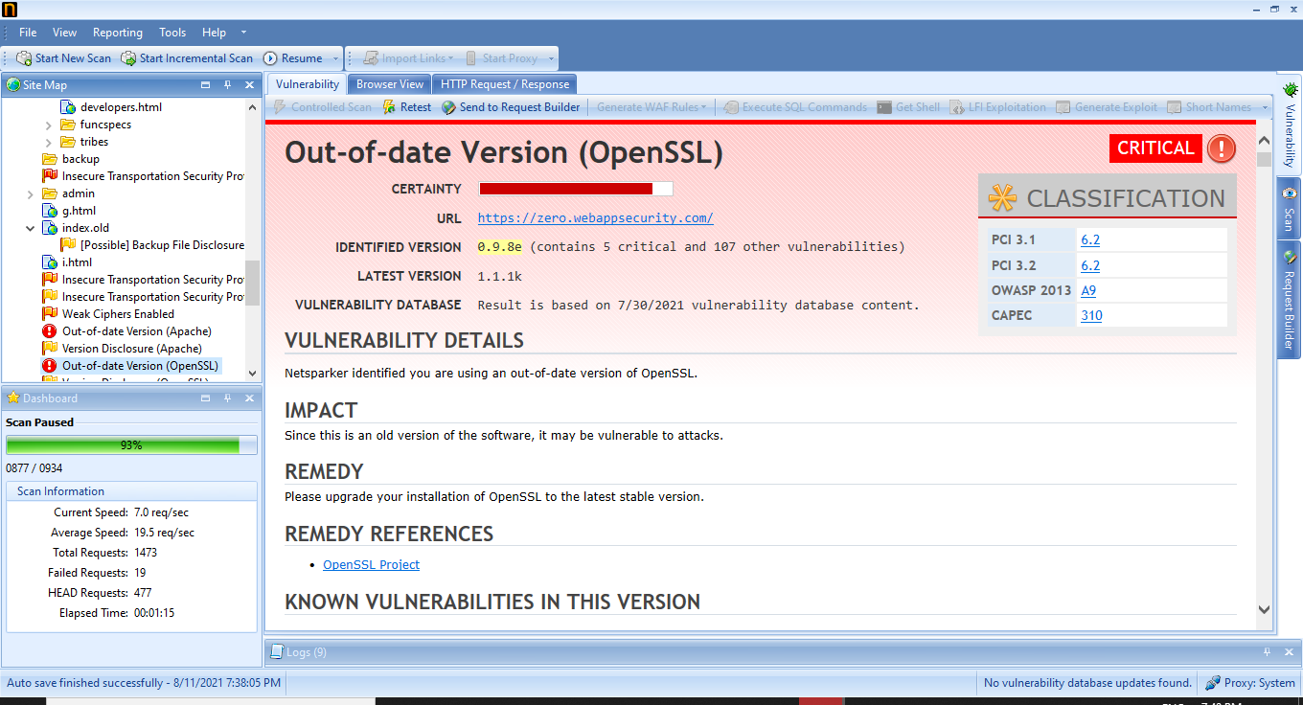
Screenshot of Netsparker’s Report

Slide 8
THANK YOU

