Slide 1
Applied Computer Vision:
From Research to Real-World Implementation
Portfolio 2
Submitted by,
Anagha Manikathuparambil Baby(5124727), Pratik Nichite(5123777),
Chandu Dadi(5124704), and Anusha Vishwanath Salimath(5124716)

Slide 2
Exercise 1: Anomaly Detection for Infrastructure Monitoring
Problem Statement
Goal: Detect cracks in concrete surfaces using image data.
Challenge: Only non-cracked (normal) images available for training.
Approach: Use generative modeling to learn what "normal" looks like, then flag anomalies.

Slide 3
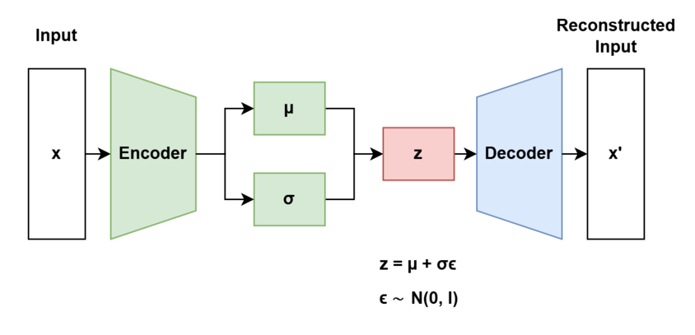
Model Choice
Options considered: Autoencoder, VAE, Diffusion Model
Final choice: Variational Autoencoder (VAE)
Justification:
Probabilistic latent space → robust & generalizable
Lighter than diffusion models
Good trade-off between complexity and performance

Slide 4
Training Process
Data Used: Only non-cracked images
Model Architecture: Encoder → Latent Space → Decoder
Loss Function: BCE + KL Divergence
Data Split:
Train: 70% (non-cracked)
Validation: 10% (non-cracked)
Test: 20% (non-cracked) + 20% (cracked)

Slide 5
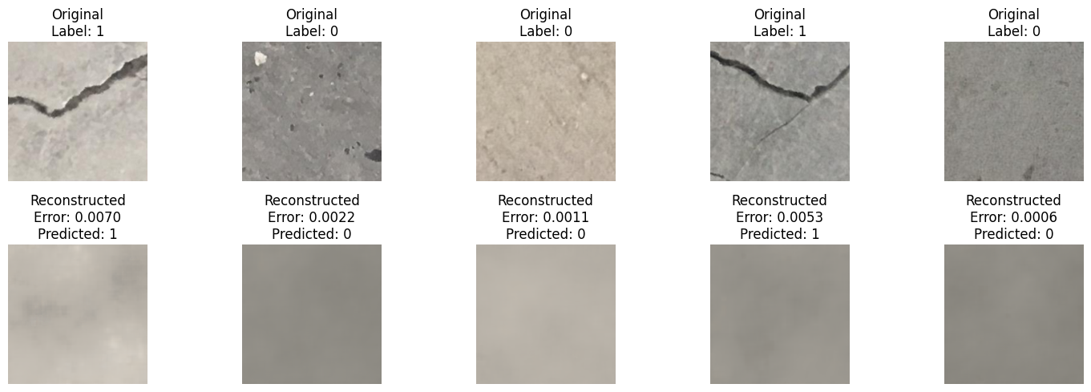
Overview of the Process
Reconstruction Error > Threshold
True
Anomaly
Input Image
Reconstructed Image
Variational Autoencoder (VAE)

Slide 6
Anomaly Detection Strategy
How anomalies are identified:
Compute mean of reconstruction error for non-cracked images
Use threshold (mean + 3σ) from validation errors
Flag images with high error as cracked
Reasoning: Model can't reconstruct cracks well → high error
Low error
High error

Slide 7
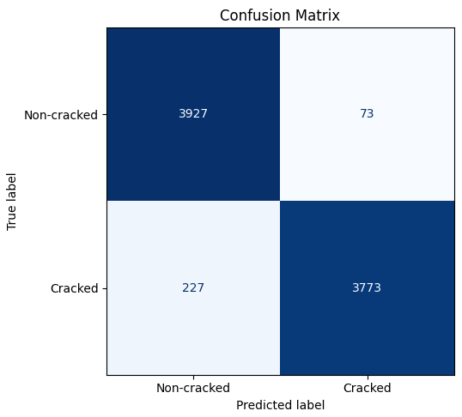
Evaluation Metrics
ROC AUC: ≈ 99%
Precision: ≈ 98%
Recall: ≈ 94%
F1-score: ≈ 96%
Why these metrics:
Good for imbalance,
Detailed anomaly assessment,
Interpretability
Universal standards

Slide 8
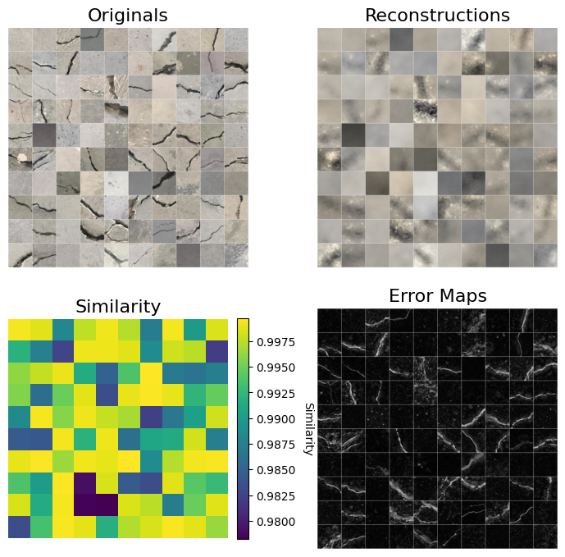
Visual Results

Slide 9
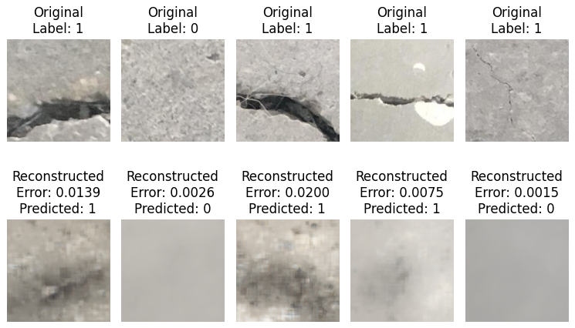
More Visualizations

Slide 10
Summary & Takeaways
VAE is a strong choice for one-class anomaly detection
Effective even without labeled cracks for training
Reached high accuracy with interpretable results
Ready for real-world deployment on visual inspection pipelines

Slide 11
Exercise 2: Traffic Sign Recognition for Embedded Systems
Model Development
Multi classification problem with 43 target labels.
Dataset split : 60 | 15 | 24
Unbalanced dataset --- > StratifiedShuffleSplit

Slide 12
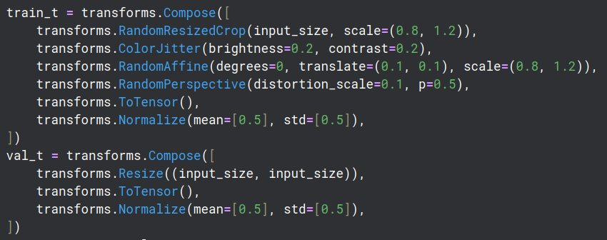
Model Development
Test images -- > analyzed the test images to identify the augmentations required for training.
Model selection particular for edge devices - EfficientNetB0 - 82 layers, 5.3M parameters
Added a drop out layer of 0.4 at the end – to avoid overfitting.

Slide 13
Model Development
Got Test accuracy : 99.12%!!!
Edge-simulated FPS: 19
Precision : 99%
Recall : 99%
F1 Score: 99%

Slide 14
Model Optimization
Applied Structured One-Shot Pruning & Fine-Tuning – One-shot structured pruning at 10%, 20%, 40% and 80% sparsity – Followed by model fine-tuning to recover performance
Used L1-BN regularization to identify unimportant channels and encourage structured sparsity.
Metrics used to analyze pruned model performance : Accuracy, Precision, Recall, and F1 score.

Slide 15
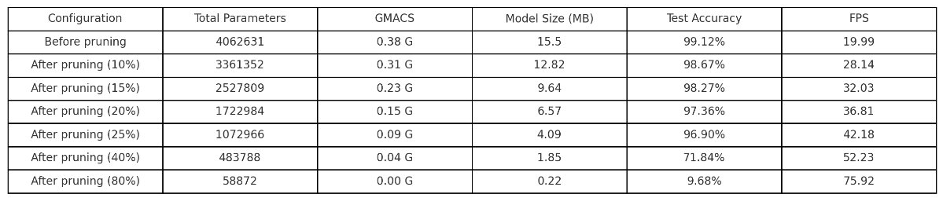
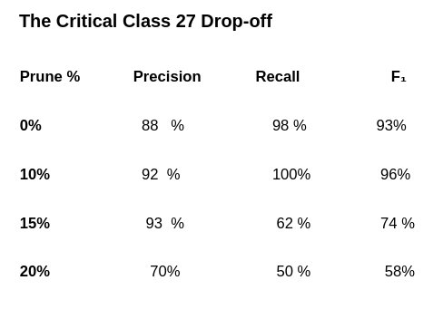
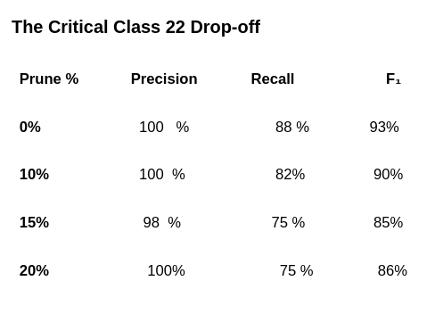
Pruned model Trade-offs

Slide 16
Pruned model Trade-offs
Baseline (0 % pruning)
15.5 MB, 0.38 GMACs → 20 FPS
99.12 % overall accuracy
Critical classes (22, 27): ≈ 100 % precision, ≥ 88 % recall
10 % Pruning (“Sweet Spot”)
12.8 MB (–17 %), 0.31 GMACs (–18 %) → 28 FPS (+40 %)
98.67 % overall accuracy (–0.45 pp)
Class 22 F₁ ≈ 90 %, recall 82 %
Class 27 F₁ ≈ 90 %, recall 82 %

Slide 17
Pruned model Trade-offs
15 % Pruning (Moderate)
9.6 MB (–38 %), 0.23 GMACs (–39 %) → 32 FPS (+60 %)
98.27 % overall accuracy (–0.85 pp)
Class 22 F₁ ≈ 85 %, recall 75 %
Class 27 F₁ ≈ 74 %, recall 62 %
20 % Pruning (Aggressive)
6.6 MB (–57 %), 0.15 GMACs (–61 %) → 37 FPS (+84 %)
97.36 % overall accuracy (–1.76 pp)
Class 22 F₁ ≈ 86 %, recall 75 %
Class 27 F₁ ≈ 54 %, recall 50 %

Slide 18
Pruned model Trade-offs
Selected 10% Pruning Model!!!
Strong per-class reliability: both critical classes maintain ≥ 82 % recall and ≥ 90 % F₁.
Substantial system gains: +40 % FPS and –3 MB size versus the unpruned model.

Slide 19
Bonus: Hardware Feasibility Study
NVIDIA Jetson Nano
Memory: 4 GB LPDDR4 easily accommodates the 12.8 MB model plus activations and OS.
Compute: 128-core Maxwell GPU @ 472 GFLOPS (FP16)– roughly 0.62 GFLOPs per inference → very light load.
Runtime: Even conservatively, TensorRT-optimized int8/FP16 inference would run at tens to hundreds of frames per second.
Deployable? Yes (≫10 FPS).

Slide 20
Bonus: Hardware Feasibility Study
Google Coral Dev Board
Memory & Storage: 1 GB LPDDR4 + 8 GB eMMC, model quantized to int8 shrinks to ≈3.2 MB on disk and in RAM.
Compute: Edge TPU ASIC @ 4 TOPS (2 TOPS/W) – easily handles 0.31 GMACs/model.
Runtime: Benchmarks show MobileNet-style models at ∼400 FPS on the TPU ,even with overhead yields ≫10 FPS.
Deployable? Yes (≫10 FPS).

Slide 21
Bonus: Hardware Feasibility Study
Google Coral Dev Board
Memory & Storage: 512 KB SRAM and 8 MB flash, model size 12.8 MB (FP32) → even int8 quantization (~3.2 MB) exceeds flash; runtime activation buffers alone would bust the 512 KB SRAM.
Compute: Cortex-M7 @ 480 MHz + M4 co-processor → orders of magnitude too weak for 0.31 GMACs.
Deployable? No. Model and activations don’t fit, and compute capability is insufficient.

