Slide 1
BPE-Dropout: Simple and Effective Subword Regularization Ivan Provilkov, Dmitrii Emelianenko, Elena Voita
Group Members:
1.Pranav Kumar Sah
2.Pratik Nichite
3.Abdul Basit Raja
Project Supervisor:
Prof. Ivan Yamshchikov

Slide 2
Subword Segmentation
Deterministic
Stochastic?
un relat ed u n relate d un rel ated
un related
KUDO(2018)
BPE DROPOUT
Refuse from BPE
Rather complicated method
BPE
Simple and Effective
BPE

Slide 3
BPE
Deterministic
Stochastic?
u-n-r-e-l-a-t-e-d
u-n re-l-a-t-e-d
u-n re-l-at-e-d
u-n re-l-at-ed
un re-l-at-ed
un re-l-ated
un rel-ated
un-related
unrelated
un relat ed u n relate d un rel ated
KUDO(2018)
BPE DROPOUT
unrelated
Refuse from BPE
Rather complicated method
BPE
Simple and Effective
BPE

Slide 4
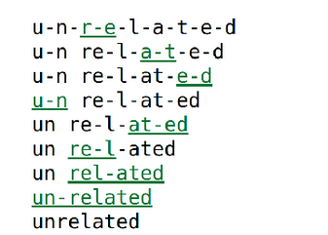
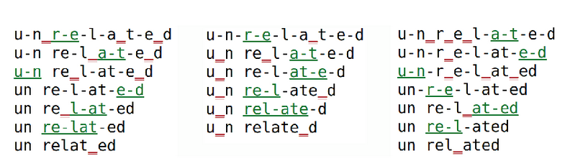
Example
BPE
BPE Dropout

Slide 5
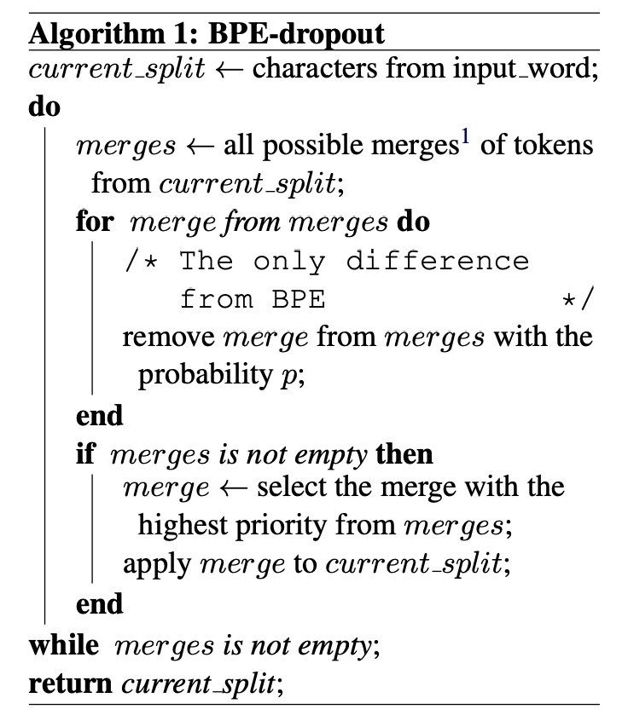
BPE-Dropout
BPE
Dropout
Merge table and vocs for BPE and BPE-dropout are the same
Train: BPE-dropout, inference: BPE
P=0.1 for most languages

Slide 6
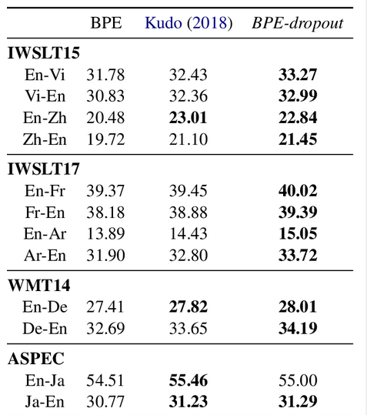
Main results

Slide 7
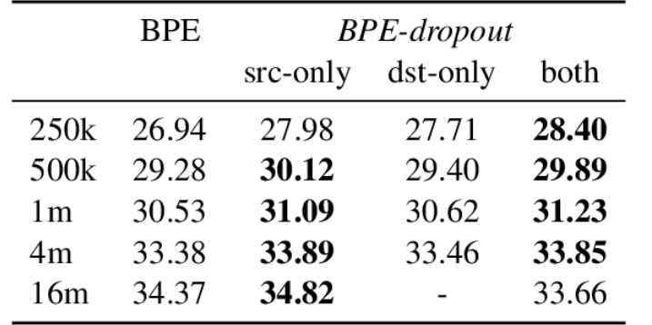
Where to apply: source, target, both
Small datasets both
Medium datasets src/both
Large datasets src

Slide 8
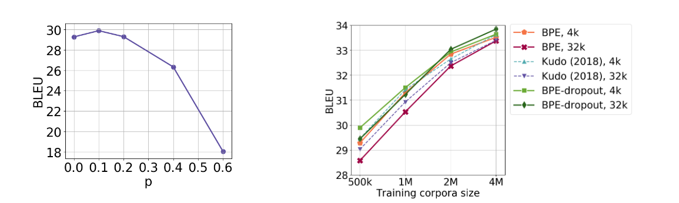
Figures
Fig 1: BLEU scores for the models trained with
BPE-dropout with different values of p. WMT14 En-Fr, 500k sentence pairs
Fig 2: BLEU scores. Models trained on random
subsets of WMT14 En-Fr.

Slide 9
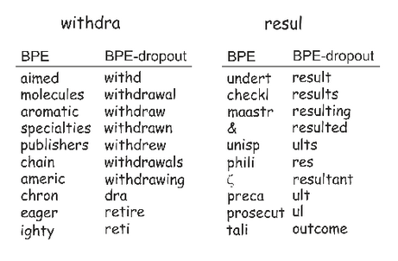
Properties of BPE-Dropout
Uses rare subwords more often.
Understands rare tokens better.
Is more robust to misspellings.
Nearest neighbors in the embeddings space.

Slide 10
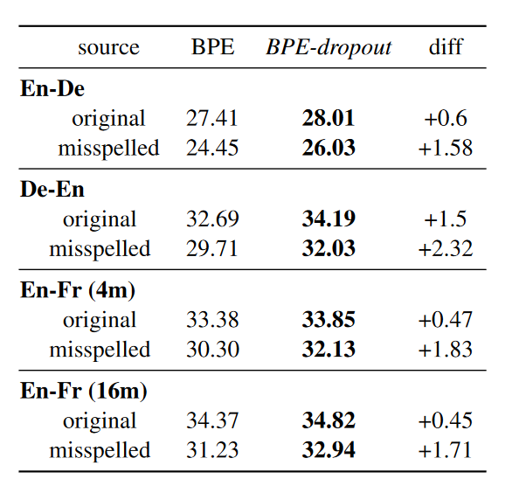
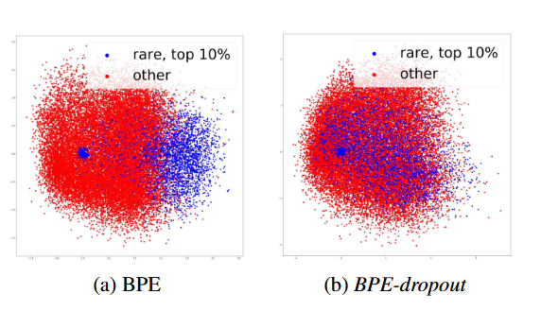
BPE Dropout
Fig:3 Visualization of source embeddings. Models trained on WMT14 En-Fr (4m).

Slide 11
Thank You

