Slide 1
Transformers: State-of- the-Art NLP
An Overview of Transformer Architectures and Pretraining
Thomas Wolf, Lysandre Debut, Victor Sanh, Julien Chaumond, et al.(2020)
Group Members:
1. Abdul Basit Raja
2. Pratik Nichite
3. Pranav Kumar Sah
Project Supervisor:
Prof. Ivan Yamshchikov

Slide 2
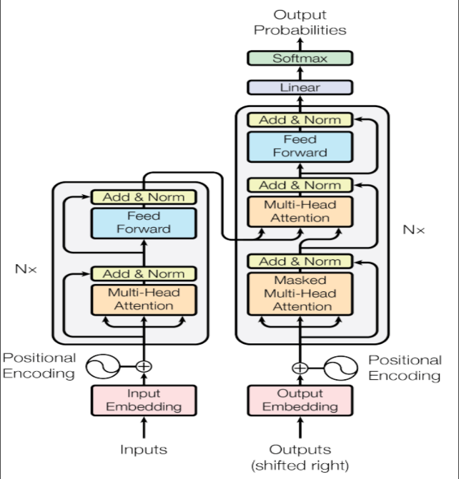
INTRODUCTION

Slide 3
INTRODUCTION
Recent NLP Progress:
Driven by advances in model architecture and pretraining.
Transformer architecture surpasses CNNs and RNNs in NLP tasks.
Transformer Advantages:
Scales with training data and model size.
Facilitates efficient parallel training.
Captures long-range sequence features.

Slide 4
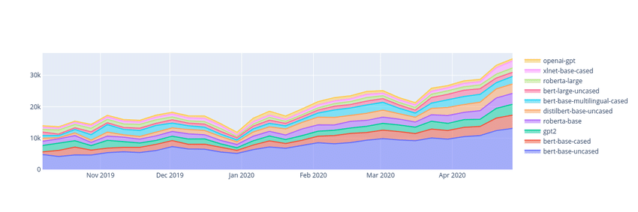
STRONG COMMUNITY (HUGGING FACE🤗)
Figure: shows average daily unique downloads of the most downloaded pretrained model using hugging face, Oct 2019 to May 2020

Slide 5
RELATED WORK
Long history of easy-to-use, user-facing libraries for general-purpose NLP, including NLTK and Stanford CoreNLP.
Currently, open-source libraries such as Spacy, AllenNLP, flair, and Stanza.
Transformers provides similar functionalities as these libraries.

Slide 6
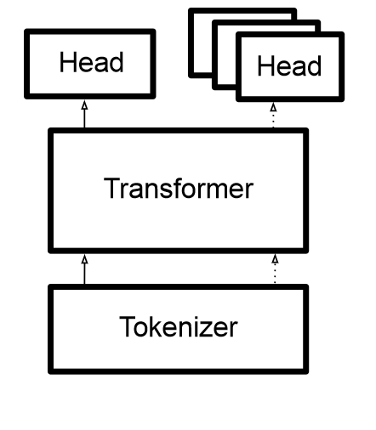
DESIGN STRUCTURE
Figure: The Model is made up of a Tokenizer, Transformer, and Head.

Slide 7
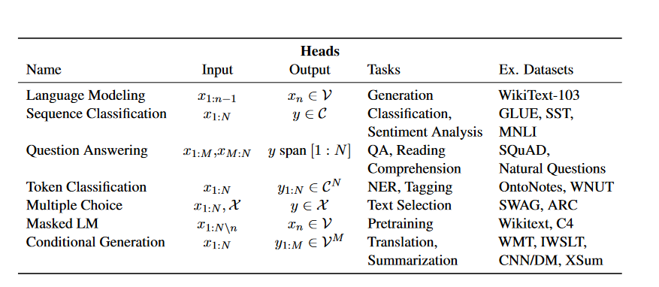
LIBRARY DESIGN
Head: which uses contextual embeddings to make a task-specific prediction.

Slide 8
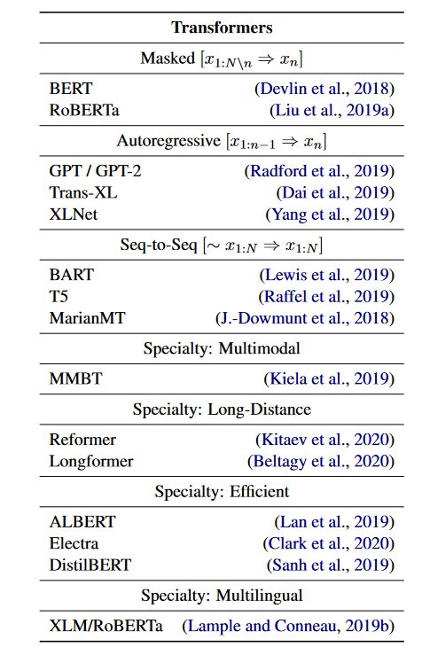
LIBRARY DESIGN
Transformers: a transformer, which transforms sparse indices to contextual embeddings.

Slide 9
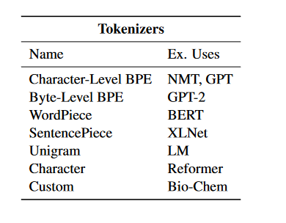
LIBRARY DESIGN
Tokenizer: a tokenizer, which converts raw text to sparse index encoding.

Slide 10
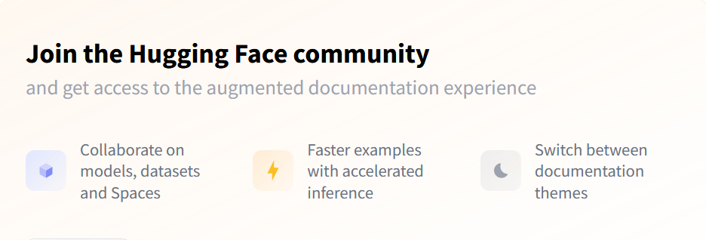
COMMUNITY MODEL HUB
Aim to facilitate easy use and distribution of pretrained models.
Hub now contains 2,097 user models, both pretrained and fine-tuned from across the community.

Slide 11
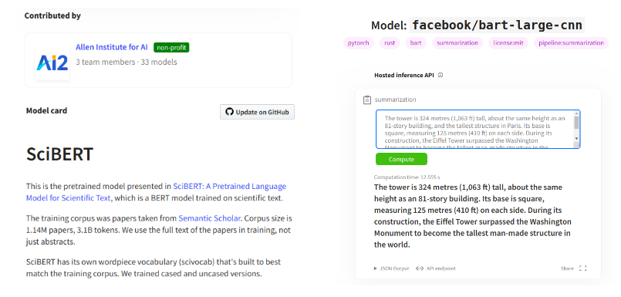
TRANSFORMER MODEL HUB
Figure: (Left) Example of a model page and model card for SciBERT. (Right) Example of an automatic inference widget for the pretrained BART model for summarization.

Slide 12
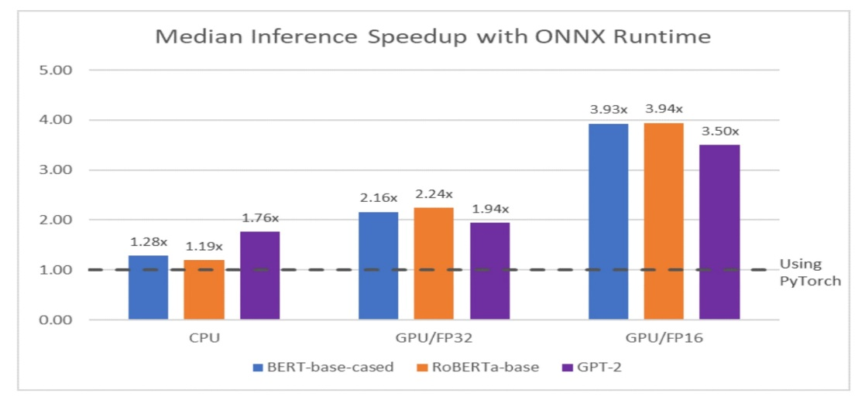
DEPLOYMENT
ONNX was able to achieve nearly a 4x speedup on this model.
Figure: Experiments with Transformers inference in collaboration with ONNX

Slide 13
CONCLUSION
Advantages:
Transformer is open source library and community.
Attracts a diverse user base, including researchers and industry professionals.
User can leverages large-scale pretrained models for tasks with state-of-the-art performance.
Challenges:
Widespread use of Transformer introduces practical challenges in training, analysis, scaling, and model augmentation.

Slide 14
Thank You

