Slide 1
Hospitality And Tourism
Checkpoint 1
COL865 Project:
Garvit Dhawan (2020CS50425)
Pratik Nimbalkar (2020CS10607)
Nikhil Unavekar (2020CS10363)

Slide 2
Existing working in the Field
Various datasets are present on Kaggle in CSV format having numerous features (column headers)
Algorithms have been developed to assess the quality and credibility of hotel reviews. This can be useful for users to filter out fake or biased reviews.
Topic modeling techniques have been applied to hotel reviews to identify common themes and topics in customer feedback.
User profiles and their review history have been analysed to personalize hotel recommendations and marketing strategies.

Slide 3
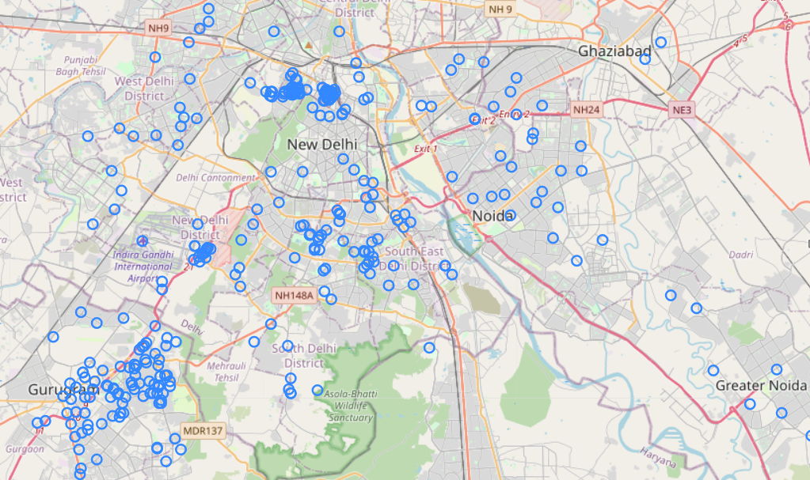
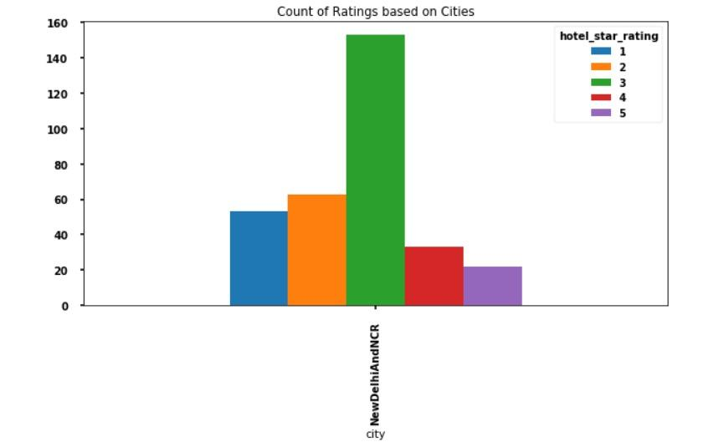
Current Progress
Collected datasets of hotels in Delhi and NCR from MakeMyTrip, Goibibo and tripadvisor
Performed preliminary analysis of the data using matplotlib
Distribution of MakeMyTrip hotels in Delhi NCR
MakeMyTrip Delhi Hotel Ratings analysis

Slide 4
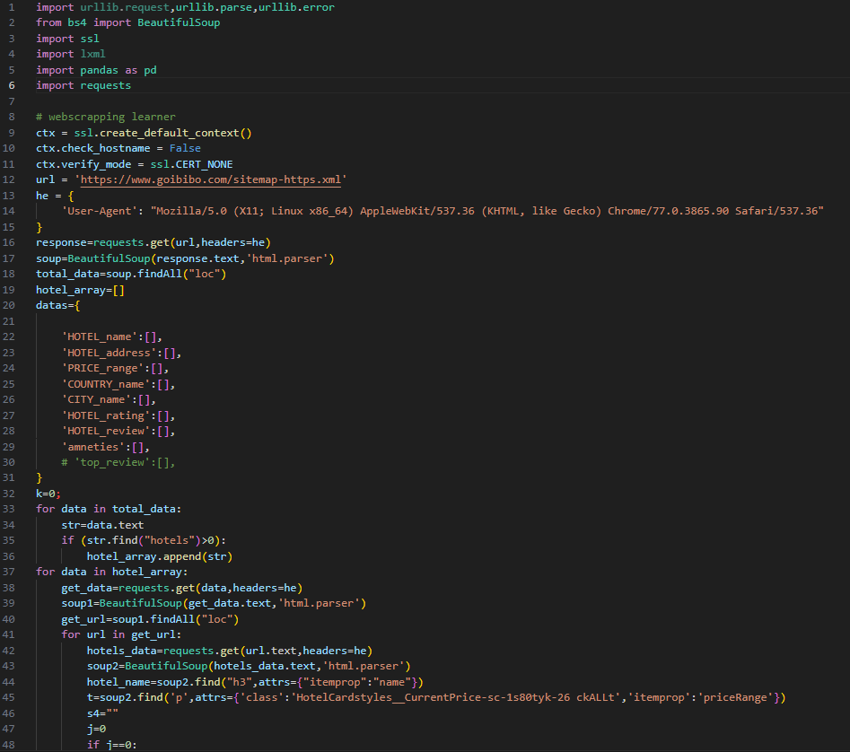
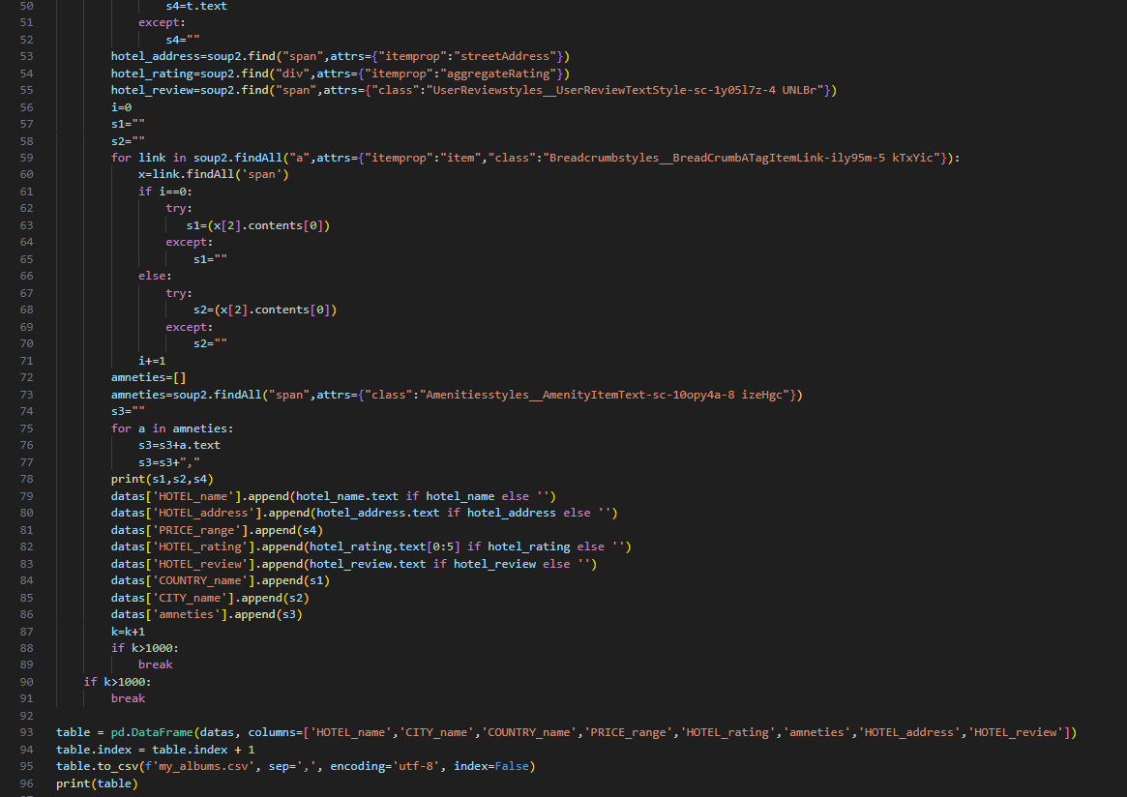
Current Progress
Started working on web scraping using BeautifulSoup library to obtain customer reviews, Hotel price, amenities (if available), Hotel ratings, etc.
Current Scrapper uses requests from .xml file and BeautifulSoup to generate excel

Slide 5
Targets for the Project
Perform web scraping on various websites and extract data on ratings, customer reviews, location, amenities, etc
Use Sentiment Analysis through NLP on text reviews and compare them with ratings to verify genuineness of data
Perform statistical analysis on the data to highlight the hotspots and the quality of Hospitality industry in different cities of India at different times (pre and post COVID)
Build a Graphical User Interface (GUI) for easy, user-friendly data visualization for further needs

Slide 6
THANK YOU!

