Slide 1
Hospitality And Tourism
Checkpoint 3
COL865 Project
Pratik Nimbalkar (2020CS10607)
Garvit Dhawan (2020CS50425)
Nikhil Unavekar (2020CS10363)

Slide 2
Targets Accomplished
Analyzed Tourism data (like monumental visits) from Government websites for different states and performed correlation analysis with that of hotel data.
Derived insights from monumental tourists visits data.
Improved GUI for Restaurant and Hotel Data for better user accessibility, adding more functionalities like BARD API.
Scrapped restaurants data and analyzed the same using Statistical and NLP techniques similar to Hotel data.

Slide 3
Corelation Analysis of Tourism Data and Hotel Data

Slide 4
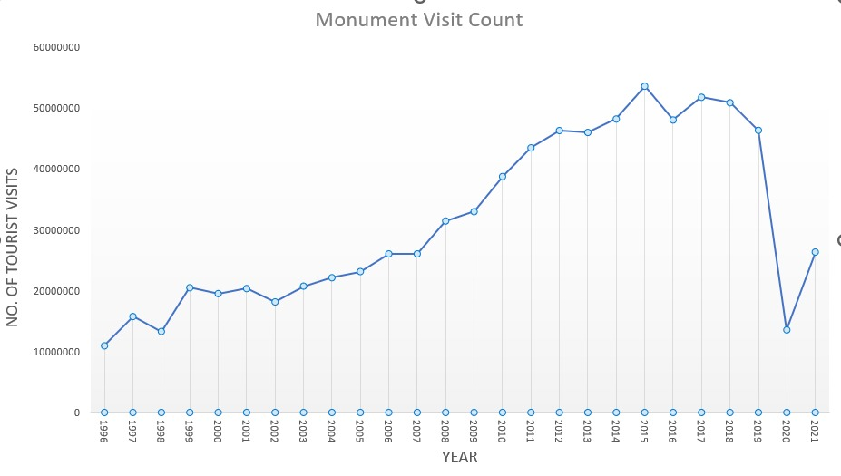
Monumental Visits Data Analysis
Monumental visits count increased consistently till Covid years.
Just like the hotel industry, Covid has also affected the monumental visits number in India and the number of domestic and international tourists were lowered after 2019.

Slide 5
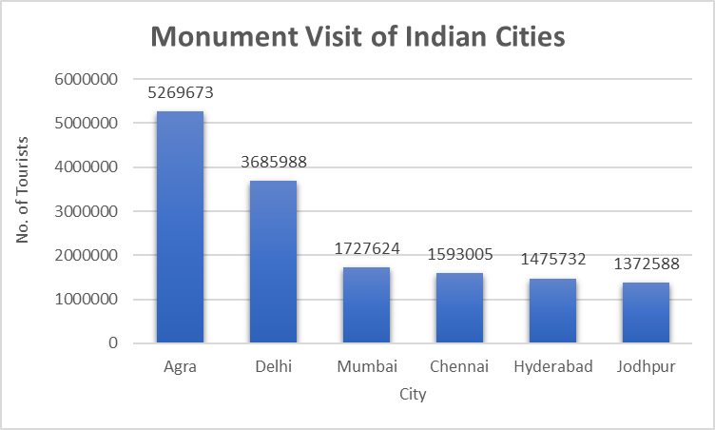
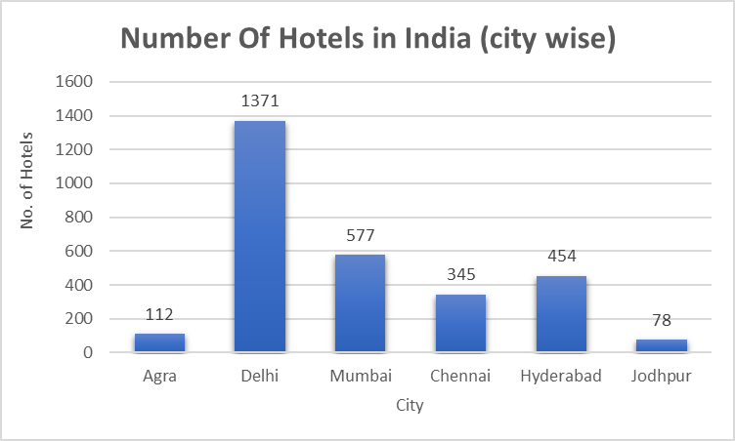
Corelation of City wise Monumental Visits & Hotel Data
We have only included Cities which have highest monumental visits in India as per MoT.
Hotel Data mentioned is taken from MakeMyTrip.
Agra is having the highest tourist attraction but the no. of hotels are very less.
Similarly Jodhpur also has a potential market for Hotel Industry.

Slide 6
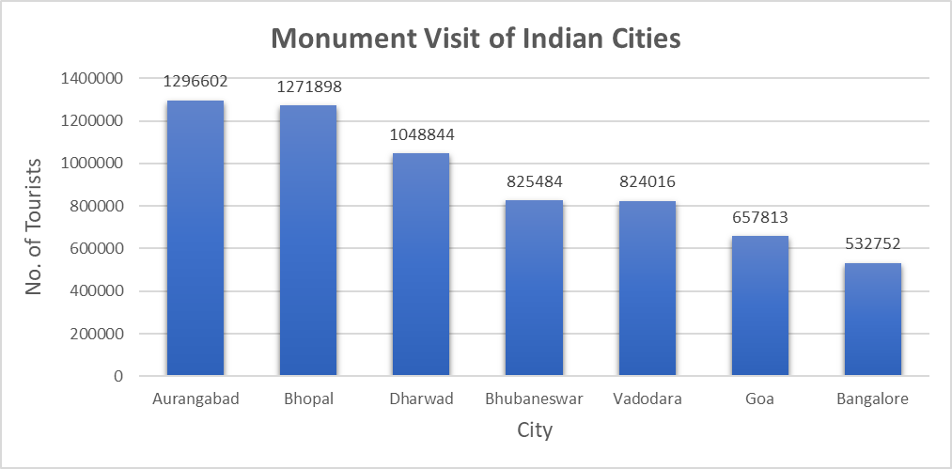
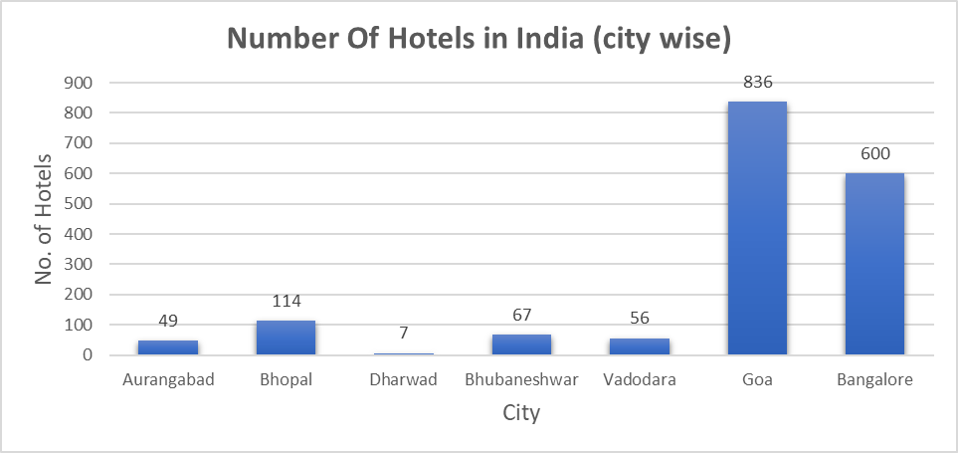
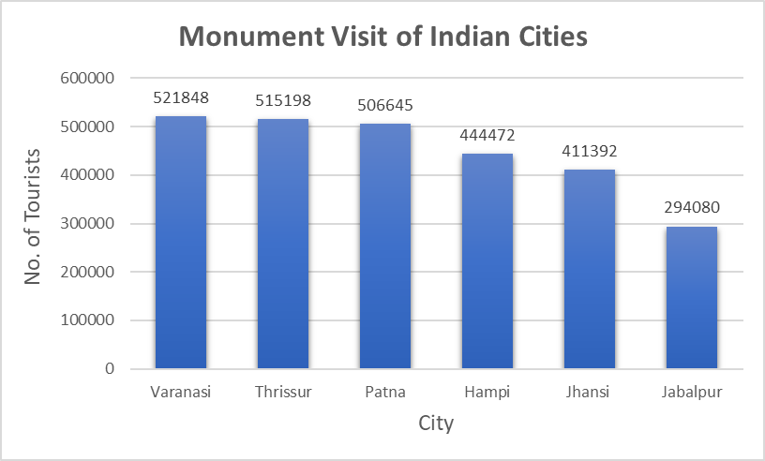
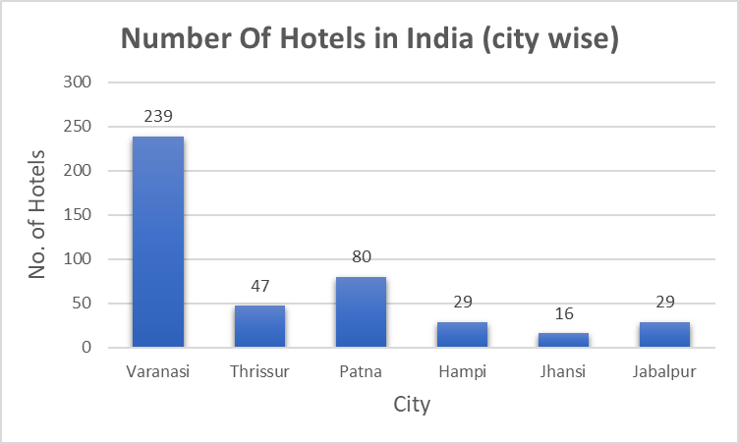
Bangalore and Goa have low monumental visits but have a huge number of hotels.
Dharwad, Aurangabad, Bhubaneshwar, Vadodara a good number of tourists due to monumental visit but hotel count is low.
All cities except Varanasi require more hotels especially Thrissur and Jhansi.
Places like Hampi, Jhansi and Thrissur have a rich monumental and historic heritage, thus providing an opportunity to expand the hotel industry.

Slide 7
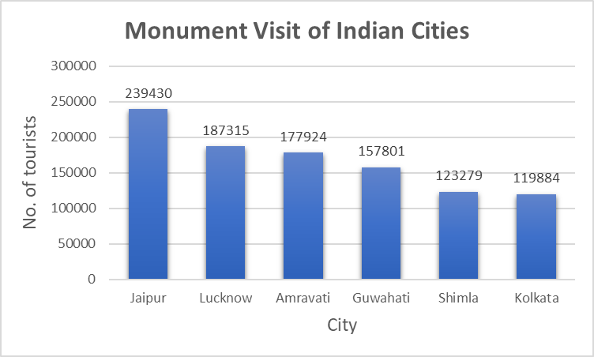
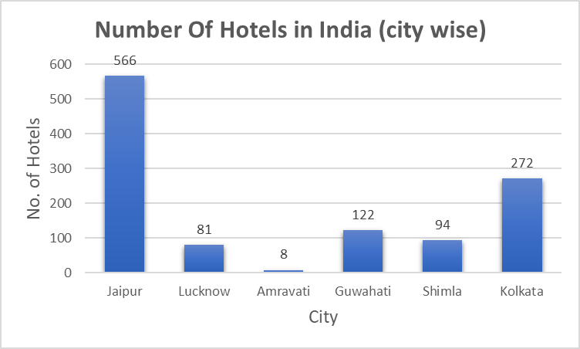
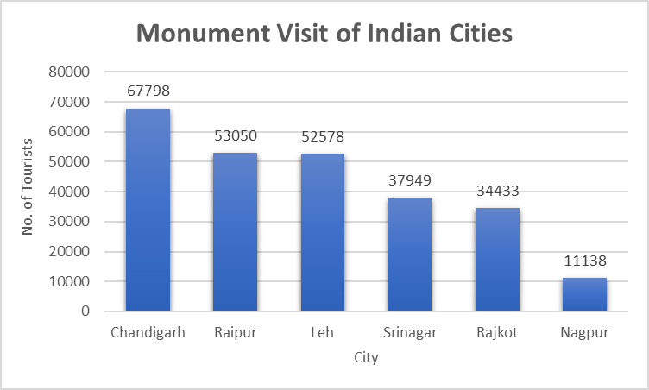
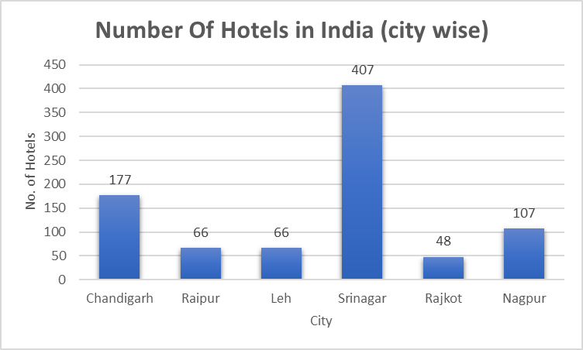
Amravati’s hotel count is very less as compared to its tourists visit number.
Lucknow also have a potential of having more number of hotels.
Surprisingly there are more hotels in Srinagar than Chandigarh.
Need for more hotels in Raipur, Leh and Rajkot.

Slide 8
Heatmap

Slide 9
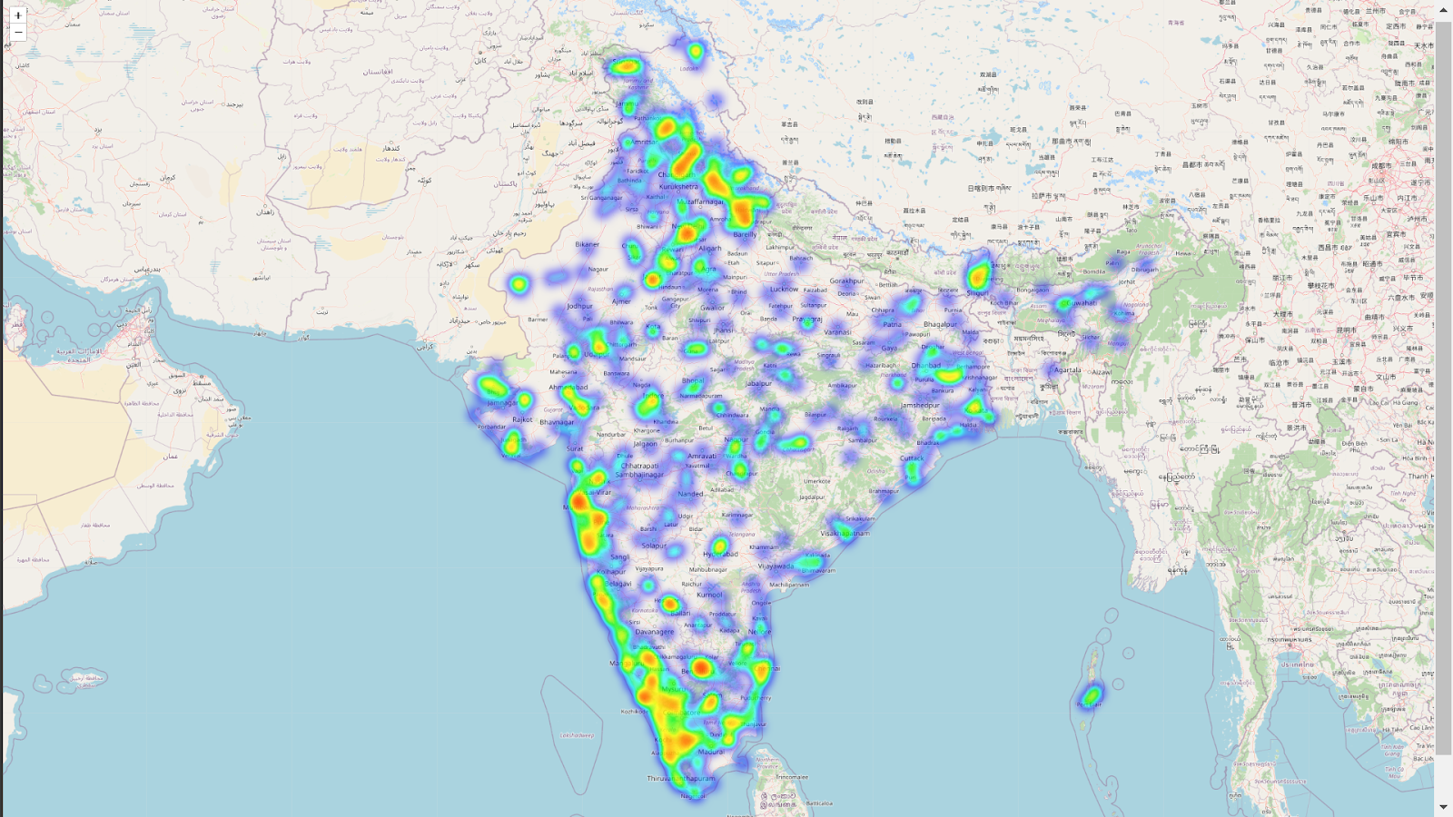
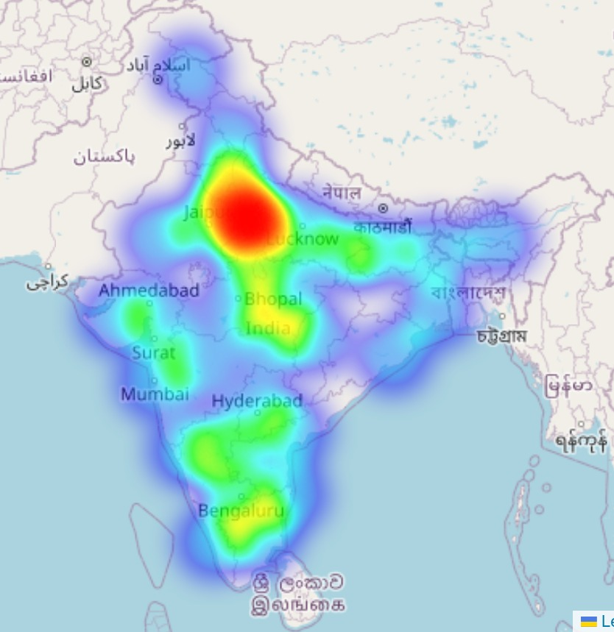
Hotel and Monnumental Visits Distribution in India using Heatmap
Monumental Visits Heatmap is highly concentrated in Delhi and Agra regions due to monuments like Taj Mahal, Agra Fort, Qutub Minar, Red Fort.
As tourist industry fuels the hotel industry, vice-versa is also true.
Hotel industry is also dense in South and West Indian regions of Kerala and MH.
Need for Hospitality Industry to invest in Monumental rich cities like Agra.
Heatmap for MakeMyTrip Hotels Data
Heatmap for Monumental Visits of Tourists Data

Slide 10
Restaurant Data Analysis

Slide 11
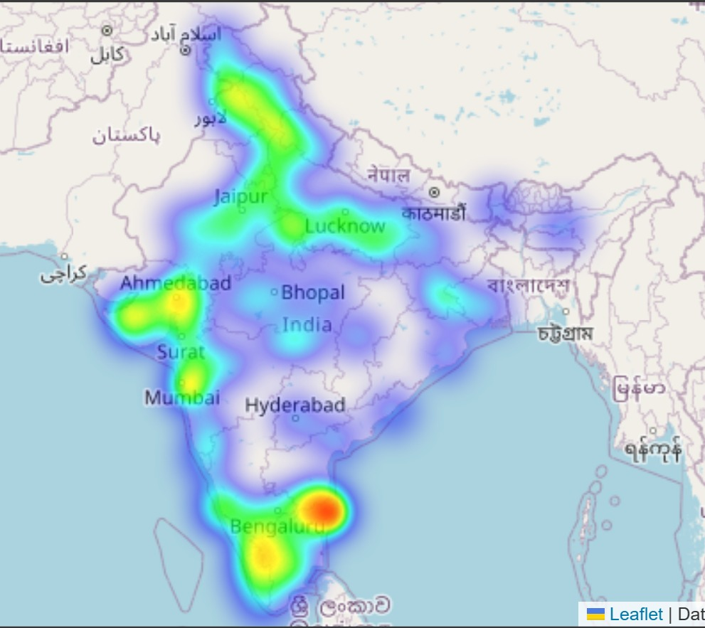
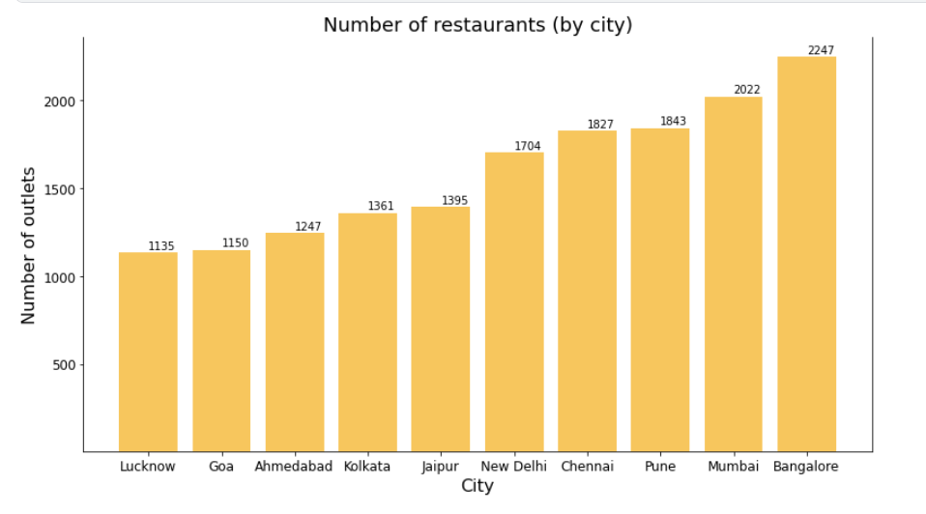
City wise Distribution
Heatmap of Restaurants
As expected, metro cities have more number of restaurants than others with South India dominating the Top 4.
Heatmap is densely populated in Southern part including Chennai and Bangalore.
Also, Gujarat, MH and Punjab, Delhi are concentrated.

Slide 12
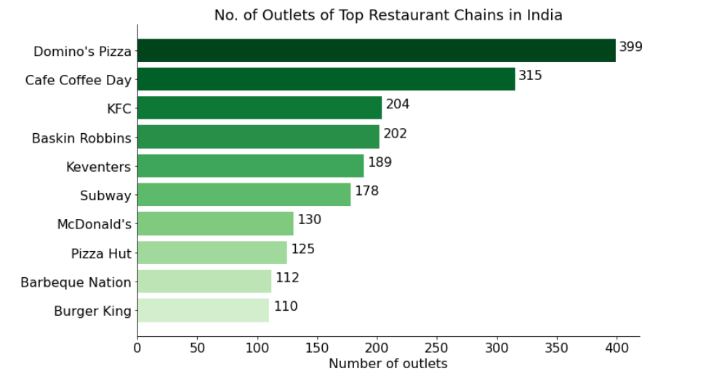
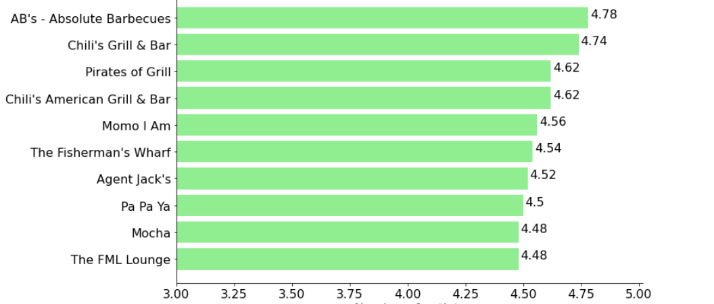
Top Restaurant Chains
Highest rated restaurant chains
Majorly dominated by big fast food chains like Dominos, CCD, KFC.
Percentage of Restaurants that are part of a chain = 35.0 %
Interestingly, no fast food chain is present in this graph. Mostly Bars are present.
To maintain a high rating, restaurants needs to provide excellent service which becomes impossible with booming fast food restaurant in every street.

Slide 13
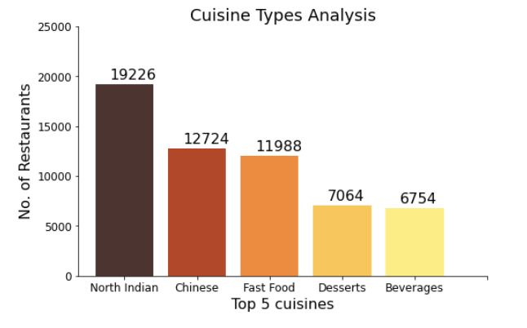
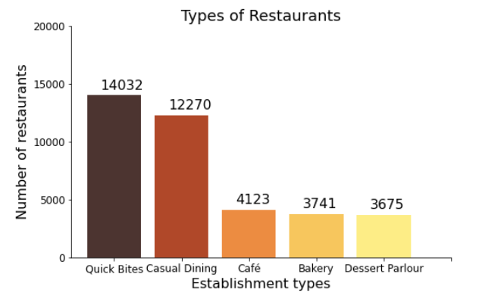
Miscallanoeus Analysis
Surprisingly, Chinese food comes second in the list of cuisines that Indians prefer, even more than fast food, desserts and South Indian food.
Top 3 represents more casual and quick service restaurants, then 4 and 5 are dessert based shops.

Slide 14
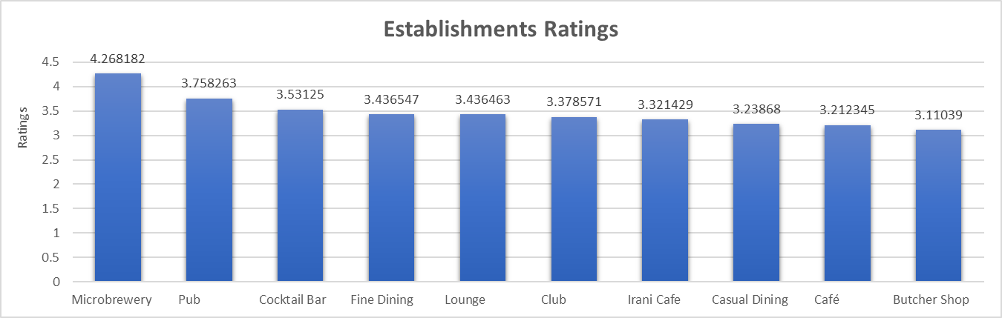
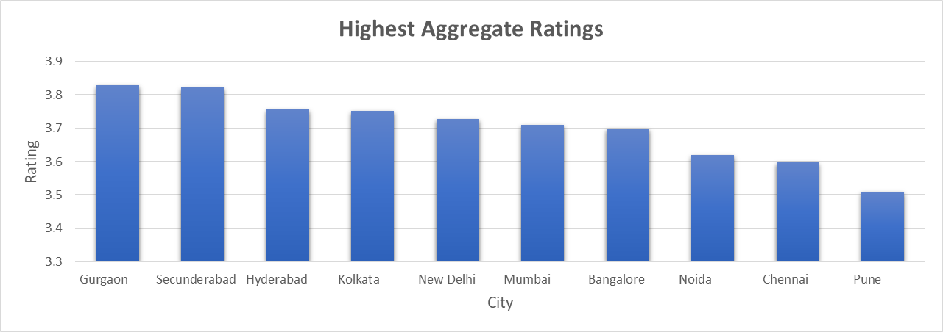
Ratings (Establishment and City wise)
It can be concluded that establishments with alcohol availability have highest average ratings.
Gurgaon has highest rated restaurants whereas Hyderabad has more number of critics.

Slide 15
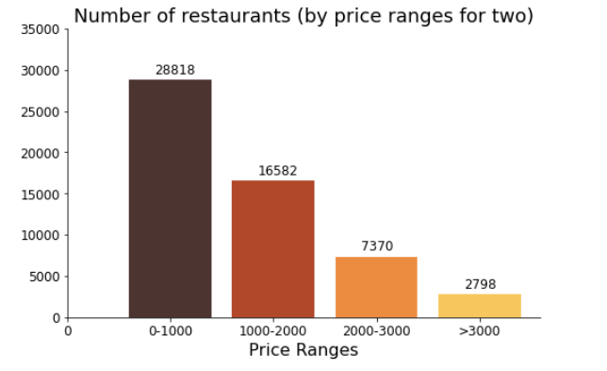
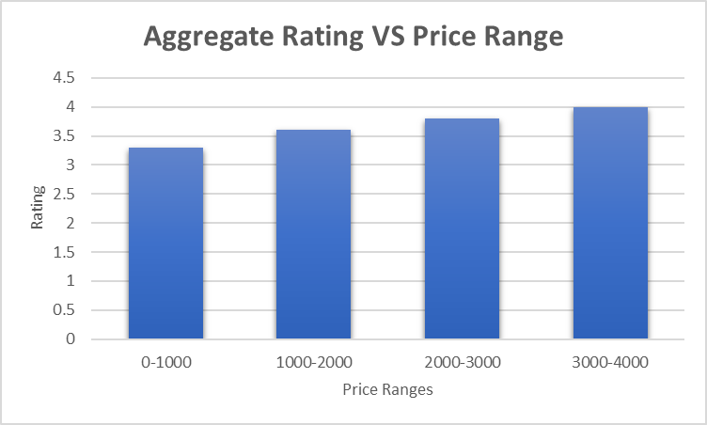
Price Range count
Relationship Between Price and Ratings
Majority of restaurants are budget friendly with an average cost between Rs.350 to Rs. 900 for two.
Number of restaurant decreases with increase in price range.
Relation between Average price for two and Rating = 0.25.
The higher the price a restaurant charges, more services they provide and hence more chances of getting good ratings from their customers.

Slide 16
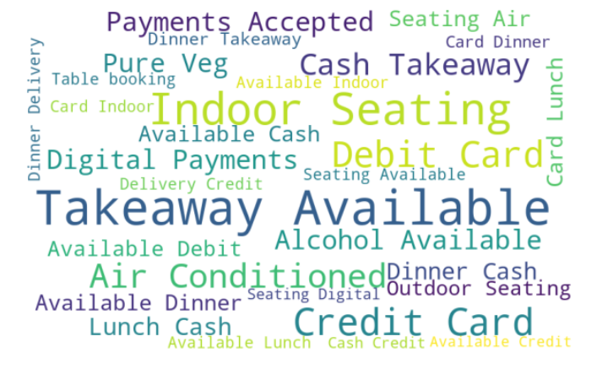
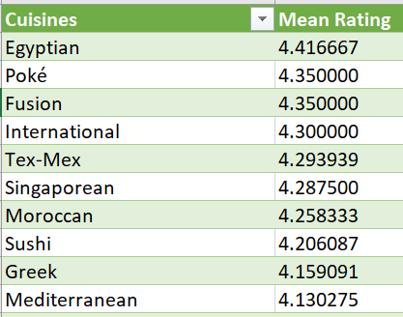
WordCloud of Highlights
Highest Rated Cuisines
International (and rarely available) cuisines are highest rated in India.
Highlights - They represent certain features that the restaurant specializes in and wants to highlight to their customers.

Slide 17
Distribution of Restaurants across Indian Cities

Slide 18
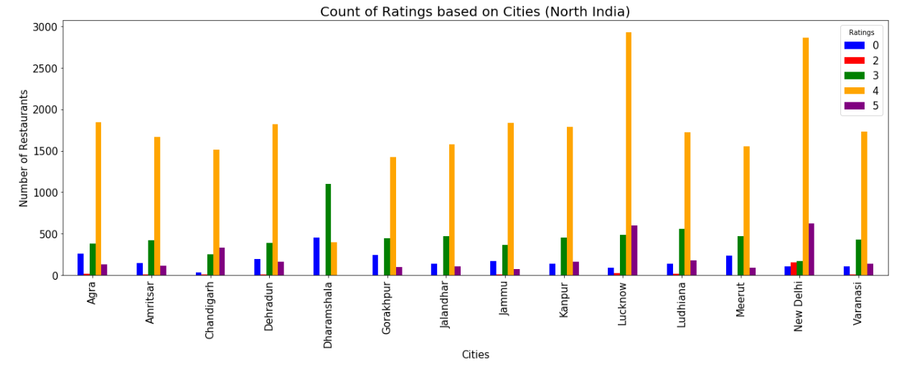
City wise Distribution (North India)
Overall 4 star restaurants count is highest (Dharmashala being an exception) and 2 star count is very less.
Dharmashala features a significant number of non-rated restaurants.
In UP, Lucknow (overall highest) is highest followed by Agra, Kanpur, Varanasi
In Punjab Ludhiana, Amritsar are leading, and not Chandigarh.
Ratings are rounded off to the nearest integer, 0 star restaurants are the ones which have not received any rating till now.
Only cities which have the highest restaurant number count from each region (which have >2000 restaurants in a city) are included

Slide 19
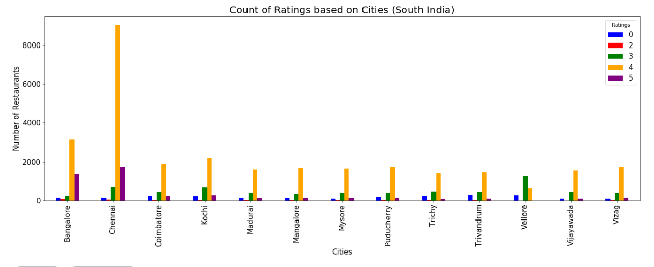
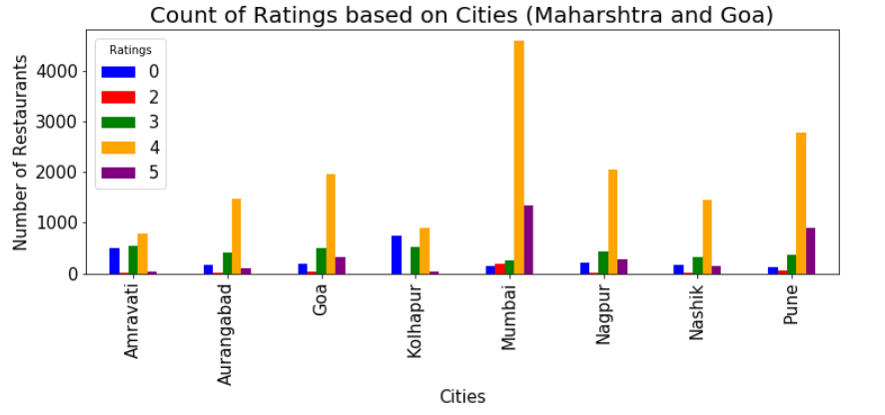
South India
Chennai has highest restaurant count in India, surpassing Delhi by three times.
Bangalore, Kochi, Coimbatore’s count is also high. Surprisingly, Hyderabad is not in the list.
South India sees very few non-rated (0-star) restaurants.
Chennai and Bangalore mark a good number of 5 star restaurants (not the case for other cities).
Maharashtra and Goa
Maharashtra has the highest number of cities which have >2000 no. of restaurants.
Mumbai, Pune have good no. of 5 star restaurants.
Kolhapur has substantial amount of non rated restaurants.

Slide 20
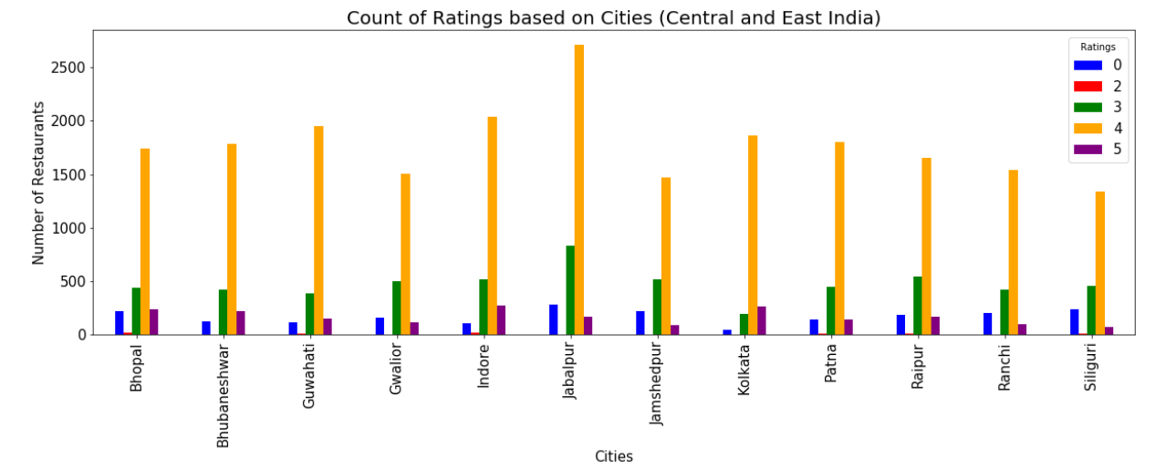
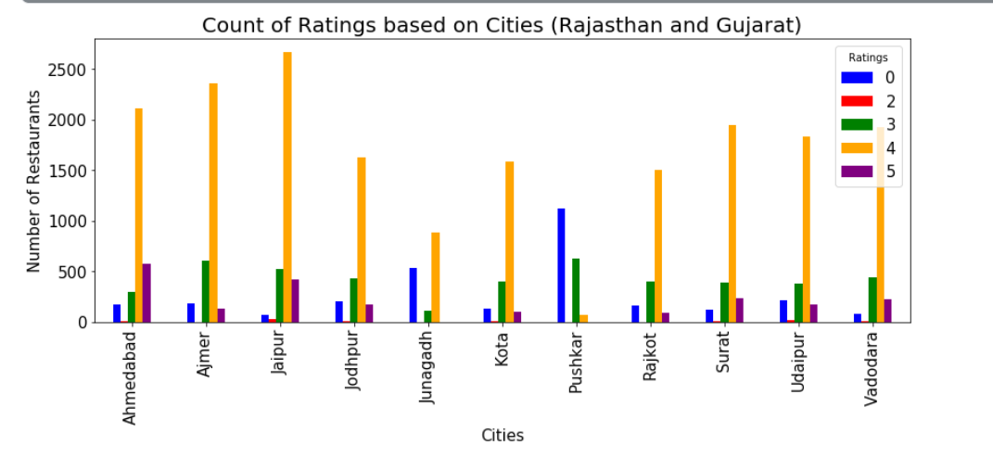
Central and East India
No City present from the North East part of India (except Guwahati).
MP’s Jabalpur, Indore, Bhopal have the highest count followed by Bhubaneshwar, Patna, Kolkata.
Kolkata surprisingly is not the highest one.
Rajasthan and Gujarat
Gandhinagar is not present in the data; count of restaurants in Gandhinagar is 152 only.
Pushkar has maximum non rated restaurants.
No 5 star hotels in Pushkar and Junagadh.

Slide 21
NLP based Analysis of Bangalore Restaurants Reviews

Slide 22
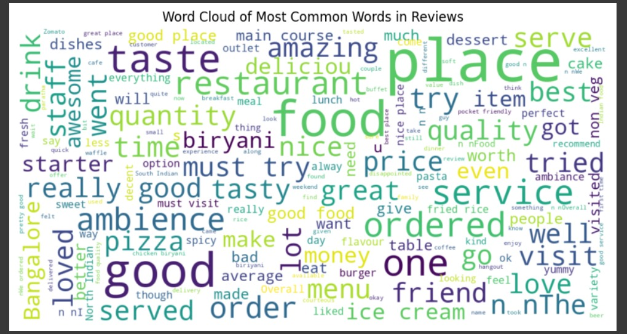
EDA - WordCloud
WordCloud suggests that food, place, quality, service, quantity, price, tasty are the aspects which are frequently mentioned in the reviews.
Aspects like flavour, pocket friendly, buffet, spicy, located are not much frequently used by customers in the reviews.

Slide 23
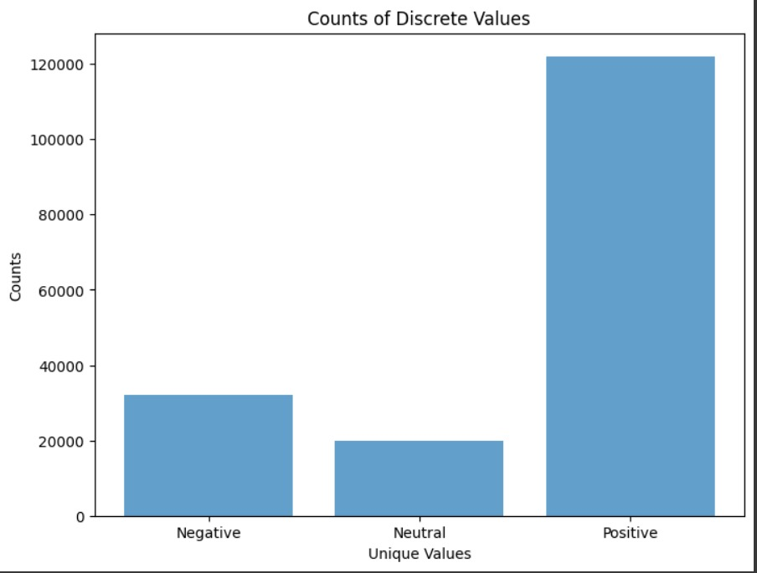
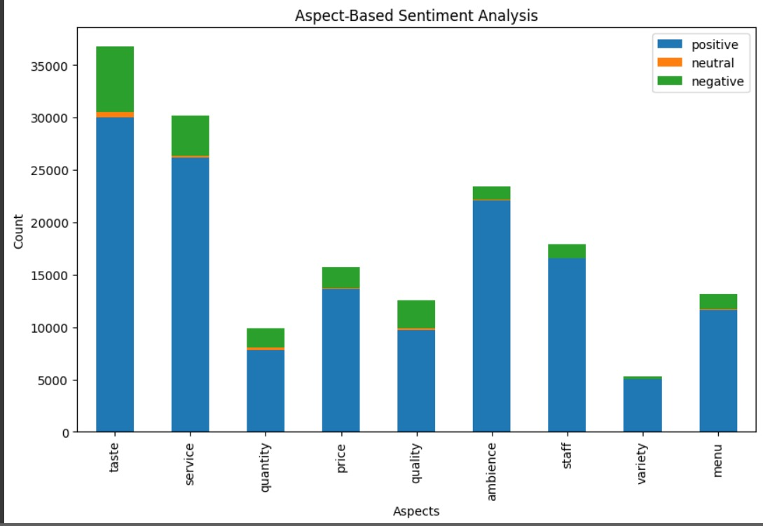
Sentimental Distribution and Aspect Based Analysis
Most of the reviews have a positive sentiment, As expected Neural count is the least.
Indian people mostly focus on taste, service, ambience, while variety, quantity don’t matter much.
Aspects like Staff, Ambience, Variety has high % of positive sentiment.

Slide 24
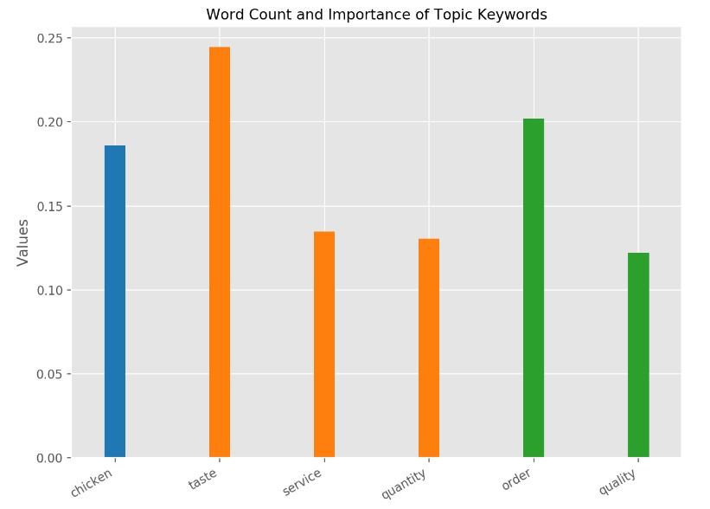
Topic Modelling
From all the reviews of our data, we found ‘taste, Chicken, order, service, quantity, quality’ to be the most prominent topics.
The topics mentioned here are the most important ones and summation of all topics values is 1.

Slide 25
Graphical User Interface

Slide 26
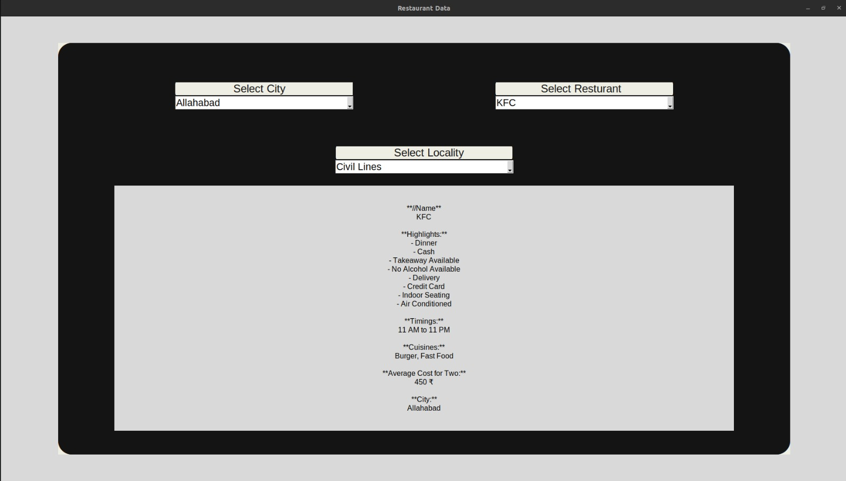
GUI for Restaurants
Our Graphical User Interface uses Bard API to give details of the restaurant selected by user according to city, name and locality.
We have included the important details such as Highlights, Timings , Cuisines and Average cost for two.

Slide 27
Conclusions
India's restaurant landscape is shaped significantly by key players like Domino's Pizza, CCD, and KFC, with 35% of establishments being a part of recognized chains.
Bangalore stands out as a culinary hub with the highest restaurant density.
Most restaurants are rated between 3 and 4 star with alcohol availability restaurants having highest average ratings and review votes.
In India, we observe a preference towards North Indian and Chinese food, with Barbeques being the highest rated food chain.
Gurgaon has highest rated restaurants (average 3.83) whereas Hyderabad has more number of critics (votes).
There are comparatively less number of restaurants at higher price ranges and their rating is generally high.

Slide 28
Conclusions
In the culinary landscape, Chennai emerges as a standout with a threefold number of restaurants compared to Delhi, the highest in the nation.
Only big metro cities like Mumbai, Bangalore, Chennai, Delhi, Pune, Lucknow have substantial amount of 5 star restaurants.
South Indian Cities have almost negligible non rated restaurants.
Covid has affected the Tourism industry which in return affected the Hotel Industry.
Cities like Agra, Jodhpur, Hampi, Dharwad, Amravati have high monumental visit tourists but poor Hotels availability, thus creating a potential for Hotel Industry.
EDA and Aspect analysis show similar results in terms of topics of concern.

Slide 29
References
https://tourism.gov.in/sites/default/files/202209/India%20Tourism%20Statistics%202021%20(1).pdf – Government Tourism Report
https://www.kaggle.com/code/shahules/zomato-complete-eda-and-lstm-model/notebook - Kaggle’s Bangalore Restaurants Data
https://arslanr369.medium.com/exploring-indian-restaurants-dataset-a-comprehensive-eda-on-kaggle-d2fcf34b6f3f - EDA of Indian Restaurants
https://www.kaggle.com/code/devarsheesandilya/zomato-delhi-eda/notebook - Delhi Restaurants Analysis

Slide 30
THANK YOU!

