Slide 1
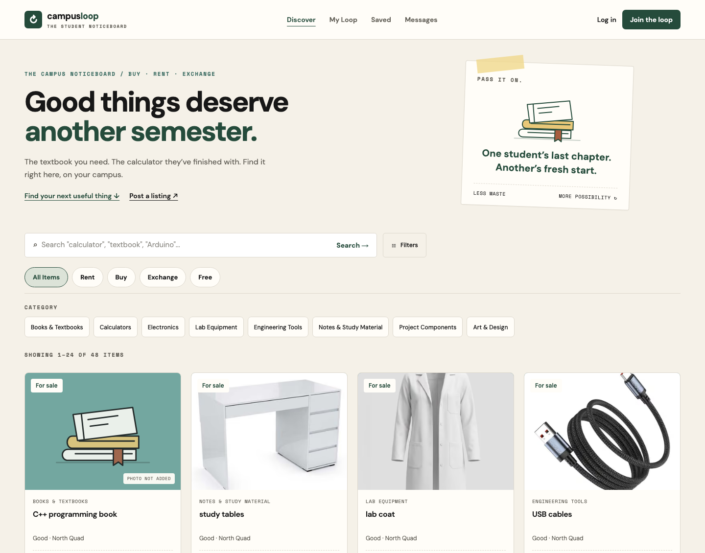
COLLEGE PROJECT PRESENTATION
Campus Loop
A marketplace
for college students.
Buy • Sell • Rent • Exchange • Give away
Presented by
Srusthi Pisal • Shraddha Dhadas
Sanchita Yadav
CAMPUS LOOP / COLLEGE PROJECT
01 / 10
Notes:
Introduce Campus Loop as a campus-focused marketplace for useful student items. Explain the four modes: buying/selling, renting, exchanging and giving away. Presented by Srusthi Pisal, Shraddha Dhadas and Sanchita Yadav. The screenshots show the actual deployed application, not a design mockup.

Slide 2
01 / PROBLEM STATEMENT
Why do we need Campus Loop?
Students need an organised place to find and share useful items.
DISCOVERY
AVAILABILITY
RECORDS
Scattered information
Unclear item status
No organised history
Item details are shared through chats and contacts, making them difficult to find later.
Students may not know whether an item is still available or has already been taken.
Informal exchanges do not provide one place to track messages and completed deals.
CAMPUS LOOP / COLLEGE PROJECT
02 / 10
Notes:
Explain the problem with a simple example: a student needs a calculator while another student no longer uses one. Chat groups help people communicate, but item information and availability are difficult to organise. These are the problems addressed by the project; we have not conducted a formal survey or measured cost savings.

Slide 3
02 / PROJECT OBJECTIVES
What does our project aim to do?
One account can be used for both buying and selling.
01
Find useful items
02
Support reuse
Search by category and listing type.
Buy, sell, rent, exchange or give away items.
03
Keep clear records
04
Help administration
Save conversations and completed deals.
Manage users, listings and reported issues.
CAMPUS LOOP / COLLEGE PROJECT
03 / 10
Notes:
State these four objectives clearly. The target users are students, who can both buy and sell, and administrators, who maintain the platform. Each objective is linked to an implemented feature. Reuse is the intended benefit; avoid claiming a measured reduction in waste or cost without a study.

Slide 4
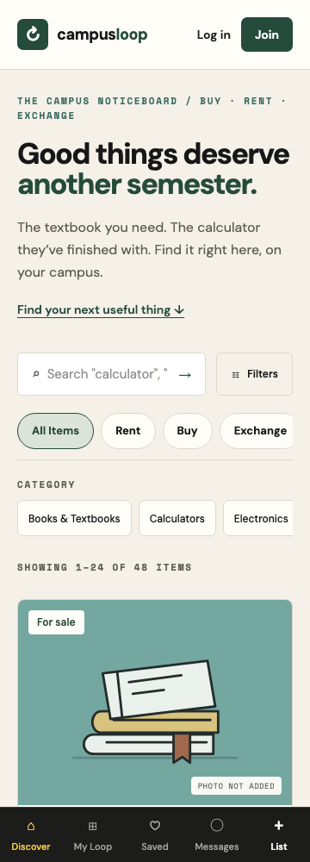
03 / MAIN FEATURES & INTERFACE
A simple website for student needs.
Search items, save favourites, message the owner and track deals in My Loop.
DESKTOP
MOBILE
Search first
Clear prices
Category filters
Real item photos
Responsive cards
Compact navigation
Readable forms
Visible feedback
CAMPUS LOOP / COLLEGE PROJECT
04 / 10
Notes:
Show the screenshots and describe the practical design choices: search is easy to find, listing cards show the information needed to compare items, and mobile navigation fits smaller screens. Real photos are used when uploaded; illustrated placeholders are labelled when a photo is missing.

Slide 5
04 / WORKING OF THE SYSTEM
How does a student complete a deal?
Example: one student sells a calculator to another student.
01
02
03
04
05
Discover
Discuss
Request
Confirm
Record
→
→
→
→
Search and filter
relevant listings
Use private chat
to agree details
Seller requests
handoff confirmation
Buyer confirms
after receiving item
Completed deal
appears in My Loop
The seller starts the request. The buyer confirms receipt. Both can view the completed deal.
CAMPUS LOOP / COLLEGE PROJECT
05 / 10
Notes:
The seller requests confirmation and the buyer confirms receipt. A seller cannot simply mark a transaction as sold independently. The system prevents competing pending deals for the same listing. Mention cancellation and the durable record visible to both participants. This is a handoff workflow, not a payment gateway.

Slide 6
05 / SYSTEM DESIGN
How is the website built?
Three main parts work together to display pages and save information.
1. Website pages
2. Application logic
3. Database
Students browse items,
fill forms and send messages.
↔
Checks sign-in, permissions
and deal confirmation.
↔
Stores accounts, items,
messages and deal records.
Next.js • React • Tailwind CSS
Next.js server • TypeScript
PostgreSQL • Prisma
Extra services: Auth.js for login • Cloudinary for photos • Resend for email
CAMPUS LOOP / COLLEGE PROJECT
06 / 10
Notes:
Explain the architecture through a simple action: when a student posts an item, the website sends the form to server-side code; the code checks the input and signed-in user, then saves it in PostgreSQL using Prisma. The website displays the saved item. Prisma is the tool used to access the database, not a separate database. Use the technology names only after explaining their purpose.

Slide 7
06 / DATABASE & MAINTENANCE
What information do we save?
The database keeps records available after a student closes the website.
RECORD
INFORMATION STORED
How we maintain it
Students
Name, email and account role
Keep item status up to date.
Admin reviews records and reports.
Export records when needed.
Back up data before major updates.
Items
Owner, title, price and availability
Messages
Conversation, sender and message
Deals
Buyer, seller, item and deal status
Example: a completed calculator deal links the buyer, seller and item in one saved record.
CAMPUS LOOP / COLLEGE PROJECT
07 / 10
Notes:
Explain this table instead of describing every database table. One student account can be a buyer in one deal and a seller in another, so separate buyer and seller accounts are unnecessary. The deals record connects both students to the item. Maintenance means keeping availability correct, reviewing reports, exporting records and backing up data before significant changes. A backup was taken before the production update; do not describe backups as an automatic scheduled feature. Passwords are stored as hashes, not plain text. The table shows selected fields, not the entire schema.

Slide 8
07 / ADMIN PANEL & EMAIL
How is the platform managed?
Students use the marketplace. Administrators manage its records and reported issues.
Admin panel
Automatic email
View and search users and listings
Suspend accounts when required
Hide or restore listings
Review reports and export records
Alert users to unread messages
Send deal confirmation updates
Send password reset links
Allow notification preferences
CAMPUS LOOP / COLLEGE PROJECT
08 / 10
Notes:
Only an account with the admin role can open the admin panel. Srusthi has admin access for the demonstration. Explain that email is for notifications; replies are sent inside Campus Loop. Email is sent to the address saved on the account. Users can turn message and deal notifications on or off. The system prevents repeated message emails while the same conversation is still unread. Avoid promising that every email will reach the inbox: the provider can accept mail that a receiving service later filters.

Slide 9
08 / TESTING & DEPLOYMENT
How did we check it and make it live?
We checked important student actions before publishing the website.
WHAT WE TESTED
EXPECTED RESULT
Available online
Login and access
Protected pages require permission
Vercel hosts the website.
Neon stores the database.
Students open a link to use it.
Item posting and search
Saved items appear in search
Deal confirmation
Only the buyer can confirm receipt
Phone and desktop views
Content fits the screen
No app installation needed.
Result: checks passed; live pages also verified.
CAMPUS LOOP / COLLEGE PROJECT
09 / 10
Notes:
Use the test examples on the slide rather than leading with technical statistics. Login should protect restricted pages. A saved listing should appear in search. The seller starts a request and only the selected buyer confirms receipt. Layouts should fit phones and desktops. Supporting evidence: 208 unit tests, 11 browser tests and database integration checks passed during implementation; live public pages and access controls were also checked. Email behaviour was tested with a simulated provider, not by confirming real inbox delivery. Vercel hosts the application and Neon hosts its PostgreSQL database. A production backup and rehearsal preceded the database update. These checks are not a formal load test or security audit.

Slide 10
09 / CONCLUSION & FUTURE SCOPE
A practical platform for student reuse.
WHAT WE BUILT
FUTURE SCOPE
A central place to find campus items
Chat and confirmed deal records
Admin controls and email updates
Online payment integration
Push notifications
College identity verification
Current scope: students arrange payment and pickup themselves.
campus-loop-rho.vercel.app
Thank you / Q&A
CAMPUS LOOP / COLLEGE PROJECT
10 / 10
Notes:
Open the live link and keep two student sessions ready if demonstrating a handoff. Start with discovery, then show messaging, seller request and buyer confirmation. Finish with My Loop history and the admin panel. Explain that online payments, push notifications and campus identity verification are future possibilities, not implemented features. Close with the intended benefit: making useful student items easier to find and reuse. Invite questions.

