Slide 1
Jigsaw Capstone Project

Slide 2
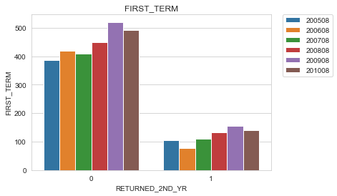
Problem definition
Attrition rate: Students who dropped out within one year of joining the program.
Note: Here 1 defines attrition and 0 means the student did not attrite.
Observations:
As evident, attrition rate remains between 21 to 23% across all the years with 2006 being the exception.
Our objective is to reduce this rate by finding out key drivers for attrition and finally building a prediction model to know beforehand if the given student would attrite early.

Slide 3
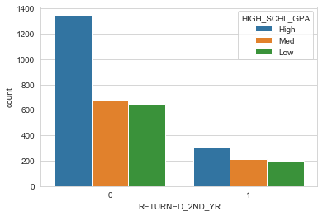
EDA- Key features
GPA
Observation: Student with higher GPA (>3.2) are comparatively less likely to attrite.

Slide 4
Observation: Students staying on campus are more likely to attrite
Recommendation:
Check how students are spending time on campus, find out what’s distracting them from focusing on studies, it could be anything from poor hostel facilities, poor meals to noisy surroundings
Housing Status

Slide 5
Distance form home
Observation: We saw earlier that students who stay on campus are more likely to attrite, now here we see that those students for whom the distance from university and home is more are more likely to attrite. It is likely that these are the same students who stay on campus as distance from home is more. In other words students who belong to same city as university are more likely to continue and finish the course.
Recommendation:
Maybe students are wasting time commuting between home and university, so institute can come up with pick and drop service which would consume less time.

Slide 6
Financial conditions
Observation: Students for whom the family contribution is less and therefore higher unmet needs are more likely to attrite.
Recommendation: Come up with attractive finance scheme or scholarship programs for needy.

Slide 7
EDA- Few more observations
Apart from above mentioned features, it was also found that students who opt for following courses are more likely to attrite:
Criminal Justice,
Exercise Science,
Art,
Computer Science Games,
Marketing and
Engineering studies have higher proportions of dropouts

Slide 8
Prediction Model
Xgboost results
Model executed an accuracy score of 0.8049
Confusion matrix:
Performance metrics:
 | Predicted
Actual | 0 | 1
0 | 779 | 22
1 | 152 | 67
Report | Precision | Recall | F1-score
0 | 0.84 | 0.97 | 0.90
1 | 0.75 | 0.31 | 0.44

Slide 9
Summary of recommendations
Attract Students with High School GPA>3.2.
Improve on campus hostel facilities.
Provide more job opportunities.
Help financially needy students with special scholarships.
Use the prediction model to predict which students are likely to attrite.

Slide 10
Thanks!

