Slide 1
Deep Neural Network (DNN) modeling for Weather Forecasting
ECE 656 : Machine Learning and Adaptive Systems
Final Project Presentation
Instructor: Dr. M R Azimi
Given by : Pratik Mohan Ramdasi
Date : 12/15/2015

Slide 2
Introduction
1. Why Weather Forecasting is important ?
The changes of climate could impact people’s daily life, therefore people never cease their efforts on predicting the trend of weather changes.
Unlike data sets in other domain, weather data has some particularities. Specifically, there is season-to-season, and year-to-year variability in the trend of weather data.
The cycle could be multi-month, multi-season or multi-year, and the main difficulty of investigations is to capture all the possible cycles.
2. Objective of the project:
The objective is to explore the potential of DNN in weather forecasting.
In time series problem, the correlations among the features are obviously but not easy to be identified. If we can analyze the correlations and represent the features properly, the prediction accuracy is expected to increase and DNNs could be a reasonable and suitable tool to analyze the time series features.
3. Motivation for the project:
Until recently, ANN's with back propagation learning rule are used in solving various classification and prediction problems. However, the depth of the practical NN was limited to one hidden layer.
Deep Neural Networks (DNN) have many layers of nonlinear functions, unlike shallow networks, which allow them to compactly represent highly non-linear and highly-varying functions. This increases learning ability.

Slide 3
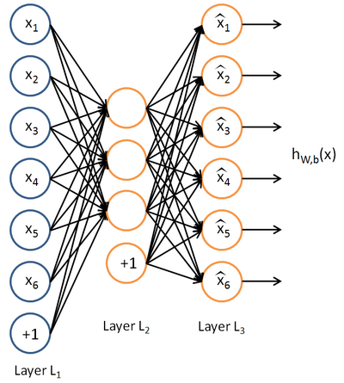
Auto Encoder DNN:
Procedure:
In the training process of each layer the input vectors have to pass through three layers and the vectors in hidden layers (layer L2) (also called as transformed vectors) are representations of the input vectors and can be used to reconstruct the input vectors.
Thus, in every layer of the deep NN, the input of the current layer is the output of the previous layer, and then we train the input data via an Auto-Encoder, and use the transformed vectors as the output of the current layer.
We can see that through a DNN, the raw data can be represented in new feature spaces layer by layer. In other words, DNN can learn features from the original data sets.
Learned features are then used for validation and testing.

Slide 4
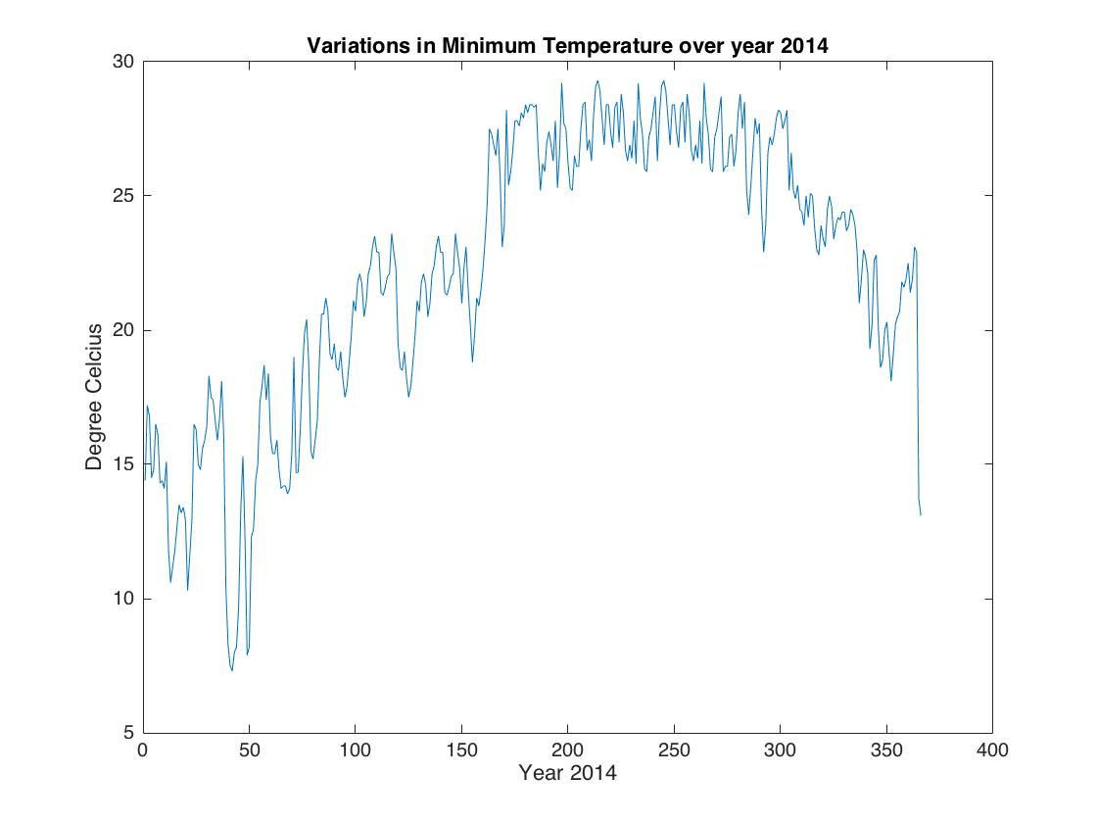
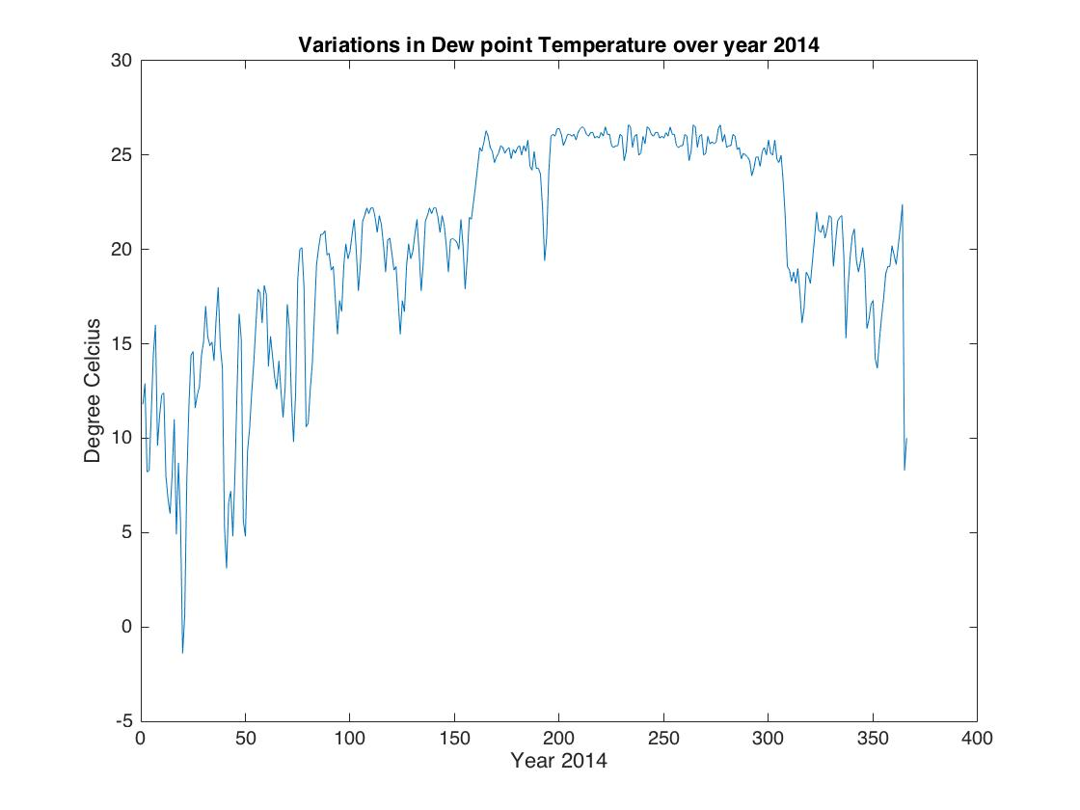
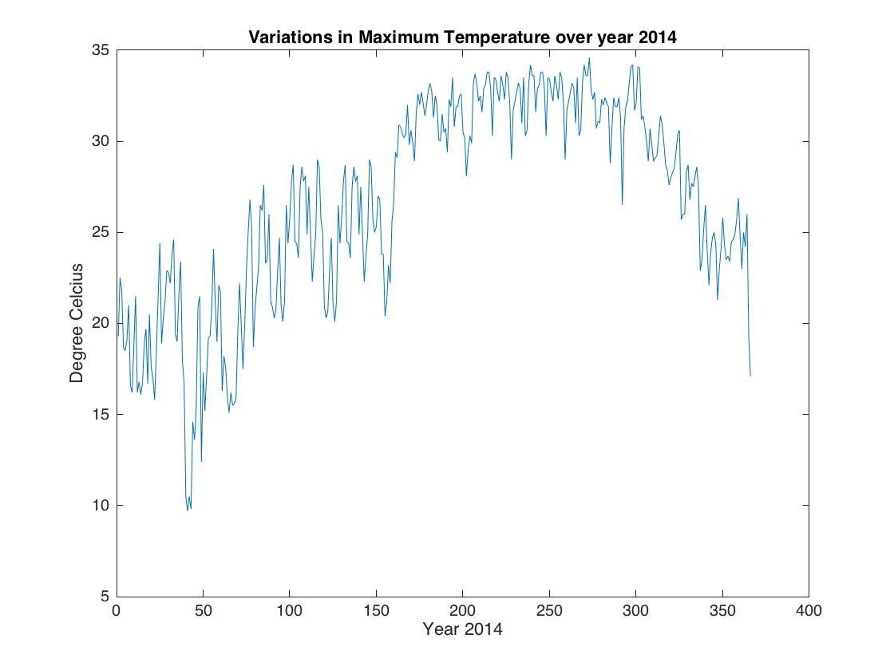
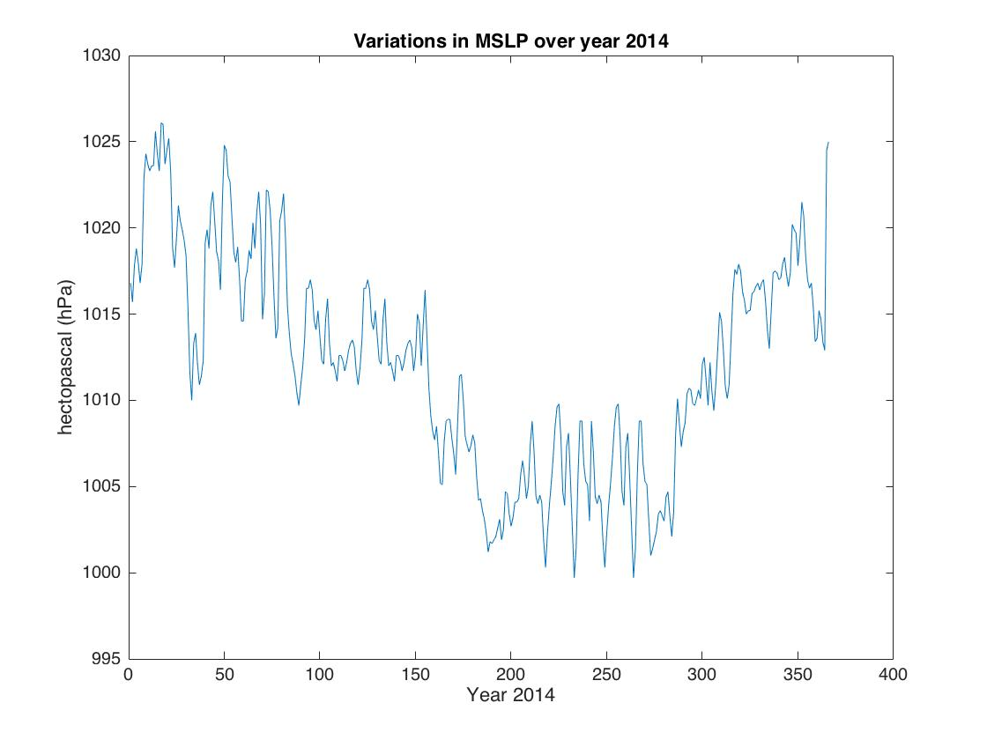
Variations in the distribution of parameters:

Slide 5
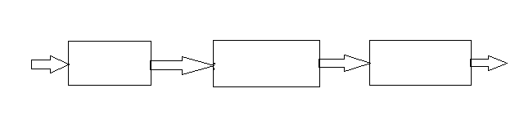
Methodology
Data collection
DNN modeling
Prediction
Gather Weather data
Stacked auto Encoder model and NAR model
Stepwise Procedure:
1. Collection of database:
Contains weather data corresponding to MSLP, Minimum and Maximum Temperature, Dew point temperature recorded per day from 1st January 1997 to 31st December 2015.
2. Neural Network Modeling
Implementation of Auto Encoder DNN and non-linear auto Regressive model in MATLAB using NN toolbox.
Prediction
4. Results and Conclusion.

Slide 6
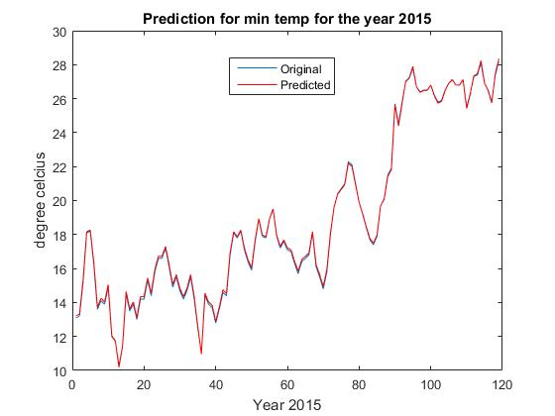
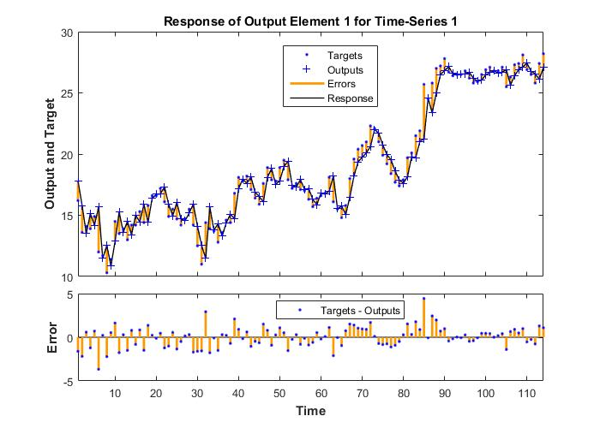
Prediction Results:
1. Prediction of Minimum Temperature over the year 2015
Using Auto encoder DNN
Using non-linear AR model
 | MSE | Regression (R)
Stacked Auto Encoder DNN | 0.0097 | 0.99
Non-linear AR model | 0.1 | 0.97

Slide 7
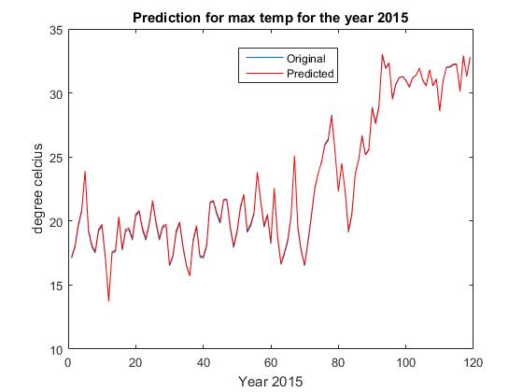
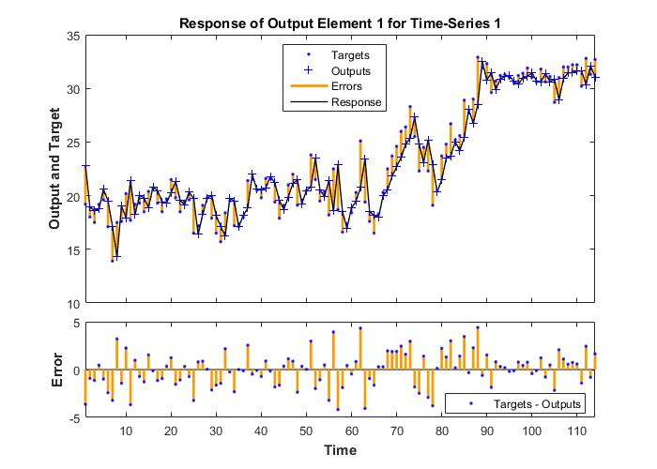
Prediction Results:
2. Prediction of Maximum Temperature over the year 2015
Using Auto encoder DNN
Using non-linear AR model
 | MSE | Regression (R)
Stacked Auto Encoder DNN | 0.0113 | 0.99
Non-linear AR model | 0.1 | 0.94

Slide 8
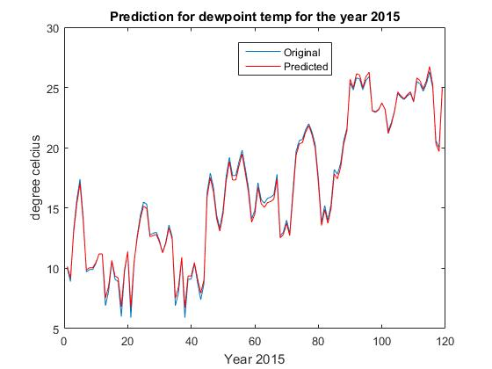
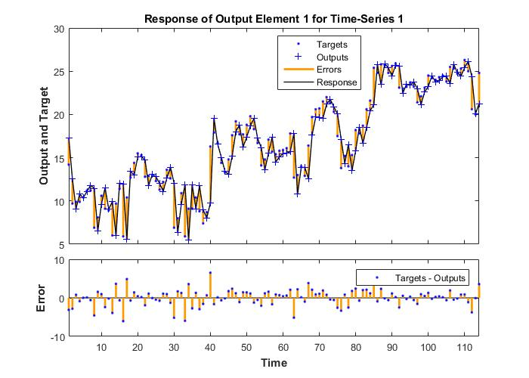
Prediction Results:
3. Prediction of Dew point Temperature over the year 2015
Using Auto encoder DNN
Using non-linear AR model
 | MSE | Regression (R)
Stacked Auto Encoder DNN | 0.0043 | 0.99
Non-linear AR model | 0.09 | 0.93

Slide 9
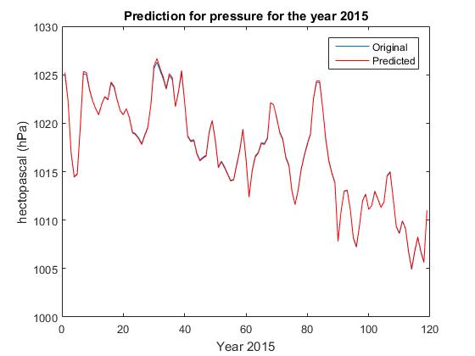
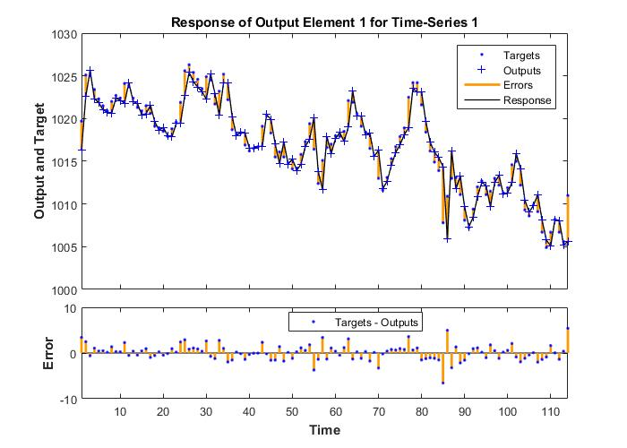
Prediction Results:
4. Prediction of MSLP over the year 2015
Using Auto encoder DNN
Using non-linear AR model
 | MSE | Regression (R)
Stacked Auto Encoder DNN | 0.0103 | 0.98
Non-linear AR model | 0.06 | 0.95

Slide 10
Conclusion:
Auto encoder based DNN model is applied for prediction and the results are compared with that obtained from non-linear AR model.
The proposed DNN model using Stacked Auto encoder may represent the features of the raw weather data layer by layer and experimental results show that the obtained features can improve the performances of classical computational intelligence models.
DNN provides a way better representation of generating estimation of the original data and due to ‘learning features’ feature, it can be used for prediction of more larger and complex dataset.

