Slide 1







CAPSTONE PROJECT
PRATIK PAUL
01/21/2024

Slide 2



OUTLINE
Executive Summary
Introduction
Methodology
Results
Visualization – Charts
Dashboard
Discussion
Findings & Implications
Conclusion
Appendix

Slide 3

EXECUTIVE SUMMARY
This project describes the role and tasks of a Data Analyst in a global IT and business consulting services firm.
The main objective is to collect and analyze data on the top programming skills that are most in demand for this year’s report on emerging skills
The data sources include job postings, training portals, and surveys
The data analysis involves scraping web sites, accessing APIs, data wrangling, statistical techniques, and IBM Cognos Analytics

Slide 4

INTRODUCTION
As a Data Analyst, I’m tasked with collecting data from various sources and identifying trends for this year's report on emerging skills
The first task is to collect the top programming skills that are most in demand from various sources including:
Job postings
Training portals
Surveys
Analyze the data and identify insights and trends that may include the following:
What are the top programming languages in demand?
What are the top database skills in demand?
What are the popular IDEs?

Slide 5

METHODOLOGY
Data Collection
Job postings
Training portals
Surveys
Data Wrangling
Handling Missing Values
Handling Duplicates
Exploratory Data Analysis
Distribution
Outliers
Correlation
Data Visualization
Dashboard Creation

Slide 6

RESULTS
VISUALIZATION - CHARTS

Slide 7
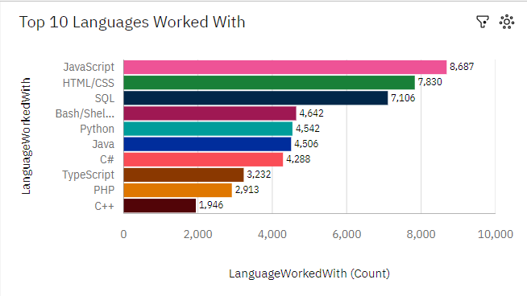
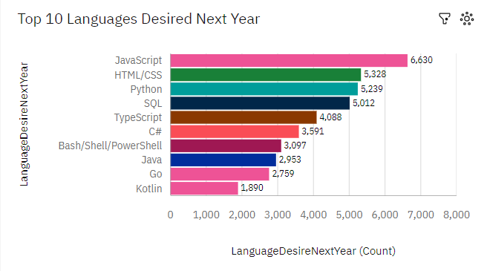
PROGRAMMING LANGUAGE TRENDS
Current Year
Next Year

Slide 8
PROGRAMMING LANGUAGE TRENDS - FINDINGS & IMPLICATIONS
Findings
JavaScript and HTML/CSS are the top programming languages
There has been a decline in Bash/Shell/Powershell
Python has overtaken SQL in terms of popularity
Implications
The desire for programming languages is still substantial
The popularity of Python is increasing
People seem to be more open towards TypeScript

Slide 9
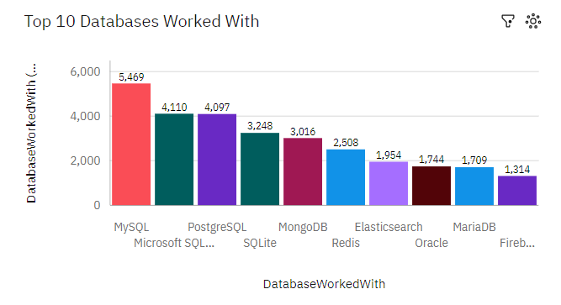
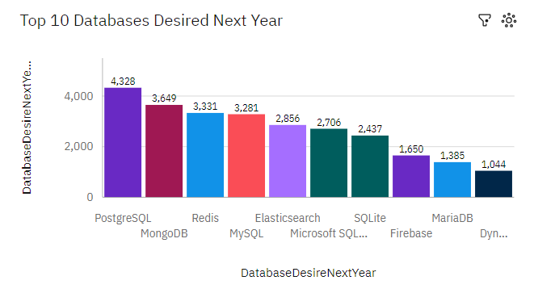
DATABASE TRENDS
Current Year
Next Year

Slide 10
DATABASE TRENDS - FINDINGS & IMPLICATIONS
Findings
MySQL is the most popular database
PostgreSQL has topped the charts for next year
Microsoft SQL Server has taken a decline
Implications
The need for databases is on the rise
The popularity of PostgreSQL and MongoDB is increasing
There are huge differences between the popularity for current year and next year

Slide 11

DASHBOARD
https://github.com/PratikRules/courserarepo/blob/8c123f020a910900fa62df5f3a85977c9cbe8bdc/Dashboard.pdf

Slide 12
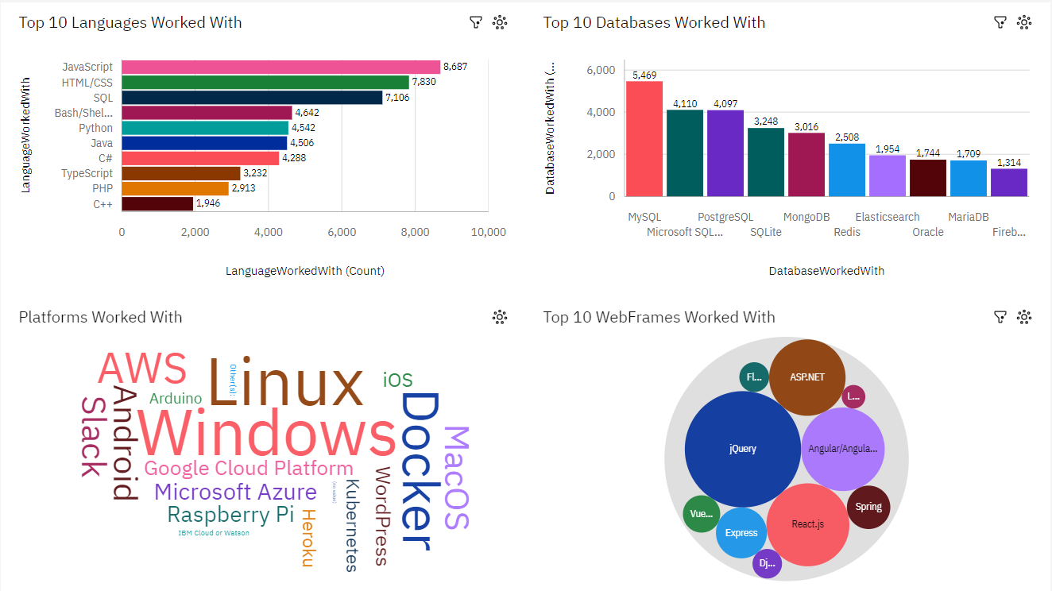
CURRENT TECHNOLOGY USAGE

Slide 13
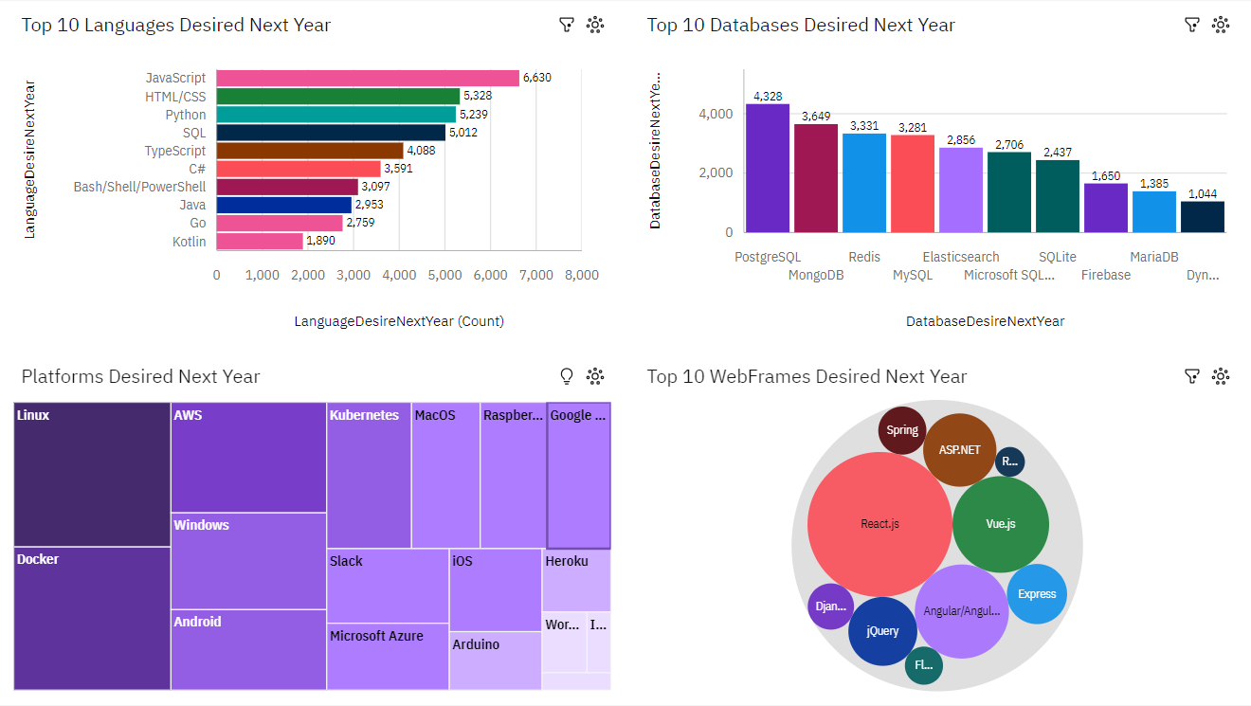
FUTURE TECHNOLOGY TREND

Slide 14
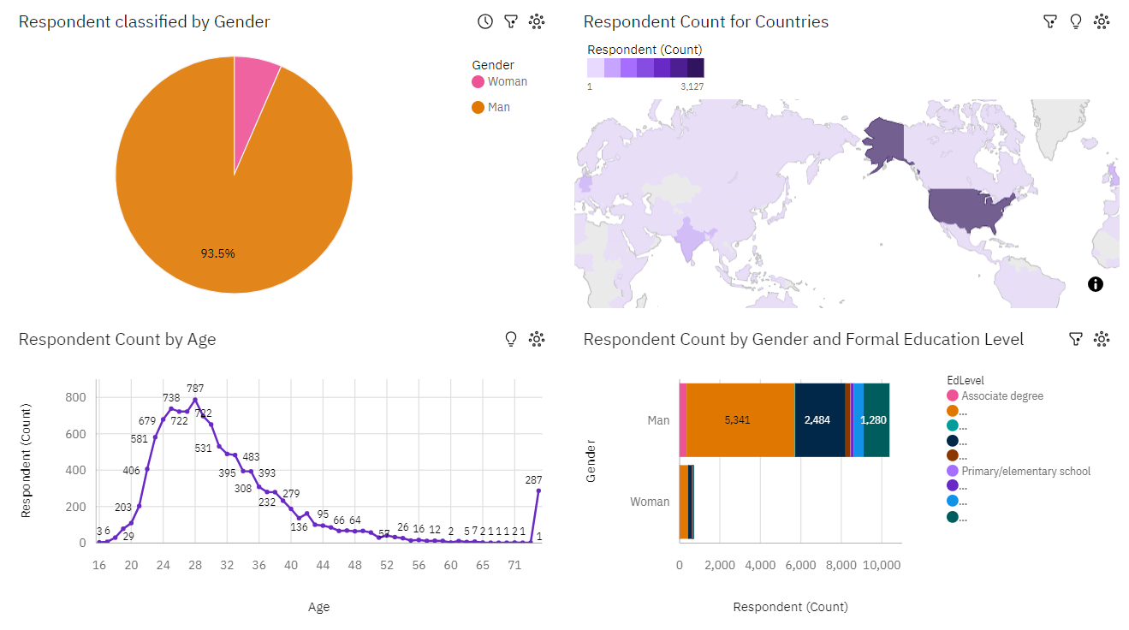
DEMOGRAPHICS

Slide 15
DISCUSSION
What are the top programming languages in demand?
What are the top database skills in demand?
What are the popular IDEs?

Slide 16
OVERALL FINDINGS & IMPLICATIONS
Findings
Linux is the most popular platform people use
United States has the highest number of respondents
The popularity of React.js is increasing
Implications
Developers want to stick to Linux as their main platform
United States has become the hub for all technologies
The trend for JavaScript is on the rise

Slide 17

CONCLUSION
The top programming languages are JavaScript, followed by HTML/CSS
The in-demand database is PostgreSQL
Linux and Windows are at neck-to-neck as the most used platform
Web Frames like React.js are on the rise

Slide 18

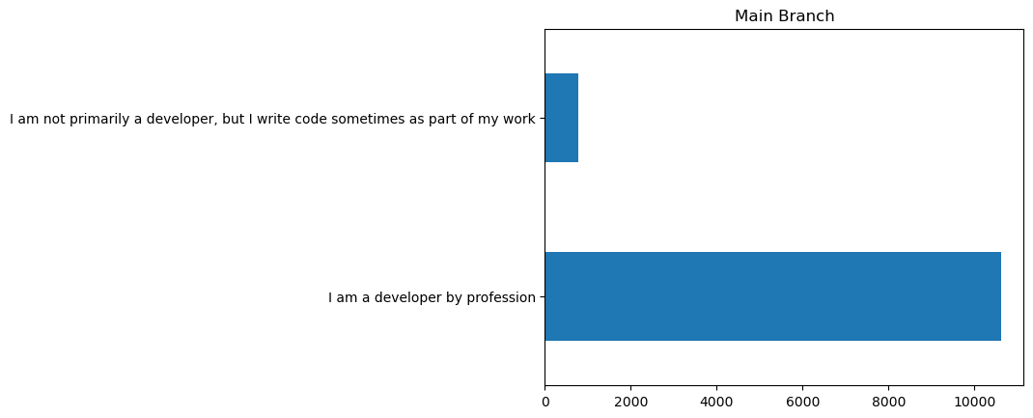
APPENDIX

Slide 19
JOB POSTINGS

Slide 20
POPULAR LANGUAGES

