Slide 1
Intergrated customer segmentation & churn
Pratik Sarkar
Dept. of computer science, RKMVERI

Slide 2
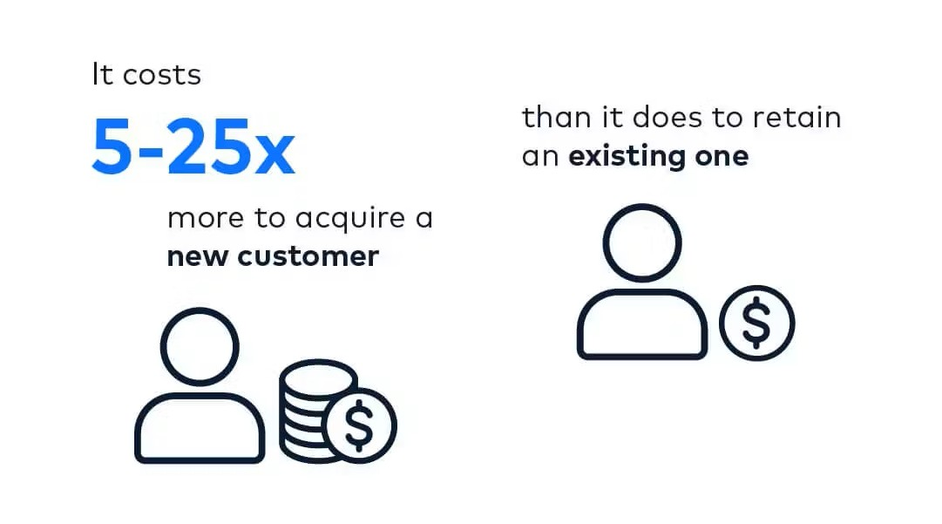
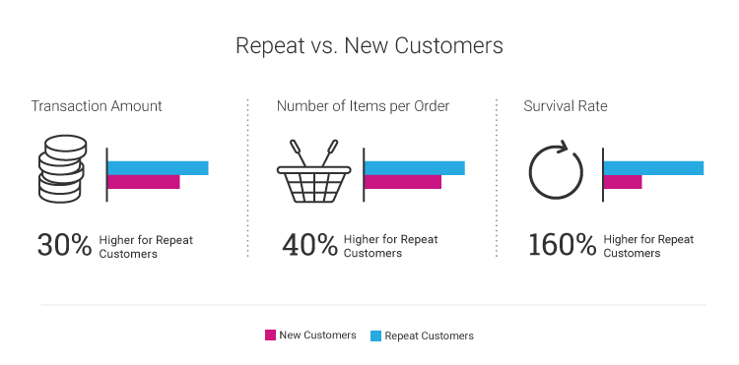
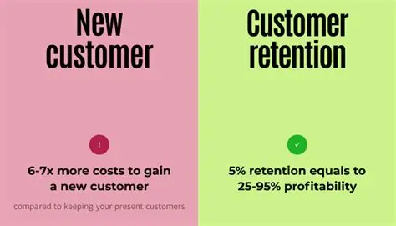
Customer Retension Vs Acquisition
Factors That Make It More Expensive To Acquire Customers
Marketing And Advertising
Campaign Targeting
Market Saturation
Increasing Customer Expectations
dc

Slide 3
Problem Statement & Methodology
Problem
Methodology
Telecom companies face revenue loss due to customer churn
Objectives
To Segment Customers owing to behavioral cohorts using unsupervised learning to expose group-level churn patterns
To build predictive models to estimate individual churn probability per segment , enabling targeted retention actions.
Data Preprocessing
Convert some non numeric data to numeric data.
impute missing values with median
apply SMOTE to balance classes on training data.
Segmentation
Elbow & Silhoute Method are used to find optimal cluster.
Reduce dimensionality with PCA (2 components for visualization) and apply K-Means
Prediction
Train and compare Logistic Regression, Random Forest, Gradient Boosting, and XGBoost. Evaluate using Accuracy, Precision, Recall, Fl-score, and ROC-AUC

Slide 4
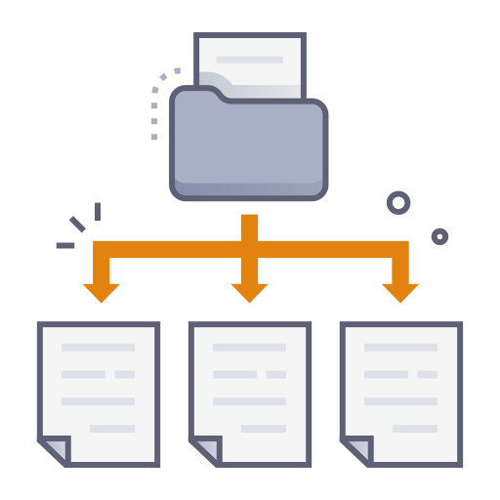
Dataset Details
The dataset used is the Telco_Churn_Segmented.csv
7,043 customers.
24 columns
Data Set Split
Training 70%
Validation 10%
Test 20%

Slide 5
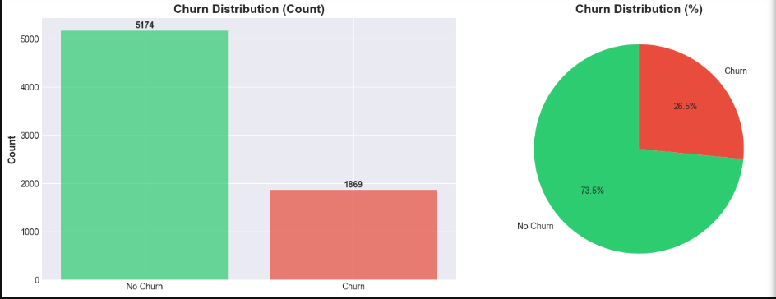
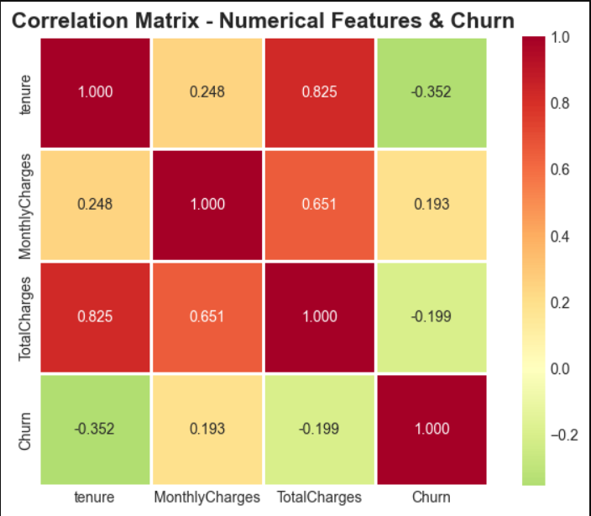
EDA- EXPRORATORY DATA ANALYSIS
No Churn (0): 5174 (73.46%)
Churn (1): 1869 (26.54%)
FEATURE CORELLATION WITH CHURN
Feature Correlation
MonthlyCharges 0.193356
TotalCharges -0.199037
Tenure -0.352229

Slide 6
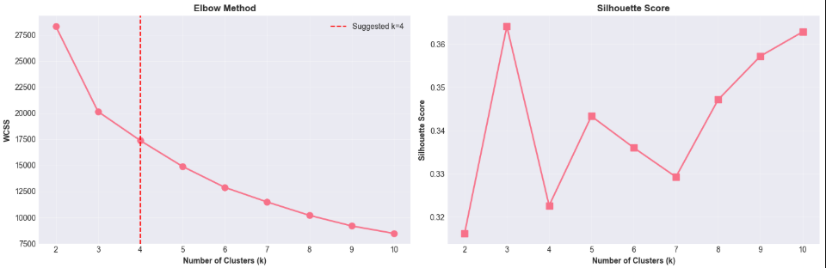
Customer segmentation
Selected 6 features for clustering
Tenure → Detects new vs long-term customers
MonthlyCharges → Detects heavy vs light users
TotalCharges → Shows total lifetime value
Contract_encoded → Identifies stable vs high-risk groups
InternetService_encoded → Indicates usage behavior
PaymentMethod_encoded → Reveals risk/loyalty behaviors
Elbow Method & Silhoutte to find optimal number of clusters.

Slide 7
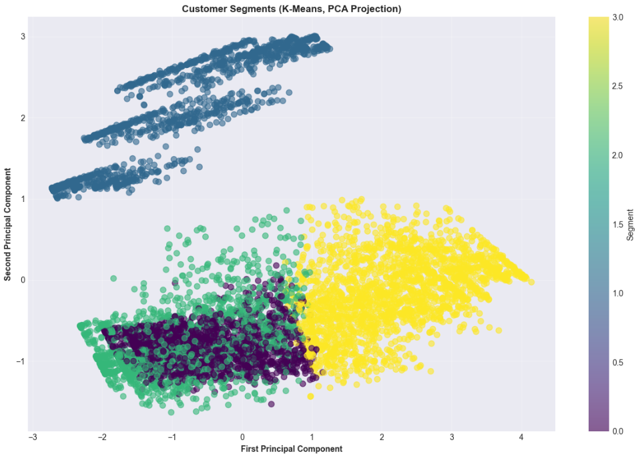
Kmeans Clustering & PCA Visualisation
K-Means complete with k=4
Cluster Distribution
Segment 0: 1925 customers (27.3%)
Segment 1: 1526 customers (21.7%)
Segment 2: 1622 customers (23.0%)
Segment 3: 1970 customers (28.0%)

Slide 8
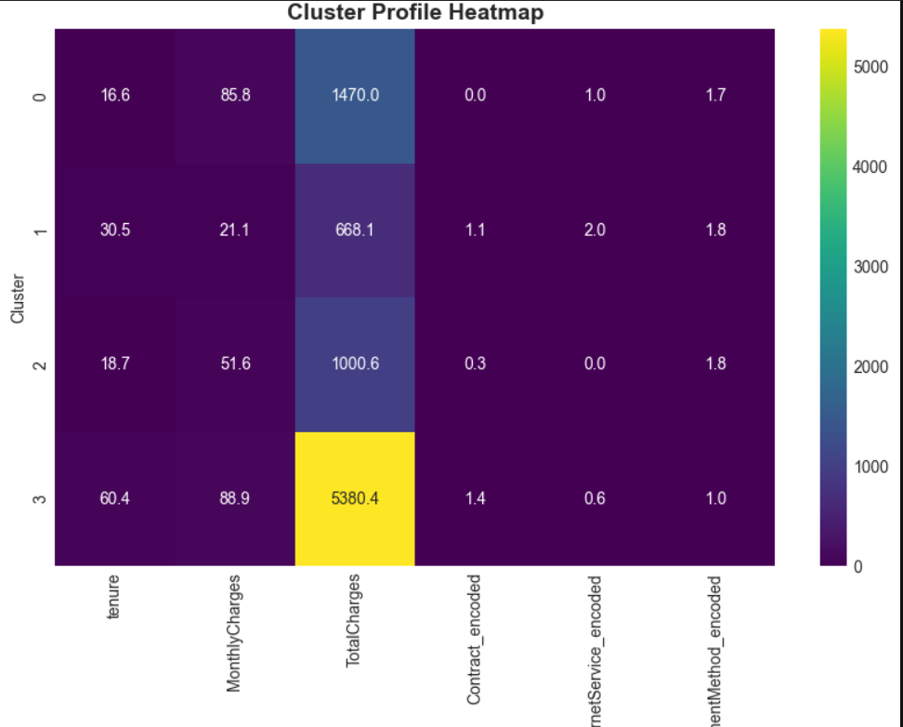
Analysis Of Each Segments
Segment | Meaning
0 | New customers on expensive plans
1 | Low-pay, low-value stable customers
2 | Medium-term, low-engagement, churn-prone customers
3 | Loyal high-value customers

Slide 9
Churn Prediction Modeling
Used unsupervised K-Means segment as an input feature to predict churn.
model is using 20 input features to predict churn.
Main Core Features for Churn Prediction
Tenure
MonthlyCharges
TotalCharges
SeniorCitizen
Segment_Kmeans
Train / Validation / Test Split (70/10/20)
SMOTE — Balancing the Training Data

Slide 10
Model Comparisons
Model | Accuracy | Precision | Recall | F1-Score | ROC-AUC
Logistic Regression | 0.755 | 0.529 | 0.714 | 0.608 | 0.823
Random Forest | 0.786 | 0.595 | 0.612 | 0.603 | 0.826
Gradient Boosting | 0.769 | 0.554 | 0.663 | 0.603 | 0.833
XGBoost | 0.772 | 0.569 | 0.583 | 0.576 | 0.815

Slide 11
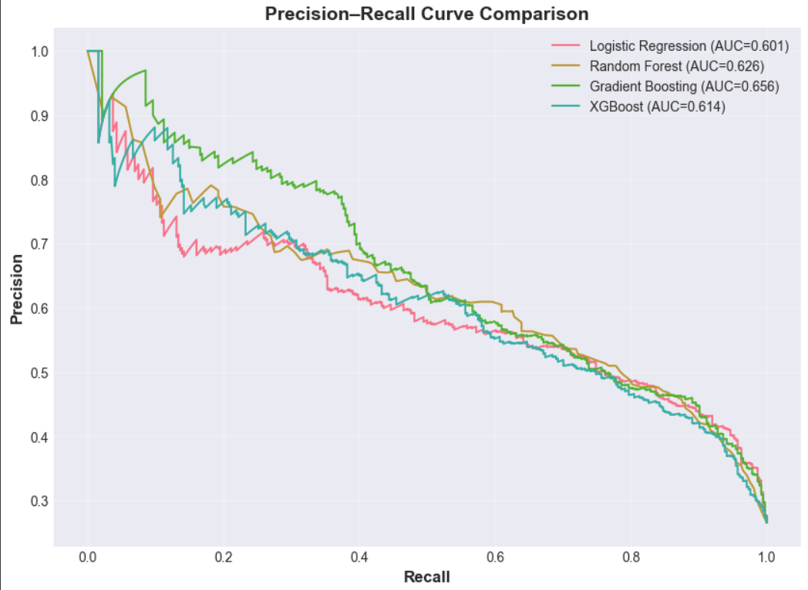
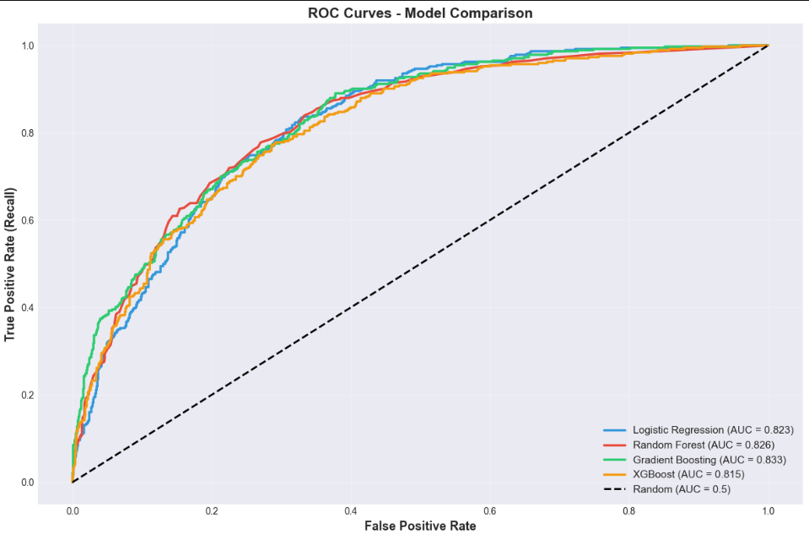
Curve Analysis…
How well each model identifies true churners (positive class)
Performance on imbalanced datasets (recall and precision are more meaningful than accuracy)
Area under curve (PR-AUC) for each model

Slide 12
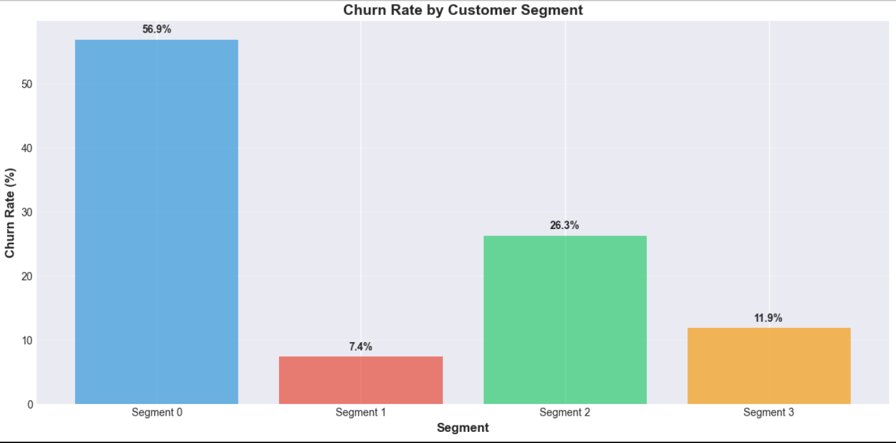
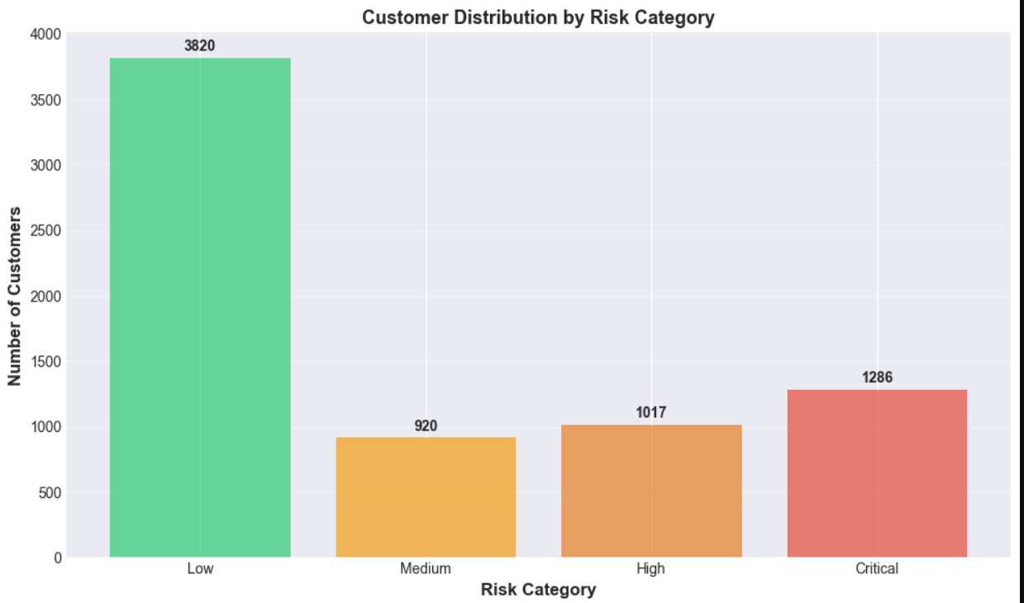
Segment Wise Churn Analysis

Slide 13
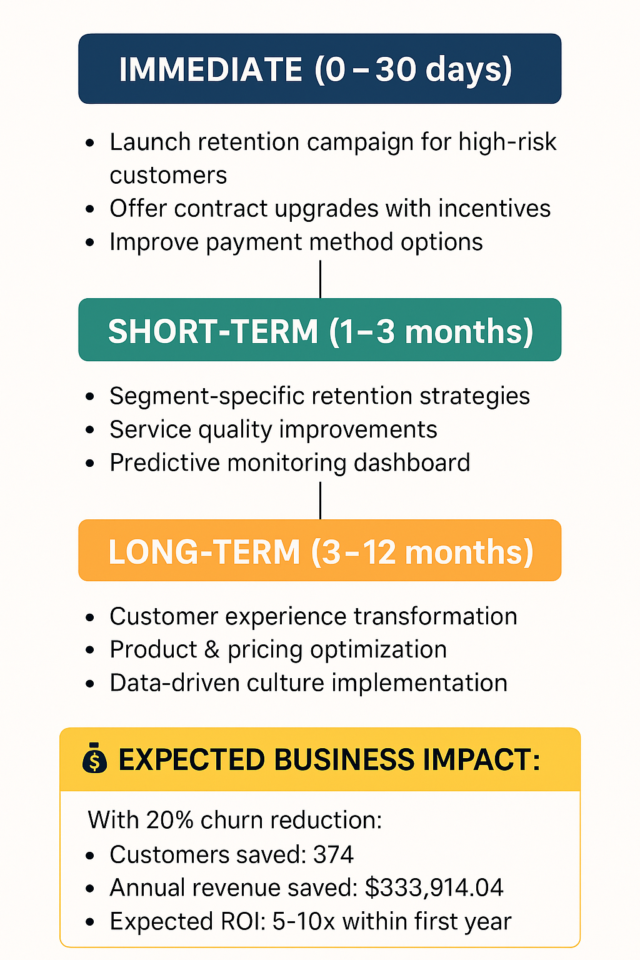

Business Insights & Key Findings

Slide 14
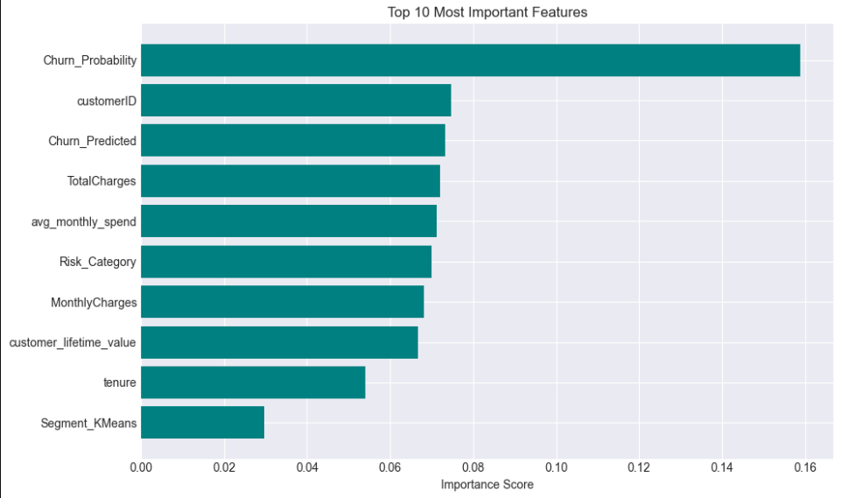
Feature Experiments….
New Features Created:
tenure_group
customer_lifetime_value
avg_monthly_spend
total_services
charges_category
New Features- 32

Slide 15
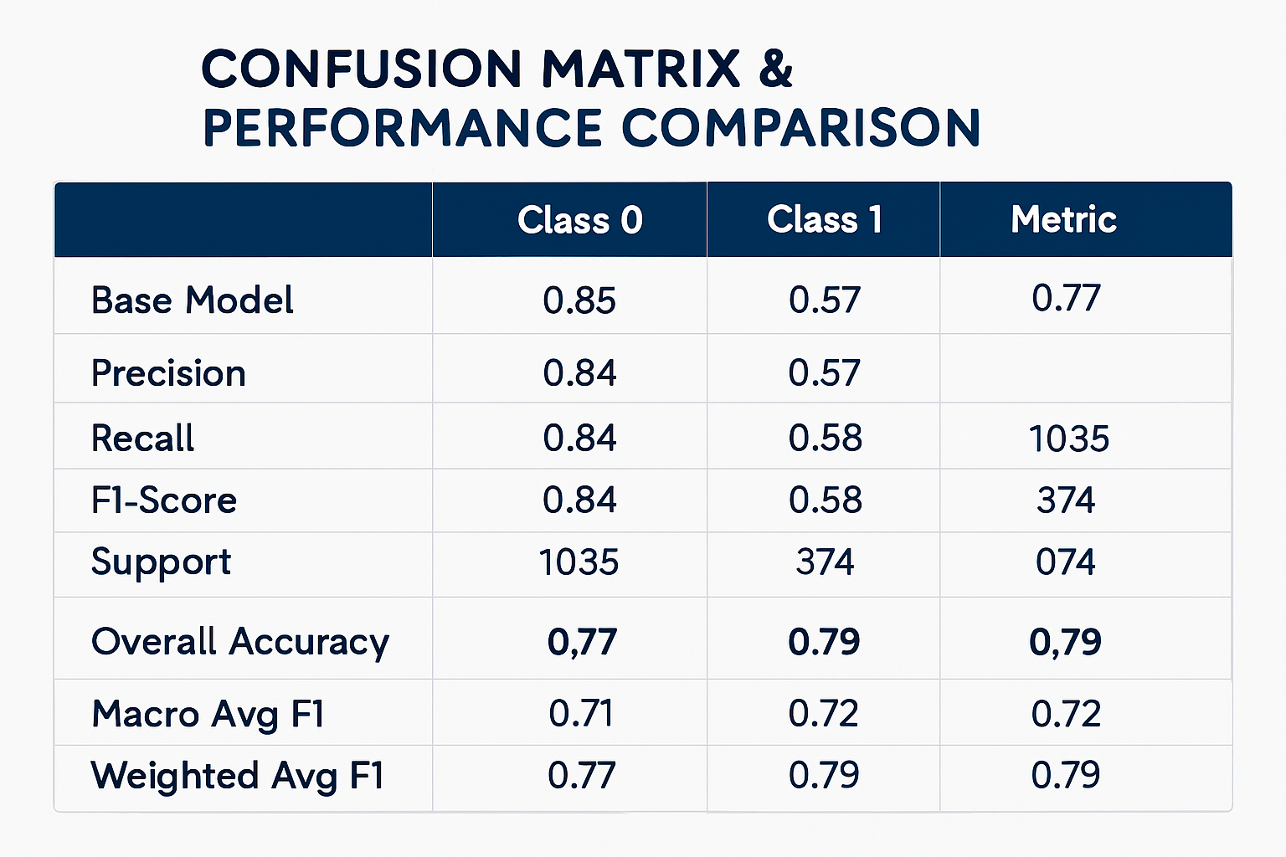
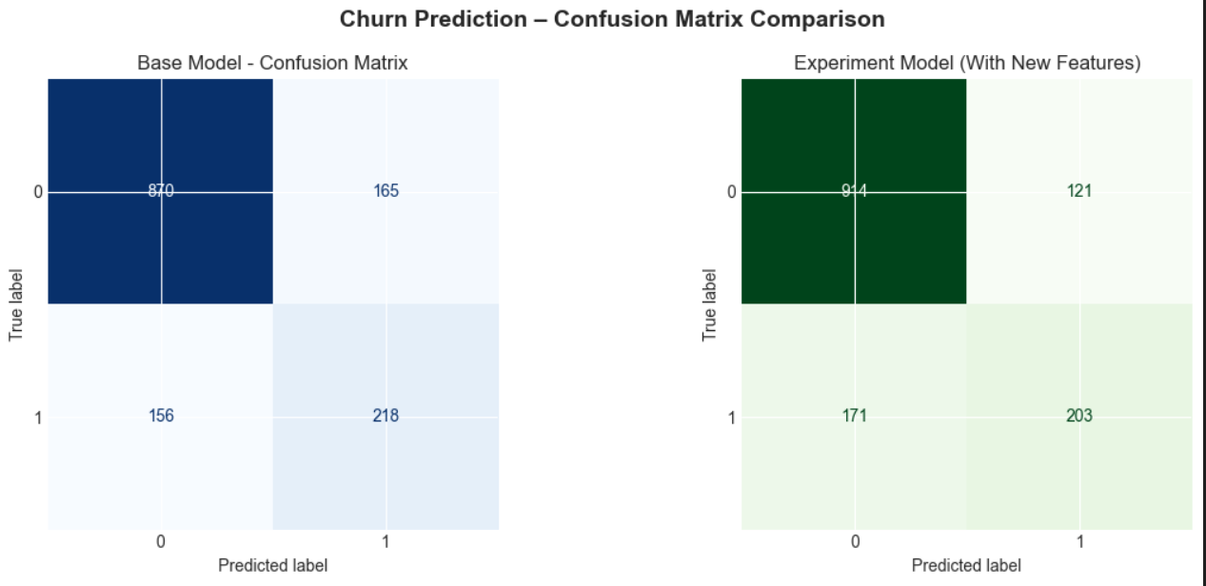
Base Vs Experiment Model

Slide 16
Thank You

