Slide 1
Strictly local band projectors and Wannier functions
Pratik sathe
In collaboration with Fenner Harper and Rahul roy

Slide 2

Background
Localization properties
Bloch wavefunctions: Subspace
Wannier functions^{[1]}
Projection operators
Localization $↔$ topology
[1] Wannier, G. H., 1937, Phys. Rev. 52, 191.
Notes:
Much of the effort in condensed matter physics is centered around obtaining solutions the Schrodinger’s equation.
Often, much insight can be gained by using the independent electron approximation.
The localization properties of wavefunctions can have implications on the physical properties of many systems.
For example, whether the eigenstates of a Hamiltonian are localized is intimately connected to electronic conduction properties, as well as quantum information storage.
In the presence of translational invariance, Bloch’s theorem tells us that the Hilbert space is divided according to so-called bands, with wave-like Bloch wavefunctions being the eigenstates of the Hamiltonian. These states span a subspace of the Hilbert space.
In certain applications it is beneficial to instead obtain a set of localized wavefunctions which span such a subspace. They are called Wannier functions.
The projection operators onto such spaces have been used as tools in order to obtain such Wannier functions.
Localization properties have connections with topology
Flat band Hamiltonians prove to be useful settings in order to understand various phenomena such as Anderson localization, superconductivity and Fractional Chern insulators.
Efforts to create model Hamiltonians.

Slide 3
Wannier functions: review
Properties:
Span a band or a set of bands
Mutually orthogonal
Translates of each other

Slide 4
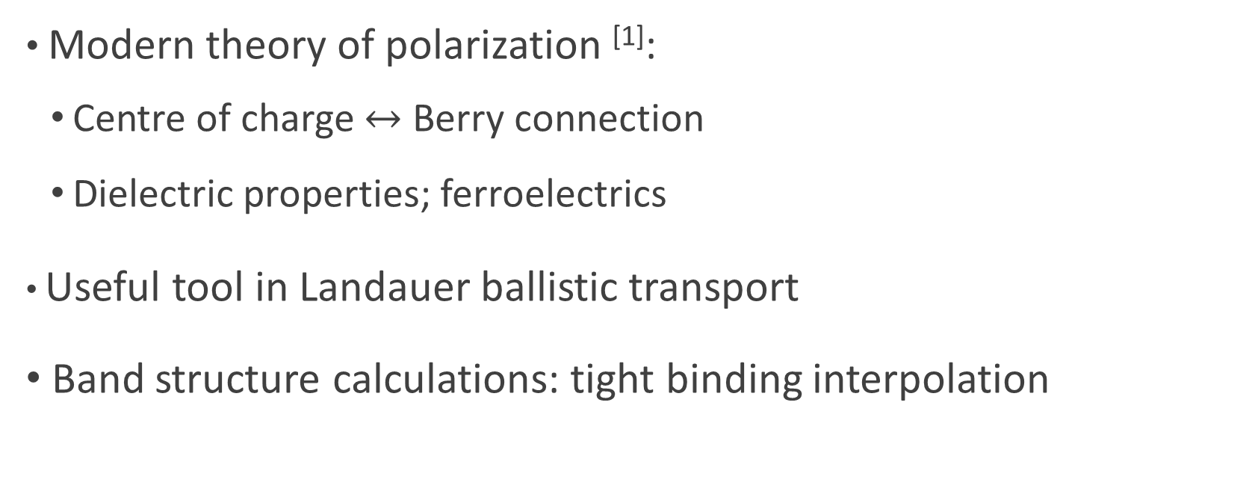
Wannier functions: applications
Modern theory of polarization ^{[1]}:
Centre of charge $↔$ Berry connection
Dielectric properties; ferroelectrics
Useful tool in Landauer ballistic transport
Band structure calculations: tight binding interpolation
[1] Raffaele Resta 2010 J. Phys.: Condens. Matter22 123201

Slide 5



Wannier functions: non-uniqueness
Bloch wavefunctions
Wannier functions
Fourier transform
$$w_{nR}\left(r\right)=\frac{V}{2π} \int_{BZ}{dk ψ_{nk}\left(r\right)e^{−ik.R}}$$
$$ψ_{nk}\left(r\right)=e^{ikr}u_{nk}(r)$$
Gauge choice:
$$u_{nk}\left(r\right)→u_{nk}\left(r\right)e^{iφ\left(k\right)}$$

Slide 6
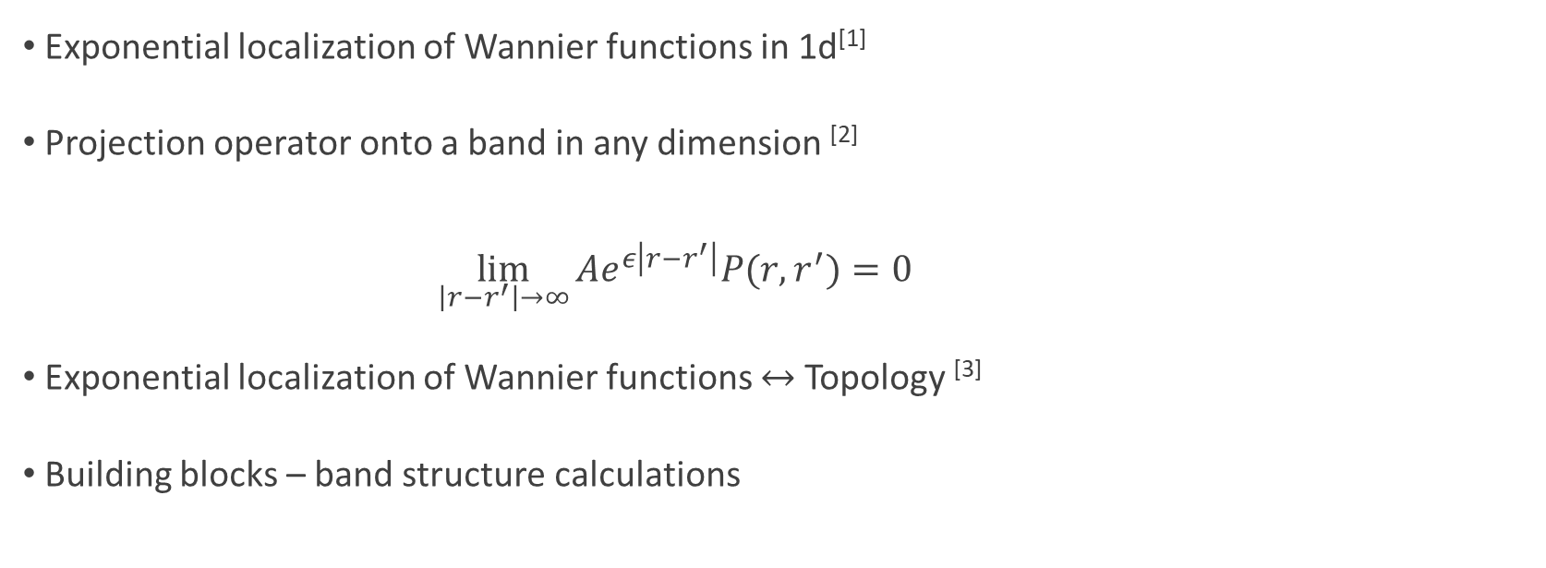
Localized Wannier functions
Exponential localization of Wannier functions in 1d^{[1]}
Projection operator onto a band in any dimension ^{[2]}
$\lim_{\left|r−r^{′}\right|→∞}{Ae^{ε\left|r−r^{′}\right|}P(r,r^{′})}=0$
Exponential localization of Wannier functions $↔$ Topology ^{[3]}
Building blocks – band structure calculations
[1] Kohn, W., 1959, Phys. Rev. 115, 809.
[2] Des Cloizeaux, J., 1964 Phys. Rev. 135.3A: A685.
[3] Panati, G., 2007, Ann. Inst. Henri Poincare´ 8, 995.

Slide 7
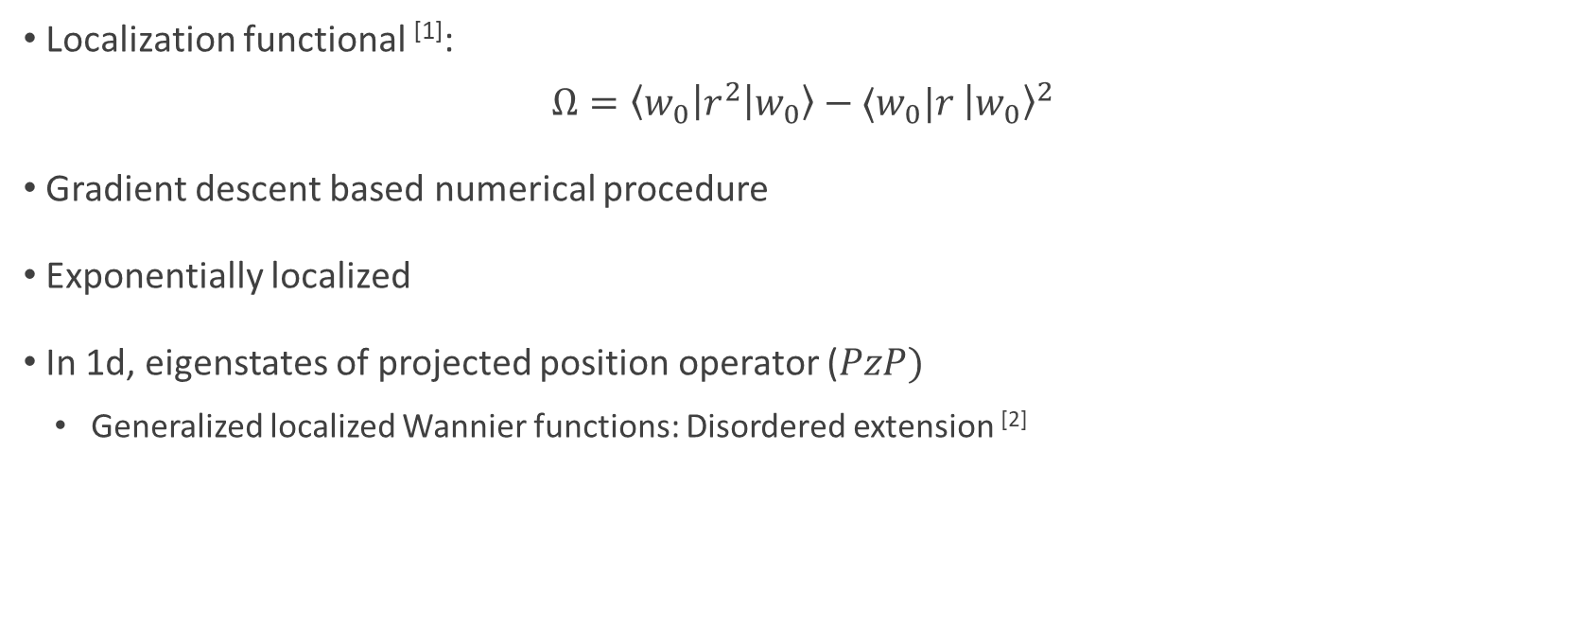
Maximally localized Wannier functions
Localization functional ^{[1]}:
$$Ω=\left\langle w_{0}\right|r^{2}\left|w_{0}\right\rangle −⟨w_{0}|r {\left|w_{0}\right\rangle }^{2}$$
Gradient descent based numerical procedure
Exponentially localized
In 1d, eigenstates of projected position operator ($PzP)$
Generalized localized Wannier functions: Disordered extension ^{[2]}
[1] Marzari, N., and D. Vanderbilt, 1997, Phys. Rev. B 56, 12 847.
[2] Kivelson, S. 1982, Phys. Rev. B 26.8 : 4269.

Slide 8





Compact support
Extreme form of localization:
$$f\left(r\right)=\left\{\begin{aligned}f_{ab}\left(r\right) if r∈\left[a,b\right] \\ 0 otherwise\end{aligned}\right.$$
No-go theorems: Compactly support Wannier-type functions^{[1]}
Strictly-local flat-band Hamiltonians ^{[2,3]}
$$|ψ\left(r\right)|$$
$$|ψ\left(r\right)|$$
$$a$$
$$b$$
Exp. loc
Compact
[1] Read, N. 2017, Phys. Rev. B 95.11: 115309.
[2] Chen L, et al. 2014, J. of Phys. A: Math. and Theo. 47(15):152001.
[3] Maimaiti W, et al. 2019, Phys. Rev. B.;99(12):125129.

Slide 9
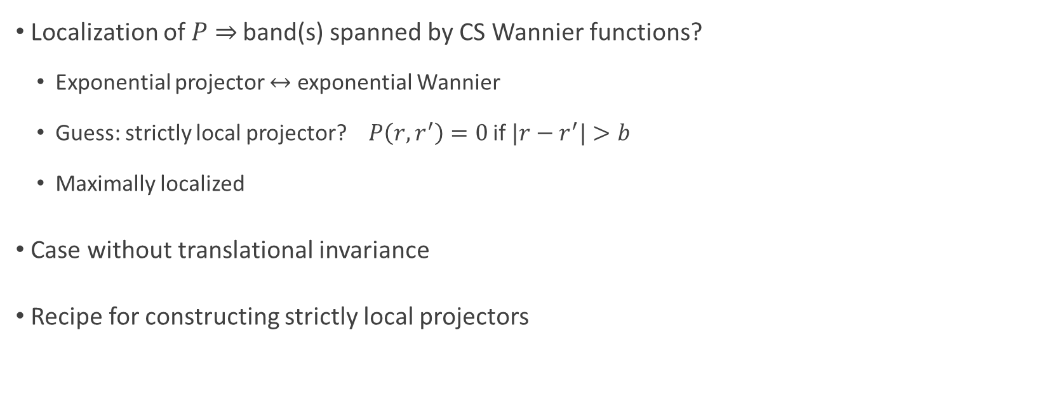
Open questions
Localization of $P$ $⇒$ band(s) spanned by CS Wannier functions?
Exponential projector $↔$ exponential Wannier
Guess: strictly local projector? $P\left(r,r^{′}\right)=0$ if $|r−r^{′}|>b$
Maximally localized
Case without translational invariance
Recipe for constructing strictly local projectors

Slide 10
Main result
Difficult
In 1d, Hilbert subspace spanned by C.S. orthonormal basis
Corresponding projection operator is strictly local
Simple

Slide 11













Notation
Hilbert space:
$$ℋ_{total}: \left|z,α\right\rangle$$
Cell index $z∈ℤ$
Orbital index
$$α=1,…,n$$
Cell
Orbitals
$$−2$$
$$−1$$
$$0$$
$$1$$
$$2$$
$$n$$
$$1$$
$$2$$
$$3$$
$$ℋ_{total}=⨁_{z∈ℤ}{ℋ^{z}}$$
Or $ℋ_{total}=ℤ⊗ℋ$

Slide 12







Projection operator
Matrix $P$:
$$P^{2}=P$$
$$P^{†}=P$$
Strict locality:
$\left\langle z,α\left|P\right|z^{′},α^{′}\right\rangle =0$ if $\left|z−z^{′}\right|>b$
Band
diagonal
Compactly supported orthonormal eigenbasis
$$0$$
$$0$$
Simple
$$P≡$$
$$≠0$$
Difficult
$$0$$
$$0$$

Slide 13
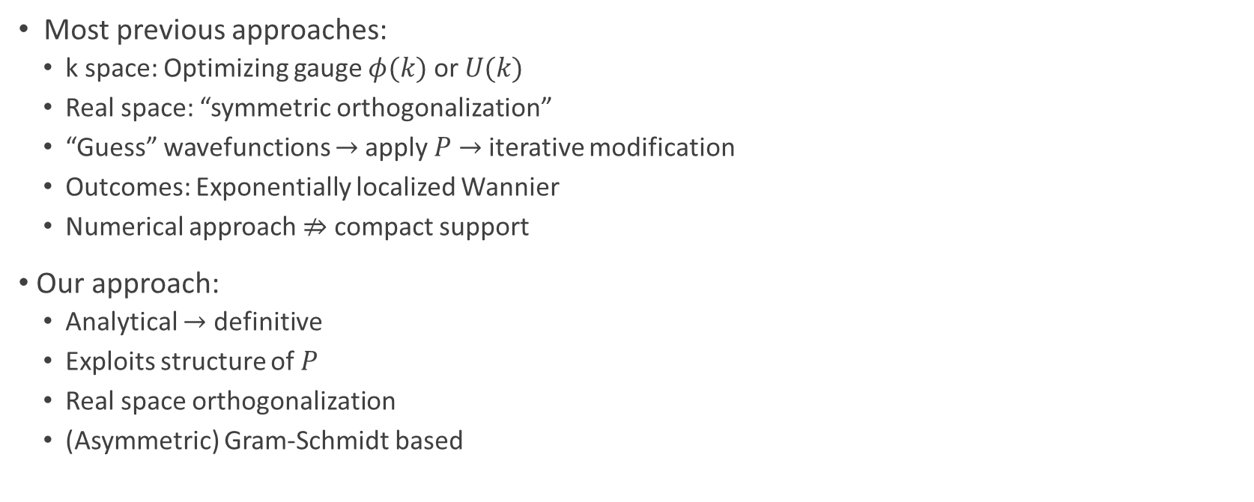
Comments on our approach
Most previous approaches:
k space: Optimizing gauge $φ(k)$ or $U(k)$
Real space: “symmetric orthogonalization”
“Guess” wavefunctions $→$apply $P$ $→$ iterative modification
Outcomes: Exponentially localized Wannier
Numerical approach $⇏$ compact support
Our approach:
Analytical $→$ definitive
Exploits structure of $P$
Real space orthogonalization
(Asymmetric) Gram-Schmidt based

Slide 14



Our approach
Strictly local projector
Nearest neighbor projector
Disordered
Disordered
Translationally invariant
Gram Schmidt procedure
Generalized localized Wannier basis
Maximally localized Wannier basis
Max size 3
Not $PzP$ eigenstates
Max size 2
$PzP$ eigenstates
Max size 2
$PzP$ eigenstates

Slide 15
Non-translationally invariant projectors
Aka Disordered Projectors
(The more general case)

Slide 16




Machinery
Define “hopping matrices” ${(P}_{δ}^{z})ij ≡\left\langle z+δ,i\left|P\right|z,j\right\rangle$
For example: $2×2$
Strict locality $⇒$ $P_{δ}^{z}=0 ∀ δ>b$.
$$P_{3}^{z}$$
$$z$$
$$z+3$$

Slide 17












Strictly local to nearest neighbor
Convert a strictly local projector to a nearest neighbor projector
“Supercell representation”
Primitive cell
$$b=3$$
$$=$$
$$n=2$$
Not NN
$$z−3$$
$$z$$
$$z+3$$
Supercell
$$b=1$$
$$=$$
$$n=6$$
NN form
$$z−1$$
$$z$$
$$z+1$$

Slide 18
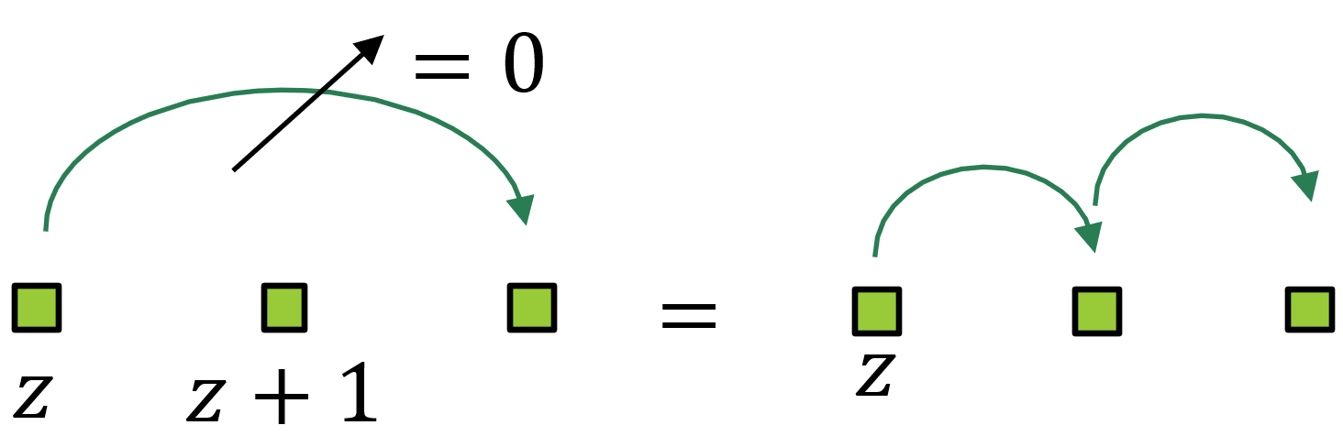
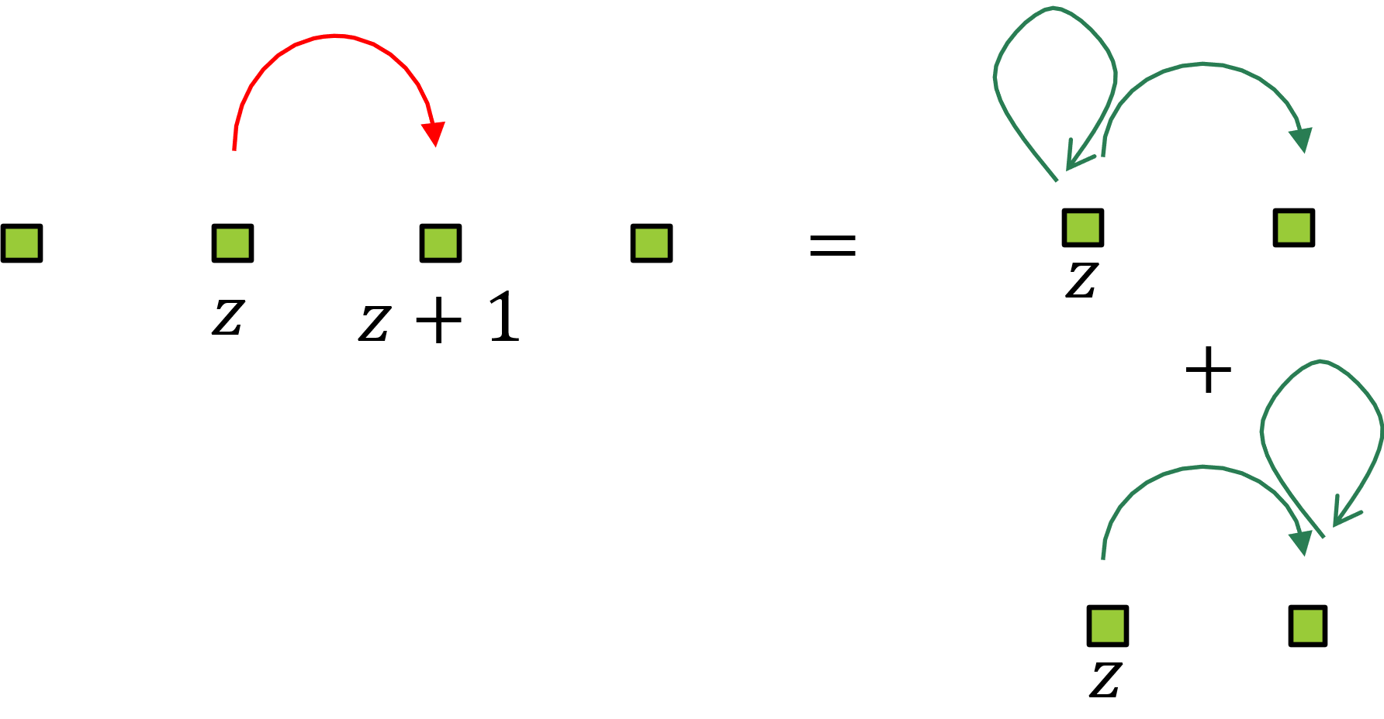
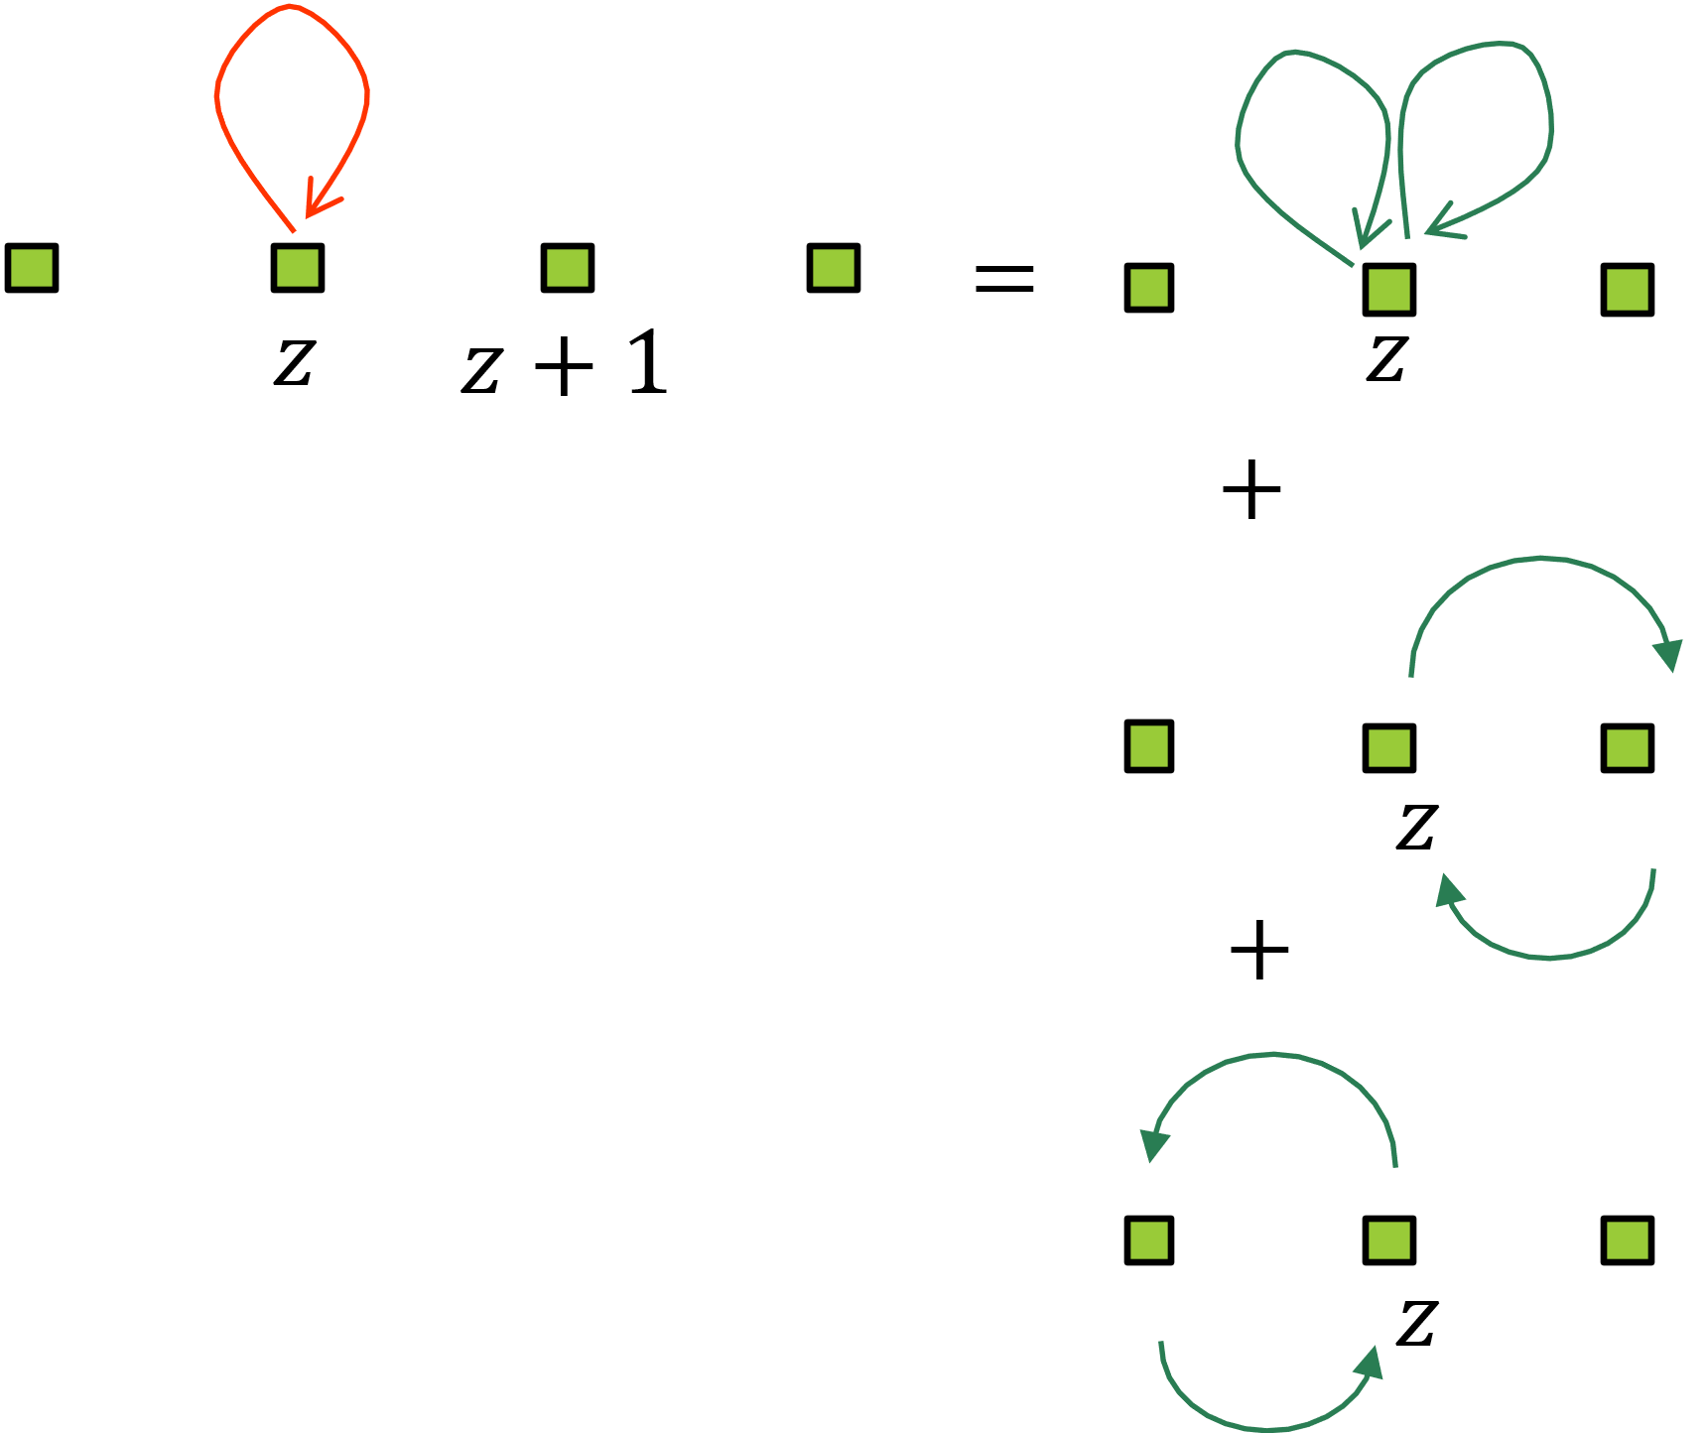



Nearest neighbor projector
Only three matrices per $z$: $P_{0}^{z}$, $P_{1}^{z}$ and $P_{−1}^{z}$
Matrix equations:
$P_{0}^{z†}=P_{0}^{z}$
$P_{−1}^{z+1}=P_{1}^{z†}$
$P_{1}^{z}=P_{1}^{z}P_{0}^{z}+P_{0}^{z+1}P_{1}^{z}$
$P_{0}^{z}={(P_{0}^{z})}^{2}+P_{−1}^{z+1 }P_{1}^{z}+P_{1}^{z−1}P_{−1}^{z}$
$P_{1}^{z+1}P_{1}^{z}=0$
$$P^{†}=P$$
$$P^{2}=P$$

Slide 19
Approach 1: Gram-Schmidt procedure

Slide 20
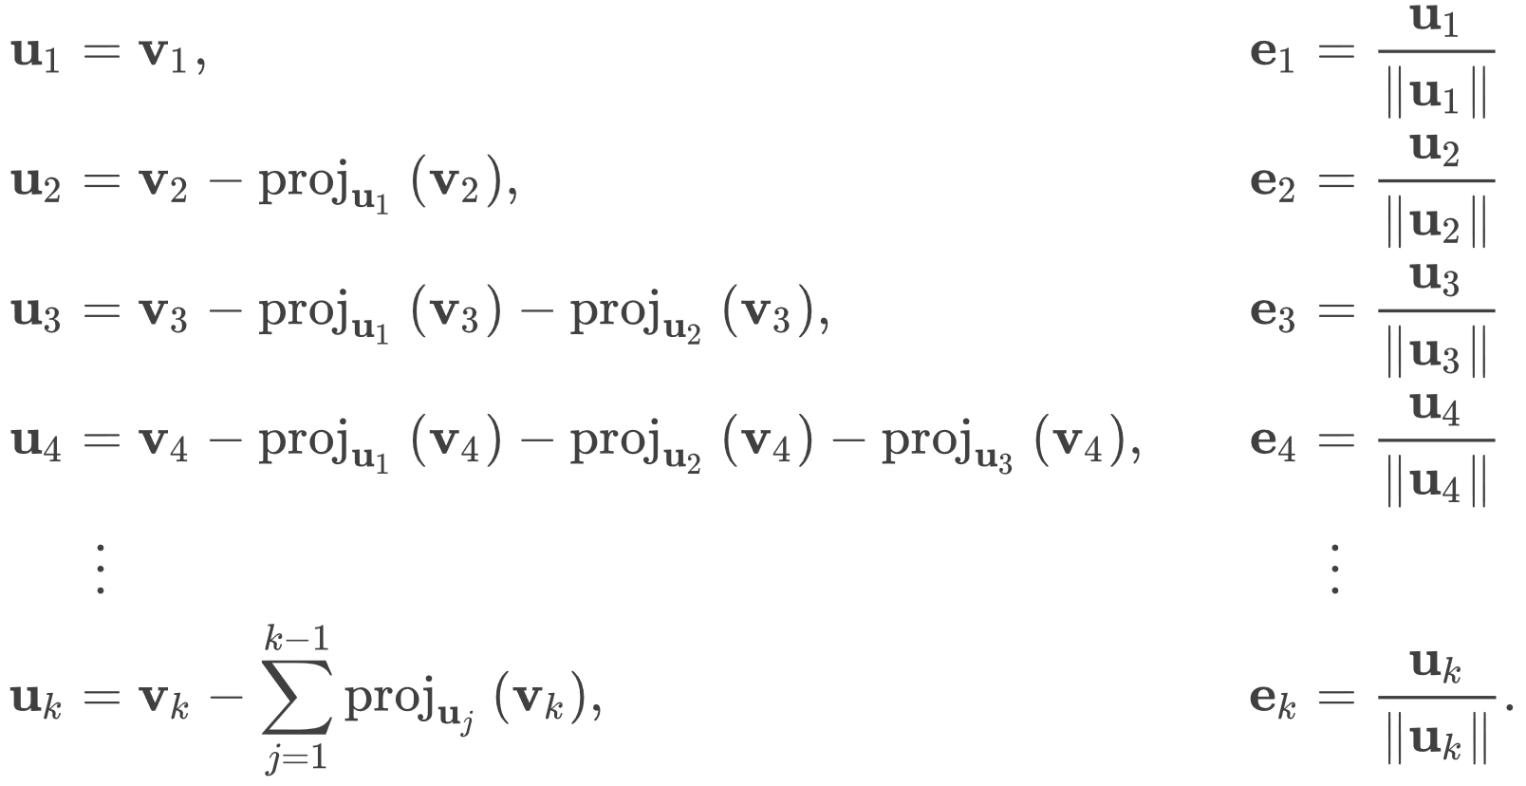
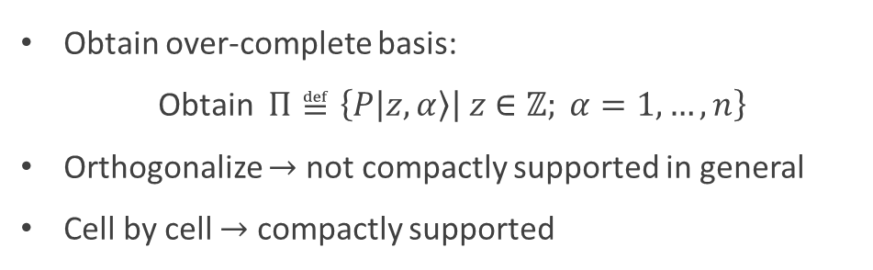

Approach 1: Gram-Schmidt procedure
Given $\vec{\{v_{i}}\}$
Obtain over-complete basis:
Obtain $Π≝\left\{P | z,α\right\rangle \left| z∈ℤ; α=1,…,n\right\}$
Orthogonalize $→$ not compactly supported in general
Cell by cell $→$ compactly supported
Sequence dependent

Slide 21
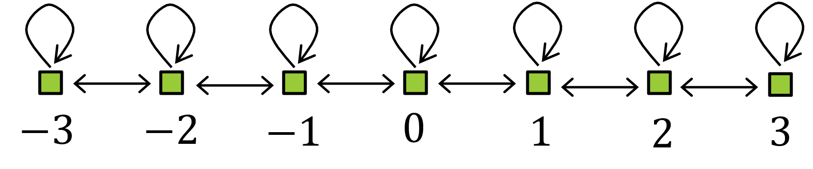
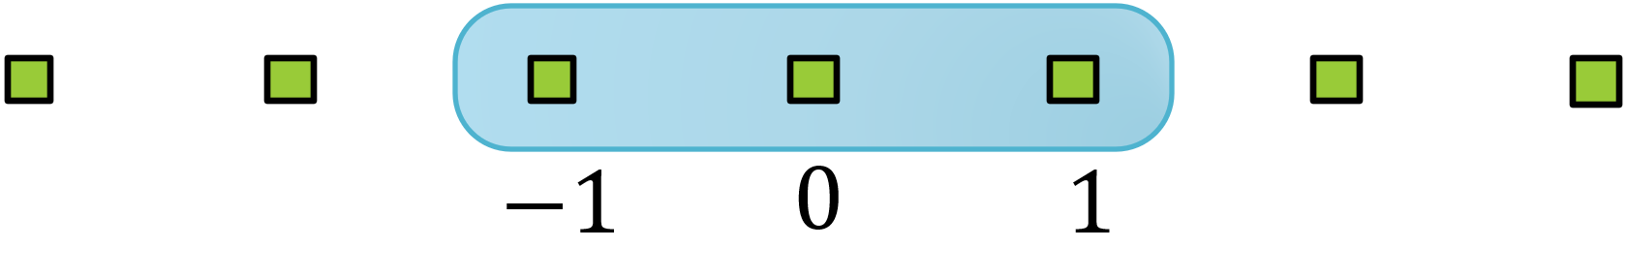
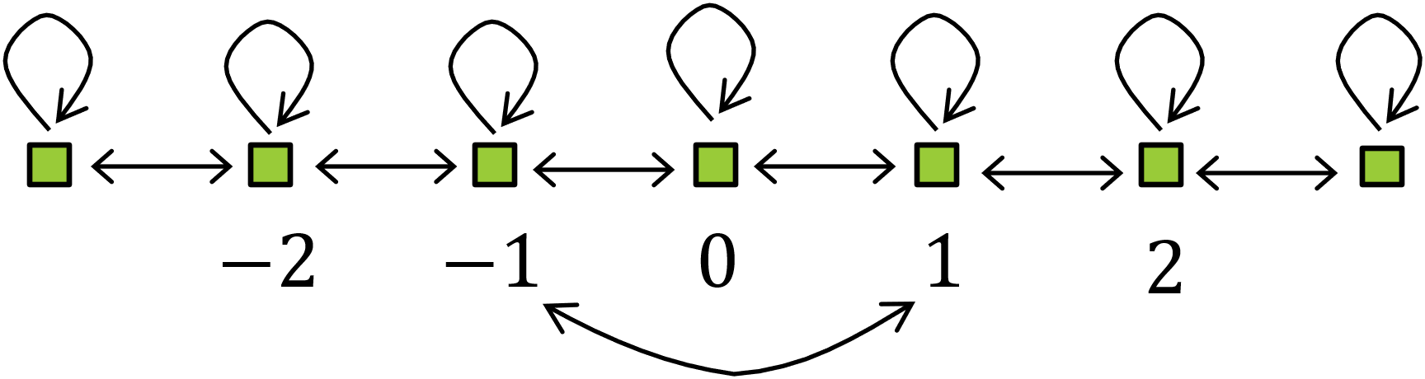
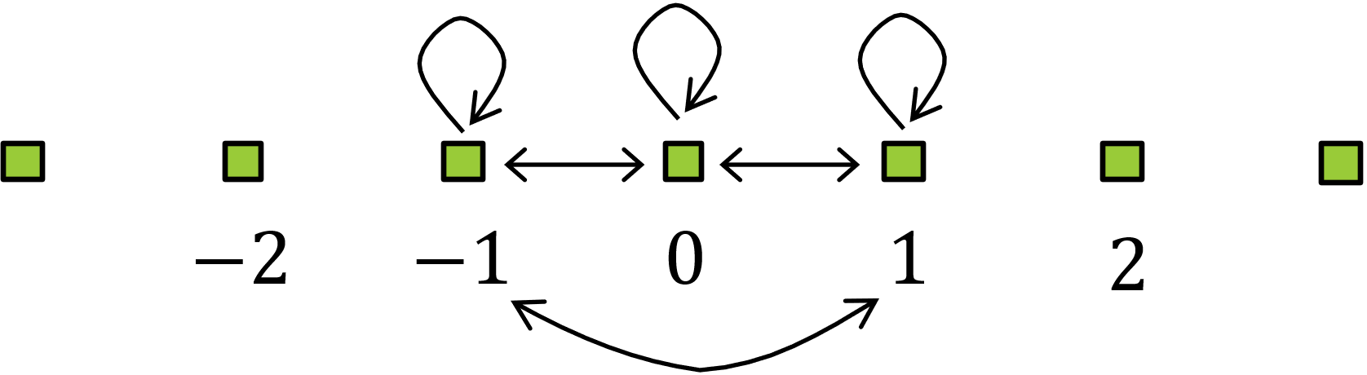










Orbital by orbital orthogonalization
$P$ connectivity
Obtain and normalize $P|z=0,1⟩$
Projector $P_{0,1}$
$(P−P_{0,1})$ connectivity
$P_{0,1}$ connectivity
… Size keeps growing
$$−2$$
$$−1$$
$$0$$
$$1$$
$$2$$

Slide 22
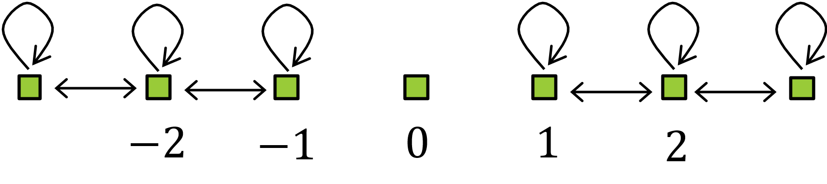









Cell by cell orthogonalization
Step 0. Define cell sequence e.g. $𝒮=0,−1,1,−2,…$
Step 1. $Π^{0}≝\left\{P | 0,α\right\rangle \left|α=1,…,n\right\}$
$Π^{0}$ wavefunctions
Orthonormalize: ${\tilde{Π}}^{0}$wavefunctions
Obtain Projector $P_{0}$
Key observation:
$P−P_{0}$ connectivity:
$$𝒮=0,−1,1,−2,…$$
$$−1$$
$$0$$
$$1$$
Appendix: Proof

Slide 23

Output
Compactly supported orthonormal basis
Positives:
Easy to implement
Maximum size 3
Negatives:
Not the most localized ($PzP$)
Translationally invariant case $→$ not Wannier
Opaque
Method for maximally localized wavefunctions?
Appendix: Algorithm format

Slide 24

Approach 2: Generalized Wannier functions
$PzP$ eigenstates

Slide 25

Underlying ideas
Matrix identities $→$ Understand the structure of $P$
Unitary rotations $→$ Make matrices sparse
Simultaneously
All $P_{0}^{z}$ diagonal
“Diagonalize” all $P_{1}^{z}$
Sequential: cell by cell

Slide 26



Step 1: $P_{0}$ diagonal basis
$P_{0}^{z†}=P_{0}^{z}$:
Spectrum $Λ^{z}$
Real eigenvalues $λ$ $→$ multiplicity = $n_{λ}^{z}$
eigenvectors $\left|λ_{i}^{z}\right\rangle$, $i=1,…,n_{λ}^{z}$
$ℋ=⊕_{λ∈Λ^{z}}ℋ_{λ}^{z}$
$λ∈\left[0,1\right]$ (${⇐P}_{0}^{z}={(P_{0}^{z})}^{2}+P_{1}^{z† }P_{1}^{z}+P_{−1}^{z†}P_{−1}^{z}$)

Slide 27


















$P_{0}$ diagonal basis
Example:
$$|{0.2 }_{1}^{z}⟩$$
$n=$3
$$λ=0.2$$
$$n_{0.2}^{z}=2$$
$$P_{0}^{z}$$
$$|{0.2 }_{2}^{z}⟩$$
$\{|α⟩|α=1,2,3\}$
$$Λ^{z}=\{0.2,0.7\}$$
$λ=0.$7
$$|{0.7 }_{1}^{z}⟩$$
$$n_{0.7}^{z}=1$$
$$z$$
Old basis
New basis
$$\left|z,α\right\rangle$$
$$\left|z\right\rangle ⊗|λ_{i}⟩$$
$P_{0}$ diagonalization
$$ℤ$$
$$ℋ$$

Slide 28





$P_{1}^{z}$ matrix
Consider $λ∈Λ^{z}$ and $μ∈Λ^{z+1}$
$\left\langle μ_{j}^{z+1}\right|P_{1}^{z}\left|λ_{i}^{z}\right\rangle ≠0$ only if $λ+μ=1$
$P_{1}^{z}\left|0_{i}\right\rangle =P_{1}^{z}\left|1_{j}\right\rangle =0$
$$0$$
$$0.3$$
$0.$7
1
Appendix: Proof A
Appendix: Proof B

Slide 29
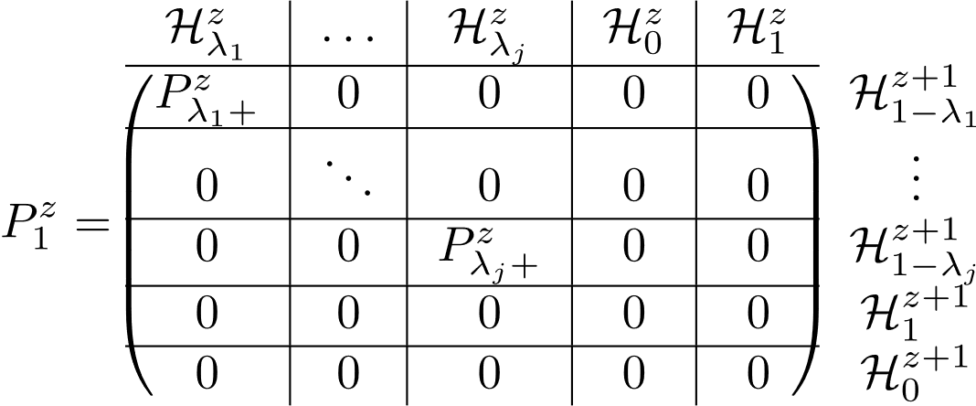

$P_{1}^{z}$ is block diagonal
Make $P_{1}^{z}$ “diagonal” $→$ treat $P_{λ+}^{z}$ separately

Slide 30
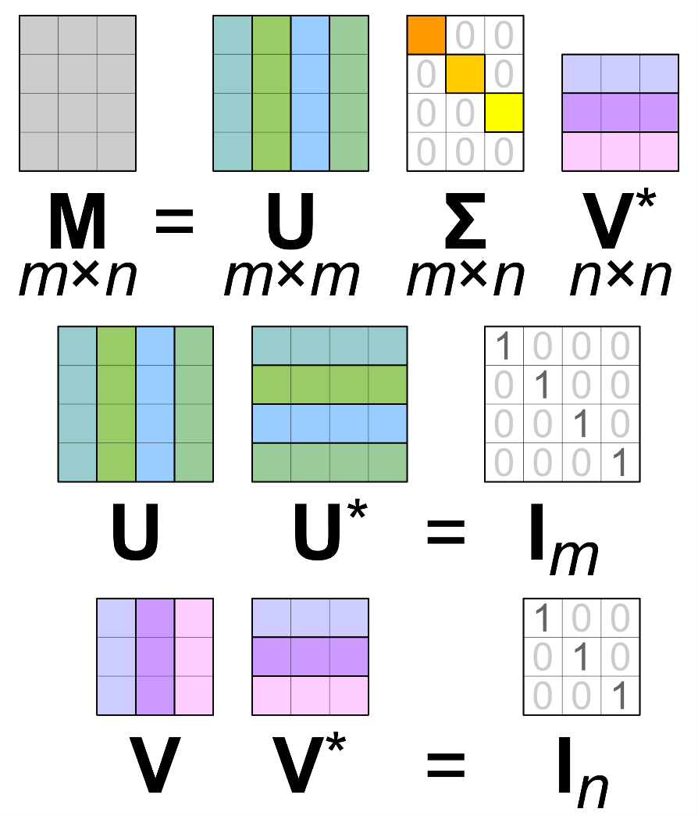
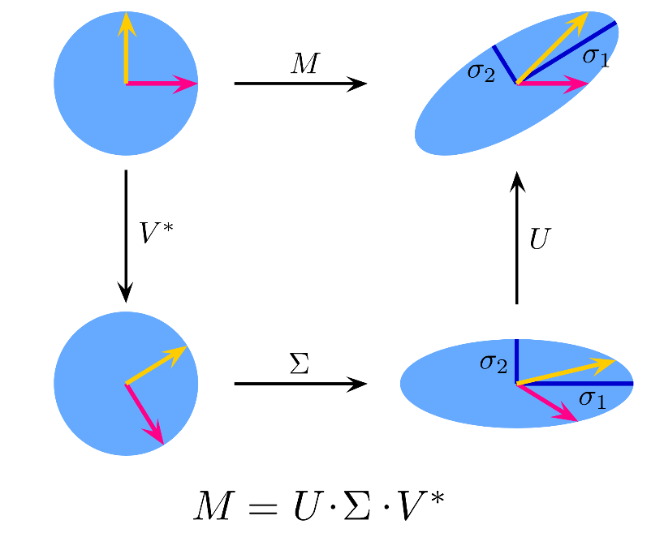
Singular Value decomposition (SVD)
Generalization of diagonalization
https://en.wikipedia.org

Slide 31











SVD of $P_{λ+}^{z}$
Matrix $P_{λ+}^{z}:$ ${\left(P_{λ+}^{z}\right)}_{ij}=\left\langle {(1−λ)}_{i}^{z+1} | P_{1}^{z} | λ_{j}^{z}\right\rangle$
Singular value decomposition:
$P_{λ+}^{z}=UΣ_{λ} V^{†}$
Basis transformations
$ℋ_{λ}^{z}:\left|λ_{i}^{z}\right\rangle →{\left|λ_{i}^{z}\right\rangle }_{+}≔V|λ_{i}^{z}⟩$
$ℋ_{1−λ}^{z}:\left|{(1−λ)}_{i}^{z+1}\right\rangle →{\left|{(1−λ)}_{i}^{z+1}\right\rangle }_{−}≔U\left|{(1−λ)}_{i}^{z+1}\right\rangle$
$${\left|λ_{1}\right\rangle }_{+}$$
$${\left|{(1−λ)}_{1}\right\rangle }_{+}$$
$${\left|λ_{2}\right\rangle }_{+}$$
$${\left|{(1−λ)}_{2}\right\rangle }_{+}$$
$${\left|λ_{3}\right\rangle }_{+}$$
$${\left|{(1−λ)}_{3}\right\rangle }_{+}$$
$${\left|λ_{4}\right\rangle }_{+}$$
$$z$$
$$z+1$$

Slide 32
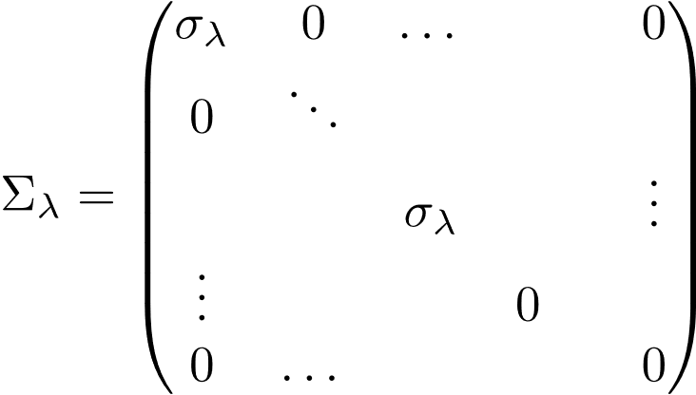



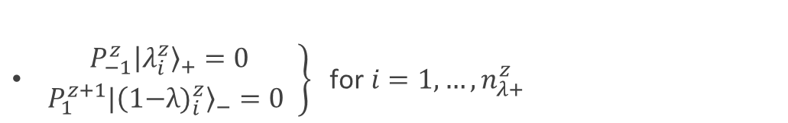

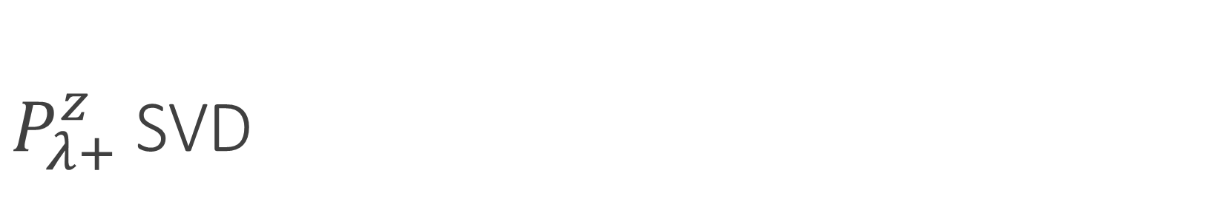







$P_{λ+}^{z}$ SVD
Singular values $σ_{λ}=\sqrt{λ\left(1−λ\right)}$
$3×3$ matrix
$$P_{0.3+}^{z}$$
$$n_{0.3+}^{z}=2$$
$$n_{λ+}^{z}$$
$$0$$
$$0.3$$
$0.$7
1
$$z−1$$
$$z$$
$$z+1$$
$$z+2$$
Before SVD
$\left.\begin{aligned}P_{−1}^{z}{\left|λ_{i}^{z}\right\rangle }_{+}=0 \\ P_{1}^{z+1}|{(\text{1−}{λ)}_{i}^{z}〉}_{−}=0 \end{aligned}\right\} \text{for} i=1,…,n_{λ+}^{z}$
After SVD
Appendix: Proof

Slide 33







Approach 2: Iterative procedure
$$0$$
$$0.3$$
$0.$7
1
$$z−1$$
$$z$$
$$z+1$$
$$z+2$$

Slide 34




















Iterative procedure: cell by cell
“Structural orbital basis” of $P$
$$−3$$
$−$2
$$−1$$
$$0$$
$$1$$
$$2$$
$$3$$
$$4$$
$$0$$
$$P_{1}^{−2}$$
$$P_{1}^{−1}$$
$$P_{1}^{0}$$
$$P_{1}^{1}$$
$$P_{1}^{2}$$
$0.$8
$$0.2$$
$0.$7
$$0.3$$
1
$$𝒮=0, −1, 1, −2, 2,−3,3…$$
Appendix: Details

Slide 35




















Obtaining a compactly supported basis
Operate $P$ on all “right-facing”, or $+$ orbitals
Operate $P$ on all $λ=1$ orbitals
$$0$$
$0.$8
$$0.2$$
$0.$7
$$0.3$$
1
$$−3$$
$−$2
$$−1$$
$$0$$
$$1$$
$$2$$
$$3$$
$$4$$
$$P_{1}^{−2}$$
$$P_{1}^{−1}$$
$$P_{1}^{0}$$
$$P_{1}^{1}$$
$$P_{1}^{2}$$
Appendix: Details

Slide 36
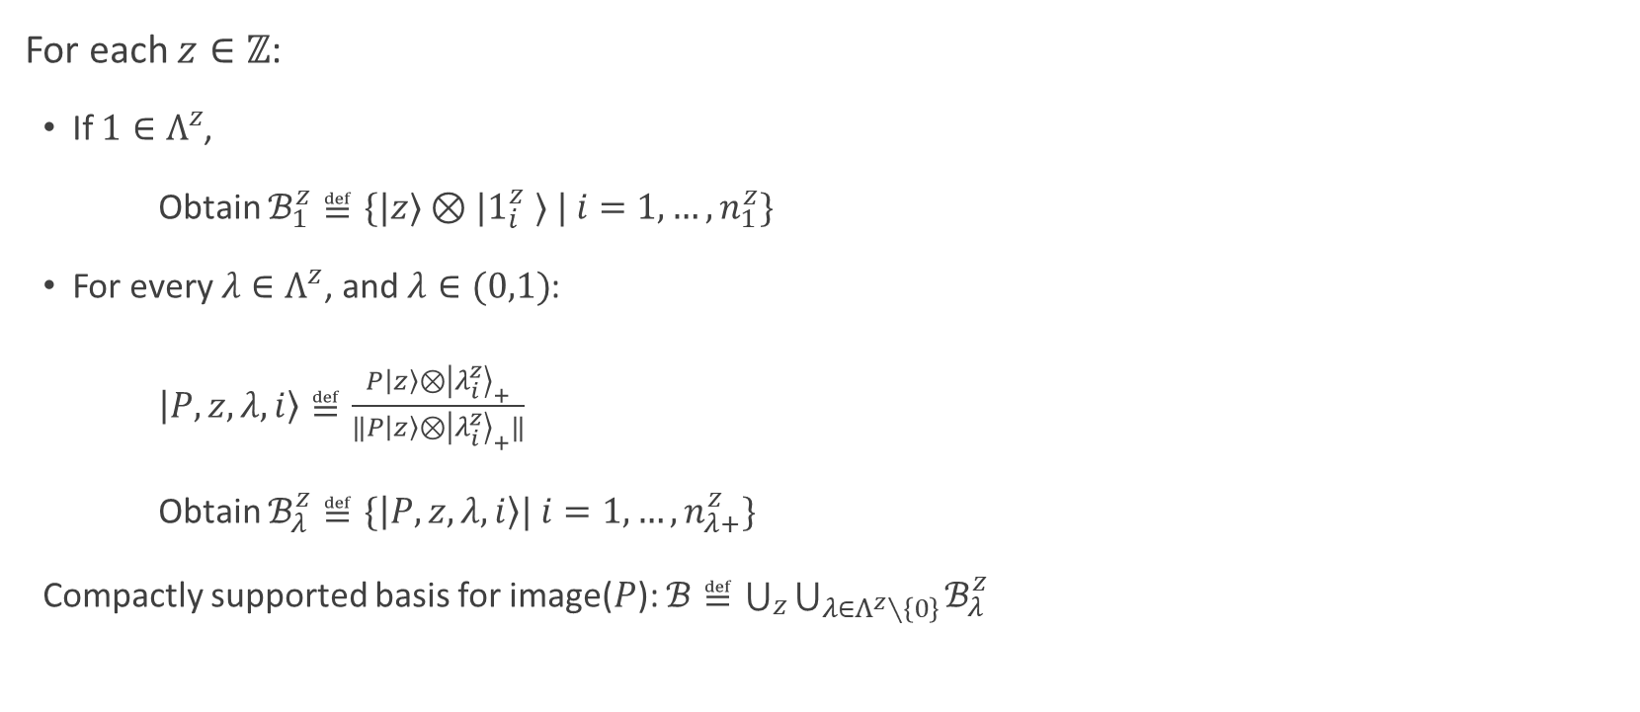
Algorithm
For each $z∈ℤ$:
If $1∈Λ^{z}$,
Obtain $ℬ_{1}^{z}≝\{|z⟩⊗|1_{i}^{z} ⟩ | i=1,…,n_{1}^{z}\}$
For every $λ∈Λ^{z}$, and $λ∈(0,1)$:
$\left|P,z,λ,i\right\rangle ≝\frac{P\left|z\right\rangle ⊗{\left|λ_{i}^{z}\right\rangle }_{+}}{‖P\left|z\right\rangle ⊗{\left|λ_{i}^{z}\right\rangle }_{+}‖}$
Obtain $ℬ_{λ}^{z}≝\{\left|P,z,λ,i\right\rangle | i=1,…,n_{λ+}^{z}\}$
Compactly supported basis for image($P$): $ℬ≝\bigcup_{z}{\bigcup_{λ∈Λ^{z}∖\left\{0\right\}}{ℬ_{λ}^{z}}}$

Slide 37

Output
Generalized localized Wannier basis
Maximum size 2
Reveals the structure of $P$
Recipe for constructing arbitrary short ranged projectors

Slide 38
Translationally invariant projectors
Symmetry creates more structure

Slide 39

Translationally invariant case (NN)
Definition:
$P_{δ}^{z}=P_{δ}^{0}$
Drop $z$: only two matrices $P_{1}$ and $P_{0}$
Both approaches work
Basis: not Wannier
Symmetry $→$ additional structure
Modified approach 2 $→$ maximally localized Wannier

Slide 40



Translationally invariant NN projectors
Matrix identities:
$P_{0}^{†}=P_{0}$
$P_{−1}^{†}=P_{1}$
$P_{0}=P_{0}^{2}+P_{1}P_{1}^{†}+P_{1}^{†}P_{1}$
$P_{1}=P_{1}P_{0}+P_{0}P_{1}$
$P_{1}^{2}=P_{1}$
$$P^{†}=P$$
$$P^{2}=P$$

Slide 41
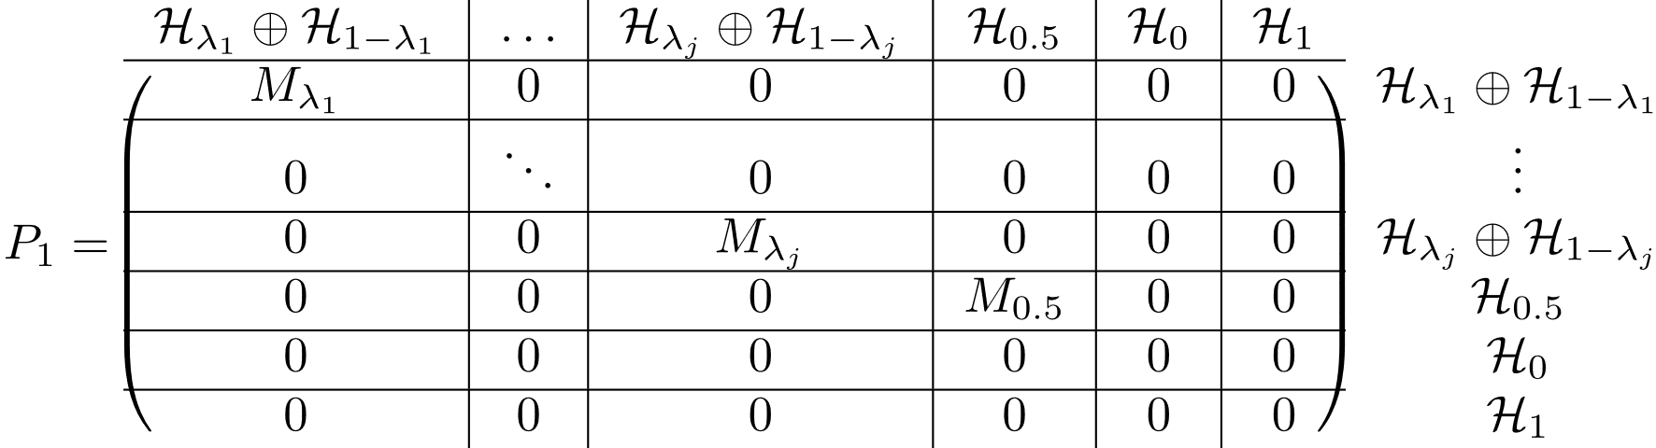
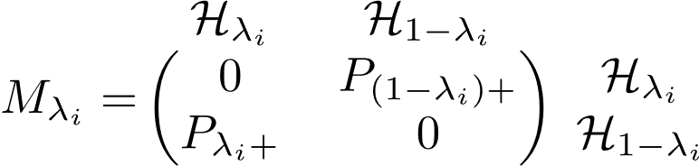


Lemmas
If $λ∈Λ$ and $λ≠0,1$, then $1−λ∈Λ$
$P_{1}$ only connects eigenspaces $λ$ and $μ$ if $λ+μ=1$
$M_{0.5}$ is special

Slide 42

Lemmas (continued)
$n_{0.5}$ is even
Rank of $M_{0.5}$ $={n_{0.5}}/2$
$n_{λ}=n_{1−λ}$ if $λ≠0,1$
Appendix: Proof

Slide 43









Wannier function procedure
Not cell by cell
eigenspace by eigenspace
e.g. for $λ∉\{0,0.5,1\}$
$0.$8
$$0.2$$
$0.$7
$$0.3$$
$$P_{0.2+}$$
$$P_{0.8+}$$
$$P_{0.3+}$$
$$P_{0.7+}$$

Slide 44

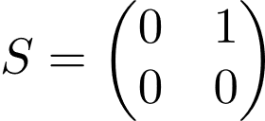

Wannier function procedure
$λ=0.5$ $M_{0.5}:ℋ_{0.5}→ℋ_{0.5}$
$M_{0.5}^{2}=0 ⇒$

Slide 45

Output
$PzP$ eigenstates
Maximally localized Wannier functions
Analytical result vs. numerical
Recipe for creating arbitrary projectors

Slide 46
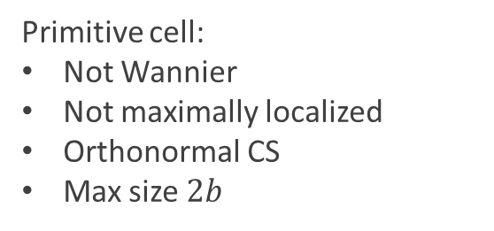
Caveats: Strictly local projectors
Strictly local projector
Supercell representation: strictly local to nearest neighbor
Obtain orthonormal basis
Transform back to primitive cell representation
Breaks translational invariance
Primitive cell:
Not Wannier
Not maximally localized
Orthonormal CS
Max size $2b$

Slide 47
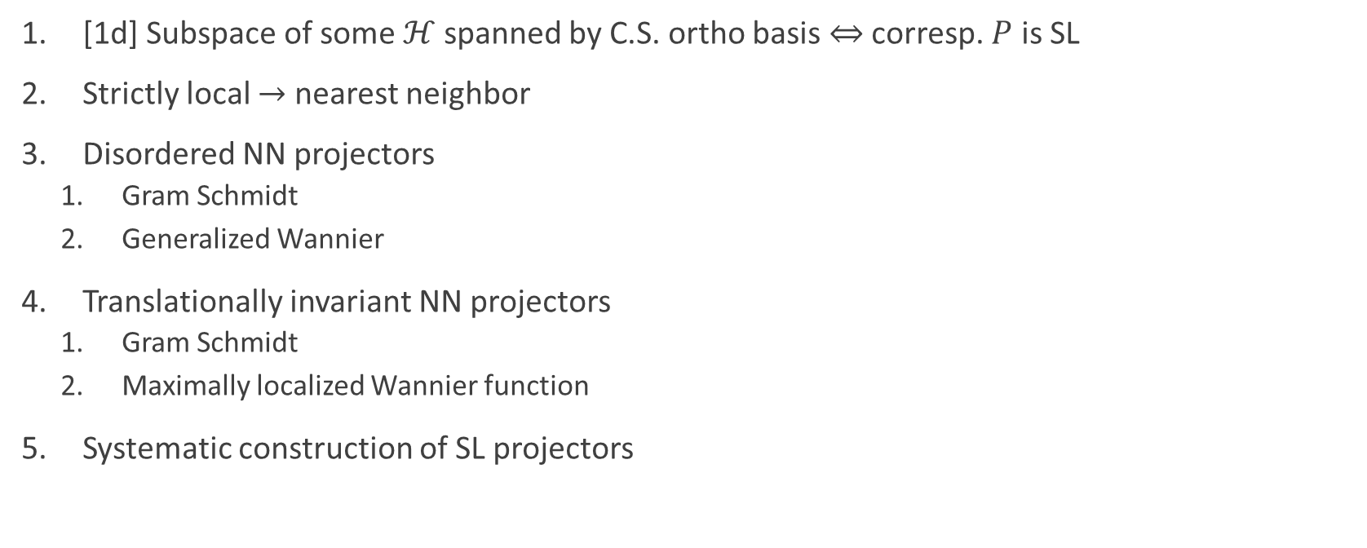
Conclusion
[1d] Subspace of some $ℋ$ spanned by C.S. ortho basis $⇔$ corresp. $P$ is SL
Strictly local $→$ nearest neighbor
Disordered NN projectors
Gram Schmidt
Generalized Wannier
Translationally invariant NN projectors
Gram Schmidt
Maximally localized Wannier function
Systematic construction of SL projectors

Slide 48

Future directions and projects
Paper writing in progress
[In progress] Compactly supported Wannier-type functions
$↓$
Localization bound on corresp. Wannier functions
Many-body localization

Slide 49
Acknowledgements
Committee members for your attention and review
Advisor and mentor: Prof. Rahul Roy
Post-doc and collaborator: Fenner Harper
Group peers: Dominic Reiss, Xu Liu, Albert Brown and Spenser Talkington
Family and friends

Slide 50
Appendices
Proofs of lemmas

Slide 51
Appendix: Gram Schmidt proof
Go back

Slide 52





Appendix: Gram-Schmidt procedure
Sequence $𝒮:z_{0},z_{1},…$
Initialize $i=0$. Do:
Set $z=z_{i}$
Obtain $Π^{z}=\left\{P | z,α\right\rangle \left|α=1,…,n\right\}$
Orthogonalize $→{\tilde{Π}}^{z}$
Projector onto ${\tilde{Π}}^{z}→P_{z}$
Update projector $P←P−P_{z}$
$i←i+1;$ go to step 1
Output: $\tilde{Π}=\bigcup_{z}{{\tilde{Π}}^{z}}$
e.g. $𝒮=0, 1,−1, 2,…$
$$−1$$
$$0$$
$$1$$
Go back

Slide 53
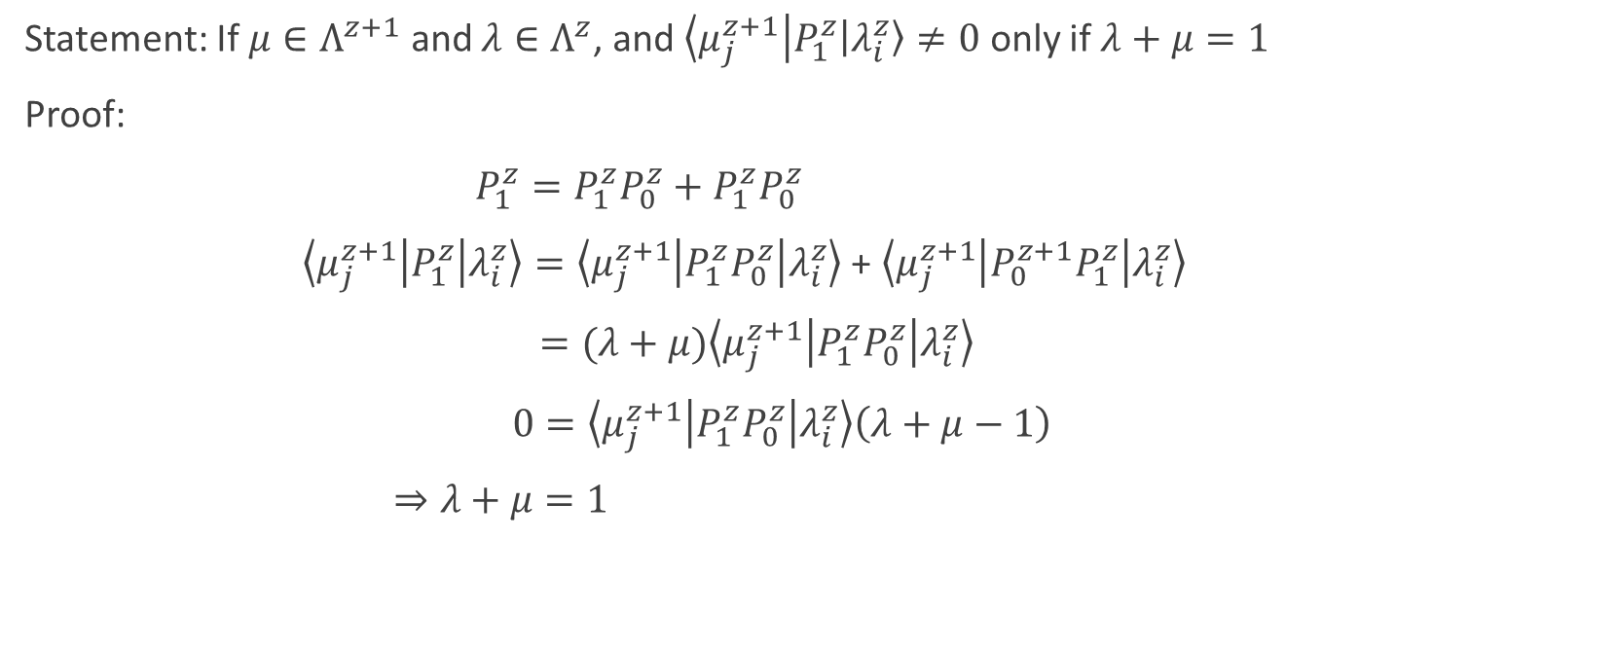

Appendix: $P_{1}^{z}$ connectivity proof
Statement: If $μ∈Λ^{z+1}$ and $λ∈Λ^{z}$, and $\left\langle μ_{j}^{z+1}\right|P_{1}^{z}\left|λ_{i}^{z}\right\rangle ≠0$ only if $λ+μ=1$
Proof:
$P_{1}^{z}=P_{1}^{z}P_{0}^{z}+P_{1}^{z}P_{0}^{z}$
$\left\langle μ_{j}^{z+1} | P_{1}^{z} | λ_{i}^{z}\right\rangle =\left\langle μ_{j}^{z+1} | P_{1}^{z}P_{0}^{z} | λ_{i}^{z}\right\rangle$ + $\left\langle μ_{j}^{z+1} | {P_{0}^{z+1}P}_{1}^{z} | λ_{i}^{z}\right\rangle$
$=(λ+μ)\left\langle μ_{j}^{z+1} | P_{1}^{z}P_{0}^{z} | λ_{i}^{z}\right\rangle$
$0=\left\langle μ_{j}^{z+1} | P_{1}^{z}P_{0}^{z} | λ_{i}^{z}\right\rangle \left(λ+μ−1\right)$
$⇒λ+μ=1$
Go back

Slide 54
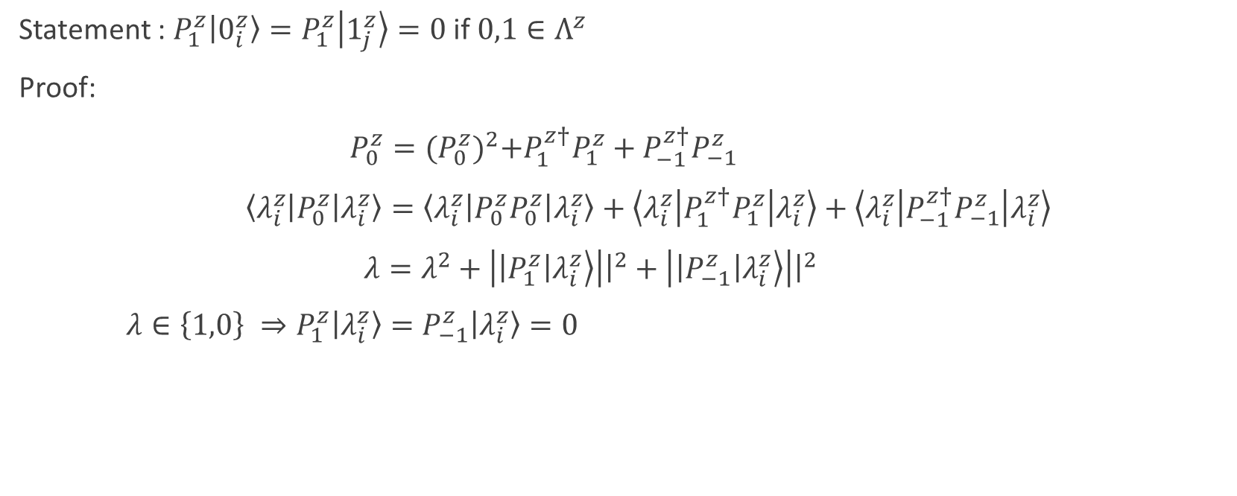

Appendix: $P_{1}^{z}$ on $0$ and $1$
Statement : $P_{1}^{z}\left|0_{i}^{z}\right\rangle =P_{1}^{z}\left|1_{j}^{z}\right\rangle =0$ if $0,1∈Λ^{z}$
Proof:
$P_{0}^{z}={(P_{0}^{z})}^{2}+P_{1}^{z†}P_{1}^{z}+P_{−1}^{z†}P_{−1}^{z}$
$\left\langle λ_{i}^{z} | P_{0}^{z} | λ_{i}^{z}\right\rangle =\left\langle λ_{i}^{z} | P_{0}^{z}P_{0}^{z} | λ_{i}^{z}\right\rangle +\left\langle λ_{i}^{z} | P_{1}^{z†}P_{1}^{z} | λ_{i}^{z}\right\rangle +\left\langle λ_{i}^{z} | P_{−1}^{z†}P_{−1}^{z} | λ_{i}^{z}\right\rangle$
$λ=λ^{2}+\left|\left|P_{1}^{z}\right|λ_{i}^{z}\right\rangle \left|{\left.​\right|}^{2}+\left|\left|P_{−1}^{z}\right|λ_{i}^{z}\right\rangle \right|{\left.​\right|}^{2}$
$λ∈\left\{1,0\right\} ⇒P_{1}^{z}\left|λ_{i}^{z}\right\rangle =P_{−1}^{z}\left|λ_{i}^{z}\right\rangle =0$
Go back

Slide 55
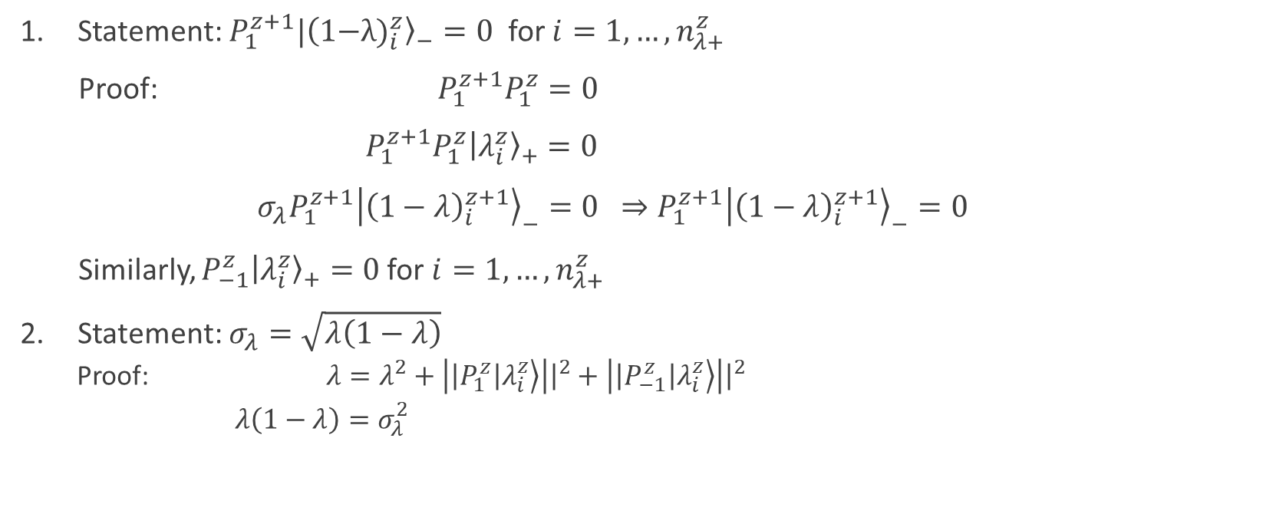

Appendix: $P_{λ+}^{z}$ SVD proofs
Statement: $P_{1}^{z+1}|{(\text{1−}{λ)}_{i}^{z}〉}_{−}=0$ for $i=1,…,n_{λ+}^{z}$
Proof: ${P_{1}^{z+1}P}_{1}^{z}=0$
${P_{1}^{z+1}P}_{1}^{z}{\left|λ_{i}^{z}\right\rangle }_{+}=0$
$σ_{λ}P_{1}^{z+1}{\left|{\left(1−λ\right)}_{i}^{z+1}\right\rangle }_{−}=0$ $⇒P_{1}^{z+1}{\left|{\left(1−λ\right)}_{i}^{z+1}\right\rangle }_{−}=0$
Similarly, $P_{−1}^{z}{\left|λ_{i}^{z}\right\rangle }_{+}=0$for $i=1,…,n_{λ+}^{z}$
Statement: $σ_{λ}=\sqrt{λ\left(1−λ\right)}$
Proof: $λ=λ^{2}+\left|\left|P_{1}^{z}\right|λ_{i}^{z}\right\rangle \left|{\left.​\right|}^{2}+\left|\left|P_{−1}^{z}\right|λ_{i}^{z}\right\rangle \right|{\left.​\right|}^{2}$
$λ\left(1−λ\right)=σ_{λ}^{2}$
Go back

Slide 56



Appendix: “Structural orbital basis” of $P$
Non-uniqueness
Union of:
For each $z∈ℤ$
For each $λ∈Λ^{z}$
If $λ=0$ or $1$,
$\left|z\right\rangle ⊗|λ_{i}^{z}⟩$ $→$ # vectors = $n_{λ}^{z}$
If $λ∈\left(0,1\right),$
$\left|z\right\rangle ⊗{\left|λ_{i}^{z}\right\rangle }_{+}$ $→$ # vectors = $n_{λ+}^{z}$
$\left|z\right\rangle ⊗{\left|λ_{i}^{z}\right\rangle }_{−}$ $→$ # vectors = $n_{λ−}^{z}$
$$n_{λ+}^{z}+n_{λ−}^{z}=n_{λ}^{z}$$
Go back

Slide 57




















Obtaining a compactly supported basis
$\frac{P\left|z\right\rangle ⊗{\left|λ_{i}^{z}\right\rangle }_{+}}{‖P\left|z\right\rangle ⊗{\left|λ_{i}^{z}\right\rangle }_{+}‖}$
$=\frac{P\left|z+1\right\rangle ⊗{\left|{\left(1−λ\right)}_{i}^{z+1}\right\rangle }_{−}}{‖P\left|z+1\right\rangle ⊗{\left|{\left(1−λ\right)}_{i}^{z+1}\right\rangle }_{−}‖}$
For $λ∈\left(0,1\right):$
$$0$$
$0.$7
$$0.3$$
$$=\sqrt{λ}\left|z\right\rangle ⊗{\left|λ_{i}^{z}\right\rangle }_{+}+\sqrt{1−λ} \left|z+1\right\rangle ⊗{\left|{\left(1−λ\right)}_{i}^{z+1}\right\rangle }_{−}$$
1
$$=|P,z,λ,i⟩$$
$P|P,z,λ,i⟩=|P,z,λ,i⟩$ for $i=1,…,n_{λ+}^{z}$
For $λ=0$: $P\left|z\right\rangle ⊗\left|0_{i}^{z}\right\rangle =0$
$$+$$
For $λ=1$: $P\left|z\right\rangle ⊗\left|1_{i}^{z}\right\rangle =\left|z\right\rangle ⊗|1_{i}^{z}⟩$
$$+$$
$$−$$
$$−$$
$$−$$
$$+$$
$$−1$$
$$0$$
$$1$$
$$2$$
$$P_{1}^{−1}$$
$$P_{1}^{0}$$
$$P_{1}^{1}$$
Go back

Slide 58


Appendix: Translationally invariant lemmas
Statement: $n_{0.5}$ is even; Rank($P_{0.5+}$)$={n_{0.5}}/2$
Proof: $P_{1}^{2}=0$ $⇒$ $M_{0.5}^{2}=0$
$M_{0.5}$ is nilpotent order 2
Jordan canonical form
Go back

Slide 59














Figures-hop1 and 0
$$=$$
$$z$$
$$z+1$$
$$z$$
$$+$$
$$=$$
$$z$$
$$z+1$$
$$z$$
$$+$$
$$z$$
$$z$$
$$+$$
$$z$$

Slide 60





Figure- hop 2
$$=0$$
$$=$$
$$z$$
$$z+1$$
$$z$$

Slide 61
Figures P connectivity

Slide 62
Extra slides

Slide 63

















Cell by cell orthogonalization
Step 0. Define sequence e.g. $𝒮=0,−1,1,−2,…$
$P$ connectivity
$$−3$$
$$−2$$
$$−1$$
$$0$$
$$1$$
$$2$$
$$3$$
$$=$$
Step 1. $Π^{0}≝\left\{P | 0,α\right\rangle \left|α=1,…,n\right\}$
$Π^{0}$ wavefunctions
$$−1$$
$$0$$
$$1$$
Step 2. Orthonormalize $Π^{0}→{\tilde{Π}}^{0}$
Projection $P_{0}=\sum_{\left|χ\right\rangle ∈{\tilde{Π}}^{0}}{|χ⟩⟨χ|}$

Slide 64

















Cell by cell orthogonalization
Expected $P_{0}$ connectivity
$$−2$$
$$−1$$
$$0$$
$$1$$
$$2$$
Expected $P−P_{0}$ connectivity
$$−2$$
$$−1$$
$$0$$
$$1$$
$$2$$
Step 3. Obtain $Π^{−1}≝\left\{(P−P_{0}) | −1,α\right\rangle \left|α=1,…,n\right\}$
$Π^{−1}$ wavefunctions
$$−2$$
$$−1$$
$$0$$
$$1$$
larger and larger

Slide 65













Key observation
Expected $P−P_{0}$ connectivity
$$−2$$
$$−1$$
$$0$$
$$1$$
$$2$$
Actual $P−P_{0}$ connectivity
$$−2$$
$$−1$$
$$0$$
$$1$$
$$2$$
$Π^{−1}$ wavefunctions
$$−2$$
$$−1$$
$$0$$
$$1$$

