Slide 1
Online Supermarket System(Mandai)
Presented By:
Sonawane Somanath Navanath
Ghongade Pratik Balasaheb
T.C College, Baramati
M.Sc. (Computer science)-II

Slide 2
Introduction
This project is one of the sincere by for time saving &giving the better service to the customer.
In manual system there are various registers and complicated transactions. To avoiding this complication we computerized this system. To satisfy all users needs.
The system effectively maintains whole data. The system works fast. To save time and more accurate data processing. The system gives detail information about all types of product details and order detail easily.

Slide 3
Need of System
As we know manual system are quite tedious, time consuming and less efficient and inaccurate in comparison to the computerized system.
There are large numbers of commercial Online Shopping websites offering large number of products tailored to meet the shopping interests of large number of customers. These online marketplaces have thousands of products listed under various categories.
The software makes the system easy to understand.

Slide 4
Scope of System
The current system is confined only to the shopping cart process. It can be extended to have a easy to use check out process.
Users can have multiple shipping and billing information saved. During checkout they can use the drag and drop feature to select shipping and billing information.
The customer records are directly saved into databases and the databases can be maintained for a longer period of time.
Each record can be retrieved and can be verified.
Limited access is available to the operator.

Slide 5
Software required for development: Operating System: Windows XP or greater version. Backend: SQL Server. Frontend: .net Framework. Internet Browser
Software Requirement:-

Slide 6
Hardware Requirement:-
Hardware requirement for development:
i) Computer
ii) Hard drive : 10 GB.
iii) Ram : 1 GB.
iv) Processor : i2,i3 and above.
v) Printer : Any type of printer.

Slide 7
Fact Finding Techniques:-
Any software development life cycle first require systematic gathering and analysis data. To collect information for developing system we had done in following ways as:-
Questionnaires
Interviews
Record review
Observations

Slide 8
Questionnaires:-
Who is the owner of your Shop or Store ?
Do you have the software of Online Supermarket System?
If No, then how are the record maintained?
If Yes, then what would you expect from our system?
Do you have different Unit of this Store?
Do you give the bill of products to each customer?
How you feel the need of software of Online Supermarket System?

Slide 9
Observation:-
On site observations means the observing the format of how the records are maintained, how the billings are formed, transaction process etc. We observed the total working of each and every employee in the store so that we can understand the exact requirements of the store from our system which is to be developed.
After carefully analyzing the requirements and functionality of the system , I had two important diagrams by the end of the analysis phase. They are the ER diagram and data flow diagram which were the basis for finding out entities and relationships between them, the flow of information

Slide 10
Record Review:-
Documents such as Order Deliver,Payments,,Delivery boy ,Address, Date etc. records were carefully examined and we placed its data where it was required.

Slide 11
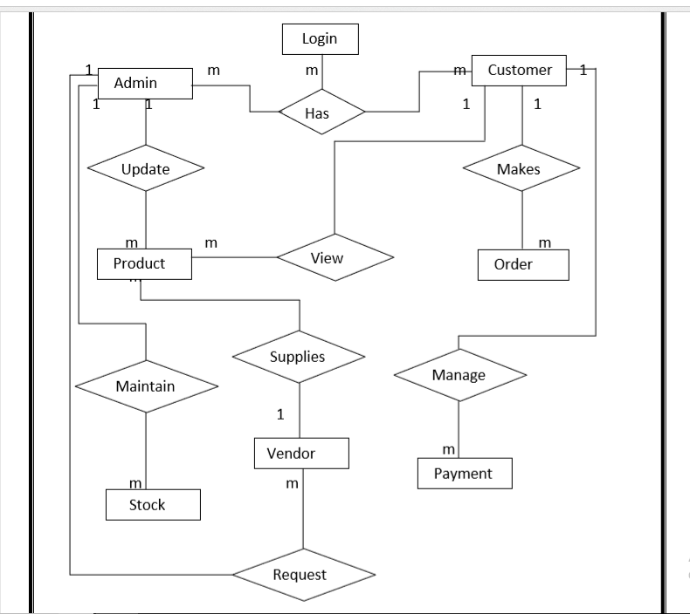
Entity Relationship Diagram:-

Slide 12
Database Design:-
Login Info:-
Sr.no | Field Name | Data type | Constraints
1 | UserId | Varchar | Primary key
2 | Password | Varchar

Slide 13
Admin Registration:-
Sr.no | Field Name | Data type | Constraints
1 | Ad_Id | Smallint | Primary Key
2 | Ad_Name | nvarchar(50)
3 | Ad_Password | nvarchar(50)
4 | Ad_Mobile | bigint
5 | Ad_email | nvarchar(50)
6 | Ad_status | Smallint
7 | Ad_createdby | Smallint
8 | Ad_createddate | Smalldatetime
9 | Ad_modifiedby | Smallint
10 | Ad_modifieddate | Smalldatetime

Slide 14
Customer Registration:-
Sr.no | Field Name | Data type | Constraints
1 | C_Id | Smallint | Primary Key
2 | C_Name | nvarchar(50)
3 | C_Password | nvarchar(50)
4 | C_Mobile | bigint
5 | C_email | nvarchar(50)
6 | C_Address | nvarchar(50)
7 | C_status | Smallint
8 | C_createdby | Smallint
9 | C_createddate | Smalldatetime
10 | C_modifiedby | Smallint
11 | C_modifieddate | Smalldatetime

Slide 15
Vendor Registration:-
Sr.no | Field Name | Data type | Constraints
1 | Ven_Id | Smallint | Primary Key
2 | Ven_Name | nvarchar(50)
3 | Ven_Mobile | bigint
4 | Ven_email | nvarchar(50)
5 | Ven_Address | nvarchar(50)
6 | Ven_DueAmt | Float
7 | Ven_OpeningBal | Float
8 | Ven_status | Smallint
9 | Ven_createdby | Smallint
10 | Ven_createddate | Smalldatetime
11 | Ven_modifiedby | Smallint
12 | Ven_modifieddate | Smalldatetime

Slide 16
Delivery Boy:-
Sr.no | Field Name | Data type | Constraints
1 | DelBoy_Id | Smallint | Primary Key
2 | DelBoy_Name | nvarchar(50)
3 | DelBoy_Mobile | bigint
4 | DelBoy_email | nvarchar(50)
5 | DelBoy_status | Smallint
6 | DelBoy_createdby | Smallint
7 | DelBoy_createddate | Smalldatetime
8 | DelBoy_modifiedby | Smallint
9 | DelBo_modifieddate | Smalldatetime

Slide 17
Group Master :-
Sr.no | Field Name | Data type | Constraints
1 | Grp_Id | Smallint | Primary Key
2 | Grp_Name | nvarchar(50)
3 | Grp_status | Smallint
4 | Grp_createdby | Smallint
5 | Grp_createddate | Smalldatetime
6 | Grp_modifiedby | Smallint
7 | Grp_modifieddate | Smalldatetime

Slide 18
Unit Master :-
Sr.no | Field Name | Data type | Constraints
1 | Unit_Id | Smallint | Primary Key
2 | Unit_Name | nvarchar(50)
3 | Unit_status | Smallint
4 | Unit_createdby | Smallint
5 | Unit_createddate | Smalldatetime
6 | Unit_modifiedby | Smallint
7 | Unit_modifieddate | Smalldatetime

Slide 19
Product Master :-
Sr.no | Field Name | Data type | Constraints
1 | Prod_Id | Smallint | Primary Key
2 | Prod_Name | nvarchar(50)
3 | Grp_Id | Smallint | FK_Key
4 | Unit_Id | Smallint | FK_Key
5 | Prod_status | Smallint
6 | Prod_createdby | Smallint
7 | Prod_createddate | Smalldatetime
8 | Prod_modifiedby | Smallint
9 | Prod_modifieddate | Smalldatetime

Slide 20
Image Master :-
Sr.no | Field Name | Data type | Constraints
1 | Img_Id | Smallint | Primary Key
2 | Prod_Id | Smallint | FK_Key
3 | Img_path | nvarchar(50)
4 | Img_status | Smallint
5 | Img_createdby | Smallint
6 | Img_createddate | Smalldatetime
7 | Img_modifiedby | Smallint
8 | Img_modifieddate | Smalldatetime

Slide 21
Stock Master :-
Sr.no | Field Name | Data type | Constraints
1 | Stk_Id | Smallint | Primary Key
2 | Prod_Id | Smallint | FK_Key
3 | Unit_Id | Smallint | FK_Key
4 | Prod_Quantity | Float
5 | Prod_rate | Float
6 | Batch | nvarchar(50)
7 | Stk_status | Smallint
8 | Stk_createdby | Smallint
9 | Stk_createddate | Smalldatetime
10 | Stk_modifiedby | Smallint
11 | Stk_modifieddate | Smalldatetime

Slide 22
User Session :-
Sr.no | Field Name | Data type | Constraints
1 | Sess_Id | Bigint | Primary Key
2 | Sess_Date | smalldatetime
3 | Start_Time | Smalldatetime
4 | End_Time | Smalldatetime
5 | Sess_status | nvarchar(50)

Slide 23
Cart Master:-
Sr.no | Field Name | Data type | Constraints
1 | CM_Id | Smallint | Primary Key
2 | Sess_Id | Bigint | FK_Key
3 | CM_Total | Float
4 | CM_Date | Smalldatetime
5 | CM_status | Smallint

Slide 24
Bill Master:-
Sr.no | Field Name | Data type | Constraints
1 | Bill_Id | Smallint | Primary Key
2 | C_Id | Smallint | FK_Key
3 | Bill_Date | Smalldatetime
4 | Paid_Amt | Float
5 | Rem_Amt | Float
6 | Bill_TotAmt | Float
7 | Bill_status | Smallint
8 | Bill_createdby | Smallint
9 | Bill_createddate | Smalldatetime
10 | Bill_modifiedby | Smallint
11 | Bill_modifieddate | Smalldatetime

Slide 25
Bill Transaction:-
Sr.no | Field Name | Data type | Constraints
1 | BillT_Id | Smallint | Primary Key
2 | Bill_Id | Smallint | FK_Key
3 | Prod_Id | Smallint | FK_Key
4 | Prod_Quantity | Float
5 | Unit_Id | Smallint | FK_Key
6 | Prod_Rate | Float
7 | BillT_Total | Float
8 | Batch | nvarchar(50)
9 | BillT_status | Smallint
10 | BillT_createdby | Smallint
11 | BillT_createddate | Smalldatetime
12 | BillT_modifyby | Smallint
13 | BillT_modifieddate | Smalldatetime

Slide 26
Cart Transaction:-
Sr.no | Field Name | Data type | Constraints
1 | CT_Id | Smallint | Primary Key
2 | CM_Id | Smallint | FK_Key
3 | Prod_Id | Smallint | FK_Key
4 | Unit_Id | Smallint | FK_Key
5 | Batch | nvarchar(50)
6 | Prod_Quantity | Float
7 | Prod_Rate | Float
8 | Prod_Total | Float
9 | CT_status | Smallint

Slide 27
INPUT & OUTPUT SCREEN’S

Slide 28

HOME PAGE

Slide 29
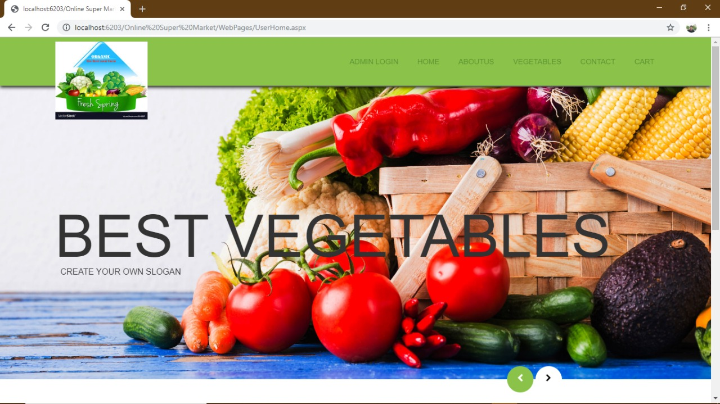

Slide 30
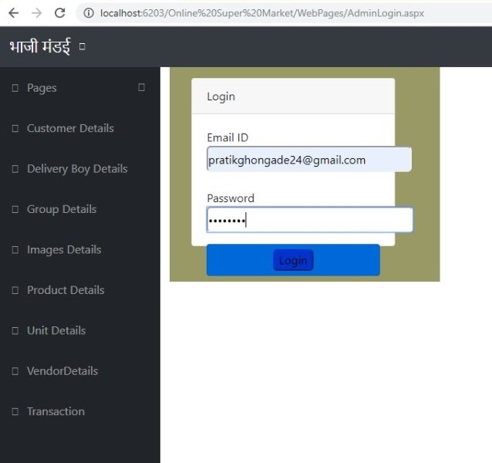
Login Form:

Slide 31
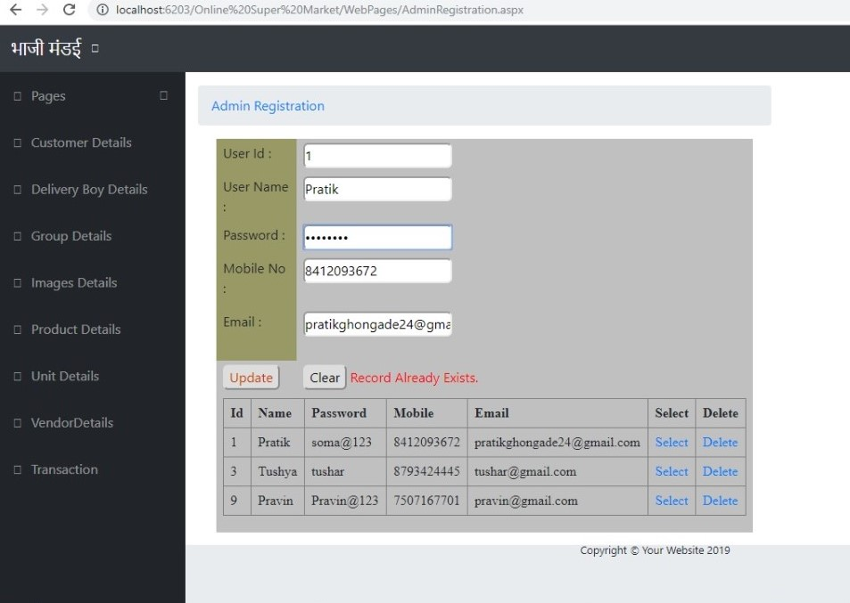
ADMIN REGISTRATION FORM :-

Slide 32
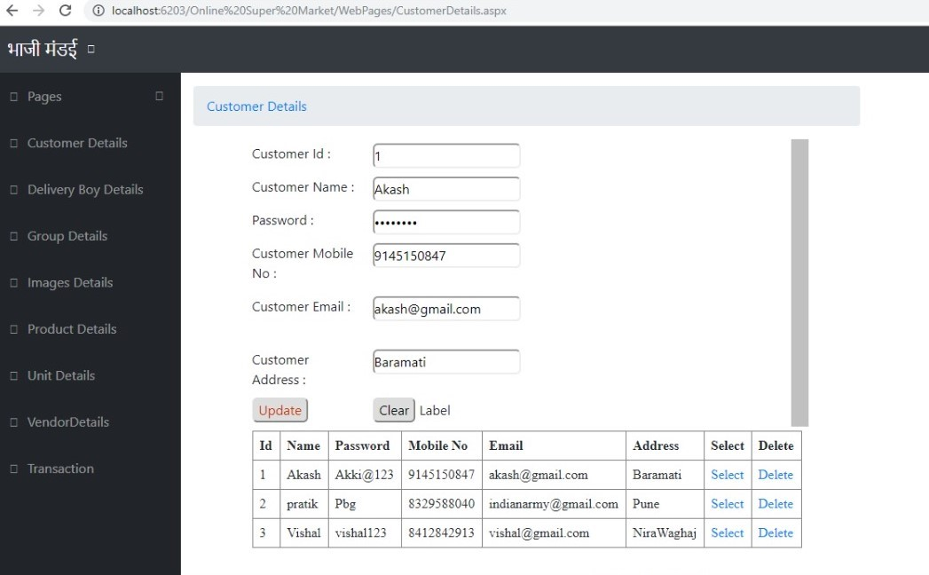
CUSTOMER REGISTRATION FORM:-

Slide 33
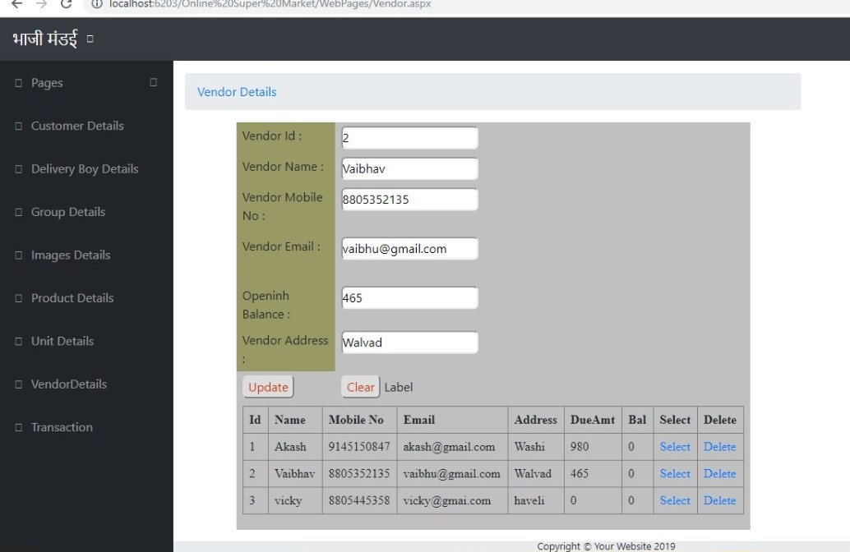
VENDOR REGISTRATION FORM:-

Slide 34
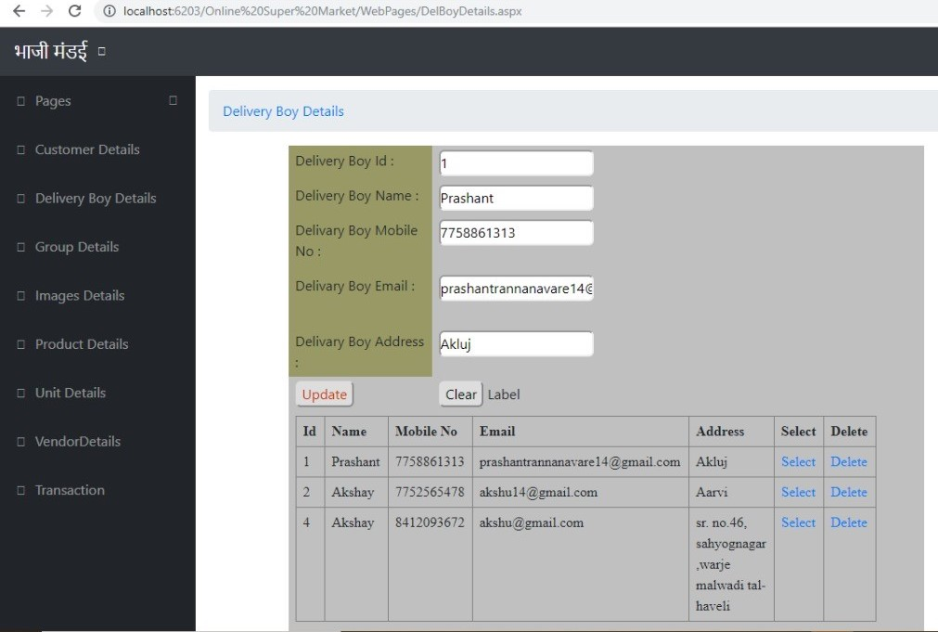
DELIVERY BOY DETAIL FORM:-

Slide 35
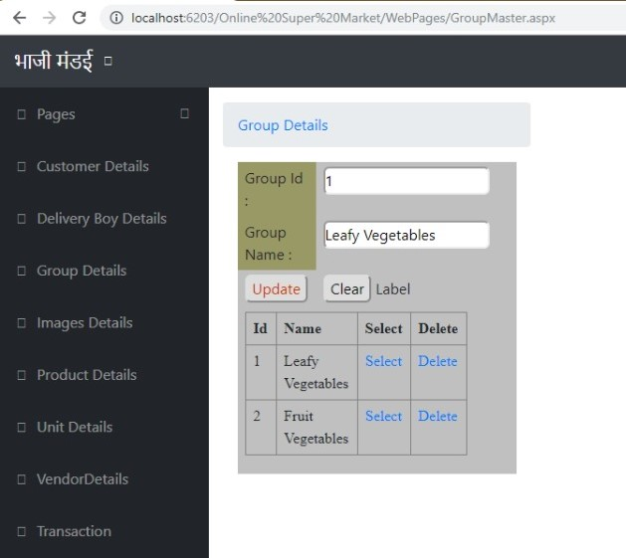
GROUP DETAILS:-

Slide 36
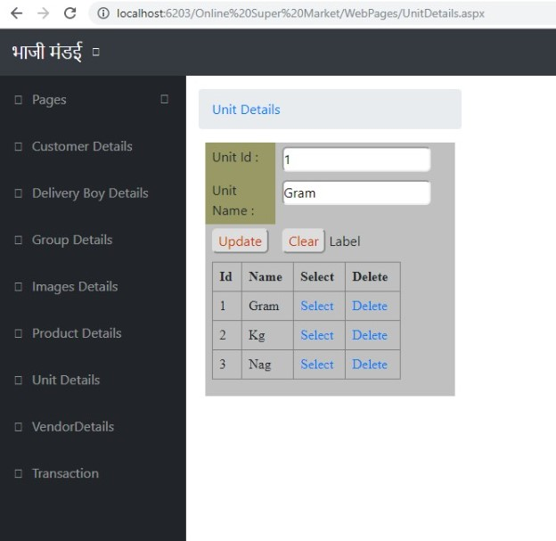
UNIT DETAILS:-

Slide 37
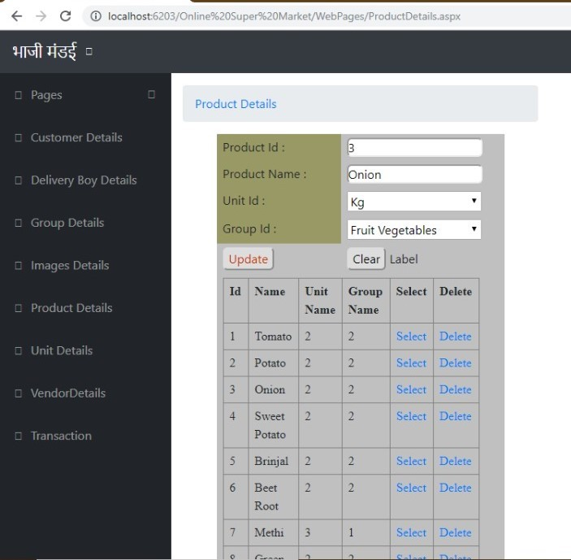
PRODUCT DETAILES:

Slide 38
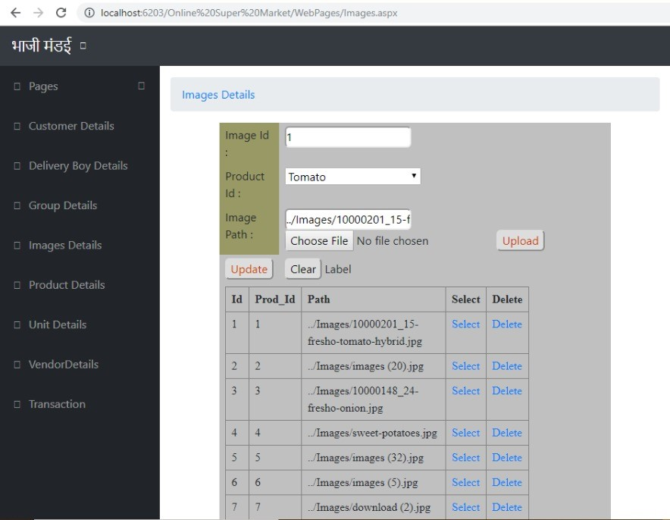
IMAGE DETAILS:-

Slide 39
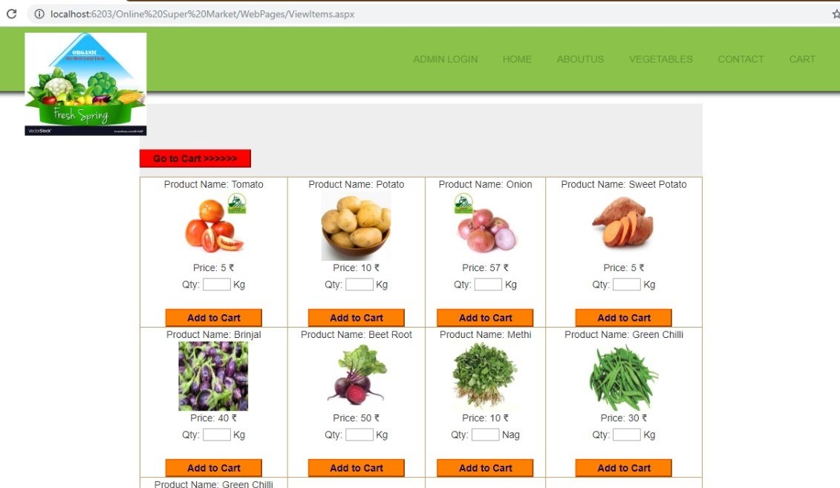
VEGITABLES:

Slide 40
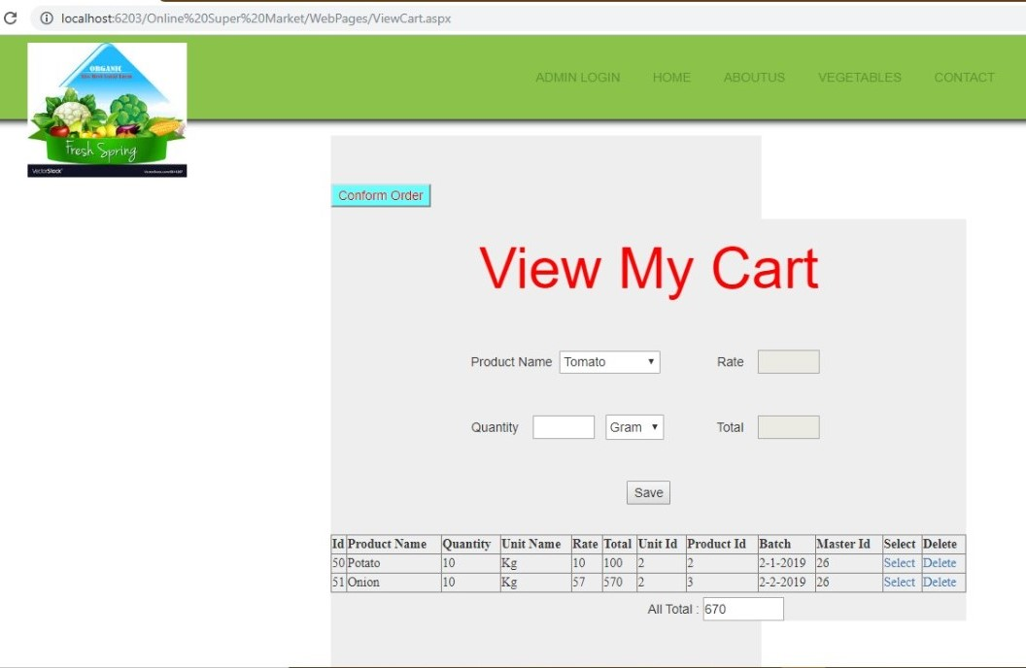
VIEW MY CART:

Slide 41
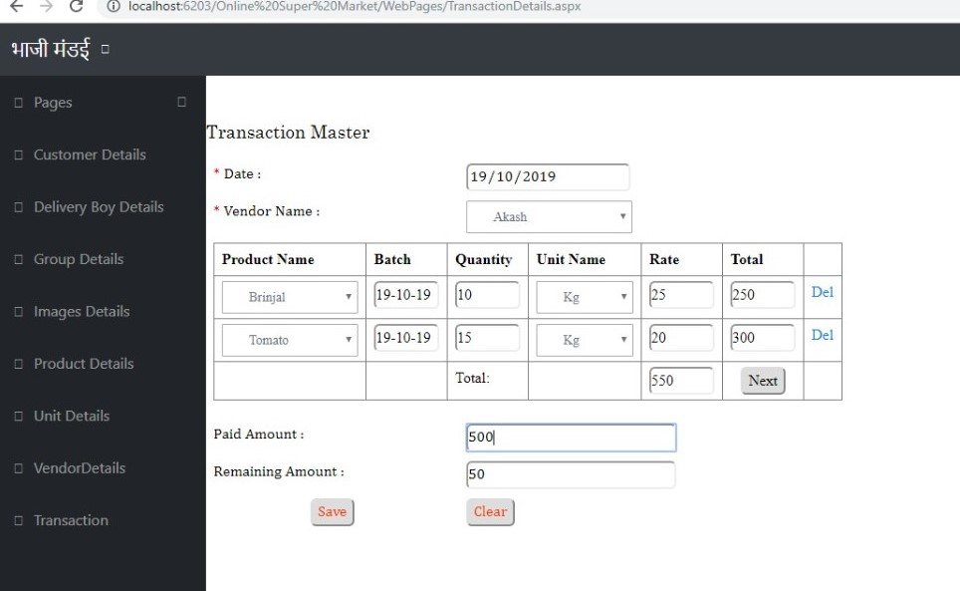
TRANSACTION MASTER:

Slide 42
Limitations:-
Since it is an online project, customers need internet connection to buy products.
People who are not familiar with computers can’t use this software.
Customer must have debit card or credit card or cash On Delivery to purchase products.
This application does not have features by which user can set price ranges for products and receive alerts once the price reaches the particular range

Slide 43
Future Enhancement:-
This web application involves almost all the features of the online shopping.
The future implementation will be online help for the customers and chatting with website administrator.
The users could subscribe for price alerts which would enable them to receive messages when price for products fall below a particular level.

Slide 44
Conclusion:-
The ‘Online Supermarket System(Mandai)’ is designed to provide a web based application that would make searching, viewing and selection of a product easier. The search engine provides an easy and convenient way to search for products where a user can Search for a product interactively and the search engine would refine the products available based on the user’s input.
The user can then view the complete specification of each product.
They can also view the product reviews and also write their own reviews.

Slide 45
THANK YOU

