Slide 1
2021F-T1 AISC1006 – Step Presentation 01 (M07 Group 1)
Student Name(s) ↓ | Student IDs ↓
Shivam Patel | 500201461
Jaydeep Bhalala | 500198056
Pratik Domadiya | 500199494

Slide 2

2021F-T1 AISC1006 - Step Presentation (Step 1) 01 (M07 Group 1) Dataset Preparation
Name : Pratik Domadiya
Loyalist ID : 500199494
pratikdomadiya@loyalistcollege.com

Slide 3

2021F-T1 AISC1006 - Step Presentation (Step 1) 01 (M07 Group 1) Data Cleaning and Modelling
Name: Jaydeep Bhalala
Student ID-500198056
jaydeepbhalala@loyalistcollege.com

Slide 4

2021F-T1 AISC1006 - Step Presentation (Step 1) 01 (M07 Group 1) Data Visualization
Name: Shivam Patel
Student ID-500201461
shivampatel@loyalistcollege.com

Slide 5
ROAD MAP
Approach and source code
Visualization & Presentation
Analysis & Experience

Slide 6
1. Approach and source code
Data set preparation
Model Preparation
Final Result Evaluation
Visualization & Analysis
Data Cleaning

Slide 7
Data Preparation
Concept
Technology
Python
Beautiful soup 4
Data Source
Requests library
Selenium web driver
Zolo Toronto website
We have created our own dataset.
Web Scraping

Slide 8
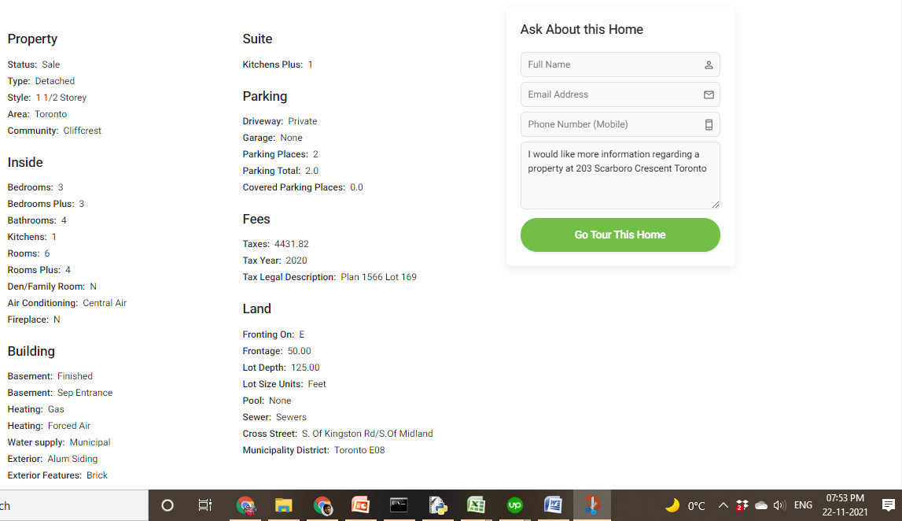
sample data on zolo website

Slide 9
Scrapping Result
Output stored in excel file. Please have a look on features.
TYPE
WALK SCORE
SIZE (SQ FT)
BEDROOMS
BATHROOMS
KITCHENES
ROOMS
DEN / FAMILY ROOM
PATIO TERRACE
ENSUITE LAUNDRY
AIR CONDITIONING
FIREPLACE
STORIES
PARKING TOTAL
MAINTAINANCE ( PER ANNUM)
TAXES
BASEMENT
HOUSE_PRICE

Slide 10
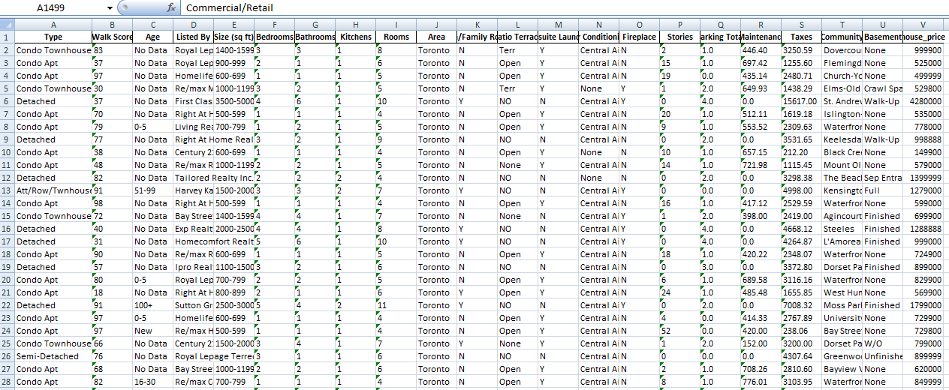
SAMPLE DATASET

Slide 11
2. Visualization & Analysis
Data Cleaning
Purpose of the Data cleaning
Data cleaning is the process of removing data that is wrong, inaccurate, incomplete, poorly structured, duplicated, or simply unrelated to the dataset's goal.

Slide 12
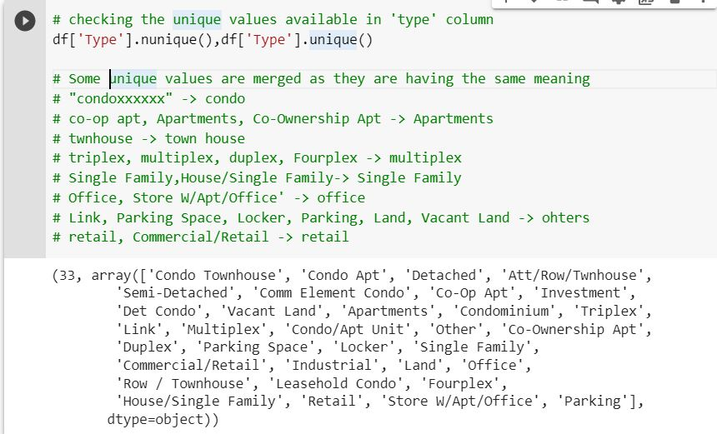
Cleaning the data
Cleaning of Type Column of the data

Slide 13
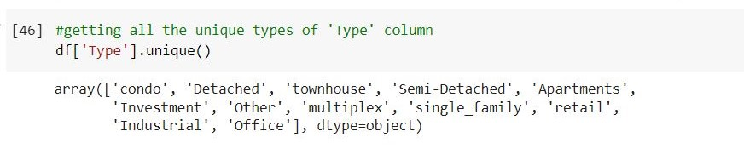
After applying Filters

Slide 14
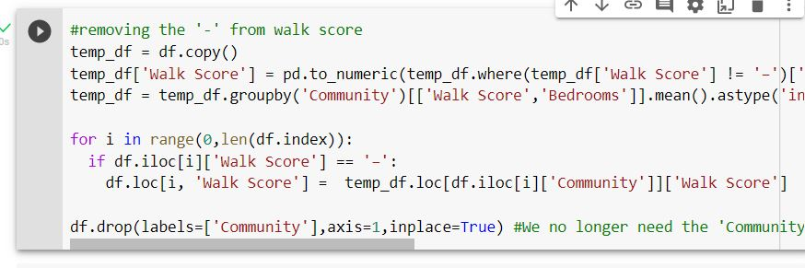
Cleaning of Walk Score Column of the data
Taking average of walk score by grouping the community.
Filling null values of walk score based on the mean value of the community

Slide 15
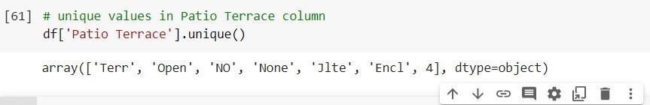
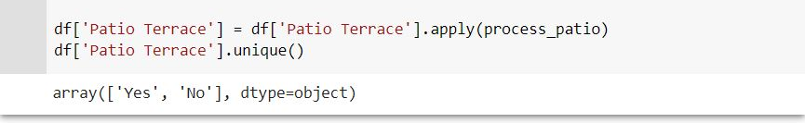
Cleaning of Patio Terrace Column of the data
Before the cleaning
After the cleaning

Slide 16
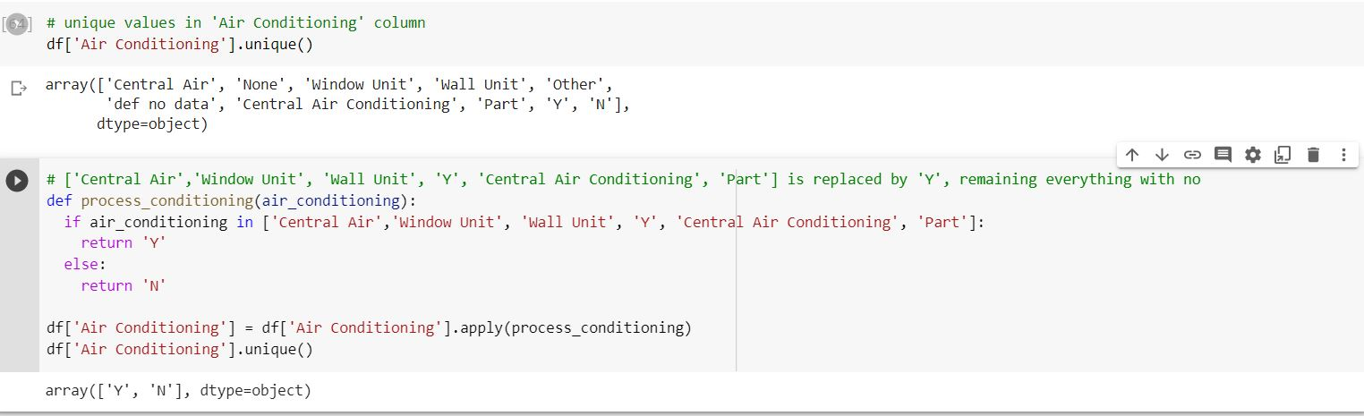
Cleaning of Air Conditioning Column of the data
If present then ‘Y’ else ‘N’
Before the cleaning
After the cleaning

Slide 17
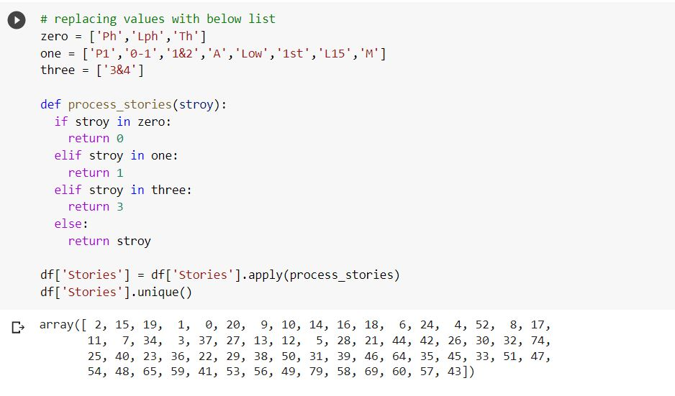
Cleaning of Stories Column of the data
Converting every code into numbers

Slide 18
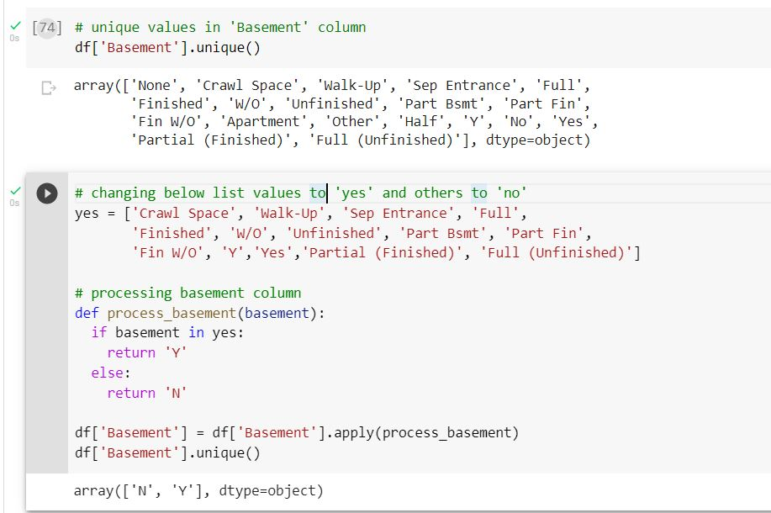
Cleaning of Basement Column of the data
If present then it then ‘Y’ else ‘N’
Before the cleaning
After the cleaning

Slide 19
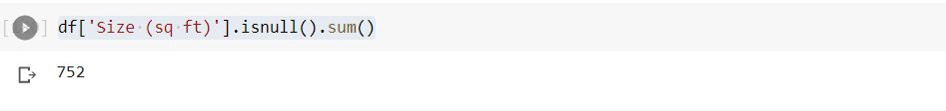
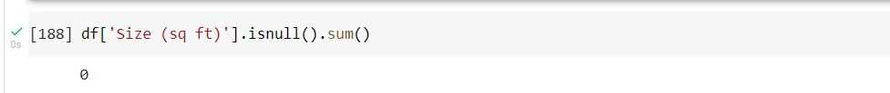
Cleaning of Size Column of the data
We will use four features('Bedrooms’, 'Bathrooms’, 'Kitchens’, 'Rooms’) to predict the null values of size column by linear regression model.
Null values Before the cleaning
Null values After filling it

Slide 20
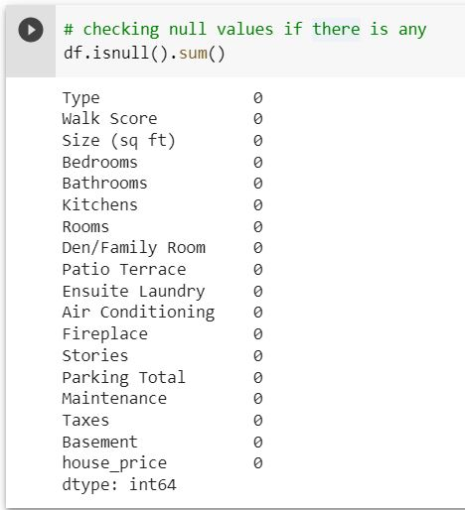
Null values in the data after cleaning

Slide 21
Data Visualization
Analyze Your Audience
Choose the Right Chart (i.e., Scatterplot, Boxplot, histogram, etc.)
Select a Software Program (we used Jupyter Notebook)
Declutter
Clarify Your Message with Color
Clarify Your Message with Text (i.e., Clear Insights)
Share Your Completed Data Visualization

Slide 22
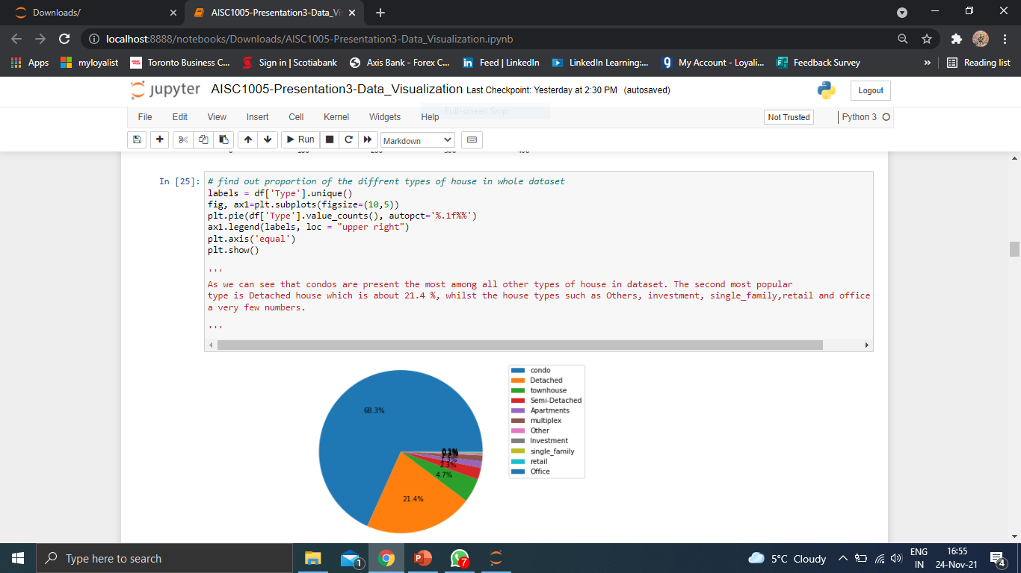
Sample Coding and Output
Whole data visualization coding file is submitted with the ppt named AISC1005-Presentation3-Data_Visualization.ipynb

Slide 23
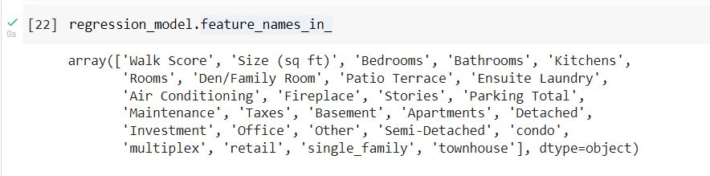
Model Preparation
We have use 2844 samples for training the linear regression model and 948 samples for validating model. For each sample we are providing features that are given below.

Slide 24
Metrics uses to measure Regression model
R-Score :
0.6017
MAE :
535598.06
MSE : 1196738095066.16
RMSE : 1093955.25

Slide 25
3. Analysis & Experience Personal Analysis – Data Preparation
We have created our own dataset instead of using just toy dataset which gives always a high accuracy. By doing so we have learned how web scraping concepts have been used for developing dataset, organizing dataset and how to extract critical features which takes the model accuracy at high level.
The one thing I have observed that by doing such a project , data preprocessing takes too much time when you deal with the completely unknown data. This is because of you don’t know actually what values are stored in each feature columns, how much missing values are existed and so on, so you have to identify missing and unique values are present in each column and then remove unnecessary data values. In our case out of total time taken by the whole project, only 60-70 % taken by the data preparation and preprocessing task.

Slide 26
Personal Analysis – Data Cleaning and Modelling
After completing this project, I learn lot about data cleaning and modelling.
We can improve this by using feature Selection, which help us in finding the most relevant feature to the house price.
To improve accuracy, we can try some more regression techniques such as Support vector regression, Decision trees and Deep learning models.
Further, we can deploy our project on any free server and make basic UI which takes all the parameters from the user and predicts the price of the house.

Slide 27
Personal Analysis – Data Visualization
As we have created our own toy dataset, after data cleaning process, we analyzed the data and performed data visualization on it.
We visualized the main information in form of pie charts, boxplot, scatterplot, histogram, etc.
We found popular insights while performing data visualization on the dataset.
We compared different features of houses accordingly to obtain accurate results.
While doing this project, we understood that data visualization can make the audience understand the data in an effective way.
In short, we cut the noise in our data and use only the useful patterns and values that can impact the business.

Slide 28
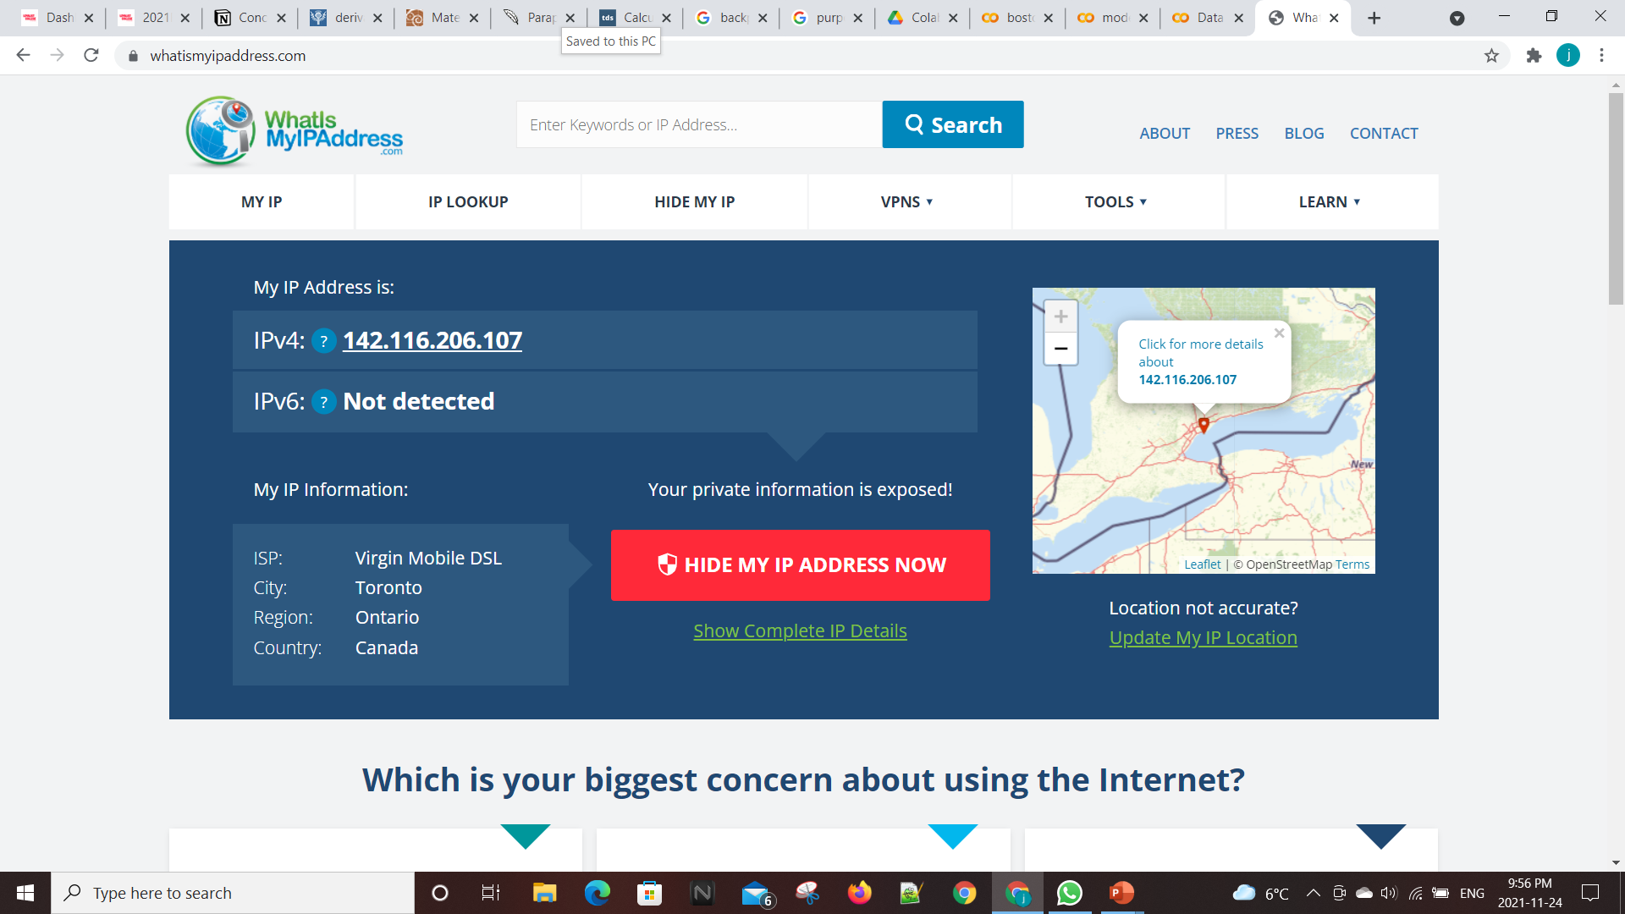

Slide 29
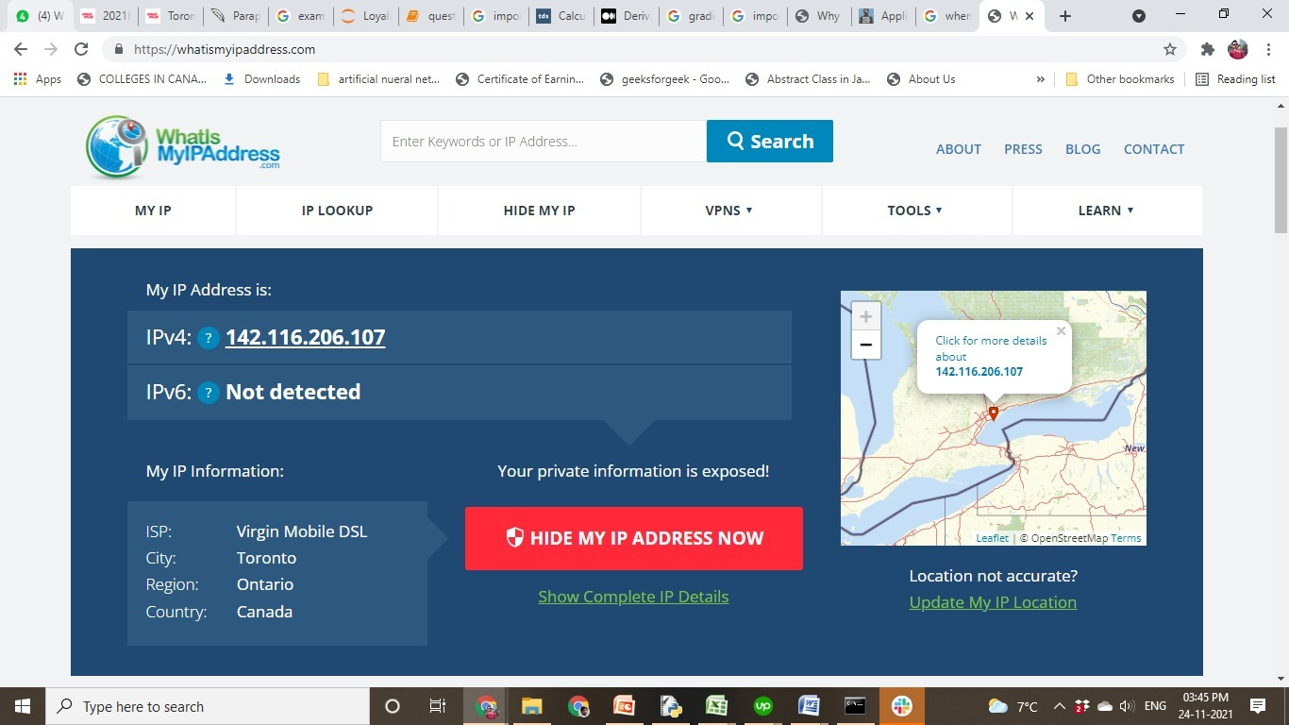

Slide 30
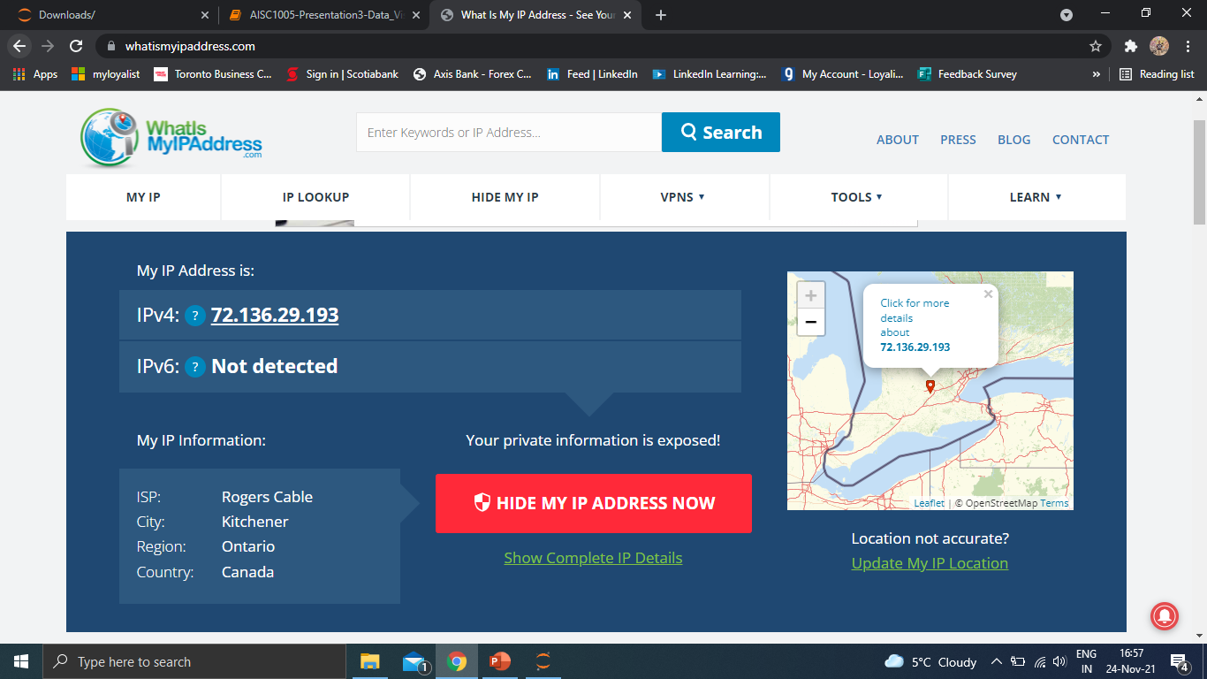

Slide 31
Thank You

