Slide 1

HungerBox Case Study
Pratik Gupta

Slide 2


Case Study Description
We are given two tables, namely the order and feedback data for a given day for 20 restaurants.
The first table has the feedback and ratings of all the restaurants catered by the food app.
The second table, on the other hand, has the data related to orders and products given by different customers to different restaurants. Order date and time are given too.
Using Excel and SQL data analysis, we have to find the solutions for the agendas mentioned ahead. I will be using pivot tables and generic Excel tools for finding data insights.

Slide 3
Agenda
With the help of the data, find some actionable insights, areas of improvement and areas of opportunity for these restaurants. Provide the analysis method and steps applied to the data to get insights. Also, provide the insights gathered.
Suggest features or ways to increase the number of feedback captured

Slide 4
Some Data Driven Actionable Insights
Agenda 1
Part 1

Slide 5
From Feedback Table
No of restaurants - Distinct count of 'Restaurant ID’ = 20
Average ratings of each restaurant -

Slide 6
Comment types - Distinct count of 'Comment Type’ = 20
Percentile distribution by each comment type

Slide 7
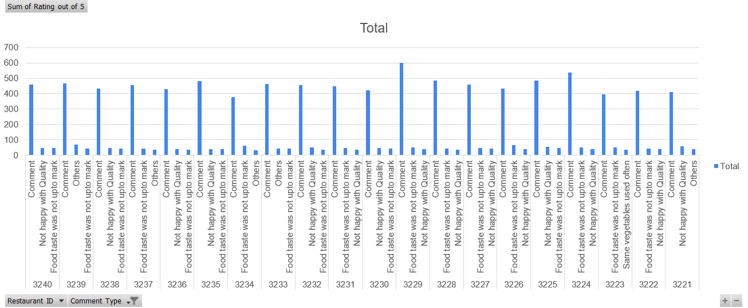
Top comments in each restaurant

Slide 8
From Order Table
Total number of orders – 7001
Number of orders on this day for each restaurant –

Slide 9
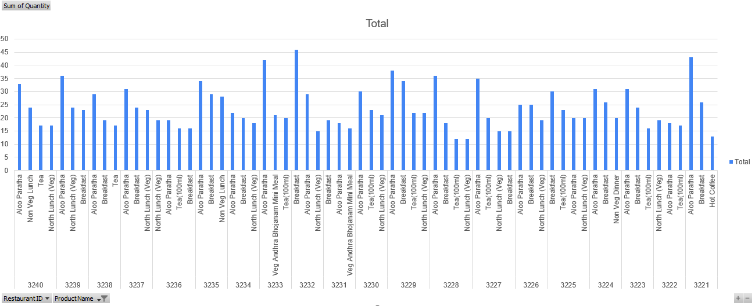
Top products by each restaurants

Slide 10
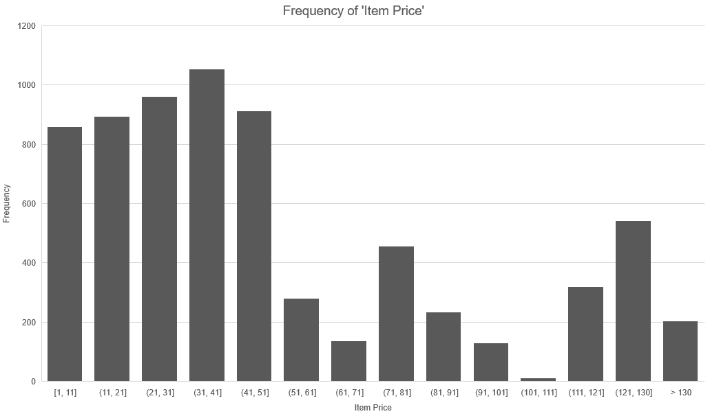
Item Price Frequency

Slide 11
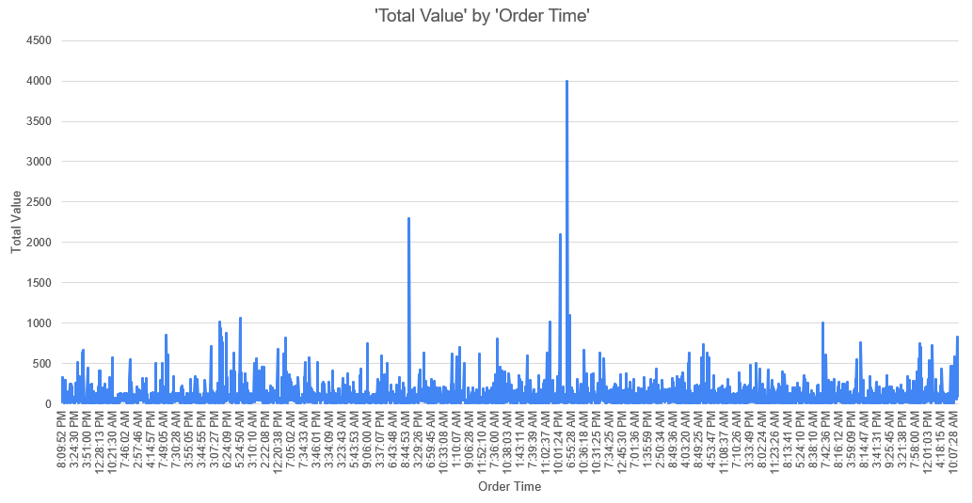
Most active time of the day

Slide 12
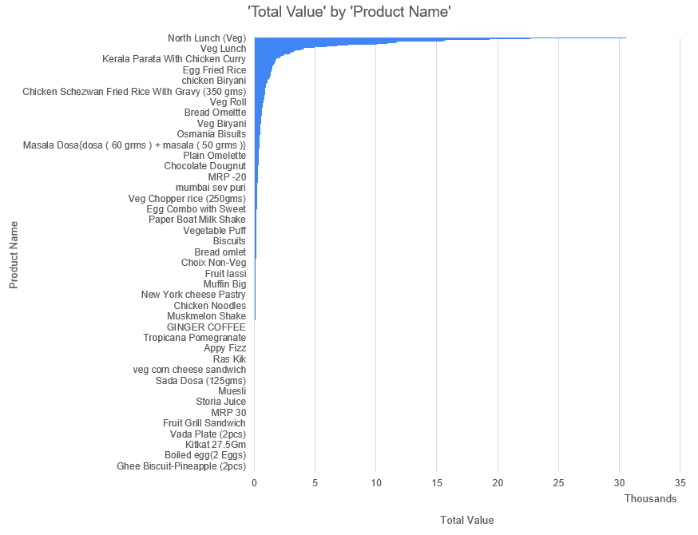
Total revenue by each product

Slide 13
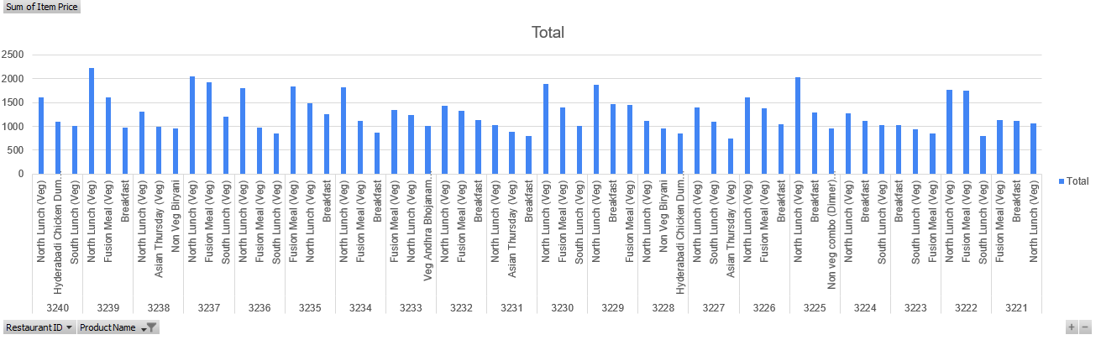
Total revenue per restaurant

Slide 14

Areas of Improvement and New Opportunities
Agenda 1
Part 2
This Photo by Unknown Author is licensed under CC BY-ND

Slide 15
Focus more on dishes which are ordered the most while maintaining the large course menu.
Focus more on dishes which are fetched in huge quantities. This ensures more sales and hence more revenue for the food app and restaurants.
Most common negative comment types which tend to decrease the user ratings the most should be catered to at the earliest.
Add credibility and increase trustworthiness of products by resolving the problems found in feedback at the earliest.

Slide 16
Try to expand the menu in restaurants . Course expansion will lead to more revenue which in turn will give more profit to the restaurants and food app.
Food apps will get more traffic at times of rush hour. Smooth app usage and restaurant seating will help bring more customers and positive feedback.
Food items which bear more revenue should be prioritized as well as the products which have more price should be given priority.
Advertising and publicizing the most priced and ordered food items more than the others should attract more customers and increase sales.

Slide 17

Ways to Increase Customer Feedback
Agenda 2

Slide 18
Use an incentive
Time is money and many customers aren't going to be willing to provide feedback if there isn't something in it for them. Thus, award-driven feedbacks tend to have greater response.
1
Know your customer demographics
Different customers tend to have different approaches toward products, thus giving entirely different feedback. Thus, knowing customer background is important.
3
Reach out to the customers
If left to themselves, customers tend to provide feedback only when the food is extremely good or bad. Therefore, approaching the customers is of essential.
4
Incentive Examples
1. Discount coupons
2. Badge system
3. Gold membership points
4. Extra desert or sweet dish
2

Slide 19
Ask relevant Questions only
Questions like " Did you like our product " tend to get mostly negative answers. Ask questions about what changes can be made to make your product better and more appealing.
1
Follow-up is a must
Even after the feedback is done, follow-up emails and SMS are a must to incite and maintain customer interest in the product.
3
Increase credibility of feedbacks
Working on the feedback and solving the problems listed in them is essential for a more positive feedback system. This would show the responsiveness of the restaurant.
4
Keep feedback short and sweet
Time consuming feedbacks tend to irritate customers. Feedback should be short and should be completed in as few clicks as possible.
2
5
6
7
8

Slide 20
Automatize Feedback System
Getting quality feedback is much easier if one has the right tools in his arsenal. Try to eradicate any manual feedback part to make the whole system smooth.
1
Chatbot and Popups
Interactive feedback systems tend to gather more attention. Chatbots and popups will grab the attention of customers and increase feedback.
2
Add colour and style to the Feedback Portal
Vibrant and colourful feedback apps will attract more customers than a dull and boring one.
3
9
10
11

Slide 21
Thank you
Pratik Gupta
Roll Number -19ucs047
Email - 19ucs047@lnmiit.ac.in

