Slide 1

Does Detroit Police deliver Equal Protection to All Neighborhoods?
Anneliese Ferguson, Pratik Kothari, Jake Yablok, Tahira Khan

Slide 2
Are Detroit's police resources equitably distributed across the city, and what are the consequences when they're not?
Why It Matters?
Response time = Prevention vs. Aftermath
Delayed response time increases crime escalation risk
Equal protection is a fundamental city service
Who should care?
Police Chief
Resource deployment
Public trust
Mayor
City Services
Equitable
Reliable
Constituent responsibility
Residents Themselves!
Equal protection
Notes:
WHY THE QUESTION MATTERS?
Public safety is a fundamental city service
every Detroit resident deserves timely emergency response
Response time isn't just a statistic
it's the difference between preventing crime escalation and dealing with its aftermath
Equity implications: Disparate police service can reinforce neighborhood decline and undermine community trust
REAL-WORLD STAKES:
Crime Escalation → DOMESTIC DISTURBANCE CAN BECOME WORSE CRIMES OR TRAGEDIES
It is important we are responding in a timely matter
Across ALL of detroit
Delayed police response increases likelihood of repeat incidents and more serious crimes
Community impact → if residents can't rely on police response, they either handle situations themselves (risking escalation) or stop calling
WHO SHOULD CARE?:
Police Chief:
Needs to deploy resources efficiently and maintain public trust across all precincts
Mayor:
Responsible for ensuring equitable city services and preventing neighborhood disinvestment
Detroit residents:
Deserve equal protection regardless of their zip code

Slide 3
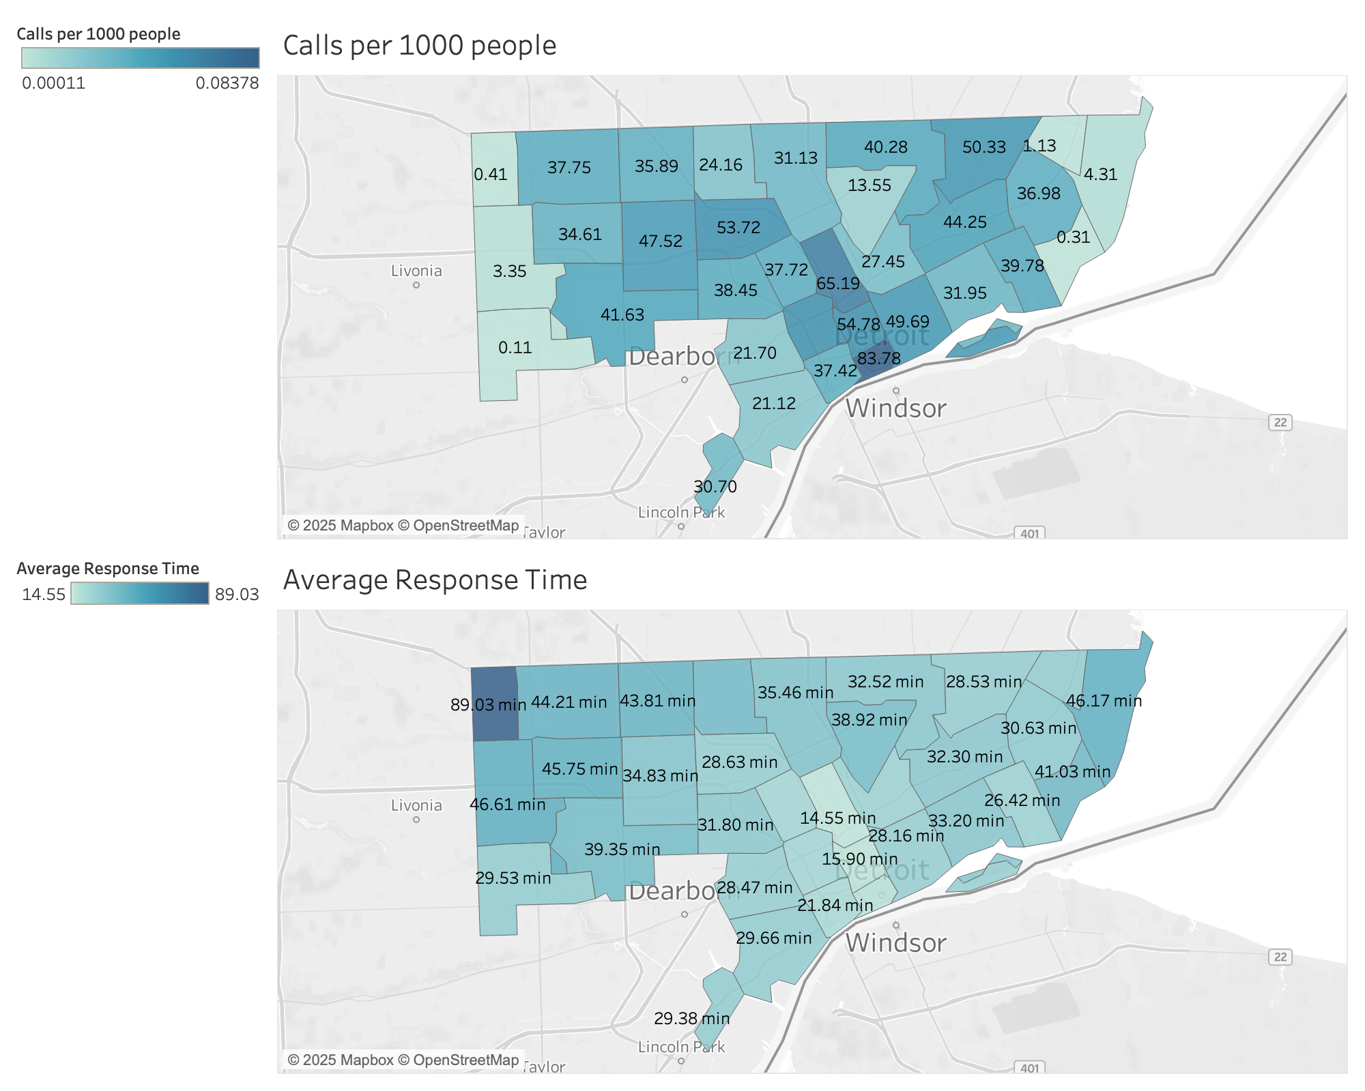
Calls per 1000 people and Average Response Times (ART) by Zip Code
Highest calling zip codes per-capita have the fastest police response times
Zip code 48240
* Filtered Data to only include Detroit Zip Codes and calls that are NOT initiated by officers
Notes:
First off, just explain that diagrams are showing calls per 1000 people by zip and average police response time by zip
As you can see in the diagram, the per capita rate of calls to the police office peak in Downtown detroit and generally decrease as you go away from downtown.
For average police response time, we notice the opposite trend with response times being the fastest around downtown Detroit and increasing as you go further away from downtown.
Zip code 48240 shows an extremely high response time, despite having very few calls per capita.
We were surprised by this data because we thought higher demand would lead to slower response.

Slide 4
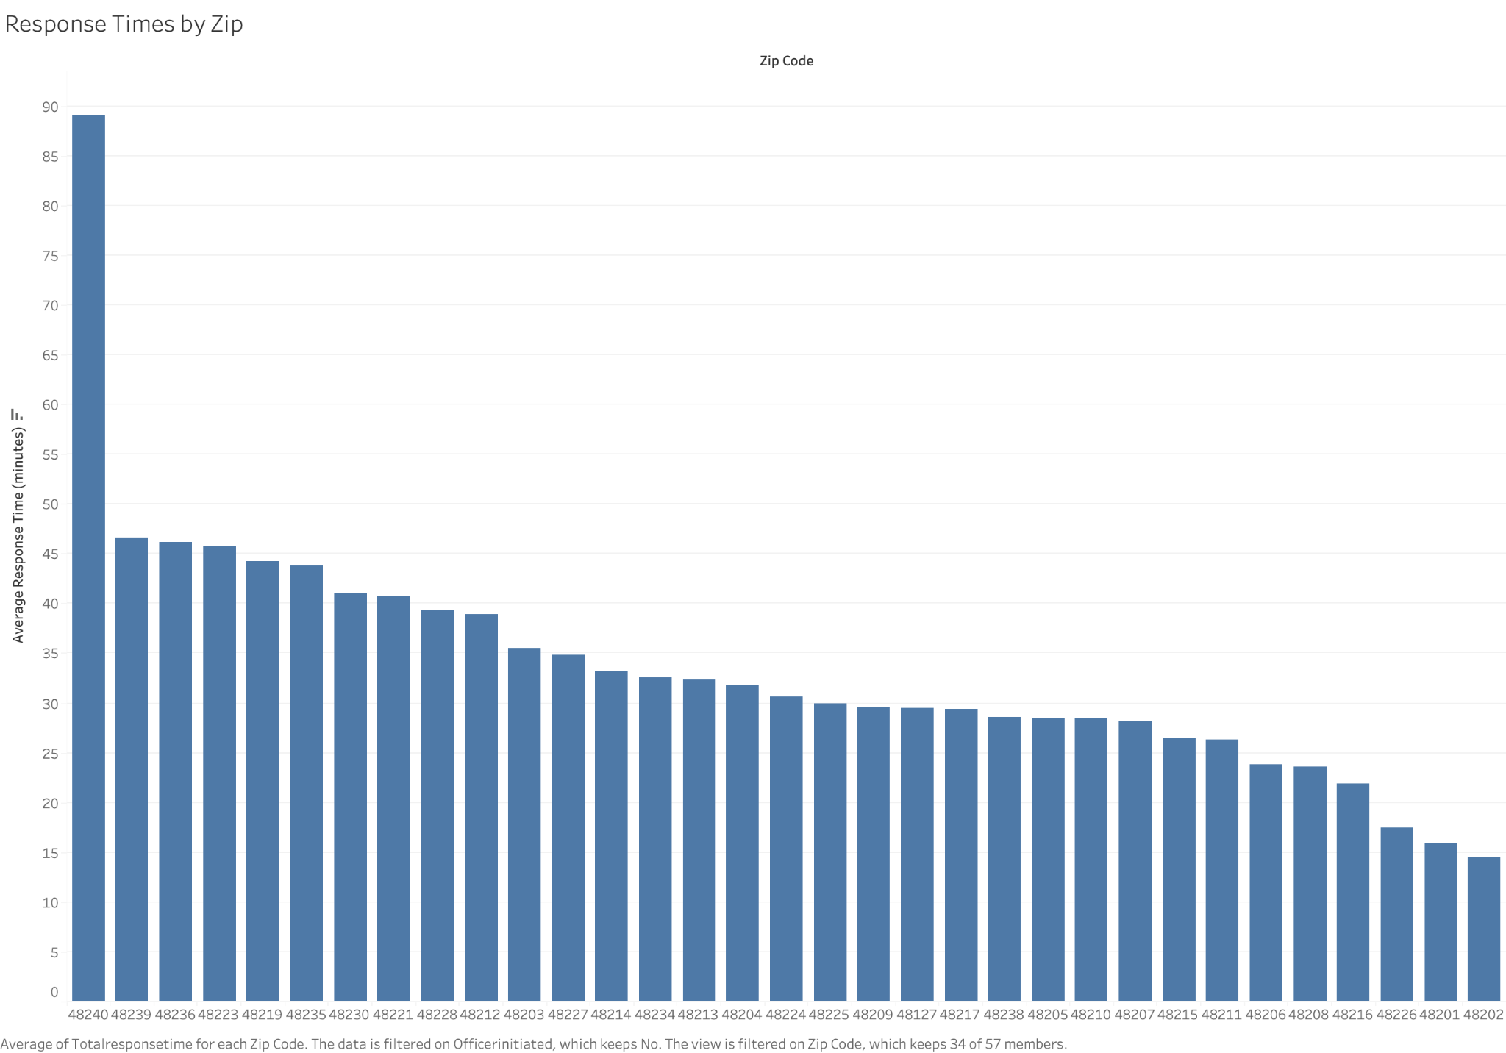
Notes:
Explain that this isn’t a great visual to show off, but really helped our group dig deeper into examining the zip codes that were performing the best/worst.

Slide 5
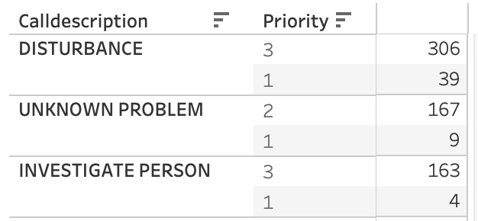
Top 3 calls in areas where ART is lowest
Table displays the top 3 call descriptions and their priority for the 3 zip codes (48201,48202,48226) with the lowest average response times
Disturbance is the largest component and majority of disturbance calls have a priority of 3
Notes:
48201 & 48202 are zip codes for midtown Detroit, 48226 is Necklace District/ Downtown

Slide 6
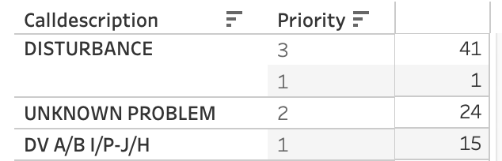
Top 3 calls in areas where ART is highest
Disturbance is the most called for complaint in the 3 zip codes (48240,48239,48236) with the highest average response time. Priority number is also the same
It is worth noting that the number of calls for Disturbance is significantly more in the zip codes where the average response time is lower, systematic misallocation of resources despite call volume
Why is it taking the police so long for these zip codes despite same call type and priority type?
Notes:
48240 & 48239 is Redford Michigan, 48236 is Grosse Pointe, Michigan

Slide 7
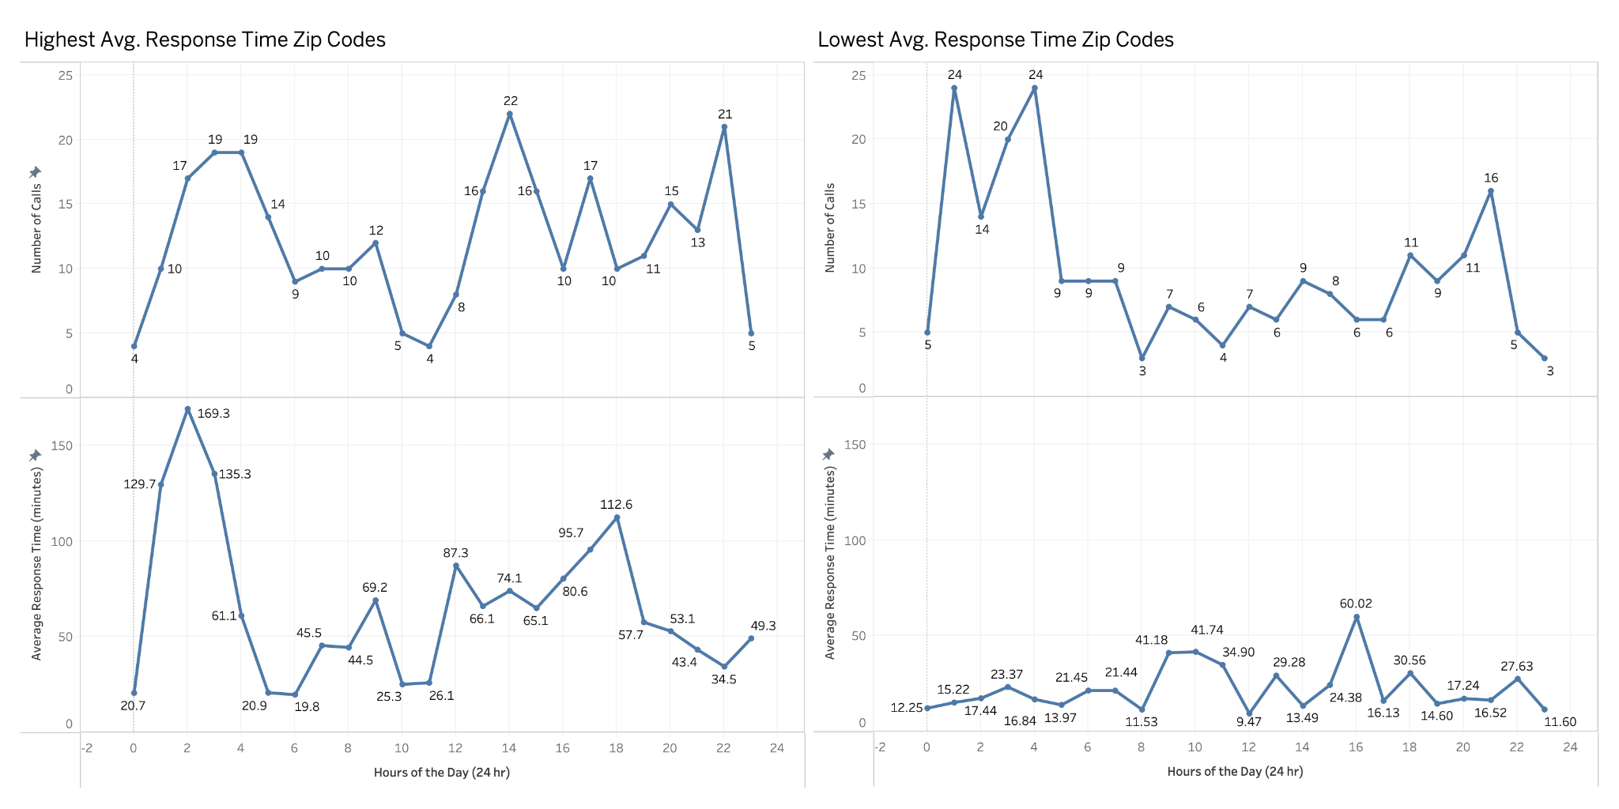
Peak Disturbance Hours Reveal Stark Resource Disparities Across Detroit
Notes:
WHAT ARE WE SEEING
We're now diving deeper into our most concerning finding - the resource disparity between neighborhoods
These charts compare disturbance call patterns in our highest vs. lowest response time zip codes
Keep in mind these axis are the same, illustrating the disparity between the response times in different Detroit zip codes
Notice both areas experience similar peak call volumes
With our HART peeking in the early hours of 19
And 22 around 2 pm
And 21 around 10 pm
LART follow some similar patterns with the peak disturbance volumes at 24 in the early morning hours
ANALYSIS
The Early Morning Crisis (2-4 AM):
7x response time difference during overnight hours (169 min vs. 23 min)
Most dangerous timing: Early morning disturbances often involve domestic violence, intoxication, mental health crises
Why This Crisis Matters/Relating back to our problem :
Disturbances are Detroit's highest-volume call type - affects the most residents
3-hour delays allow escalation from disturbances to serious crimes
Compounding disadvantage: Detroit's most underserved neighborhoods face worst service during most vulnerable hours
Public trust breakdown: Residents learn not to call because help won't arrive in time

Slide 8
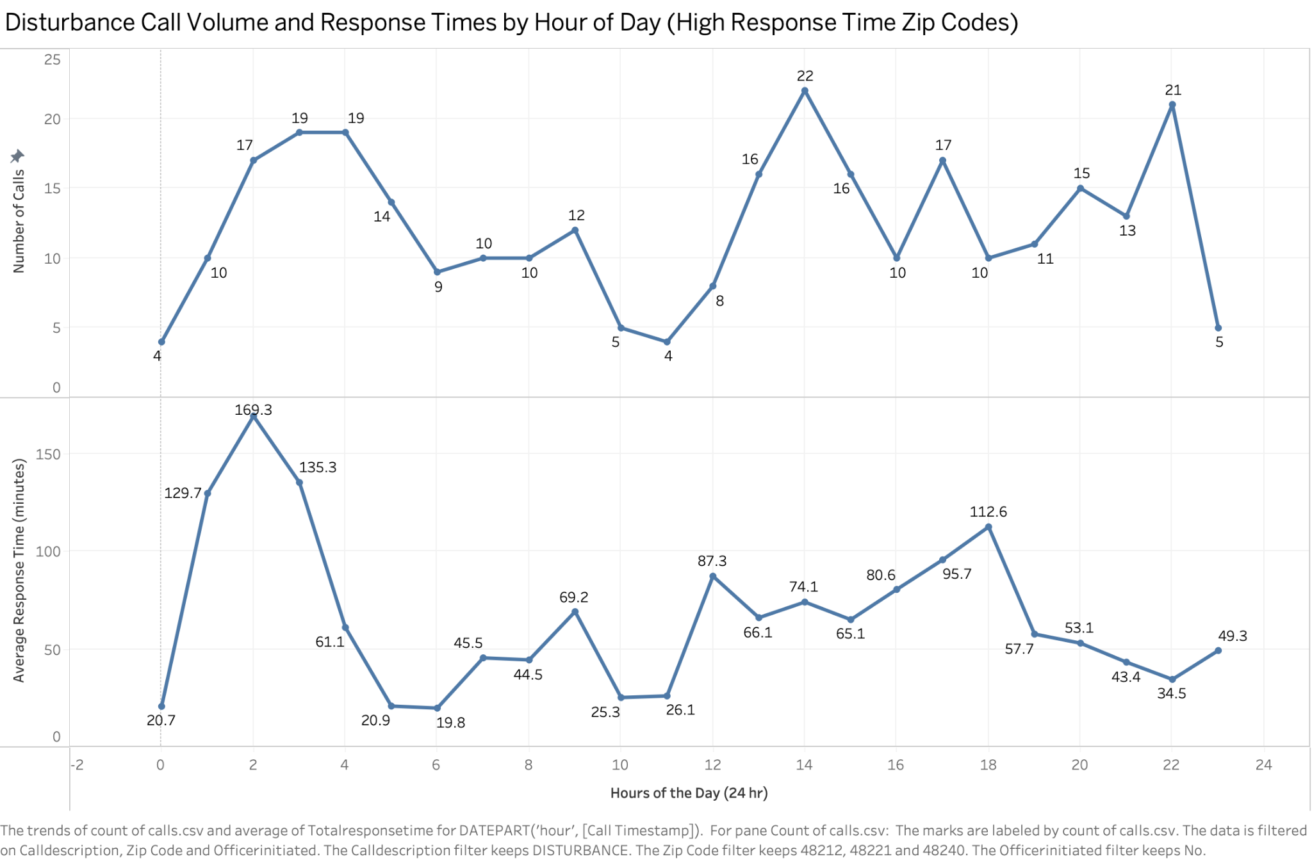

Slide 9
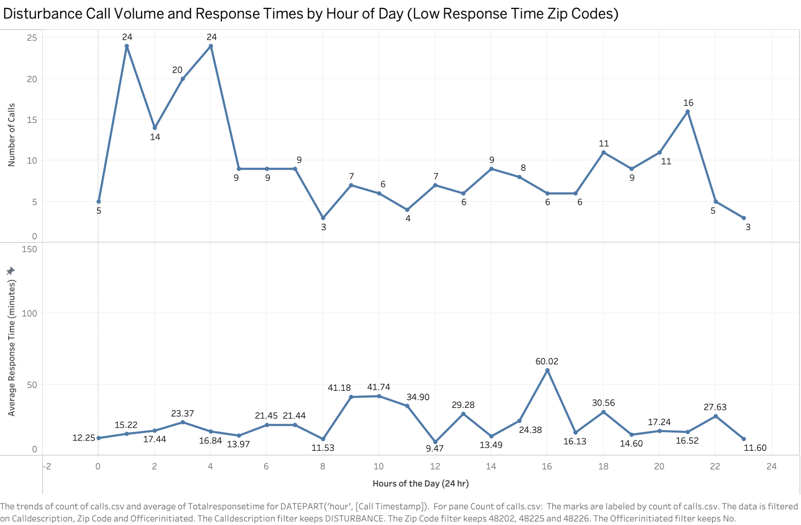
Notes:
DECREASEING average response time for the types of calls that come in the most will make an impact

Slide 10
Our Recommendations & Takeaways
Take a hard look at staffing levels, in terms of both time of day and locations
All areas deserve same response times for the same crime categories
Mayor review funding allocation
Slow response times could be due to lack of resources in certain zip codes→Low prioritization
We need to address how priority levels are assigned and treated
Better staff training for a more systematic approach throughout departments
Notes:
As we saw in the analysis, not all neighborhoods are receiving the same level of protection when it comes to police response times. Even when the type of call and its priority are the same, some zip codes experience significantly slower responses.
We recommend 3 main actions:

Slide 11
Limitations of study & next steps
Conduct the similar trend with the next highest call description category of Unknown Problem
Important to note from our results is to see the magnitude of Unknown problem calls that are at priority 2 accompany disturbances→ more uncertainty and higher demand on police resources
To elaborate on our results, we can look into the house values and see whether neighborhoods with lower house values are facing more issues
Can model how response times could improve if staffing or resource allocation shifted toward the highest-demand Zip Codes
Notes:
Next Steps:
Analyze overnight staffing deployment patterns
Examine if early morning response failures predict crime escalation
Compare this pattern across other high-volume call types

Slide 12
Takeaways
Call Volume Drives Response Time
ZIP codes with the highest call demand also face the fastest average response times
Resource allocation gap
The contrast in response time observed suggests that police resources may be spread thin or redeployed differently at night in higher-demand neighborhoods
Policy/operational implication
Addressing those late-night delays in high-call Zip Codes could be a priority intervention area, whether through staffing shifts, redeployment, or community prevention strategies

Slide 13
Questions?

