Slide 1

Customer Shopping Behavior Analysis
Uncovering insights from 3,900 transactions across product categories — spending patterns, segments, preferences, and subscriptions.

Slide 2
Dataset at a Glance
3,900
18
Purchases
Features
4
37
Categories
Missing Ratings
Demographics
Purchase Details
Behavior
Age, Gender, Location, Subscription
Item, Category, Amount, Season, Size
Discounts, Frequency, Ratings, Shipping

Slide 3

Data Preparation in Python
01
Load & Explore
Imported with pandas; used df.info() and .describe()
02
Clean & Impute
Filled missing Review Ratings with category median
03
Engineer Features
Created age_group and purchase_frequency_days columns
04
Load to PostgreSQL
Connected Python to PostgreSQL for SQL analysis

Slide 4
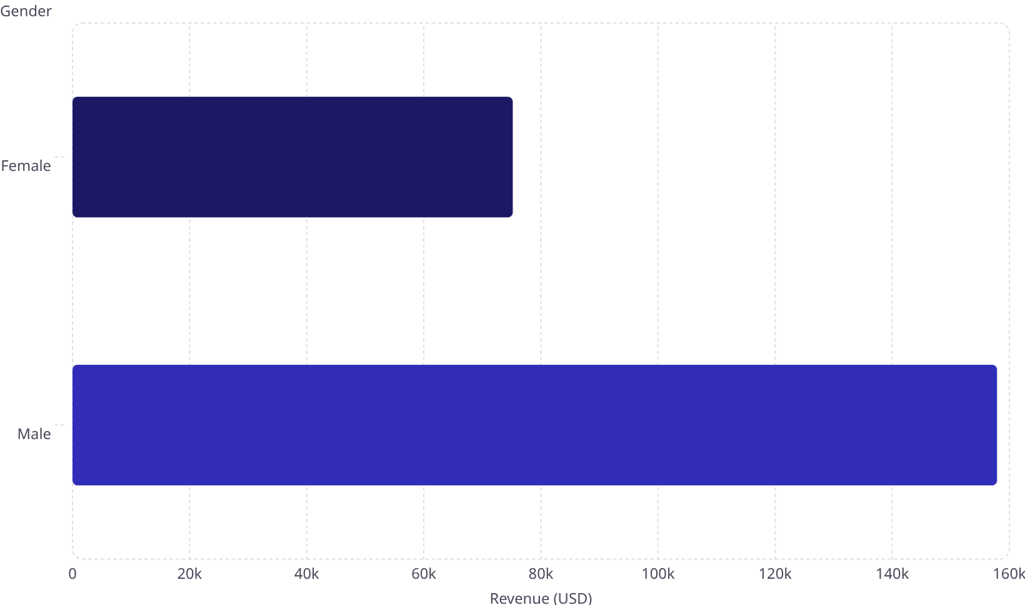
Revenue by Gender & Shipping
Shipping Type vs. Avg. Spend
Shipping
Avg. Purchase (USD)
75.2k
Standard
$58.46
Express
$60.48
158k
Male customers generate 2× more revenue than female. Express shipping users spend slightly more.

Slide 5

Subscribers vs. Non-Subscribers
Status
Avg. Spend
Total Revenue
Subscriber
$59.49
$62,645
·
Non-Subscriber
$59.87
$170,436
Non-Subscriber·73%
Subscriber·27%
·
Only 27% are subscribers — a major growth opportunity. Avg. spend is nearly identical across both groups.

Slide 6
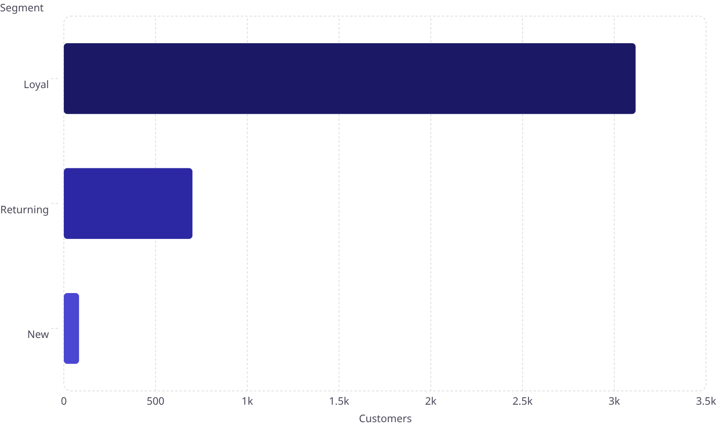
Customer Segments & Loyalty
Repeat Buyers & Subscriptions
3.12k
Among customers with >5 purchases:
Subscribed
958
701
Not Subscribed
2,518
83
80% of customers are already Loyal — yet most remain unsubscribed.

Slide 7
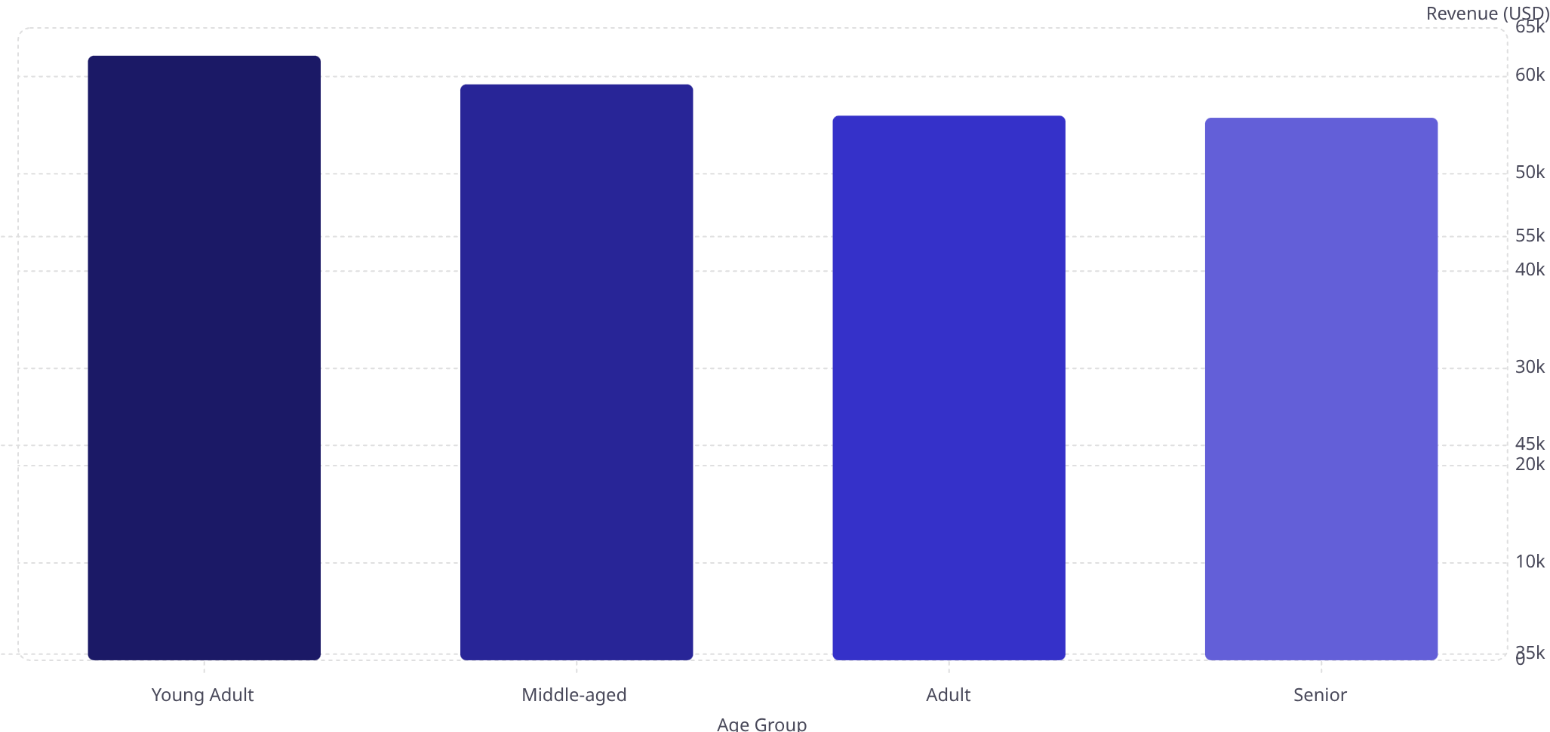
Revenue by Age Group
62.1k
59.2k
55.8k
56k
Young Adults lead in revenue at $62,143 — a key target segment for marketing campaigns.

Slide 8
Top Products & Discount Behavior
Top 5 by Rating
Most Discount-Dependent
Product
Avg. Rating
Product
Discount Rate
Gloves
3.86
Hat
50.00%
Sandals
3.84
Sneakers
49.66%
Boots
3.82
Coat
49.07%
Hat
3.80
Sweater
48.17%
Skirt
3.78
Pants
47.37%
839 customers used discounts yet spent above average — high-value discount users.

Slide 9
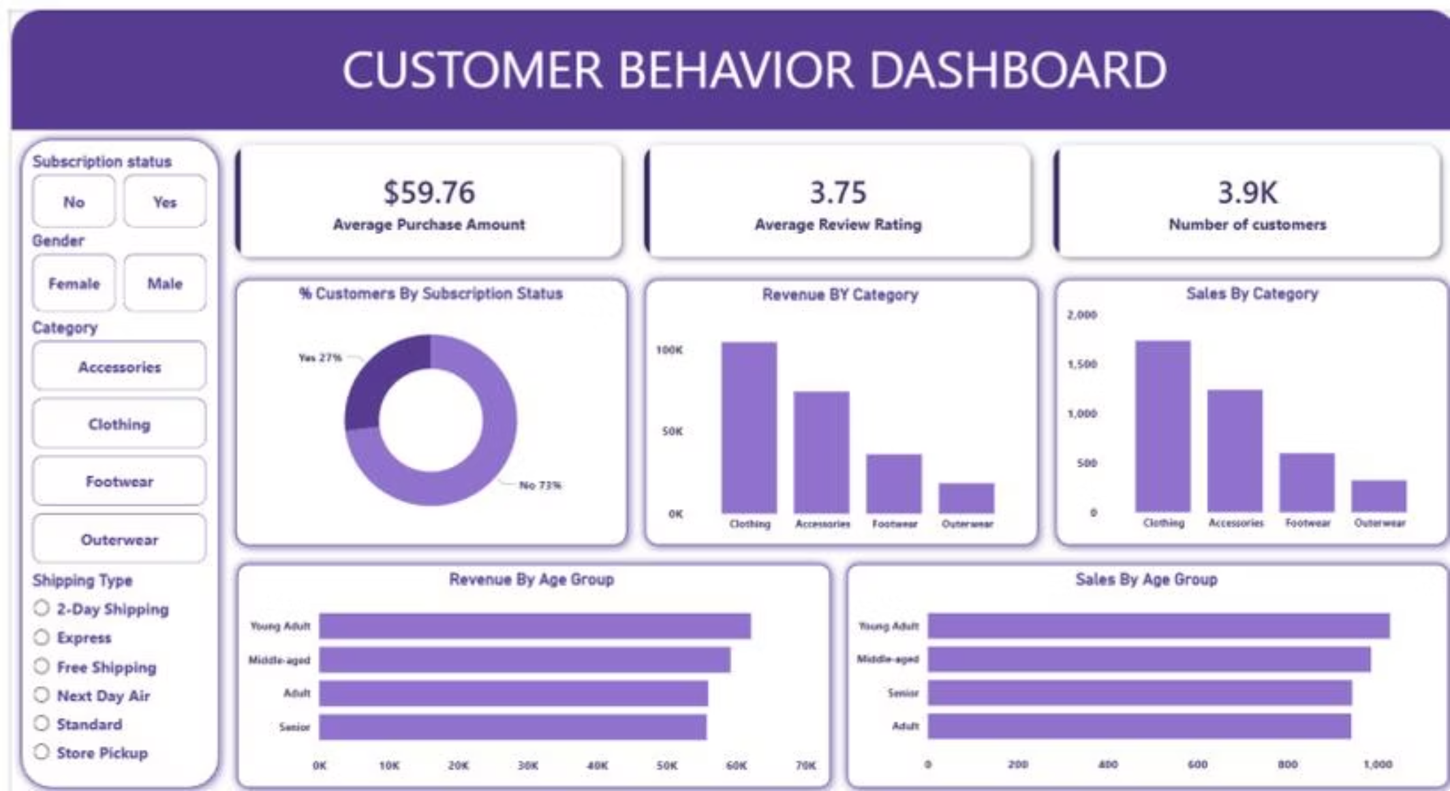
Power BI Dashboard
$59.76
3.75
Avg. Purchase
Avg. Rating
3.9K
27%
Customers
Subscribers

Slide 10

Business Recommendations
Boost Subscriptions
Promote exclusive benefits to convert the 73% non-subscribers
Loyalty Programs
Reward repeat buyers to deepen the Loyal segment
Review Discount Policy
Balance sales boosts with margin control
Targeted Marketing
Focus on Young Adults and express-shipping users

