Slide 1
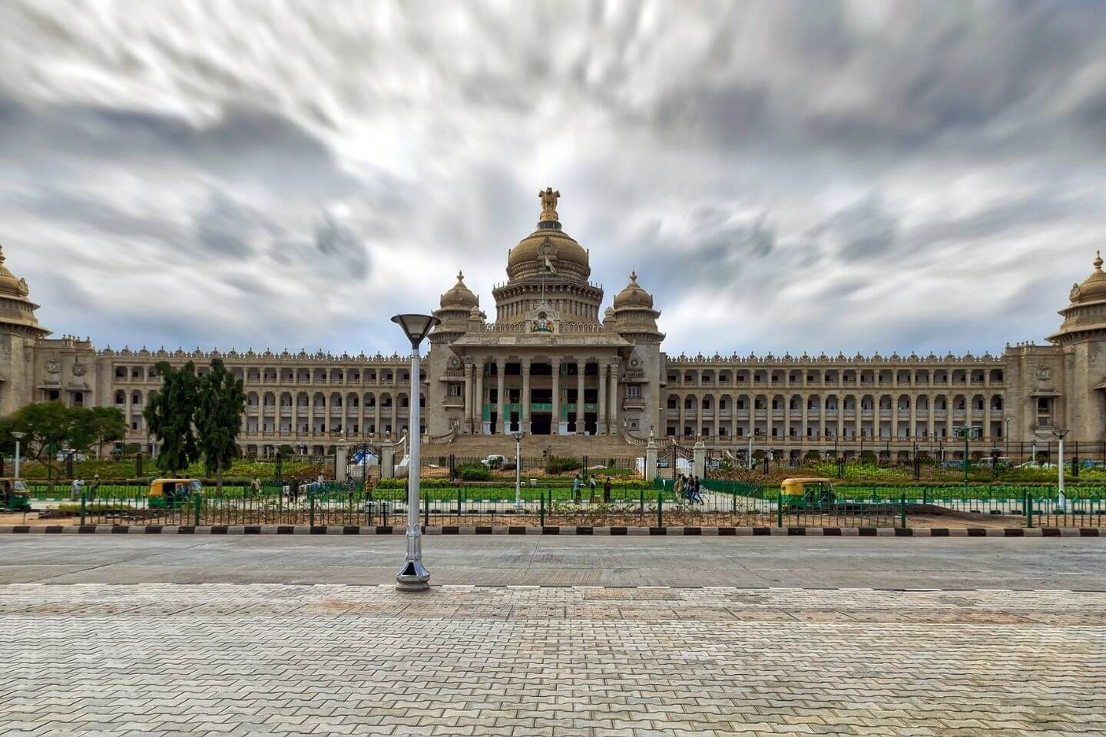
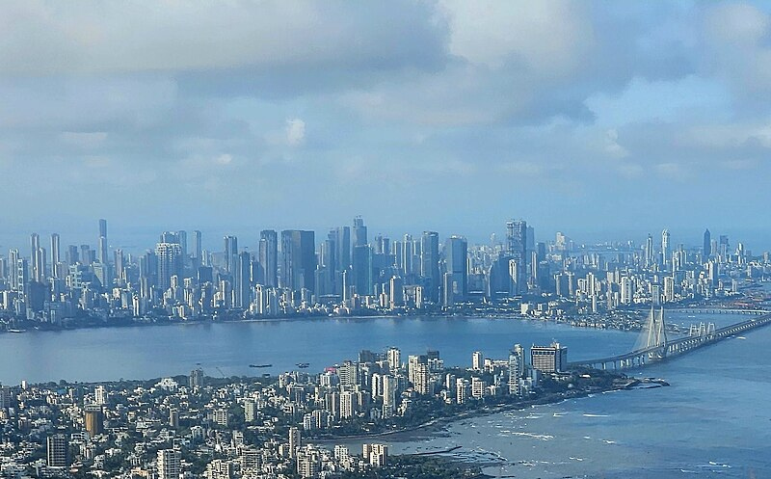
Indian History
Bengaluru
Mumbai
Bengaluru is a beautiful city
Mumbai is a beautiful city

Slide 2
The Necessity of System Thinking in Leadership

Slide 3


Indian History
Pros
Cons
Indian Army's modernization efforts are on track with the induction of advanced weaponry and technology.
Challenges in border security due to ongoing territorial disputes with neighboring countries.
Increased focus on cybersecurity to combat emerging threats in the digital age.
Budget constraints impacting the pace of infrastructure development and capacity building.

Slide 4


Indian History
Pros
Cons
Indian Army's modernization efforts are on track with the induction of advanced weaponry and technology.
Challenges in border security due to ongoing territorial disputes with neighboring countries.
Increased focus on cybersecurity to combat emerging threats in the digital age.
Budget constraints impacting the pace of infrastructure development and capacity building.
Increased focus on cybersecurity to combat emerging threats in the digital age.

Slide 5
Indian History
Pros
Cons
Indian Army's modernization efforts are on track with the induction of advanced weaponry and technology.
Challenges in border security due to ongoing territorial disputes with neighboring countries.
Increased focus on cybersecurity to combat emerging threats in the digital age.
Budget constraints impacting the pace of infrastructure development and capacity building.
Increased focus on cybersecurity to combat emerging threats in the digital age.
Budget constraints impacting the pace of infrastructure development and capacity building.

Slide 6
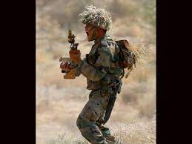
Indian History
Indian Army
Indian Army's modernization efforts are on track with the induction of advanced weaponry and technology.
Increased focus on cybersecurity to combat emerging threats in the digital age.
Indian Army's modernization efforts are on track with the induction of advanced weaponry and technology.
Increased focus on cybersecurity to combat emerging threats in the digital age.

Slide 7
Indian History
Indian Army
Indian Army's modernization efforts are on track with the induction of advanced weaponry and technology.
Increased focus on cybersecurity to combat emerging threats in the digital age.
Indian Army's modernization efforts are on track with the induction of advanced weaponry and technology.
Increased focus on cybersecurity to combat emerging threats in the digital age.

Slide 8
Indian History
Bengaluru
Bengaluru
Bengaluru is a beautiful city
Bengaluru is a beautiful city
Mumbai
Mumbai is a beautiful city

Slide 9
Indian History
Indian Army
Indian Army's modernization efforts are on track with the induction of advanced weaponry and technology.
Increased focus on cybersecurity to combat emerging threats in the digital age.
Indian Army's modernization efforts are on track with the induction of advanced weaponry and technology.
Increased focus on cybersecurity to combat emerging threats in the digital age.

Slide 10
Indian History
Indian Army's modernization efforts are on track with the induction of advanced weaponry and technology.
Indian Army
Increased focus on cybersecurity to combat emerging threats in the digital age.

