Slide 1

A Project
Report On
Grocery Delivery Application
By
Batch 2022-6520
Center : Pune(Pimpri-Chinchwad)
Under Guidance of
Chittaranjan Gosh
Technical Trainer at EduBridge(School of Coding)

Slide 2
Introduction
A grocery shopping is an web application where user purchase and order groceries online. The system is developed with a user-friendly and attractive. It deliver a wide range of groceries available online user have to first the view groceries and add them into their cart and then login into the system. They can order it by making a secure payment via cash on payment. The system functionality of products and orders is stored on server side in a web service.
Modules
Admin
Customer

Slide 3
Admin can login, Manage Categories, Manage Product, Manage Seller and also can Manage Order Products and their status and Log out.
2.
In Customer module ,customer can access the website and buy products and products to cart and buy and by category.
Now customer can register and login after that to shop.
I have devoloped this application in Java, Hibernate, Thymleaf, Rest Api , SpringBoot , SpringMVC and MySQL. It’s a web-based project so I have used HTML5, CSS, JavaScript and BootStrap,Ajax,Jquery also.

Slide 4
In Admin module ,admin can add the category and product in the specific category. He can also view the total number of user visited to the website and category and product details also.
In Customer module ,user can access the website and buy products and products to cart and buy and by category. Now user can register and login after that to shop.
Front End: JavaJ2EE technologies(Servlet, JSP), Html, CSS , JavaScript ,Hibernate, Bootstrap 5,Thymeleaf.
Back End: MySQL workbench 8.0.23CE, Rest-Api.
Browser: Best result on Google Chrome.
Operating System: Window 10.
Software Requirements :

Slide 5
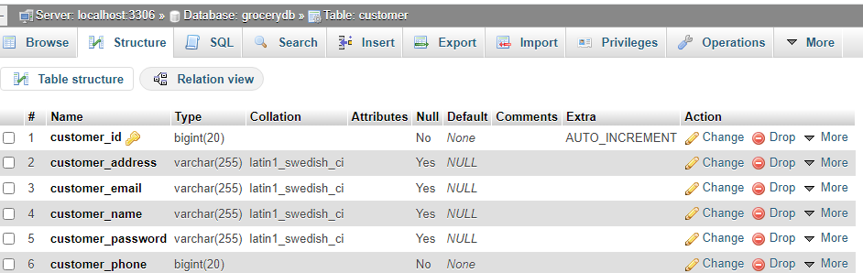
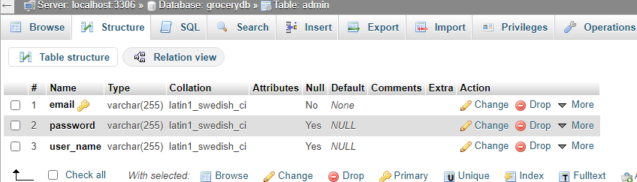
Data Dictionary
2 . Admin table

Slide 6
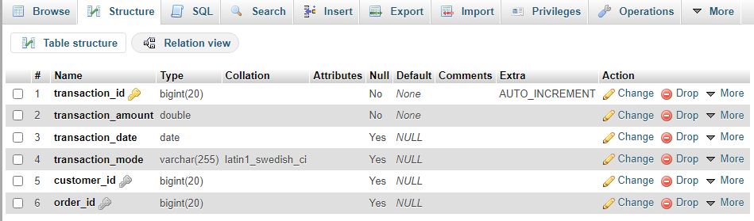
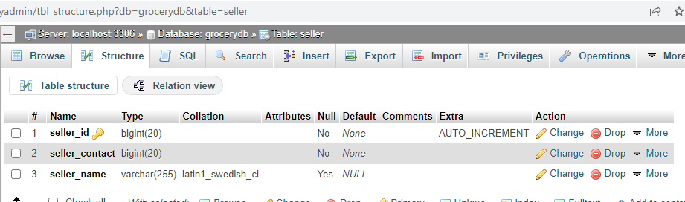
3. Transaction table
4. Seller Table

Slide 7
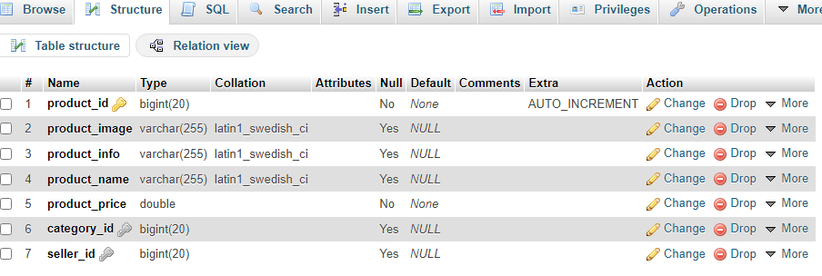
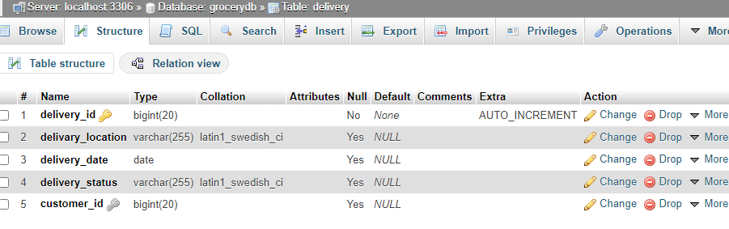
5. Product Table
6. Delivery Table

Slide 8
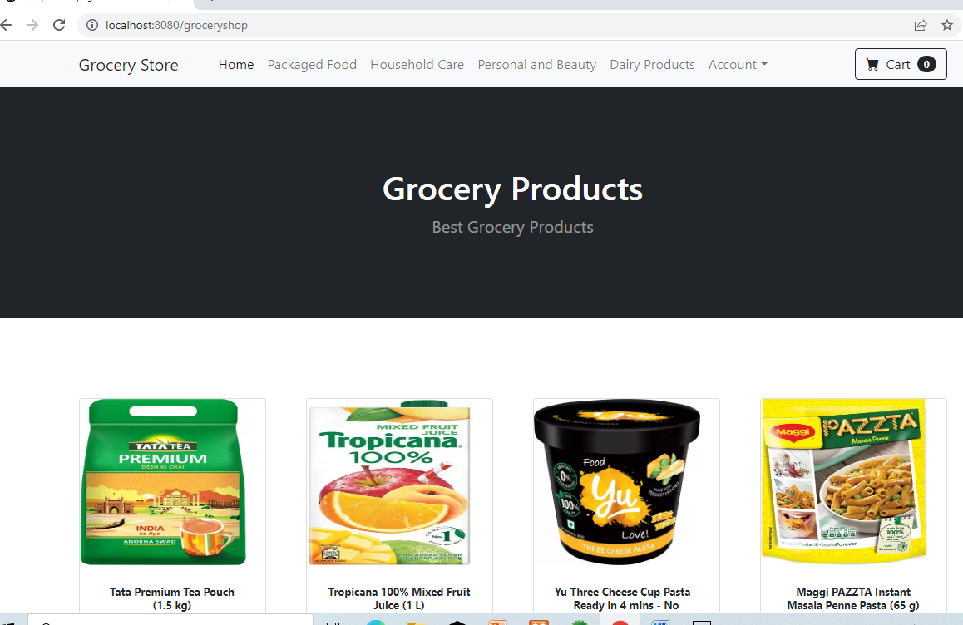
Screenshots

Slide 9
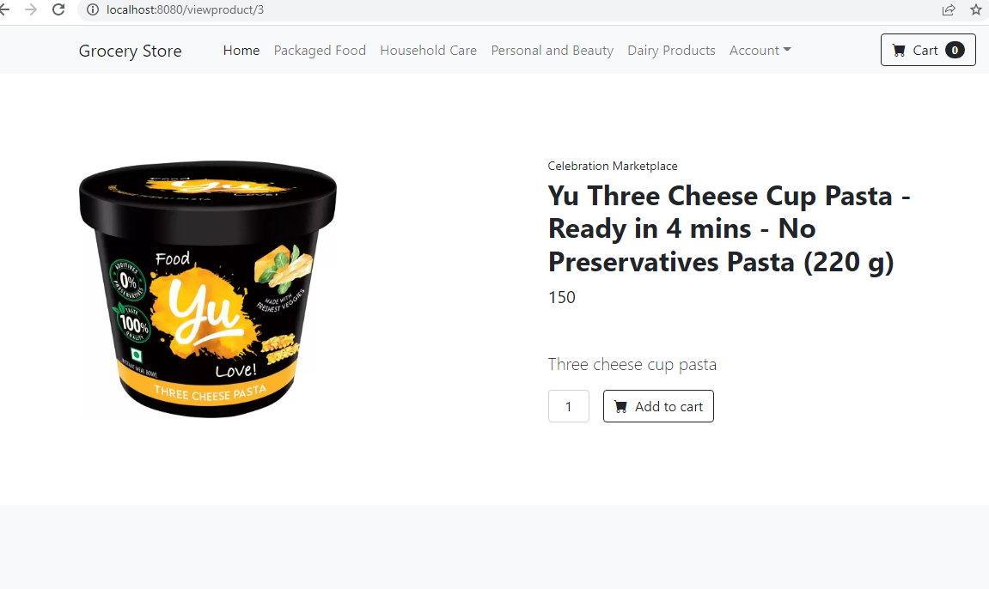

Slide 10
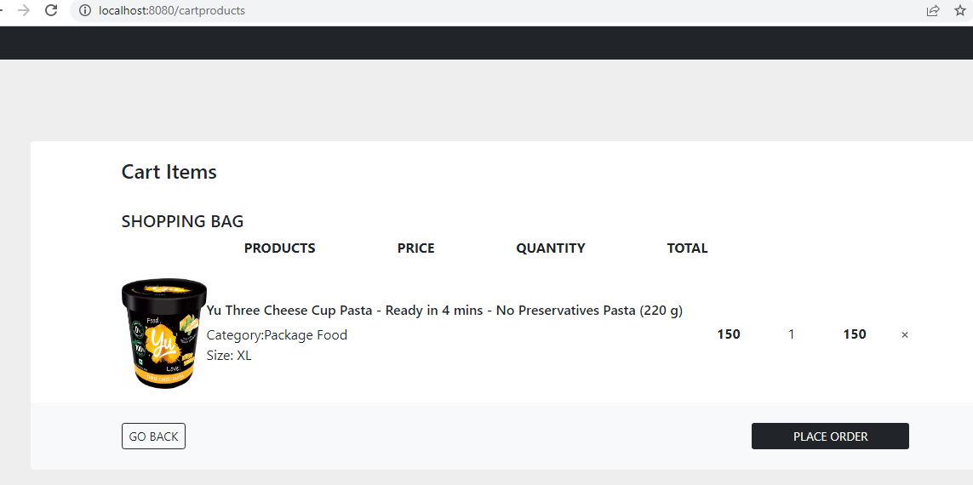

Slide 11
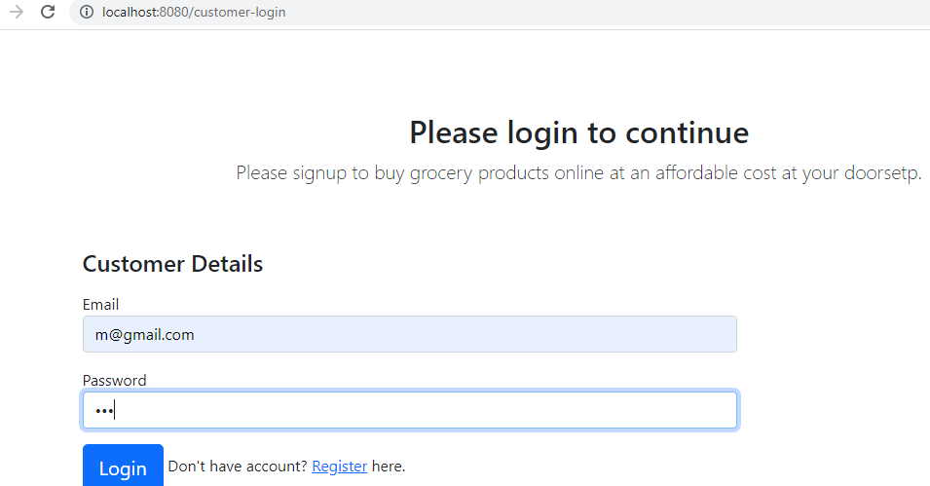

Slide 12
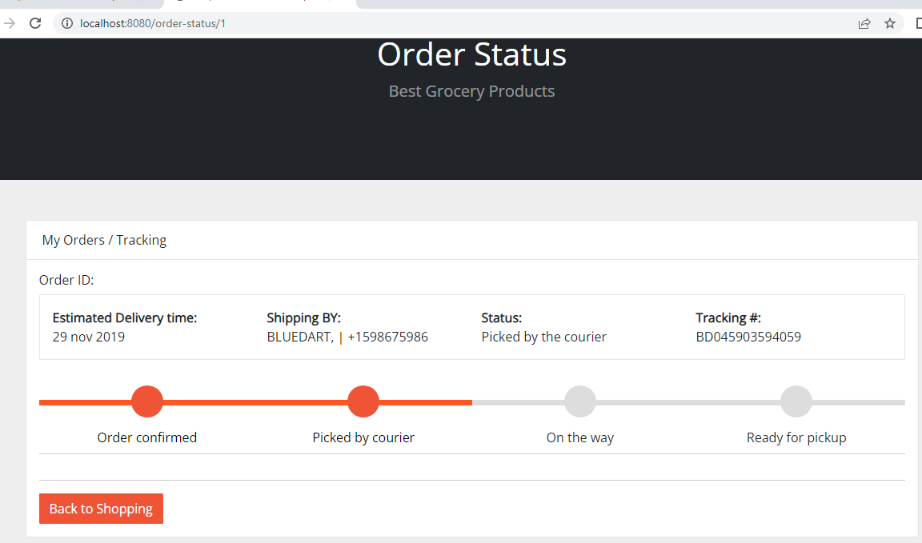

Slide 13
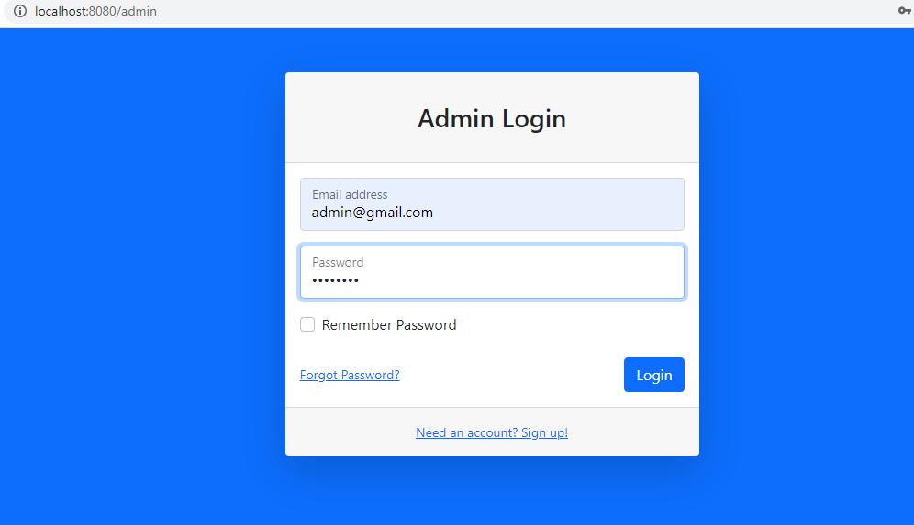

Slide 14
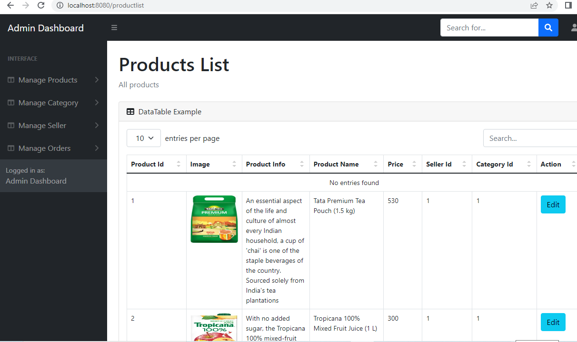
Thank you..

