Slide 1
Project/Report
Student Management System
Under Guidance of technical trainer,
Chittaranjan Gosh sir.
Batch:-6520
Center:-Pune (Pimpri-chinchawad)

Slide 2
Name : Hiray Pratiksha Sandip.
Enrollment No -EBEON1221503010
Batch :-6520
Subject :-
Student Management System.
Technology used : Java and MySQL

Slide 3
There are Two Models
1. Teacher
2. Student
1) Teacher can add ,update,delete ,view all records of Students and also can add attendance and view attendance of Students. Also can log in ,logged out.
2) Student can view their profile and attendance . Also can log in ,logged out .
Technology used : Java and MySQL
Operating System : Windows

Slide 4
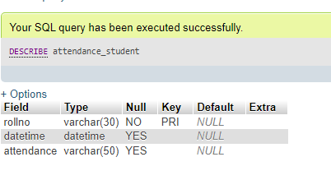

Slide 5
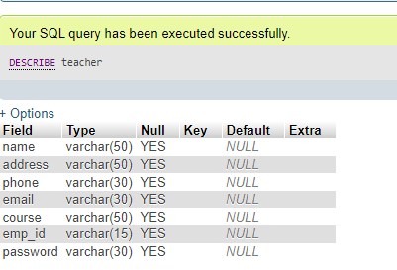

Slide 6
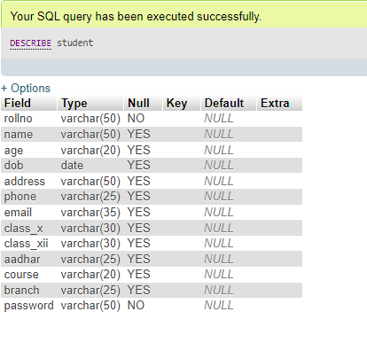

Slide 7
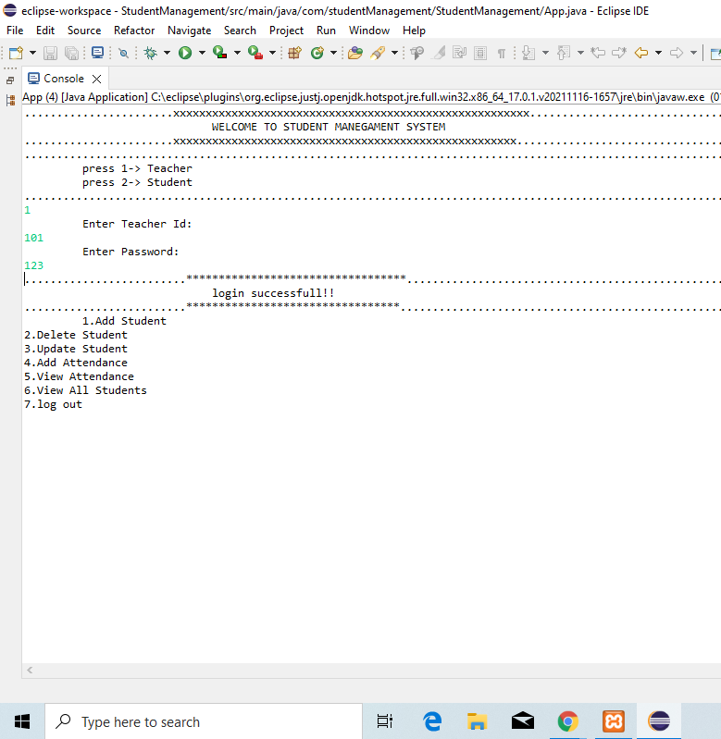

Slide 8
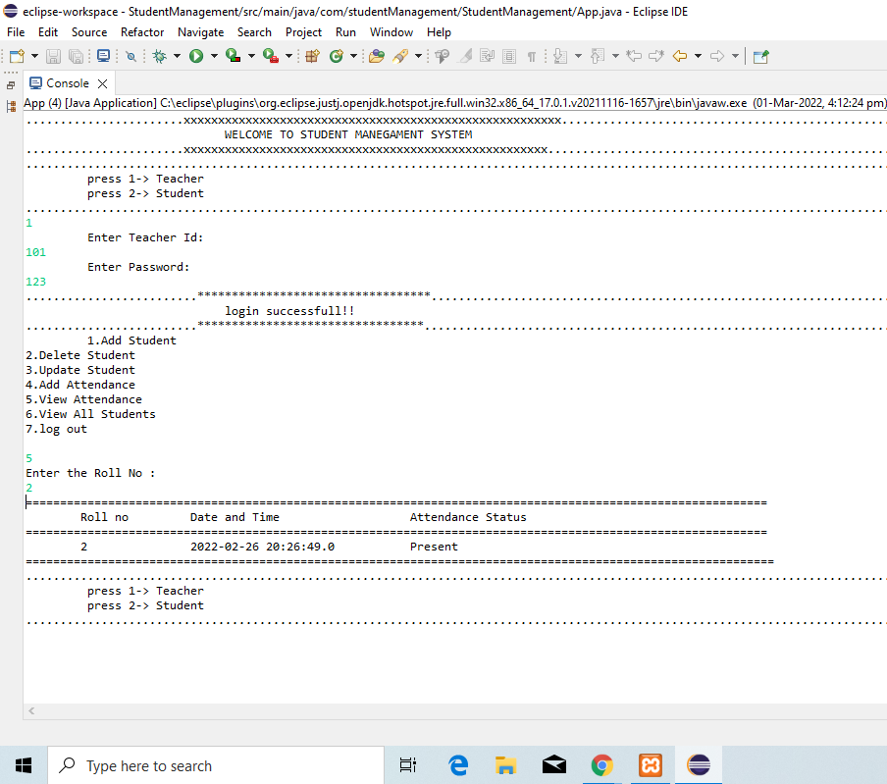

Slide 9
