Slide 1
Rubix Cube
A study in GROUP THEORY

Slide 2
Binary Operation:-
A binary operation ∘ on a set G is a function that assigns each order pair of elements of G an element of G i.e. it is a function from G × G to G.
∘ : G x G G
If (a, b) ∈ G × G then we write a ∘ b to indicate the image of the element (a, b) under the function ∘.

Slide 3
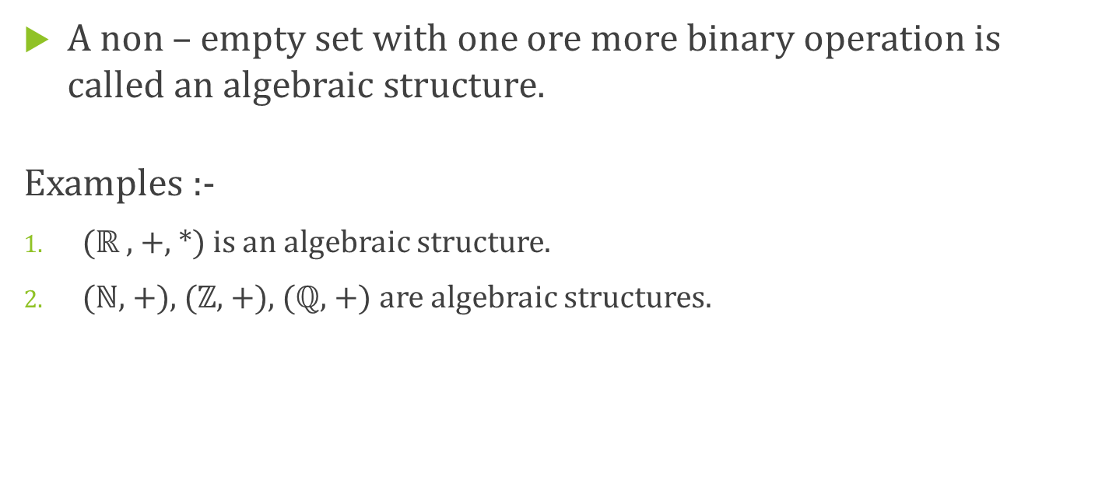
Algebraic Structure:-
A non – empty set with one ore more binary operation is called an algebraic structure.
Examples :-
($ℝ$, +, *) is an algebraic structure.
($ℕ$, +), ($ℤ$, +), ($ℚ$, +) are algebraic structures.

Slide 4
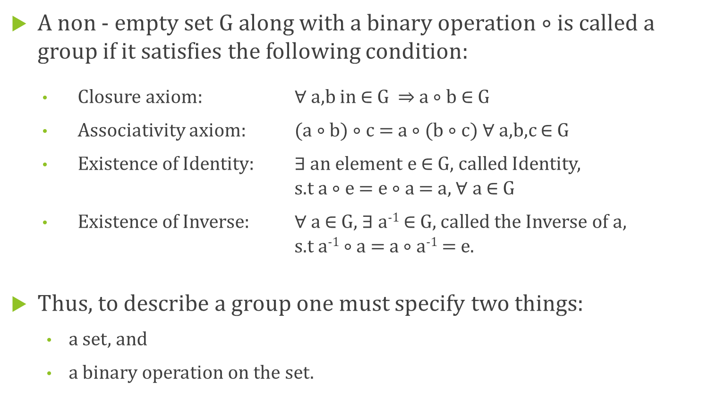
Group:-
A non - empty set G along with a binary operation ∘ is called a group if it satisfies the following condition:
Closure axiom: $∀$a,b in $∈$ G a ∘ b $∈$ G
Associativity axiom: (a ∘ b) ∘ c = a ∘ (b ∘ c) $∀$a,b,c $∈$ G
Existence of Identity: $∃$ an element e $∈$ G, called Identity,
s.t a ∘ e = e ∘ a = a, $∀$ a $∈$ G
Existence of Inverse: $∀$a $∈$G, $∃$a⁻¹ $∈$G, called the Inverse of a,
s.t a⁻¹ ∘ a = a ∘ a⁻¹ = e.
Thus, to describe a group one must specify two things:
a set, and
a binary operation on the set.

Slide 5
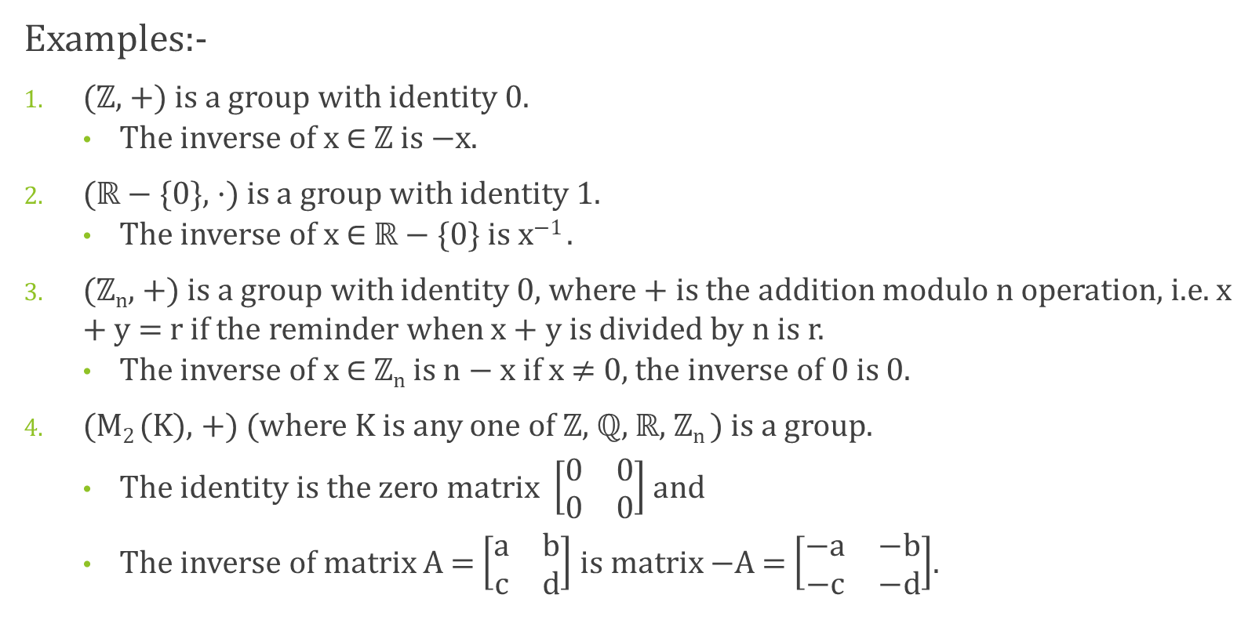
Group:-
Examples:-
($ℤ$, +) is a group with identity 0.
The inverse of x $∈$ $ℤ$ is −x.
($ℝ$ − {0}, ·) is a group with identity 1.
The inverse of x $∈$ $ℝ$ − {0} is x⁻¹ .
($ℤ$_{n}, +) is a group with identity 0, where + is the addition modulo n operation, i.e. x + y = r if the reminder when x + y is divided by n is r.
The inverse of x $∈$ $ℤ$_{n} is n − x if x $≠$ 0, the inverse of 0 is 0.
(M₂ (K), +) (where K is any one of $ℤ$, $ℚ$, $ℝ$, $ℤ$_{n} ) is a group.
The identity is the zero matrix $\left[\begin{matrix}0 & 0 \\ 0 & 0\end{matrix}\right]$ and
The inverse of matrix A = $\left[\begin{matrix}a & b \\ c & d\end{matrix}\right]$ is matrix −A = $\left[\begin{matrix}−a & −b \\ −c & −d\end{matrix}\right]$.

Slide 6
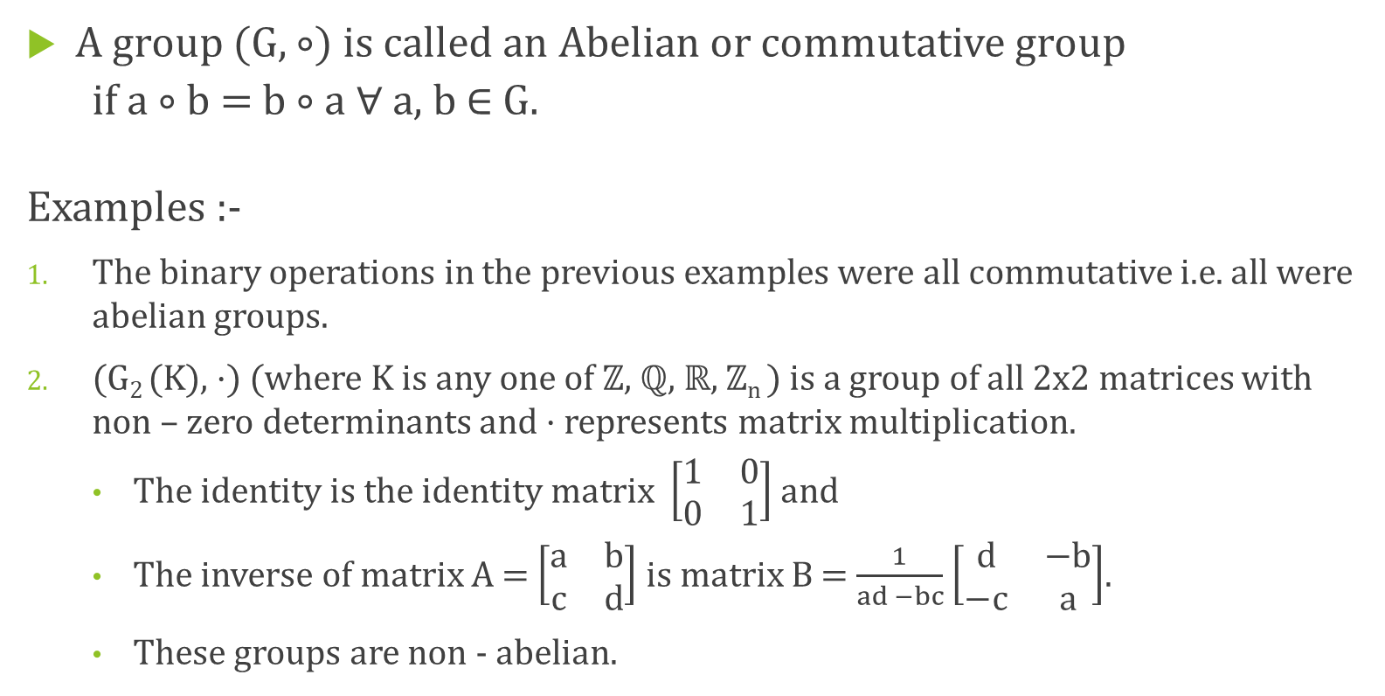
Abelian Group:-
A group (G, ∘) is called an Abelian or commutative group
if a ∘ b = b ∘ a $∀$ a, b $∈$ G.
Examples :-
The binary operations in the previous examples were all commutative i.e. all were abelian groups.
(G₂ (K), ·) (where K is any one of $ℤ$, $ℚ$, $ℝ$, $ℤ$_{n} ) is a group of all 2x2 matrices with non – zero determinants and · represents matrix multiplication.
The identity is the identity matrix $\left[\begin{matrix}1 & 0 \\ 0 & 1\end{matrix}\right]$ and
The inverse of matrix A = $\left[\begin{matrix}a & b \\ c & d\end{matrix}\right]$ is matrix B = $\frac{1}{ad −bc}$ $\left[\begin{matrix}d & −b \\ −c & a\end{matrix}\right]$.
These groups are non - abelian.

Slide 7
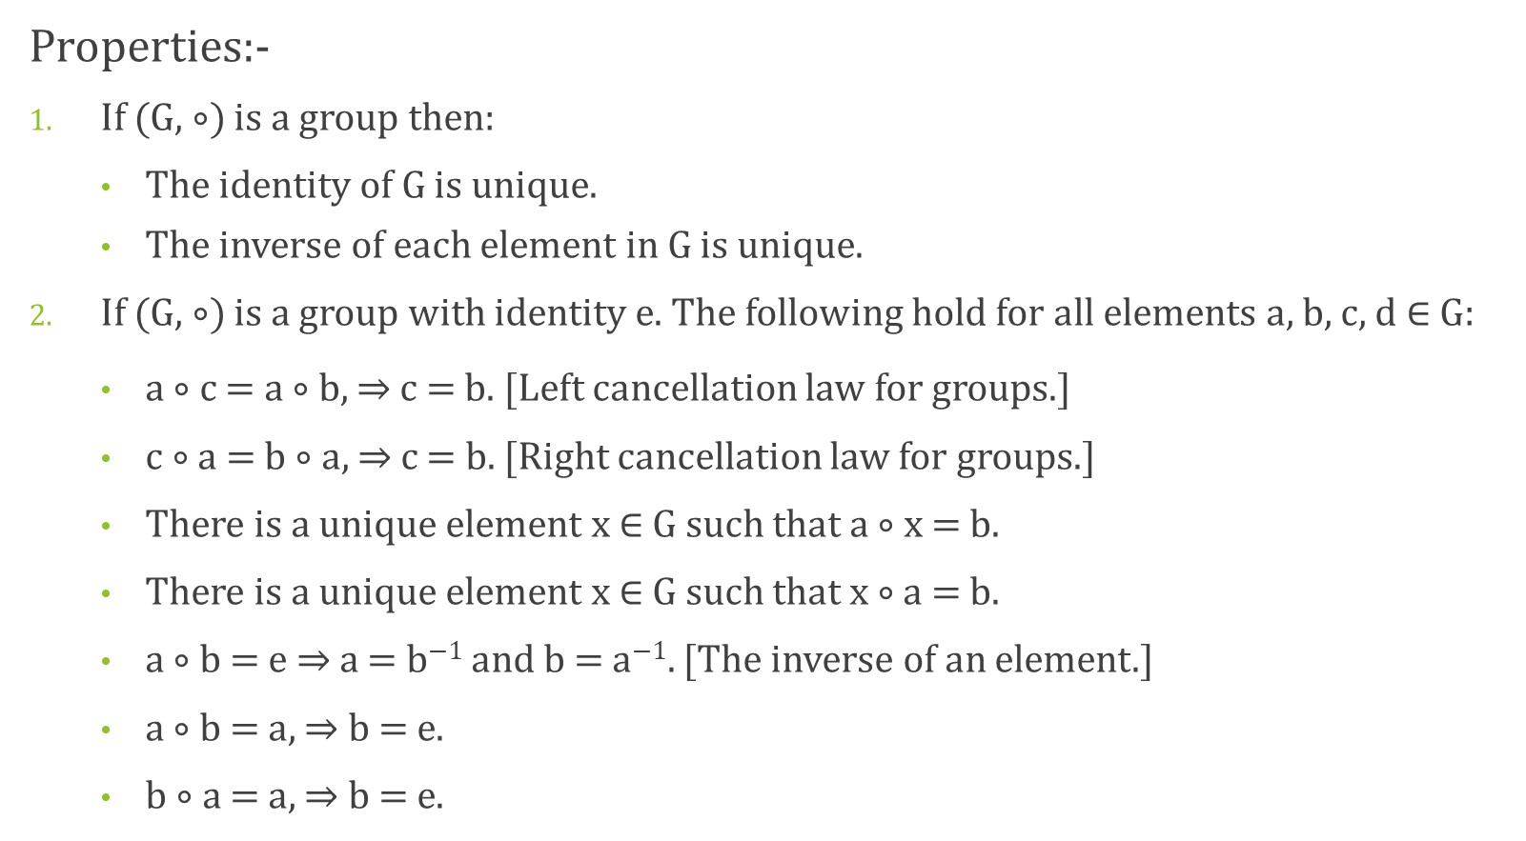
Group:-
Properties:-
If (G, ∘) is a group then:
The identity of G is unique.
The inverse of each element in G is unique.
If (G, ∘) is a group with identity e. The following hold for all elements a, b, c, d $∈$ G:
a $∘$ c = a ∘ b, c = b. [Left cancellation law for groups.]
c ∘ a = b ∘ a, c = b. [Right cancellation law for groups.]
There is a unique element x $∈$ G such that a ∘ x = b.
There is a unique element x $∈$ G such that x ∘ a = b.
a ∘ b = e a = b⁻¹ and b = a⁻¹. [The inverse of an element.]
a ∘ b = a, b = e.
b ∘ a = a, b = e.

Slide 8
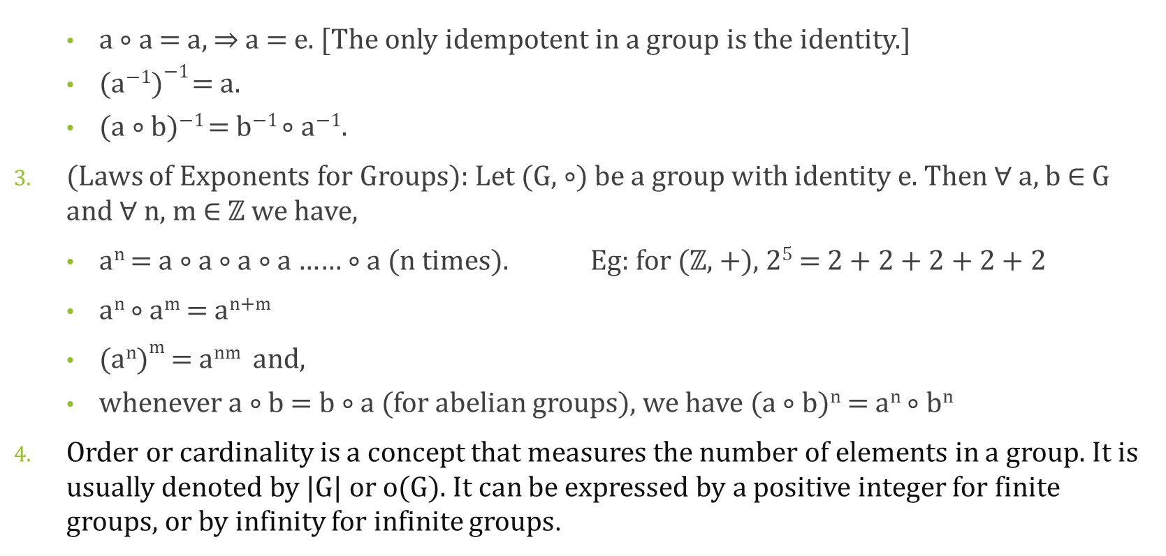
Group:-
a $∘$ a = a, a = e. [The only idempotent in a group is the identity.]
(a⁻¹)⁻¹ = a.
(a $∘$ b)⁻¹ = b⁻¹ $∘$ a⁻¹.
(Laws of Exponents for Groups): Let (G, $∘$) be a group with identity e. Then $∀$ a, b ∈ G and $∀$ n, m ∈ $ℤ$ we have,
a^{n} = a $∘$ a $∘$ a $∘$ a …… $∘$ a (n times). Eg: for ($ℤ$, +), 2⁵ = 2 + 2 + 2 + 2 + 2
a^{n} $∘$ a^{m} = a^{n+m}
(a^{n})^{m} = a^{nm} and,
whenever a ∘ b = b ∘ a (for abelian groups), we have (a ∘ b)^{n} = a^{n} ∘ b^{n}
Order or cardinality is a concept that measures the number of elements in a group. It is usually denoted by |G| or o(G). It can be expressed by a positive integer for finite groups, or by infinity for infinite groups.

Slide 9
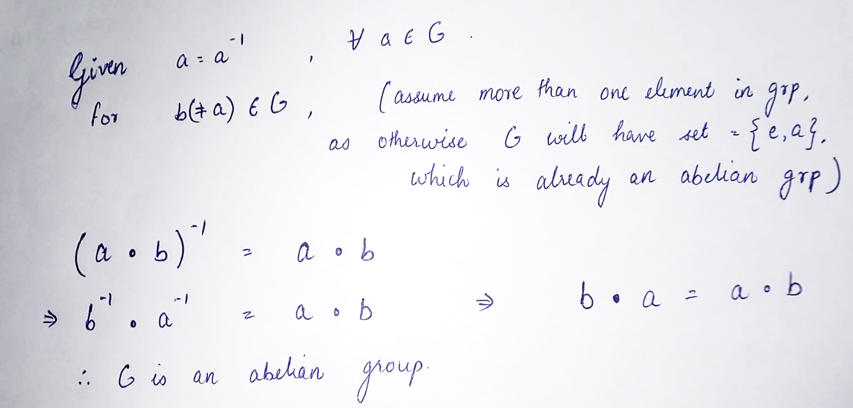
Group:-
Questions:-
Show that if every element of the group G is its own inverse, then G is abelian.

Slide 10
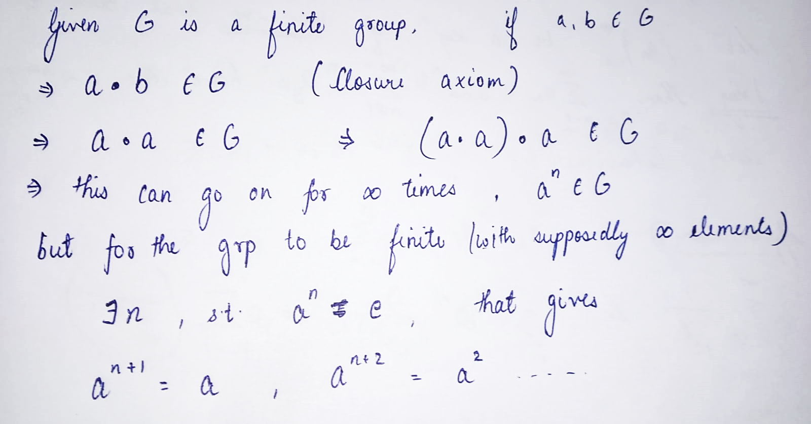

Group:-
Cyclic Group
Questions:-
If G is a finite group, show that $∃$ a positive integer n s.t a^{n} = e $∀$ a $∈$ G.

Slide 11

Group
$ℤ$
$∘$
$ℚ$
$ℕ$
$ℝ$
$∈$
$∀$
$∃$
$≠$
$⊆$

Slide 12
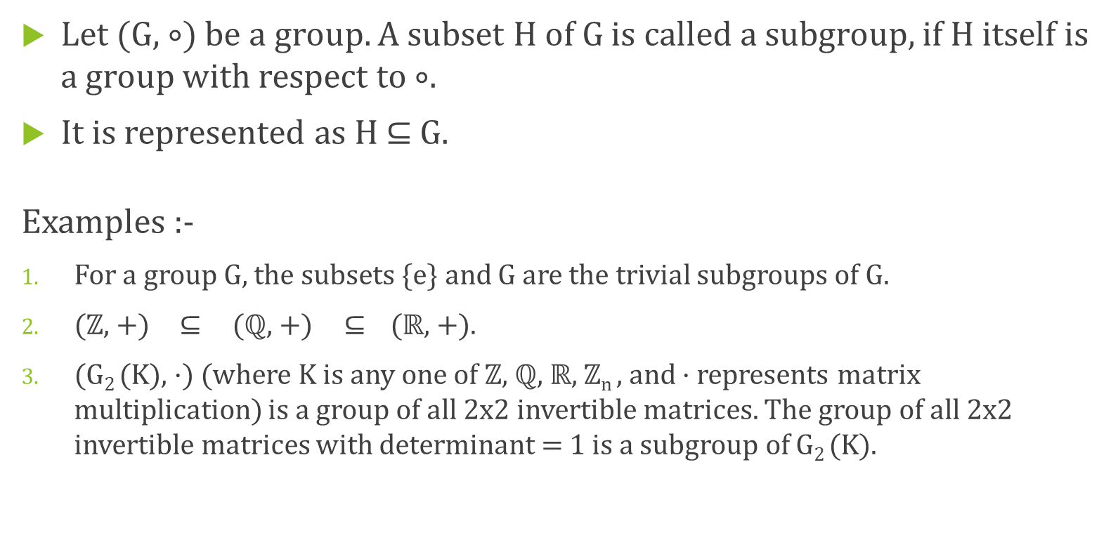
Subgroup:-
Let (G, $∘$) be a group. A subset H of G is called a subgroup, if H itself is a group with respect to $∘$.
It is represented as H $⊆$ G.
Examples :-
For a group G, the subsets {e} and G are the trivial subgroups of G.
($ℤ$, +) $⊆$ ($ℚ$, +) $⊆$ ($ℝ$, +).
(G₂ (K), ·) (where K is any one of $ℤ$, $ℚ$, $ℝ$, $ℤ$_{n} , and · represents matrix multiplication) is a group of all 2x2 invertible matrices. The group of all 2x2 invertible matrices with determinant = 1 is a subgroup of G₂ (K).

Slide 13
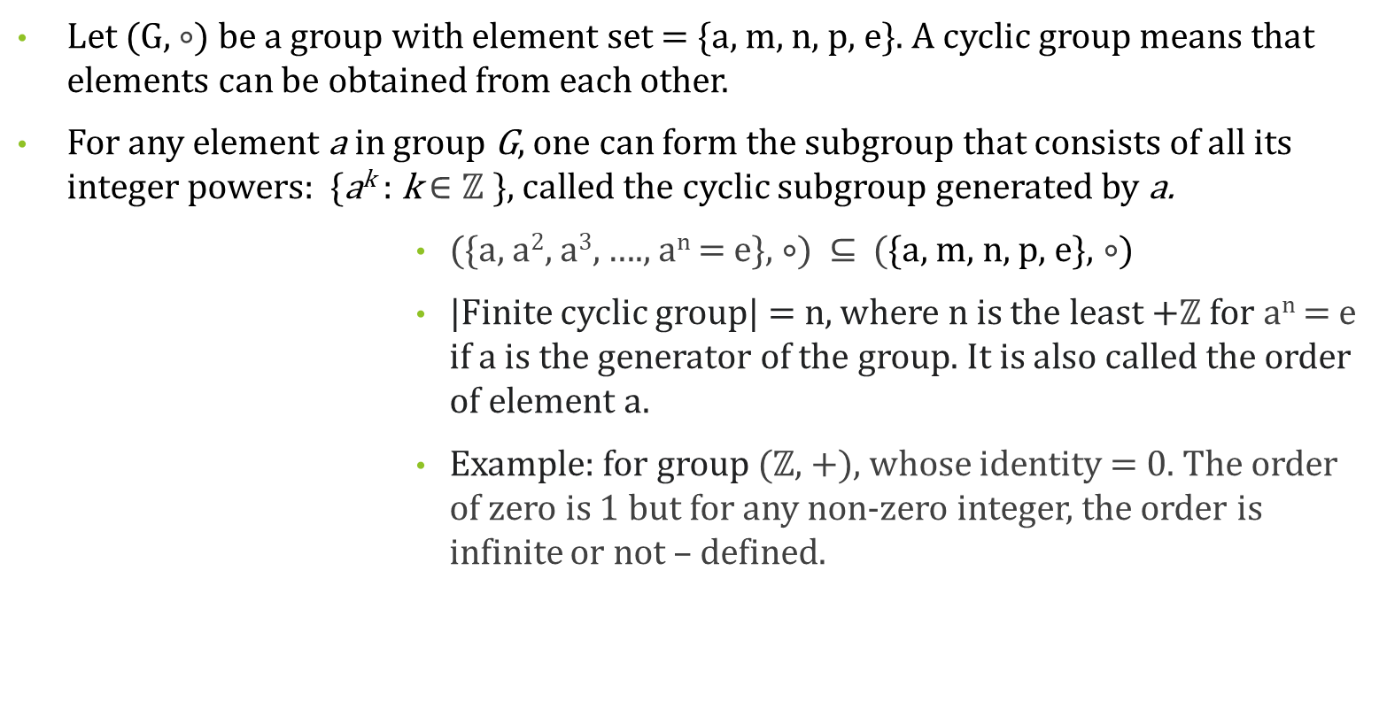
Cyclic groups:-
Let (G, $∘$) be a group with element set = {a, m, n, p, e}. A cyclic group means that elements can be obtained from each other.
For any element a in group G, one can form the subgroup that consists of all its integer powers: {a^{k} : k $∈ℤ$ }, called the cyclic subgroup generated by a.
({a, a², a³, …., a^{n} = e}, $∘$) $⊆$ ({a, m, n, p, e}, $∘$)
|Finite cyclic group| = n, where n is the least +$ℤ$ for a^{n} = e if a is the generator of the group. It is also called the order of element a.
Example: for group ($ℤ$, +), whose identity = 0. The order of zero is 1 but for any non-zero integer, the order is infinite or not – defined.
a
e
a²
a³
a^{n-1}

Slide 14
Lagrange’s Theorem:-
The order of each subgroup H of a finite group G, divides the order of the group.
|H| / |G| i.e. the order of the subgroup is a factor of the order of the group.
This theorem is used to discard of the possibility of certain subgroups.
Examples :-
If a group G has 6 elements, then a subset of G with 1, 2, 3 or 6 elements may or may not be its subgroup. But the one with 4 or 5 elements will definitely not be.
If cardinality of a group G is a prime number, then it can only have 2 subgroups, {e} and G itself, as it’s order will have no other divisor.
For a cyclic subgroup {a, a², a³, …., a^{n} = e} of group G, the order of element should divide the order of the group G i.e. n/ |G|.

Slide 15
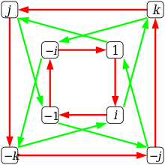
Quaternion Group:-
Group G = {1, −1, i, −i, j, −j, k, −k} define a binary operation of multiplication with identity = 1.
i² = j² = k² = -1,
i.j = -j.i = k,
j.k = -k.j = i
k.i = -i.k = j
The red arrows represent the multiplication
on right by i, and the green arrows represent the
multiplication on right by j.
This is a non – abelian group for this operation.
Inverse: i⁻¹ = -i, j⁻¹ = -j, k⁻¹ = -k, 1⁻¹ = 1, -1⁻¹ = -1.

Slide 16
Quaternion Group:-
Group G = {1, −1, i, −i, j, −j, k, −k}
Since |G| = 8, the order of subgroups can be 1, 2, 4 or 8. The following are the subgroups of G:
Order = 1: {e = 1}
Order = 2: {1, -1}
Order = 4: {1, -1, i, -i}, {1, -1, j, -j}, {1, -1, k, -k}
Order = 8: G = {1, −1, i, −i, j, −j, k, −k}

Slide 17
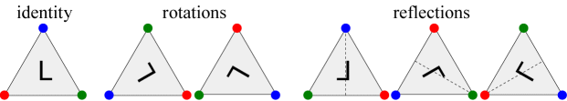
Dihedral Group:-
A dihedral group is the group of symmetries of a regular polygon, which includes rotations and reflections.
Dih_{n} or D_{n} refers to the symmetries of the n-gon, a group of order 2n.
The composition of group D₃ (the symmetries of an equilateral triangle): r₀ denotes the identity; r₁ and r₂ denote anti - clockwise rotations by 120° and 240° respectively, and s₀, s₁ and s₂ denote reflections across the three lines as shown.
r₀
r₁
r₂
s₀
s₁
s₂

Slide 18
Dihedral Group:-
r₀
r₁
r₂
s₀
s₁
s₂
 | e = r₀ | r₁ | r₂ | s₀ | s₁ | s₂
e = r₀ | r₀ | r₁ | r₂ | s₀ | s₁ | s₂
r₁ | r₁ | r₂ | r₀ | s₁ | s₂ | s₀
r₂ | r₂ | r₀ | r₁ | s₂ | s₀ | s₁
s₀ | s₀ | s₂ | s₁ | r₀ | r₂ | r₁
s₁ | s₁ | s₀ | s₂ | r₁ | r₀ | r₂
s₂ | s₂ | s₁ | s₀ | r₂ | r₁ | r₀

