Slide 1

A Phishing Awareness Training

Slide 2
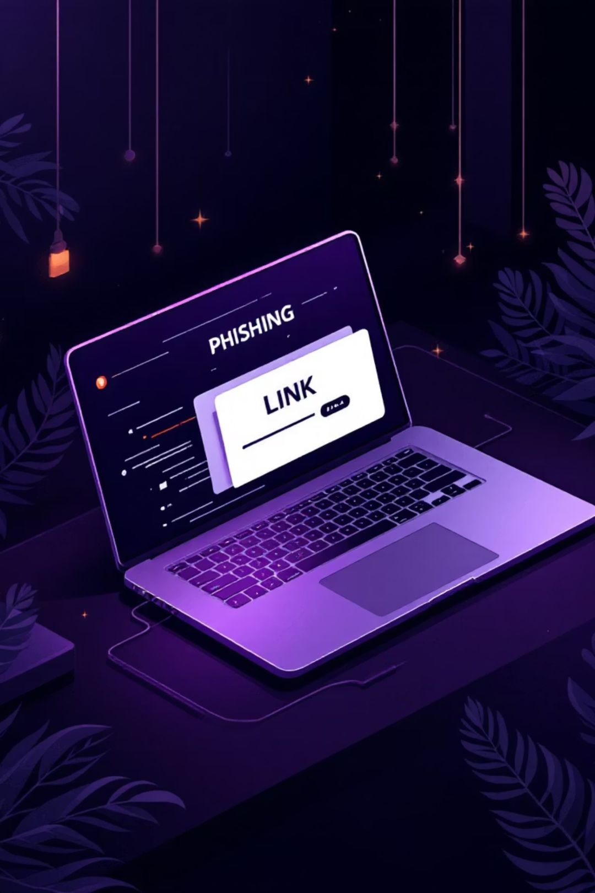

What is Phishing?
Deceptive Communications
Phishing involves fraudulent emails, messages, or websites designed to trick you.
Personal Data Theft
Attackers use these tactics to steal your sensitive personal information.
Targeted Information
They primarily target your passwords, One-Time Passwords (OTPs), and bank details.

Slide 3


How Phishing Attacks Work
Step 2: The Click
Step 1: Fake Message
The user clicks on the link without checking if it is safe.
An attacker sends a fake email, message, or website that looks real.
Step 4: Information Stolen
Step 3: Fake Website
The user enters password, OTP, or bank details, and the attacker steals this information.
The link opens a fake website that looks like a real one.

Slide 4
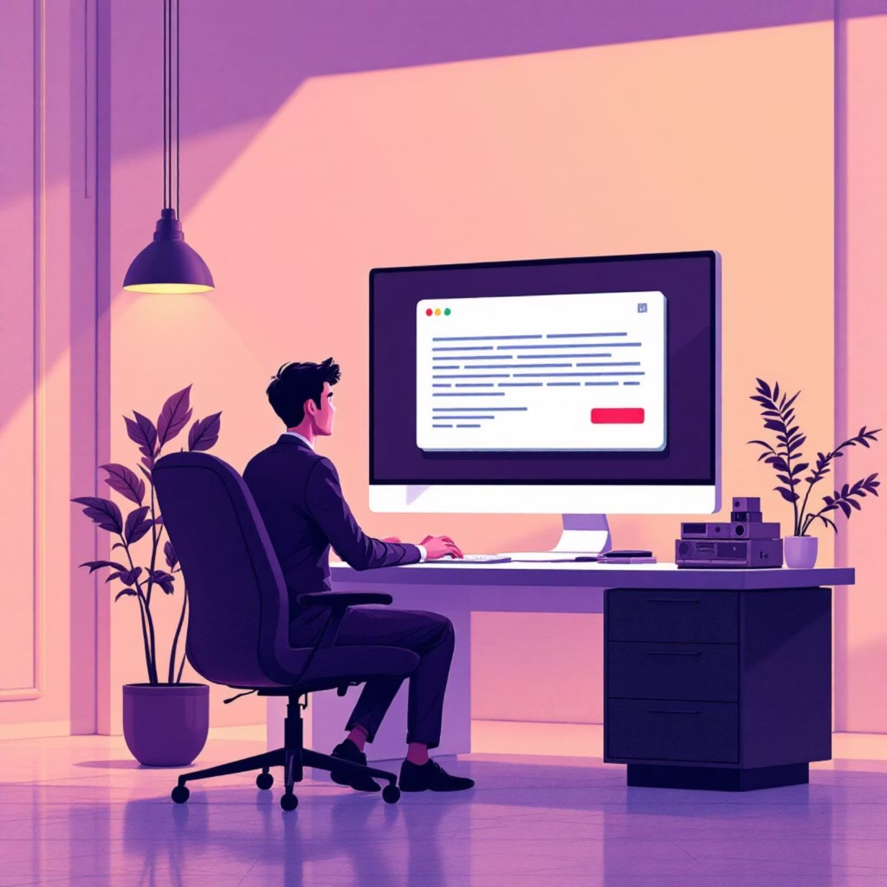
Spotting Phishing Emails: Key Indicators
Unknown Sender: Be wary of emails from addresses you don't recognize or that look slightly off.
Urgent Messaging: Phishing emails often create a sense of urgency, like "Your account will be blocked!"
Suspicious Links: Hover over links to check the actual URL before clicking. If it looks strange, don't click.
Spelling & Grammar Mistakes: Professional organizations rarely send emails with errors. This is a major red flag.
Unsolicited Attachments: Avoid opening attachments from unknown sources, especially if there's no clear reason for them.

Slide 5
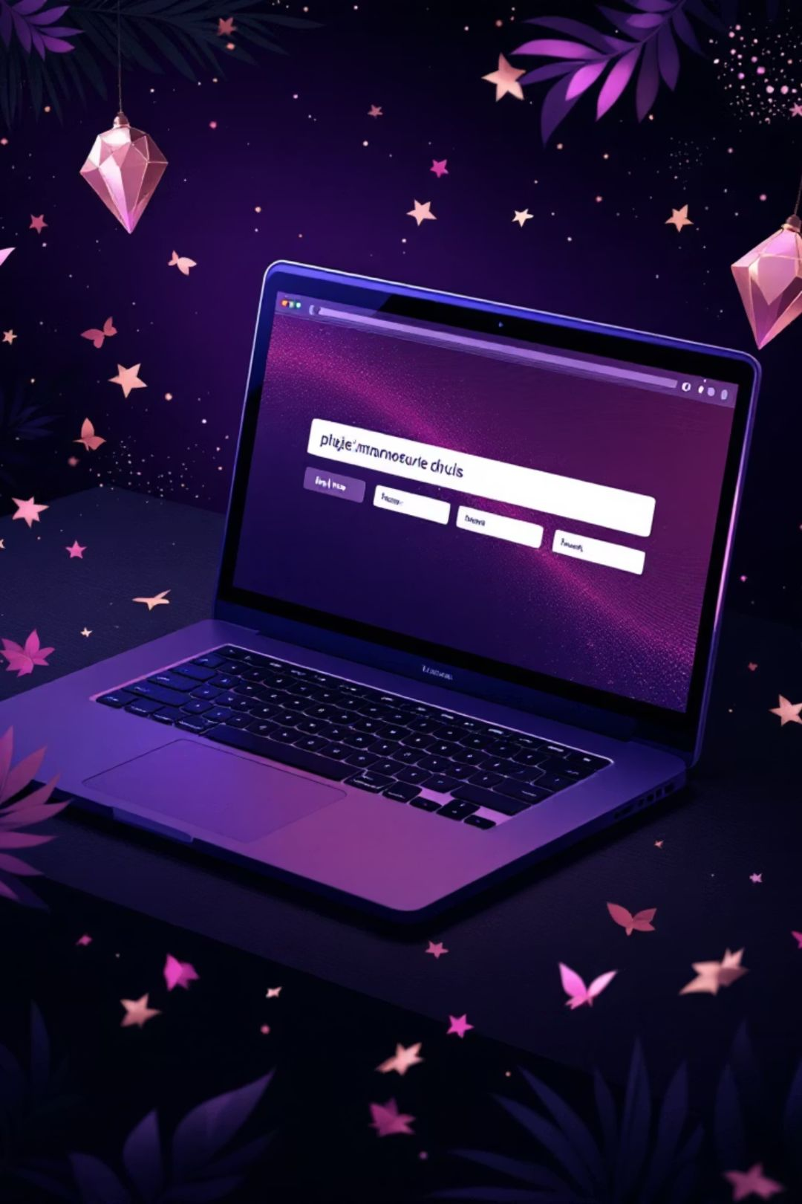
Identifying Fake Websites
Mismatched URLs
The website's URL may have subtle misspellings or use a different domain than the official one.
Missing HTTPS
Legitimate websites use 'HTTPS' (the 'S' stands for secure) in their URL. Lack of it is a warning sign.
Cloned Appearance
Fake sites often mimic the look and feel of real ones, making them hard to distinguish at first glance.
Unexpected Login Prompts
If a login page suddenly appears without you navigating to it, exercise extreme caution.

Slide 6
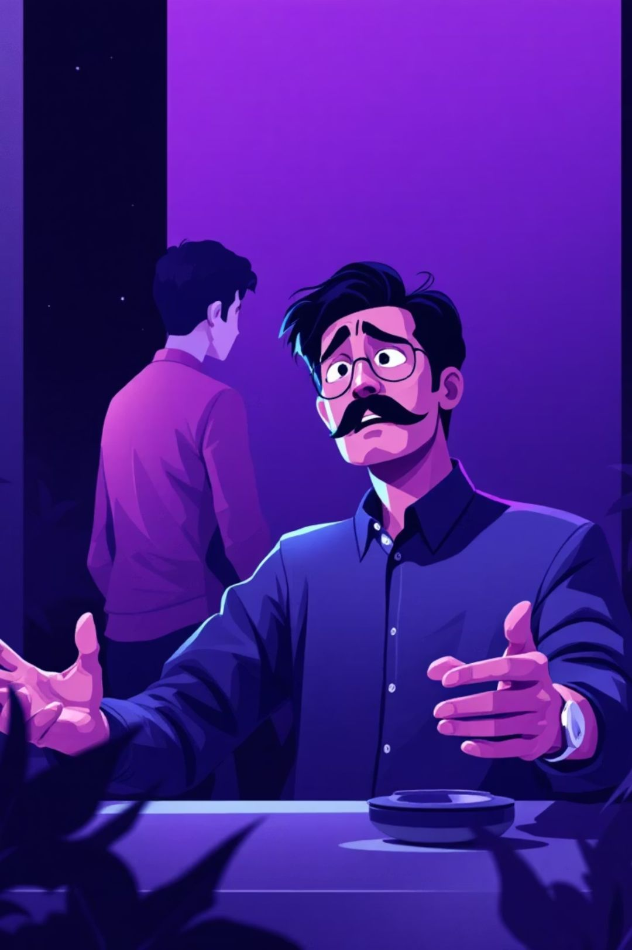


Social Engineering Tactics Used by Phishers
Fear
"Your account will be suspended if you don't act now!" They instill panic to prompt immediate, unthinking action.
Urgency
"Immediate action required!" Creating a false sense of urgency prevents victims from scrutinizing the request.
Trust
Using familiar names like "Your Bank" or "Microsoft" to establish a false sense of credibility and authority.
Greed
"You've won a free prize!" or "An exclusive offer just for you!" Appeals to a desire for something for nothing.

Slide 7
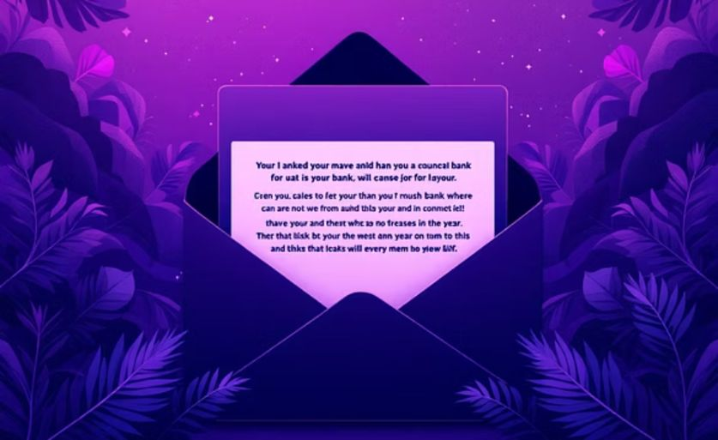
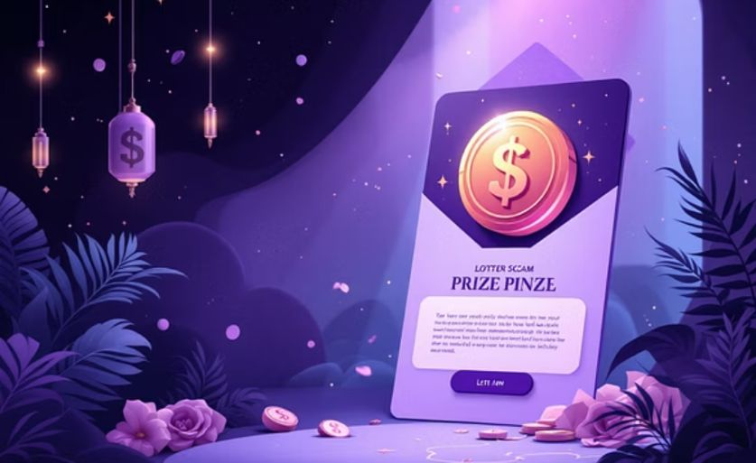
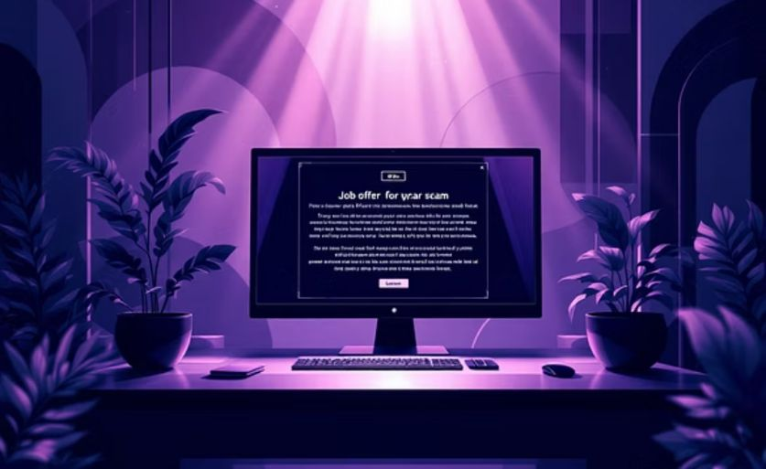
Real-World Phishing Examples
Phishing attacks come in many forms, often impersonating trusted institutions or offering tempting, too-good-to-be-true opportunities.

Slide 8
Best Practices: Protecting Yourself from Phishing
Don't Click Unknown Links
Always verify the source and legitimacy of links before clicking, especially in emails or messages.
Never Share OTPs or Passwords
Legitimate organizations will never ask for your OTP or full password via email or phone.
Verify Sender Identity
Double-check the sender's email address and contact information to confirm authenticity.
Use Two-Factor Authentication (2FA)
Adding an extra layer of security significantly reduces the risk of unauthorized access.
Install & Update Antivirus Software
Antivirus programs can detect and block malicious websites and files before they cause harm.

Slide 9
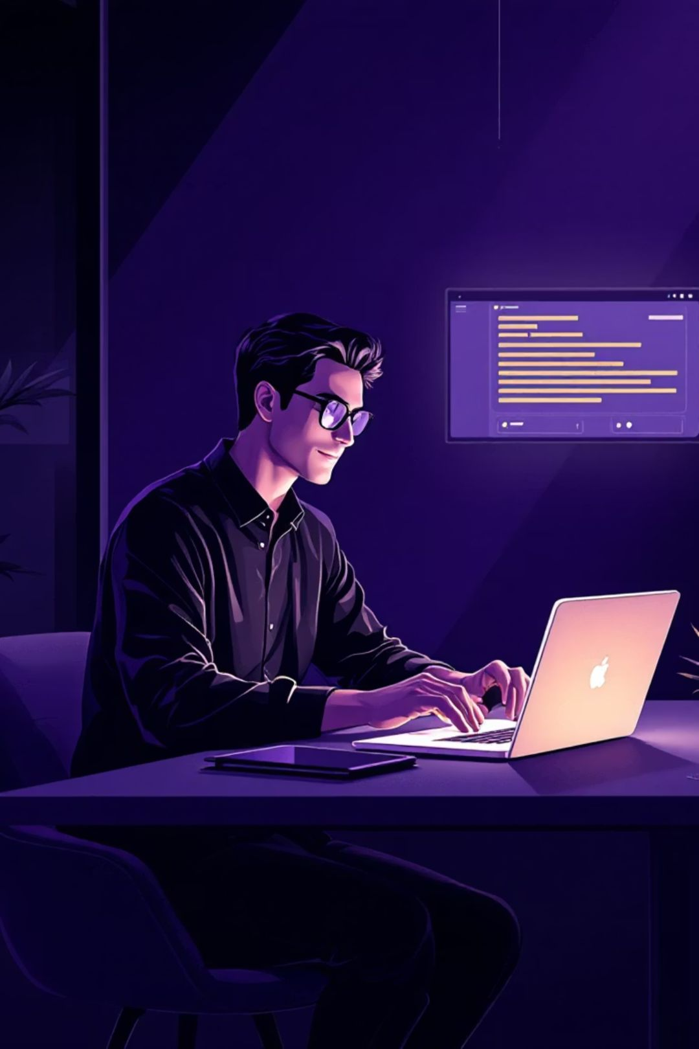

Interactive Phishing Quiz
1) You receive an email saying:
“Your bank account will be blocked today. Click the link immediately to verify your details.”
What type of email is this?
A) Genuine bank email
B) Phishing email
C) Promotional email
2) A message says:
“Your account will be permanently closed in 1 hour.”
Which social engineering technique is being used?
A) Trust
B) Fear
C) Entertainment

Slide 10

Stay Safe Online: Your Vigilance is Key
In the ever-evolving digital landscape, staying informed and vigilant is your strongest defense against phishing. Protect your information, protect yourself.

