Slide 1

AUCTION SOFTWARE CODEATHON on Music Mood Classifier and Lyrics Generator
PRATIKSHA AIGAL

Slide 2

Problem Statement
Given an unlabelled Spotify music data set, develop an algorithm to detect the mood of songs and use the insights to create a model that can generate song lyrics based on a specified mood.

Slide 3
Objectives
Data visualization and Preprocessing
Mood classification
LYRICS GENERATION
evaluation

Slide 4

Data visualization and preprocessing

Slide 5
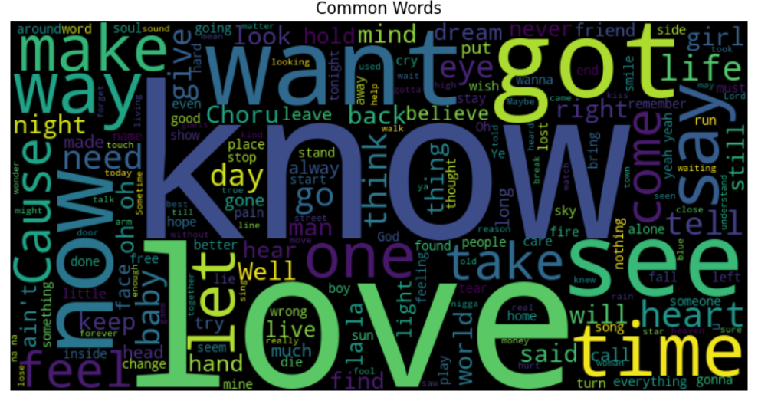
DATA Visualization
Visualized the frequently occurring words in most songs, using a word cloud to visualize the corpus data

Slide 6
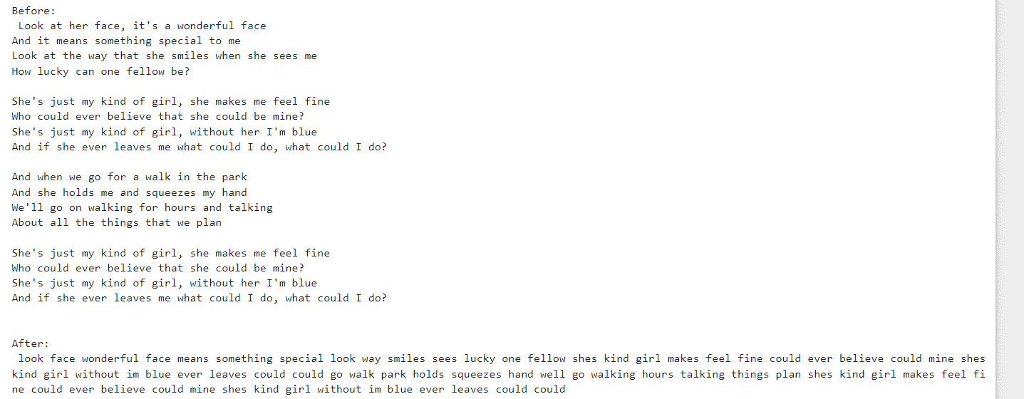
DATA Preprocessing
Stop words Removal
Removing digits and special characters
Removing any extra irrelevant data.

Slide 7
Mood classification

Slide 8
METHODOLODY
Develop Rule base sentiment analyzer using the VADER’s lexicon file.
Use the sentiment_analyzer function to computer the sentiment score of each lyrics
Build a KNN(K-nearest-neighbour) model.
Use the computed score’s as input to train the KNN model and categorize the data into 5 moods (Euphoria, Happy, Relaxed, Sad and Angry)
Analyse the computed clusters and calculate their mean to define a range of scorer for each mood.
Used the score range to classify each cluster to a mood.

Slide 9
Vader Implementation
VADER:
VADER (Valence Aware Dictionary and Sentiment Reasoner) is a rule-based sentiment analysis tool.
Developed by C.J. Hutto and Eric Gilbert, VADER is pre-trained on a large corpus of social media texts and comes equipped with a lexicon that contains sentiment scores for words and phrases.
IMPLEMENTATION:
As part of the implementatioin, the pre-trained vader_lexicon.txt file was downloaded from the original implementation https://github.com/cjhutto/vaderSentiment.
This fileis tab delimited with token, mean sentiment score, standard deviation, and raw human sentiment scores.
To implement the custom vader logic the mean sentiment score is mainly used. The score indicates each lexicon’s (root word) positive and negative scores. Multiple human judges empirically validate these scores.

Slide 10
PSUEDOCODE – Custom Vader Algorithm
analyze_sentiment(lyrics)
overallscore = 0
for token in lyrics
score = lexicon_score of token
overallscore += score
return score

Slide 11
KNN Implementation
KNN (k – nearest neighbours) method is unsupervised learning technique that’s used to classify data into group based on a distance measure.
There are 2 steps in KNN mode
1. Assign: Assign each data point to another nearest centroid using a distance measure. In our case Euclidean distance measure is used.
2. Update: Compute the centroid of each cluster and repeat step 1 until convergence.
The computed sentiment score is used to compare the distance/ similarity between two lyrics
We could have also used vectorized lyrics as an input to KNN. But since most vectorizations like TFID, and count vectorizers use the frequency of terms to represent the data, the grouping would result in songs with similar kinds of words. While this would work to some extent, it would not capture the actual sentiment of the entire song.

Slide 12
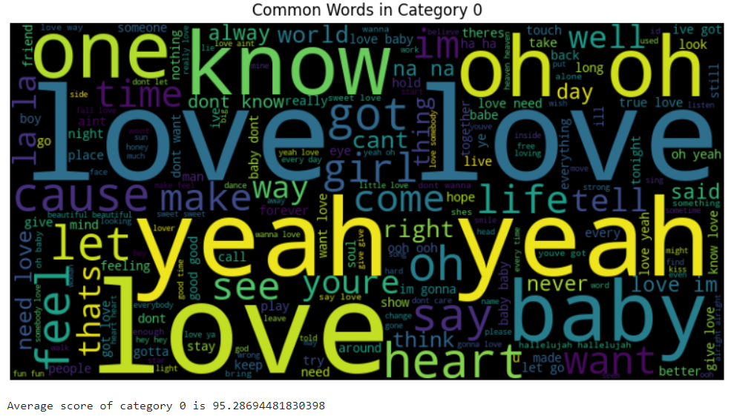
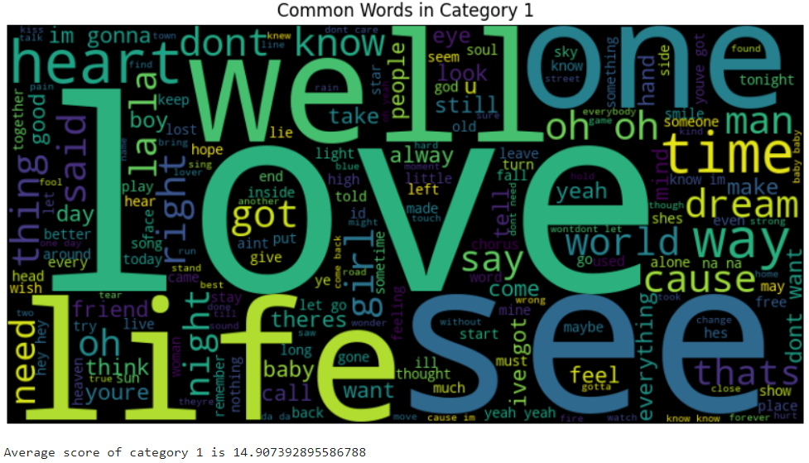
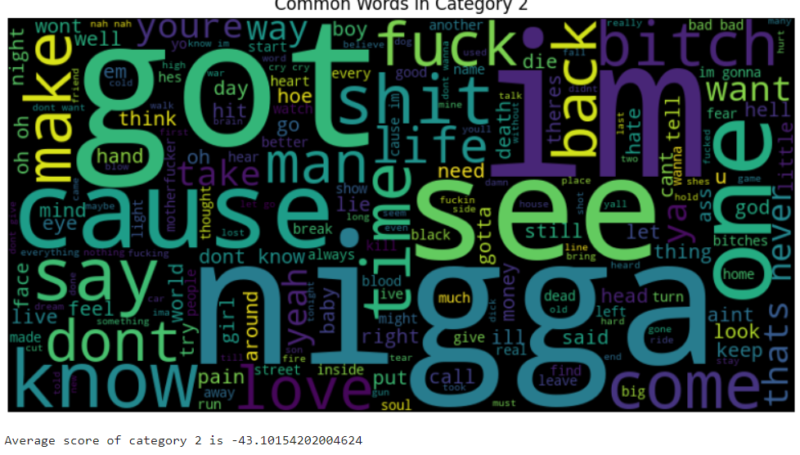
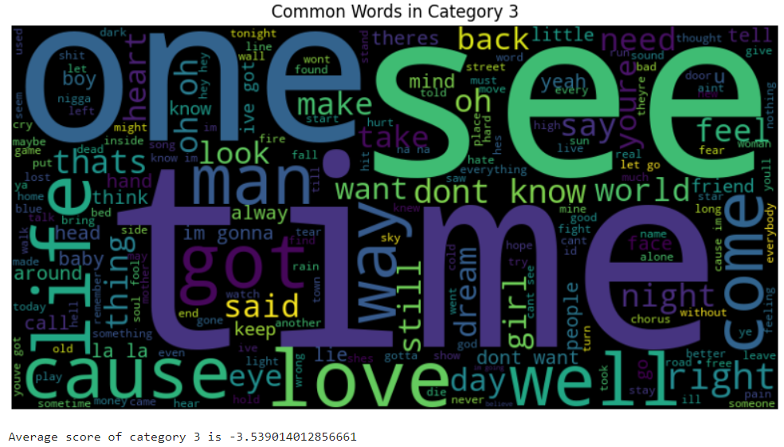
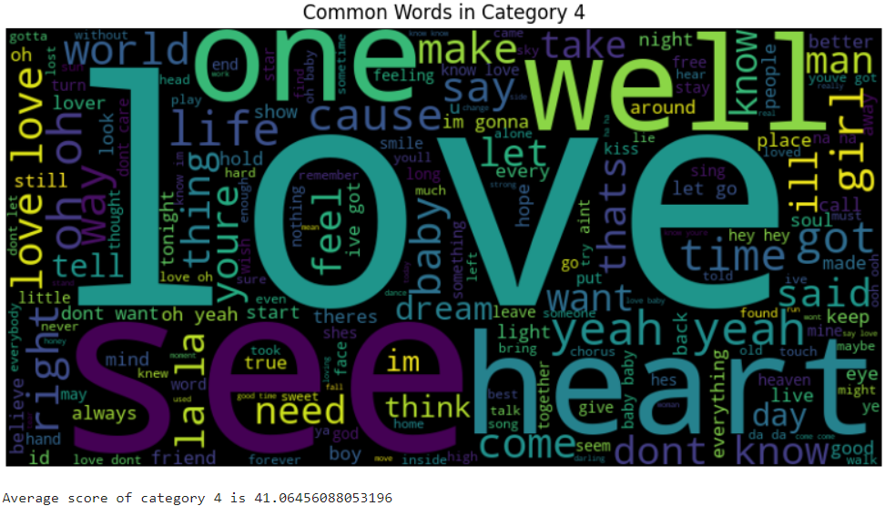
Analyse KNN CLUSTERS

Slide 13
AnalySe KNN CLUSTERS
Euphoria: category 0 has a very high positive score indicating a state of euphoria with an average score of : 95.2
Relaxed: category 1 has a very low positive score and nice emotions like love and feel etc, with an average score of 14.9
Sad: category 2 has a low negative score and words describing sad emotions with an average score of -4.8
Angry: category 3 has a very high negative score and strong angry words with an average score of -43.1
Happy: category 4 has a high positive score and high frequency of good feel words with an average score of 41.06

Slide 14
AnalySe KNN CLUSTERS
Based on the analysed score’s following score ranges were used to classify the lyrics into moods.
Angry: Below -25
Sad: Between 5 to -25
Relaxed: Between 5 to 35
Happy: Between 35 to 57
Euphoria: Above 5

Slide 15
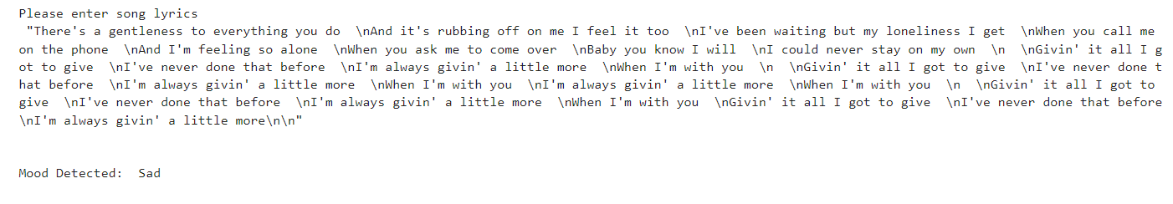
RESULTS

Slide 16
LYRICS GENERATION

Slide 17
Methodology (Ngram MODDEL)
Ngram is a probabilistic model in NLP. It models the probability of a word occurring in a text based on its preceeding word.
To develop a song generator a Trigram model is developed and trained on the corpus data identified by our mood classifier algorithm.
The algorithm builds an n-gram model for each mood category using the lyrics corpus.
Based input mood, the corresponding n-gram model is used to generate the song.

Slide 18
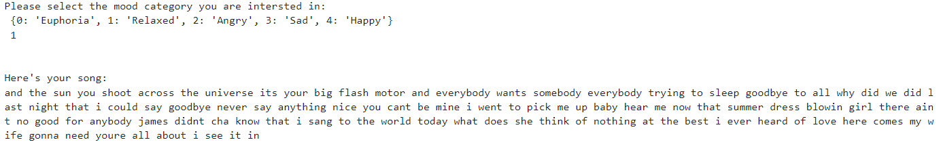
RESULTS

Slide 19
EVALUATION

Slide 20
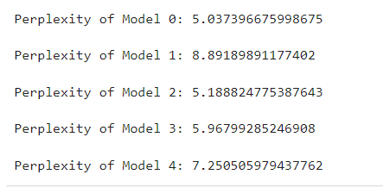
Perplexity
Perplexity is a measure to evaluate language models that quantifies how well the model can predict a sequence of words.
A lower perplexity indicates that the language model is more confident and performs better at predicting the given sequence of words.
A low perplexity was observed for most songs generated for different moods.

Slide 21

Thank you
Pratiksha Aigal​
Pratiksha.aigal@utdallas.edu |aigalpratiksha@gmail.com

