Slide 1
Final Year Project Idea Presentation
AWS based candidate registration
for campus interviews
Guided By: Prof. Mehtre
By:
Manas Dani
Pritesh Chaudhari
Payal Deshmukh
Pratiksha Kale

Slide 2
Introduction
Campus interviews, placement is a very important process held by many colleges every year to offer jobs to their students from various companies with different job profiles.
With increasing number of students and companies hiring freshers the placement activity must be carried out smoothly to avoid chaos.
In PICT campus placements, almost 100 companies visit the college and total of 700+ students appear for the placements.

Slide 3
Introduction
The TNP has the task of providing all the information about the companies, their job role offered, their criteria to select students and the package.
Another major task is to provide the data of the eligible students who want to appear for a company placement to the company officials.
At the end maintain the record of placed students, create a report of the placement activity held that year.

Slide 4
Objectives
We intend to create a website hosted on AWS which handles all he placement activity smoothly and maintains all the record at the backend.

Slide 5
Objectives
To complete the three major tasks of a TNP we can create three different products:
Product 1: The student just has to enter his/her unique registration ID in a google form provided by the TNP for a particular company. There will be a interactive web interface where the TNP can select the required details which are to be forwarded to the company and it will automatically parse the entries according to the criteria and send the csv file to the company mail-Id in just one click.

Slide 6
Objectives
To complete the three major tasks of a TNP we can create three different products:
Product 2:
To provide a website through which we can perform CRUD operations on student database. Using the web interface we can create profile of students, update it if necessary, delete it which would all get stored in a database at backend.

Slide 7
Objectives
To complete the three major tasks of a TNP we can create three different products:
Product 3: The website will also have a section in which the users can see the current placement situation of how many students are placed, report of the placement until now, upcoming companies, previous year reports, etc. Users can also view company JDs of ongoing and companies and companies which have appeared last year.

Slide 8
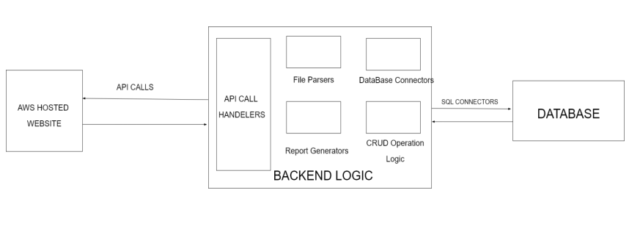
Block DIAGRAM

Slide 9







H/W anD S/W resources Required

Slide 10
Project Execution plan
Week No. | Activity Planned | Activity Completed Status
Week 1
Week 2
Week 3
Week 4
Week 5
Week 6
Week 7
Week 8
Week 9
Week 10
Week 11
Week 12

Slide 11
Future SCOPE
1. To Run ML models to predict chances of Student getting into a company.
2. To provide Login and Password for students to upload their data.
3. Do Image Recognition to validate mark sheets automatically.
4. To provide company details and average criteria to qualify for students.
5. To provide interview experience for particular company.

Slide 12
References
[1] Ahmed Othman Eltahawey. Database Using Python: A Tutorial, ResearchGate publication, December, 2016
[2] Himanshu Gore, Rakesh Kumar Singh, Ashutosh Singh, Arnav Pratap Singh, Mohammad Shabaz, Bhupesh Kumar Singh, Vishal Jagota, “Django: Web Development Simple &amp; Fast”, Annals of RSCB, vol. 25, no. 6, pp. 4576–4585, May 2021.
[3] Santhosh Kumar H, “Online Training and Placement Management system” ,International Journal of Engineering Research Technology (IJERT),ICACT - 2016 ConferenceProceedings
[4] Bryant Bost, “Overview of deployment options on AWS”, AWS whitepaper -2021

Slide 13
Thank YOU

