Slide 1

Android Audio HAL

Slide 2
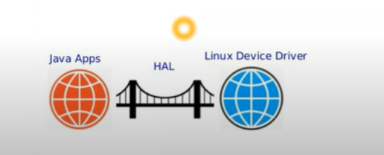
Why we need HAL?
The Hardware Abstraction Layer (HAL) in Android provides an interface between the Android framework and hardware drivers.
Types of HAL
1. HAL (Legacy HAL)
2. HIDL (HAL Interface Definition Language)
3. AIDL (Android Interface Definition Language)

Slide 3
1.HAL (Legacy HAL):
Android 7.1 and earlier
HALs are implemented as C/C++ .
The Android framework directly loads and interacts with HAL.
Why Do We Need HIDL Over Legacy HAL?
Before Android 8 (Oreo),HAL Legacy was directly linked to the Android framework.
This caused major problems when updating the Android OS because manufacturers had to rewrite or update their HALs for every Android version.
To fix this, Google introduced HIDL (HAL Interface Definition Language) in Android 8 .

Slide 4
1. HIDL(HAL Interface Definition Language):-
HIDL is an IPC (Inter-Process Communication) mechanism used in Android 8-10 to allow communication between the Android framework and Hardware Abstraction Layers (HALs).
Used in: Android 8 to 10 (Deprecated in Android 11+)
Main Goal: Separate HAL from the Android framework to enable modular updates.
Communication: Uses Binder IPC for inter-process communication between HAL and Android.
Complexity: More complex, requiring .hal files, manual implementations in C++, and heavy boilerplate code.
App ❌ Cannot use HIDL
│
▼
[ Android Framework ] ───(HIDL IPC)───▶ HAL (Hardware Abstraction Layer)
│
▼
Hardware (Speaker, Camera, etc.)

Slide 5
2. AIDL(Android Interface Definition Language):-
AIDL is now used for both:
1 App-level and Framework Communication
2 Framework and HAL Communication .
From Android 11+, AIDL replaced HIDL for HALs to make them easier to implement and faster.
Used in: Android 11+ (Preferred over HIDL for HALs)
Main Goal: Make HALs simpler and faster to implement.
Communication: Uses Binder IPC (same as HIDL but with better efficiency).
Complexity: Easier than HIDL because it supports native Java/Kotlin and C++ directly.
App
│ ──(AIDL IPC)
▼
Android Framework ───(AIDL IPC)───▶ HAL (Hardware Abstraction Layer)
│
▼
Hardware (Speaker, Camera, etc.)

Slide 6
Feature | HAL (Legacy HAL) | (HIDL) | (AIDL)
Android Version | Android 7.1 and earlier | Android 8 to 10 | Android 11+
Implementation | C/C++ (.so library) | HIDL (.hal files) | AIDL (.aidl files)
Communication | Direct function calls | Binder IPC | Binder IPC
Modularity | Tightly coupled | Modular | Highly modular
Performance | Fast, but framework-dependent | Slower due to HIDL | Faster than HIDL
Language Support | C/C++ | C++ | C++, Java, Kotlin

Slide 7
API USED IN AUDIO HAL
1)open_output_stream() – Opens an audio output stream to send audio data to the speaker, Bluetooth, or USB audio device.
When a user plays music, videos, notifications, or game sounds.
2)open_input_stream() – Opens an audio input stream to capture audio from microphone, Bluetooth headset, or USB mic.
When a user records audio (e.g., Voice Recorder, WhatsApp, Zoom calls).
3) set_parameters() – Sets audio properties like volume, routing
When switching audio between speakers and Bluetooth.
4) get_parameters() – Retrieves current audio parameters like active device, volume level etc.
When Android needs to know if audio is playing on a speaker or Bluetooth.
5)close_output_stream() – Closes an audio output stream when playback stops.
When a song or video finishes playing.
6)close_input_stream() – Closes an audio input stream when recording stops.
When a voice recording or call ends.

Slide 8
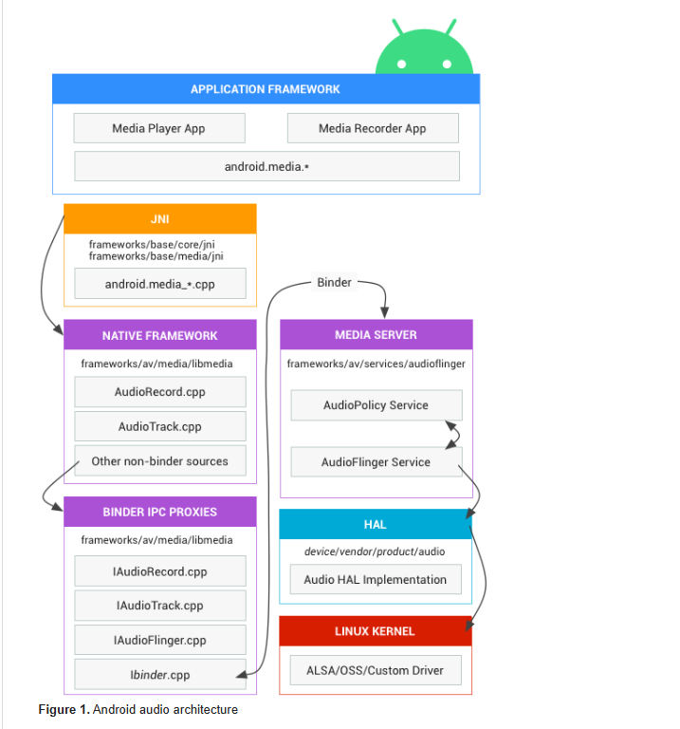
Android Audio Architecture:-

