Slide 1

Video HAL In Android

Slide 2
Android Video Architecture:
Android’s video architecture enables video playback, recording, encoding, decoding, and streaming using a combination of software and hardware components. The Hardware Abstraction Layer (HAL) plays a crucial role in bridging the Android Framework and hardware-specific drivers.

Slide 3
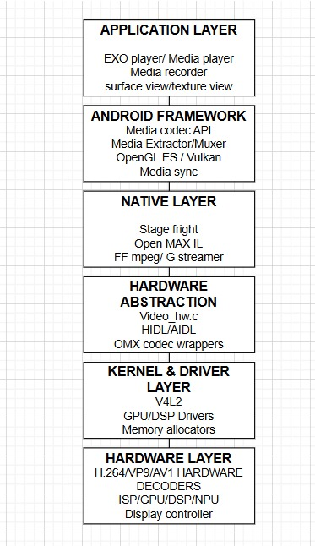

Slide 4
Application Layer in Android Video Architecture
The Application Layer is the topmost layer in Android’s Video Architecture, responsible for interacting with users and providing high-level APIs for video playback, recording, encoding, decoding, and streaming.
Components of the Application Layer:
MediaPlayer: Simple video playback API (deprecated for ExoPlayer).
ExoPlayer: Advanced customizable video player (supports streaming).
MediaRecorder: Records video and audio from Camera2 API.
MediaCodec: Low-level API for video encoding/decoding.
MediaExtractor: Extracts audio/video data from media files.
MediaMuxer: Combines audio and video streams into a single file.
SurfaceView & TextureView: Renders decoded video frames on screen.
Camera2 API: Captures video from the camera and sends it to an encoder.
WebRTC / FFmpeg: Handles real-time video streaming (for WebRTC, Live Streaming).

Slide 5
Framework Layer in Android Video Architecture:
Components of the Framework Layer:
Media Framework: Manages all media-related services (Audio/Video).
MediaPlayer Service: Handles MediaPlayer requests from apps.
MediaCodec Service: Provides access to hardware/software codecs.
MediaExtractor: Extracts raw video/audio from media files.
MediaMuxer: Merges audio and video streams.
MediaSync: Synchronizes audio and video playback.
SurfaceFlinger: Composes video frames for display using OpenGL ES.
Hardware Composer (HWC): Manages display hardware, reduces CPU load.
Camera Framework: Handles video input from camera.

Slide 6
Native Layer in Android Video Architecture:
The Native Layer in Android's Video Architecture serves as the bridge between the Framework Layer and the Hardware Abstraction Layer (HAL). It consists of low-level native libraries and APIs that handle video decoding, encoding, synchronization, and rendering efficiently using C/C++.
Stagefright: Android’s default media framework (decoding, encoding).
OpenMAX AL: Hardware-accelerated multimedia framework.
FFmpeg / libvpx: Open-source libraries for video processing (alternative to Stagefright).
MediaCodec (Native API): Low-level API for hardware/software encoding & decoding.
MediaSync: Ensures synchronization between audio & video playback.
GraphicBuffer: Manages video frame buffers in GPU memory.
SurfaceTexture: Handles rendering of decoded video frames.
Hardware Composer (HWC): Optimizes rendering pipeline for efficient GPU usage.

Slide 7
HAL (Hardware Abstraction Layer) in Android Video Architecture:
The HAL (Hardware Abstraction Layer) in Android's Video Architecture acts as a bridge between the Native Layer (Stagefright, OpenMAX, MediaCodec) and the Hardware (GPU, DSP, Video Codec Engine, Display Controller).
Components of the HAL Layer:
Hardware Codec HAL: Handles H.264, H.265, VP8, VP9, AV1 decoding/encoding.
V4L2 (Video4Linux): Provides an interface to video capture, processing, and encoding hardware.
Gralloc (Graphics Allocator): Manages buffer allocation for video frames.
HWC (Hardware Composer): Composites video frames and optimizes GPU workload.
OMX Components (OpenMAX IL): Hardware-accelerated multimedia processing.

Slide 8
APIs Used in HAL Layer of Android Video Architecture:
OpenMAX IL (Integration Layer) is the standard API used by the HAL Layer to communicate with hardware video codecs (H.264, H.265, VP8, VP9, AV1).
API | Purpose
OMX_Init() | Initializes OpenMAX Core.
OMX_GetHandle() | Gets a handle to the hardware codec component.
OMX_SendCommand() | Sends commands to the codec (start, stop, flush).
OMX_EmptyThisBuffer() | Passes an input video frame to the codec.
OMX_FillThisBuffer() | Retrieves an output frame from the codec.
OMX_FreeHandle() | Releases the codec component handle.
OMX_Deinit() | Deinitializes OpenMAX Core.
2)V4L2 (Video4Linux) APIs
V4L2 (Video for Linux 2) is a low-level kernel API used for video capture, processing, and encoding.
API | Purpose
open("/dev/video0", O_RDWR); | Opens a video device (camera, codec, etc.).
ioctl(fd, VIDIOC_QUERYCAP, &cap); | Queries device capabilities.
ioctl(fd, VIDIOC_S_FMT, &fmt); | Sets video format (H.264, MJPEG, YUV, RGB).
ioctl(fd, VIDIOC_QBUF, &buffer); | Queues a video buffer for processing.
ioctl(fd, VIDIOC_DQBUF, &buffer); | Dequeues a processed video frame.
mmap(); | Maps video buffer to memory for processing.
close(fd); | Closes the video device.

Slide 9
3. Gralloc (Graphics Allocator) APIs
Gralloc (Graphics Memory Allocator) manages GPU memory buffers for video processing.
API | Purpose
alloc_device->alloc() | Allocates memory for a video frame.
gralloc_register_buffer() | Registers a buffer for use in GPU/Video Codec.
gralloc_unregister_buffer() | Unregisters a buffer.
gralloc_lock() | Locks the buffer for reading/writing.
gralloc_unlock() | Unlocks the buffer after use.
4. Hardware Composer (HWC) APIs
HWC (Hardware Composer) handles video frame composition before display.
API | Purpose
hwc_prepare() | Prepares video frames for composition.
hwc_set() | Sends frames to GPU/display.
hwc_register_procs() | Registers HWC functions.
hwc_event_control() | Controls events like VSYNC.

Slide 10
