Slide 1

BY PRATIKSHA BALASAHEB LAD
Business Analyst Career Program - Capstone Project

Slide 2

Agenda
Data Visualisation and exploration
Statistical Analysis using Excel
Graphical Analysis using Excel
Insert the given data into the SQL server
Import the Data from the SQL Database into PowerBI
Interactive Dashboard by using visualization tools
Conclusion and Inferences
Endnotes

Slide 3
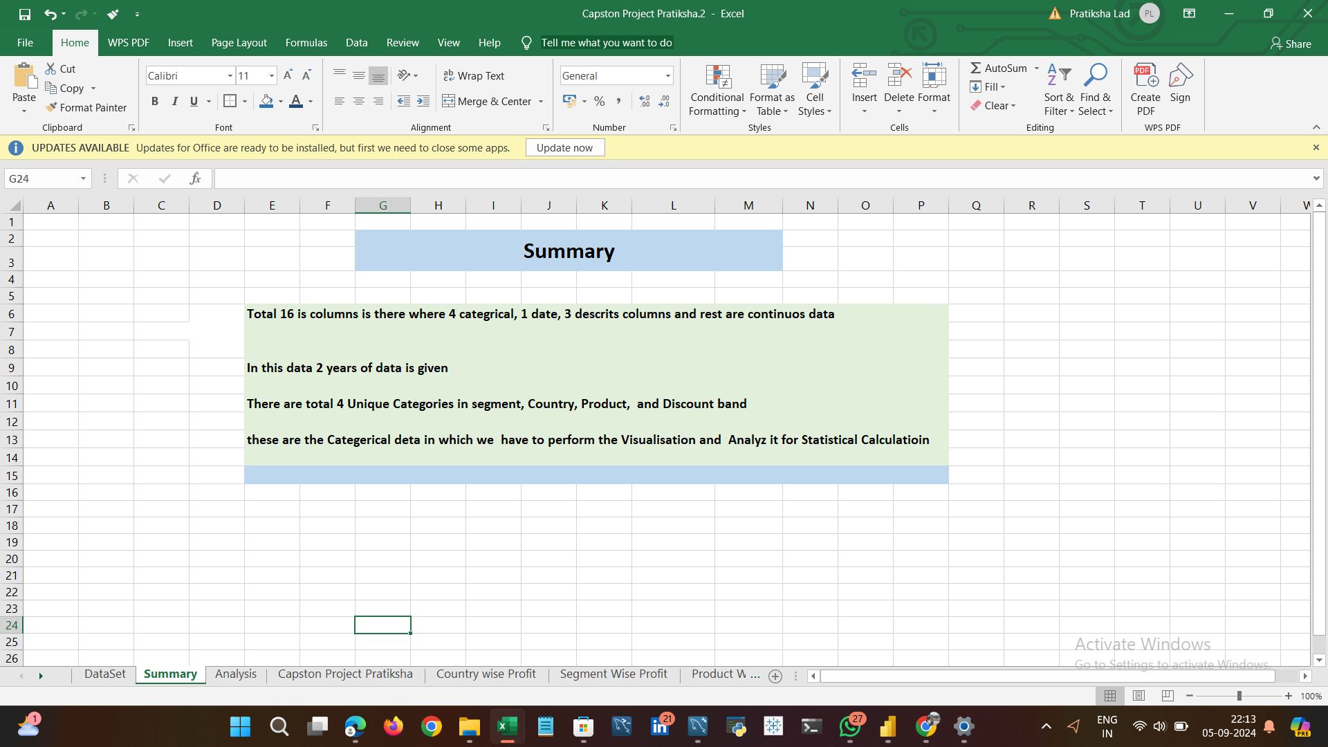
Data Exploration
I have done the data cleaning and Take some insights from it

Slide 4
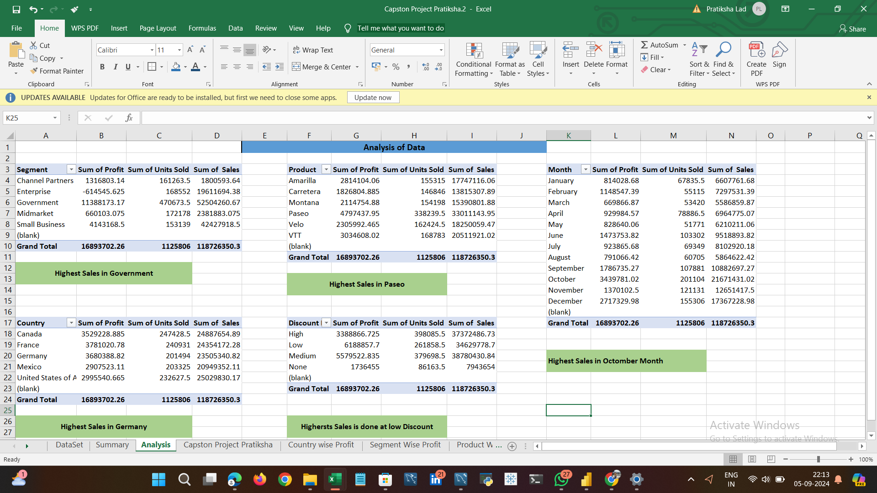
Data Analysis
I have done analysis on profit , sales and Cogs Quantity

Slide 5
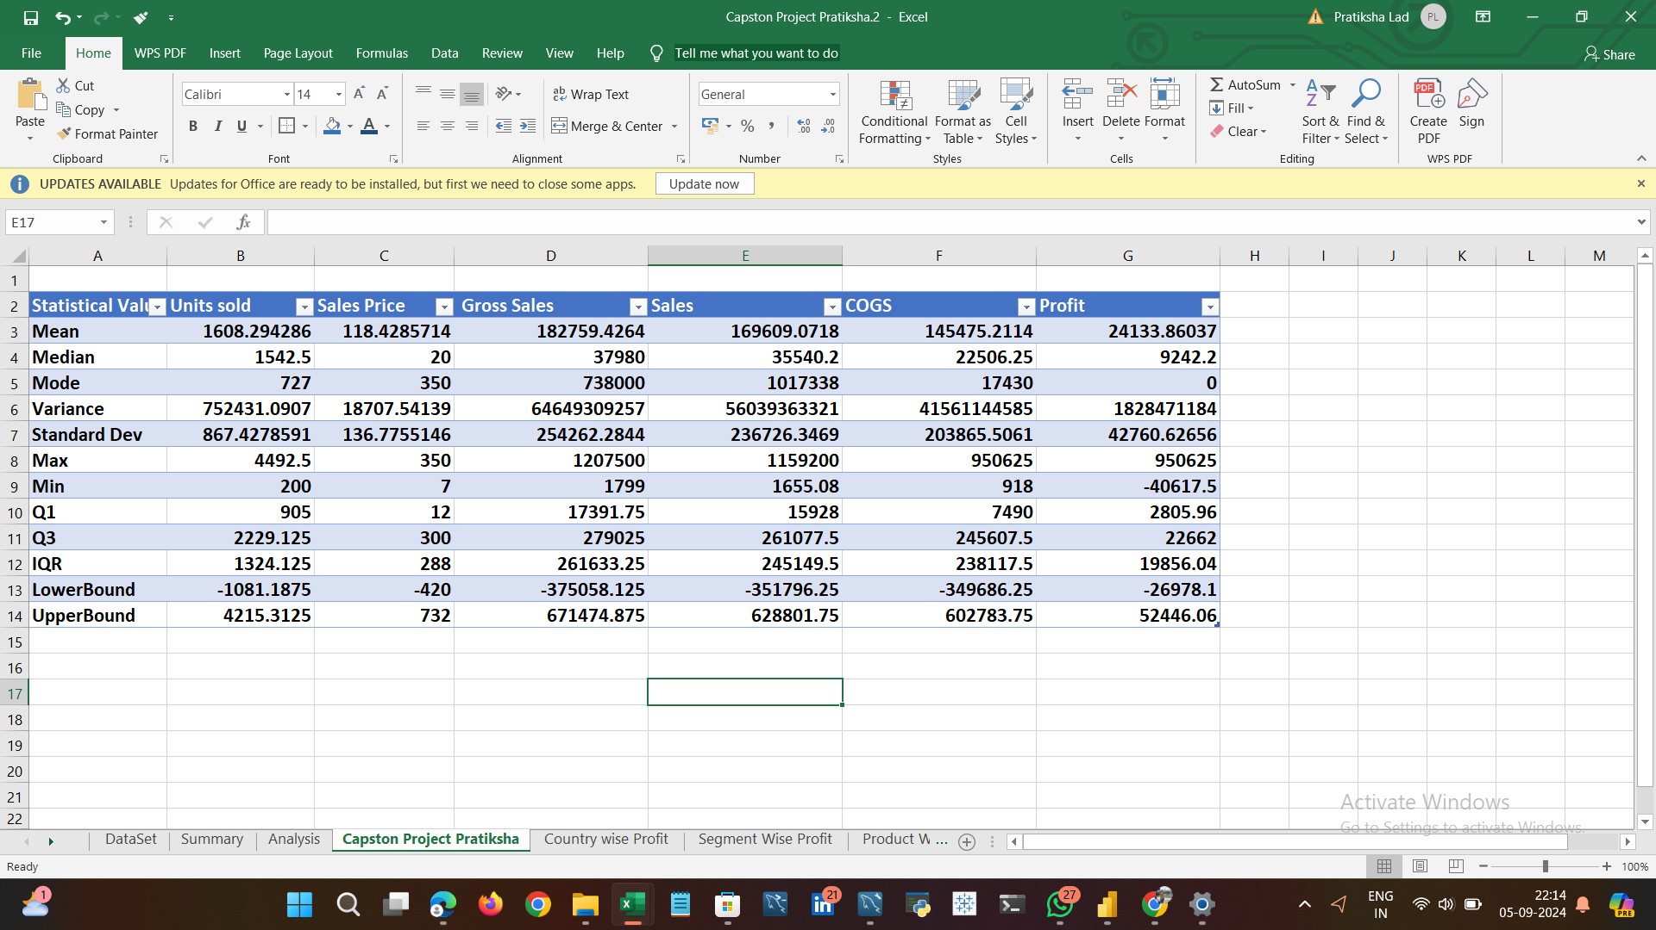
Statistical Analysis using Excel
I have performed various statistical analysis like mean ,median ,std , iqr on sales ,profit, etc.

Slide 6
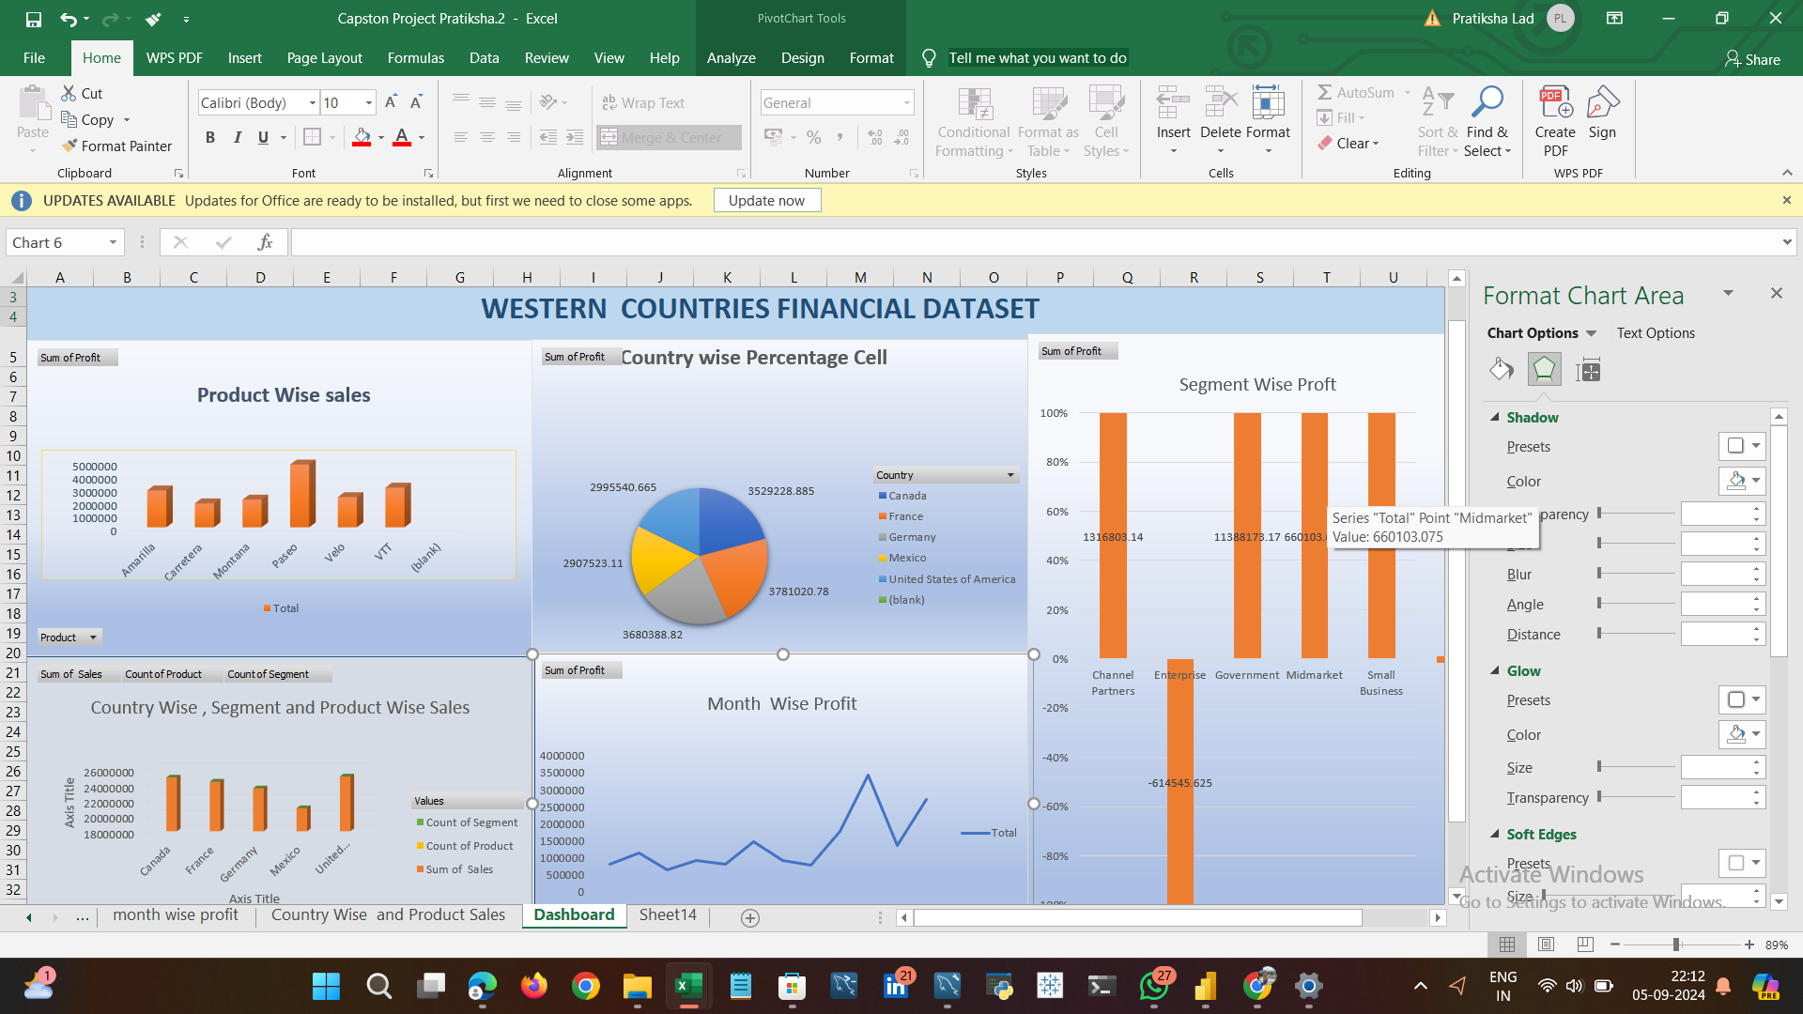
Graphical Analysis using Excel
Here is my Excel Dashboard which gives all Graphical Analysis

Slide 7
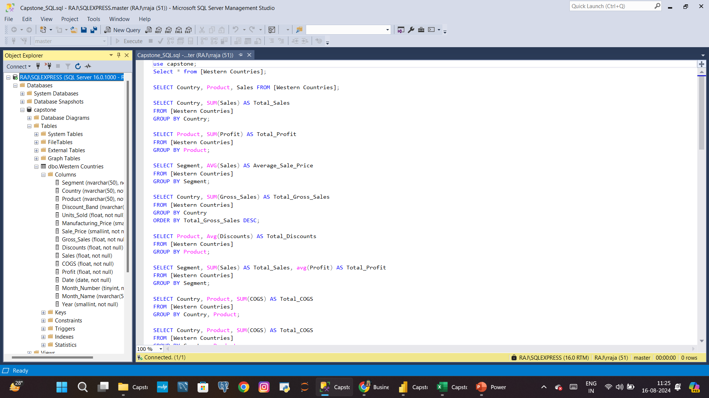
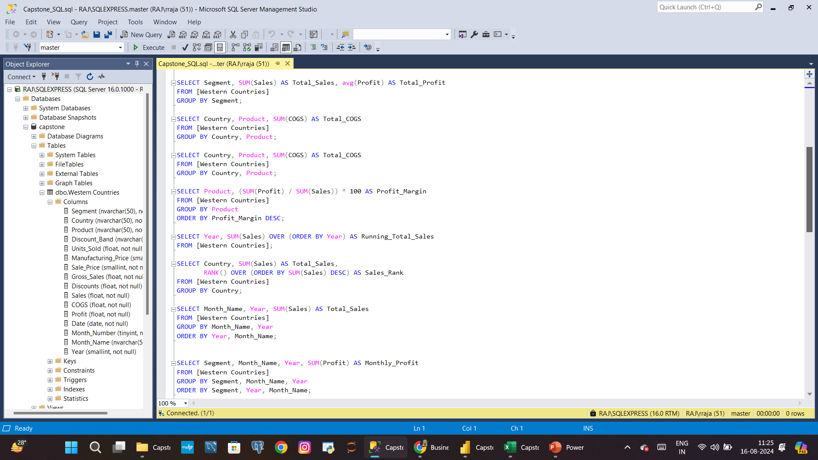
Insert the given data into the SQL server
I Uploaded the Excel file into Microsoft SQL Server and performed some basic Queries

Slide 8
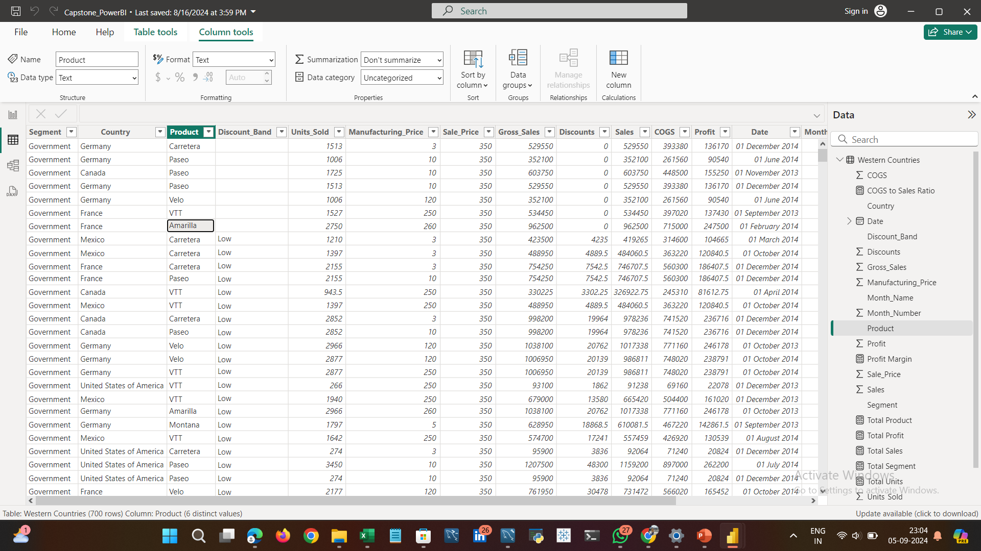
Import the Data from the SQL Database into PowerBI
The Data is Successfully Imported from SQL Database into PowerBI

Slide 9
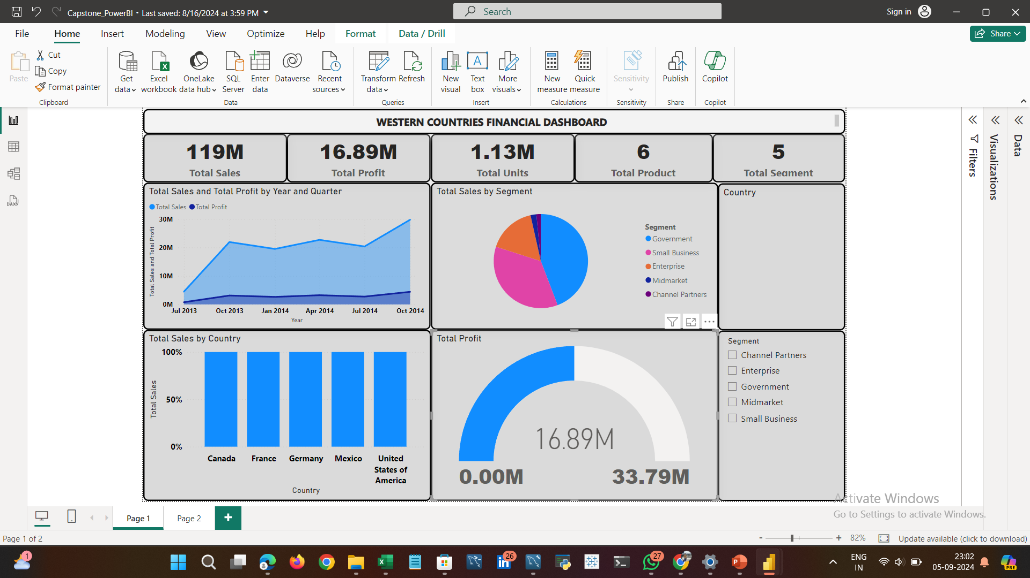
Interactive Dashboard by using visualization tools
Power-BI Dashboard

Slide 10
Conclusion and Inferences
Conclusion –
Paseo is the most sold product.
Government segment has highest number of sales.
France has highest number of sales.
Government have more sales ,which country invest they become in profit.
Enterprise sector is in loss .who invest they become in loss

Slide 11
Answers of that 6 Questions
France and Canada are top two countries
Carretera , Montana , Velo are bottom three products
Velo , Amarilla , VTT ,Paseo , Montana , Carretera.
3 Units Year over Year
Paseo Government Wise.
Paseo Government Wise.

Slide 12
Endnotes
Reference Links:-
Excel – https://github.com/PratikshaLad07/Powerbi-Capstone-project/blob/main/Capston%20Excell%20project
SQL – https://github.com/PratikshaLad07/Powerbi-Capstone-project/blob/main/capston%20Sql%20project
Power-BI - https://github.com/PratikshaLad07/Powerbi-Capstone-project

