Slide 1
Implement Bayes Theorem using Python.
AAI - Practical 3

Slide 2
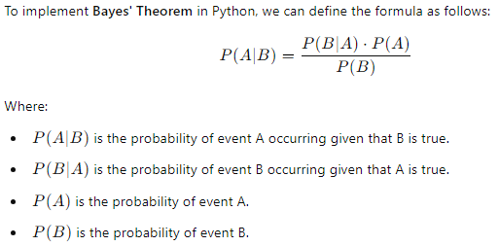

Slide 3



Slide 4



