Slide 1
Design and Expert system using AIML (Artificial Intelligence Markup Language). E.g:- An expert system for responding the patient query for identifying the flu.
AAI-Practical-1

Slide 2
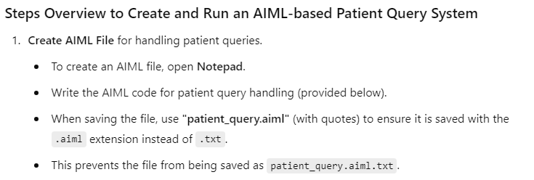


Slide 3

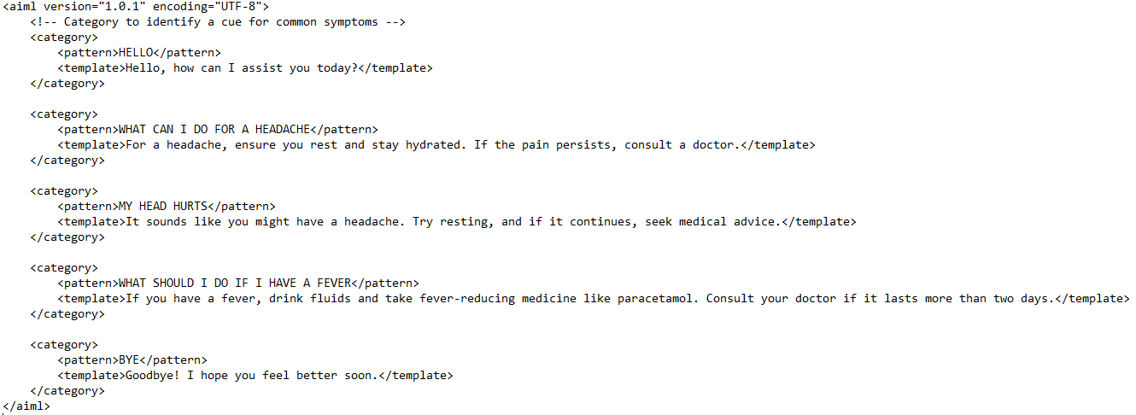

Slide 4



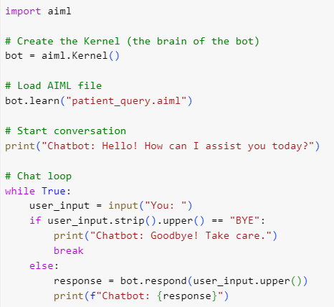
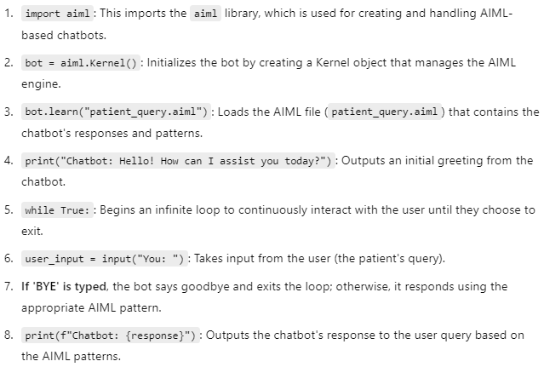

Slide 5

