Slide 1
Write a program to implement a rule-based system.
AAI – Practical - 5

Slide 2
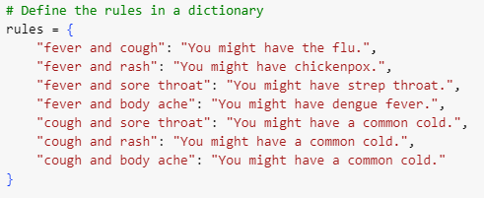




Slide 3


