Slide 1
Simulate artificial neural network model with both feedforward and backpropagation approach. You can add some functionalities to enhance the model.
AAI-Practical-10

Slide 2





Slide 3
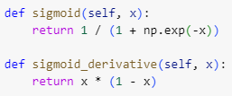
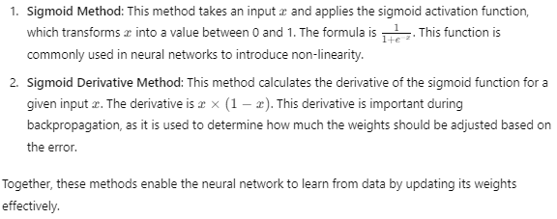



While it's true that you can obtain an output by simply multiplying inputs by weights and summing them, using the sigmoid function (or any activation function) is crucial for the following reasons:

Slide 4
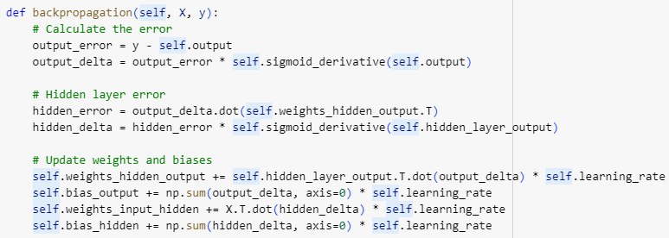
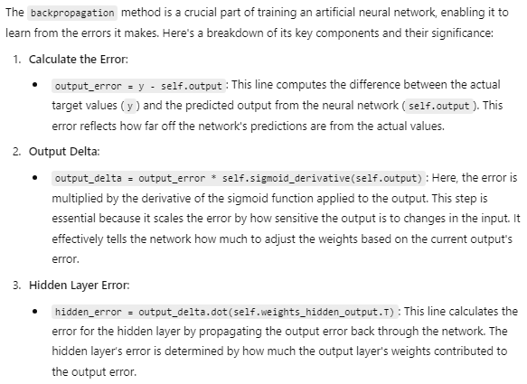
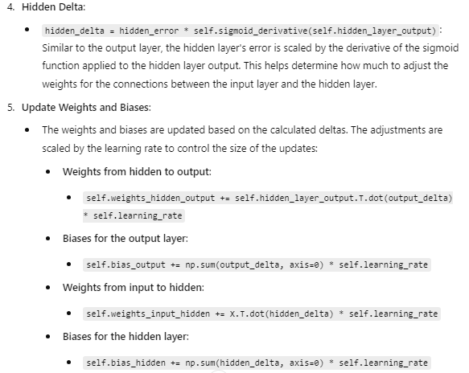

Slide 5

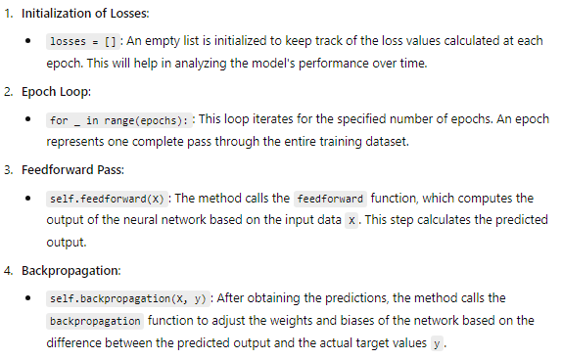
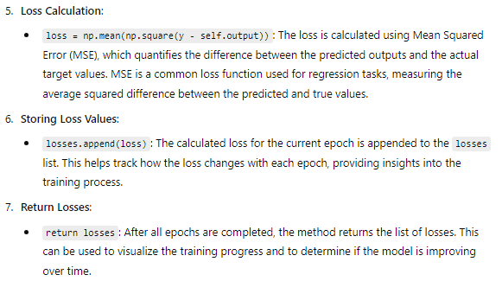
The train method combines the feedforward and backpropagation processes to iteratively improve the model's weights and biases based on the training data. By tracking the loss at each epoch, it provides a way to evaluate the network's performance and convergence during training.

Slide 6

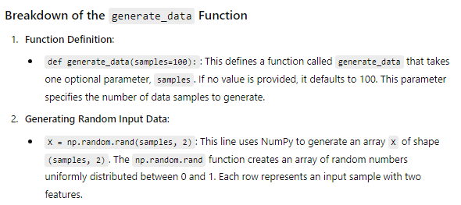
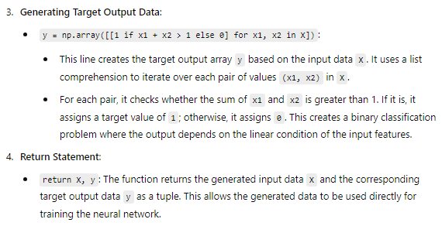

Slide 7
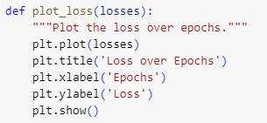
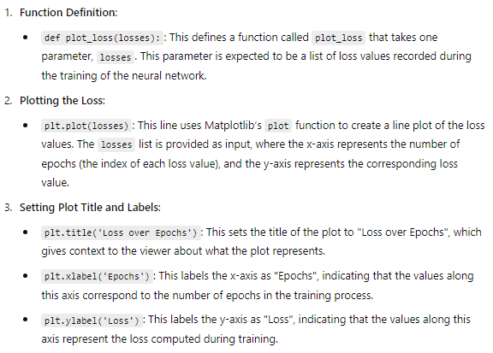

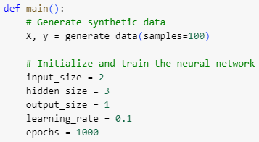

Slide 8
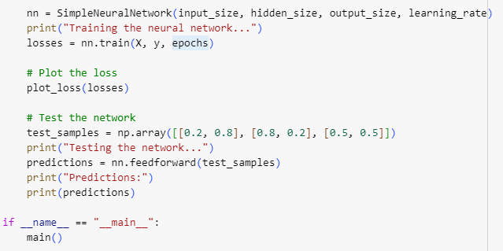
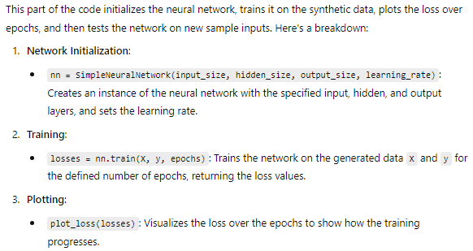
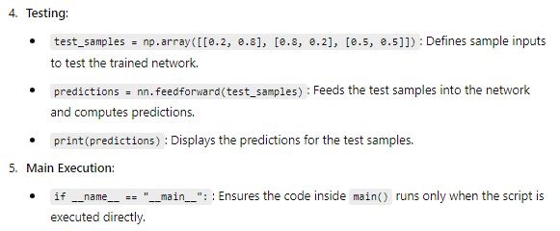

Slide 9
