Slide 1
10-A: Implement Membership and Identity Operators | in, not in.
Soft Computing Techniques Practical – 10-A

Slide 2
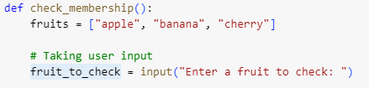
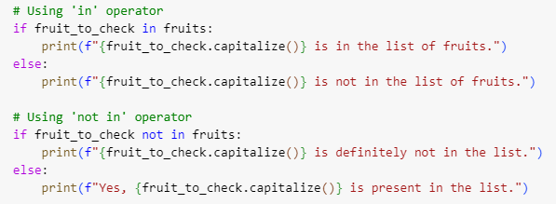
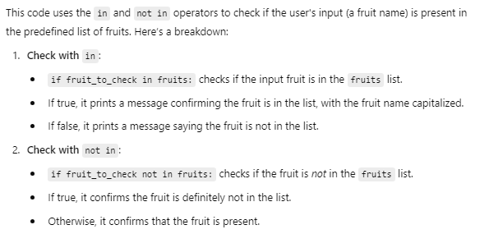

Slide 3

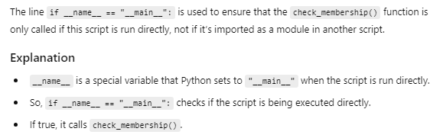



Slide 4
10-B: Implement Membership and Identity Operators, is not.
Soft Computing Techniques Practical – 10-B

Slide 5
