Slide 1
1-A:-Design a simple linear neural network model.
Soft computing Practical – 1 A

Slide 2


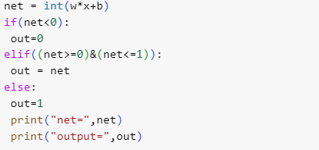
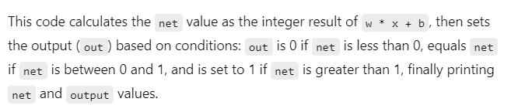

Slide 3
1-B:- Calculate the output of neural net using both binary and bipolar sigmoidal function.
Soft computing Practical – 1 B

Slide 4

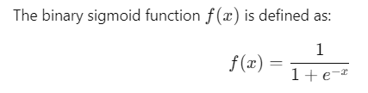
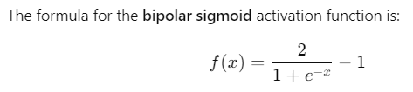

Slide 5


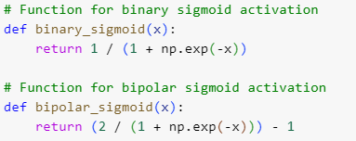




Slide 6



