Slide 1
2-A:- Implement AND / NOT function using McCulloch-Pits neuron (use binary data representation).
Soft Computing Techniques Practical – 2 A

Slide 2

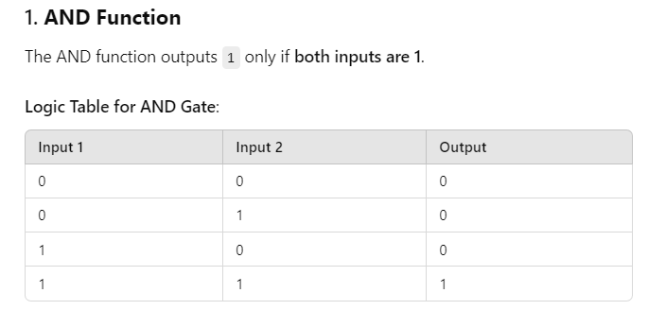


Slide 3
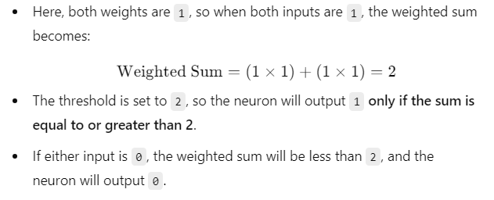
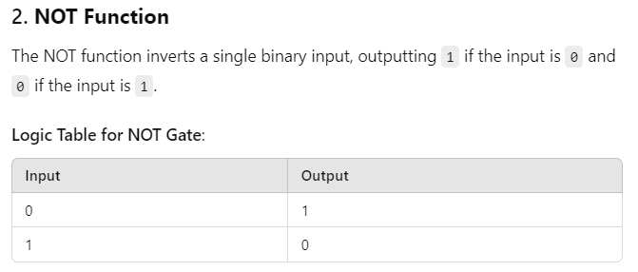


Slide 4


Slide 5


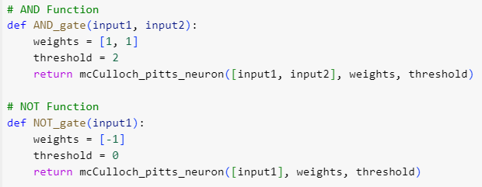


Slide 6
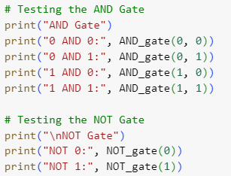


Slide 7
2-B:-Generate XOR function using McCulloch-Pitts neural net.
Soft Computing Techniques Practical - 2 B

Slide 8

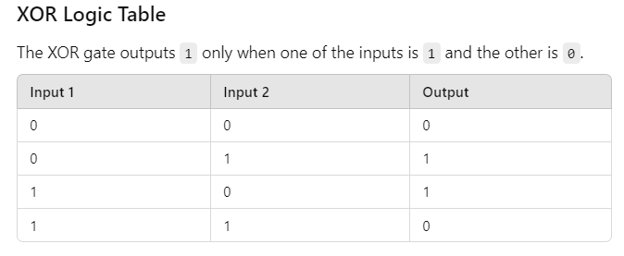

Slide 9
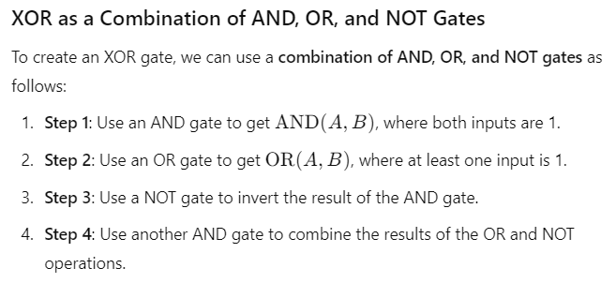


Slide 10









Slide 11
