Slide 1
Write a program for Radial Basis function.
Soft Computing Techniques Practical – 5

Slide 2

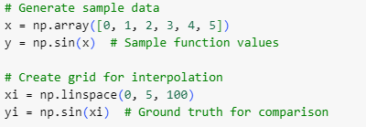

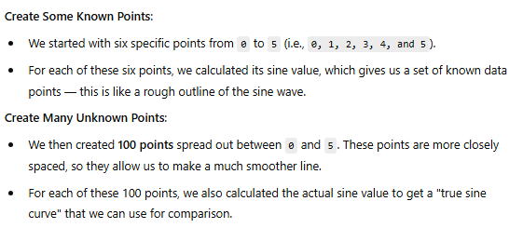

Slide 3



Slide 4
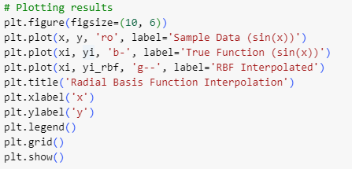


Slide 5
