Slide 1
Implement the Line Separation.
Soft Computing Techniques Practical – 6

Slide 2



Slide 3

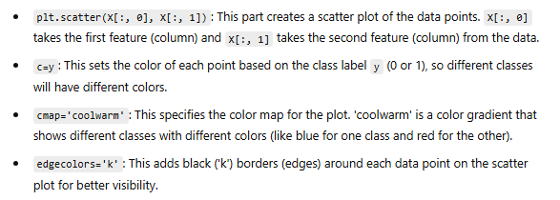

Slide 4


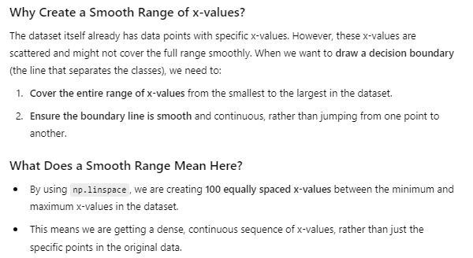


Slide 5

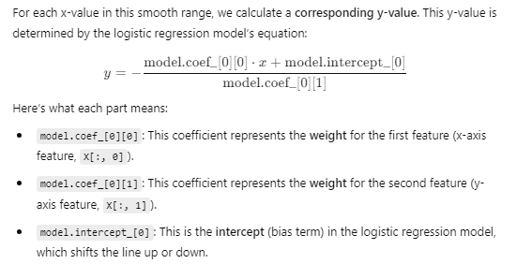

Slide 6

