Slide 1
Find ratios using fuzzy logic.
Soft Computing Techniques Practical – 7

Slide 2




Slide 3

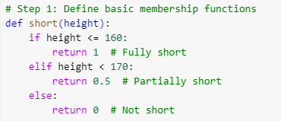


Slide 4
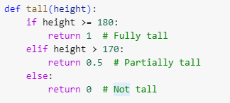




Slide 5



Slide 6
